Slide 1
Principles of IT
  IT Professionals Presentation Project

Slide 3
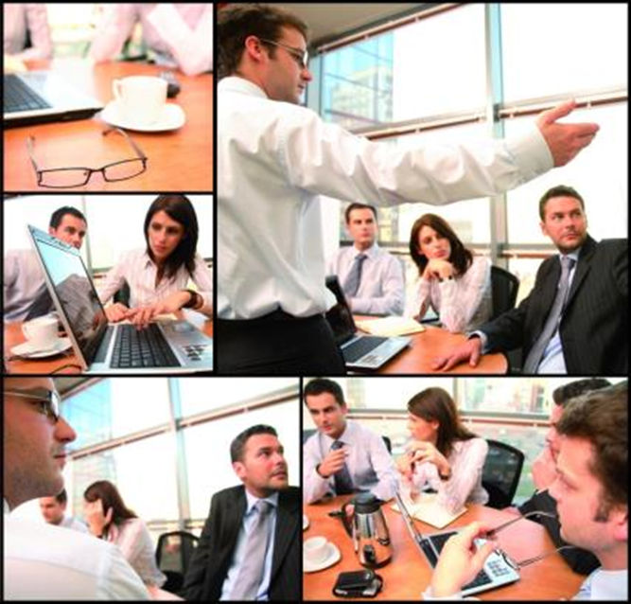
Project Requirements
  3 or 4 parts to the presentation
  Print
  Digital
  Speech
  Website (optional)

Slide 4

Project Requirements
  Print Requirements
  Essay – “A Day in the Life of …”
    Research a specific IT professional.
    Write a three-page paper showing an ideal day in the life of that person in their IT profession.
    Use proper APA or MLA formatting.
  Handout – “Why this profession?”
    Persuasive text to join profession
    Use student-taken digital photos.
    Print enough for entire class.

Slide 5
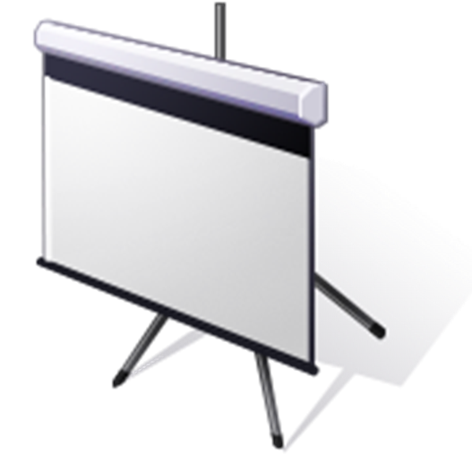
Project Requirements
  Digital Requirements
  Slide presentation – “Why this profession?”
    Persuasive information to join the profession
    Use student-taken digital photos.
    Use at least 1 chart.
    Use at least 5 slides.

Slide 6

Project Requirements
  Speech Requirements
  “Why this profession?”
    3 to 5 minute speech
    Persuading discourse to join the profession
    Use the slide presentation.
    Distribute handouts to class.

Slide 7

Project Requirements
  Website Requirements (optional)
  “Why this profession?”
    Persuading information to join the profession
    Have links to websites about the profession.
    Use student-taken digital photos.

