Slide 1
Identify Procedures for Breeding Horses
Equine Science

Slide 3
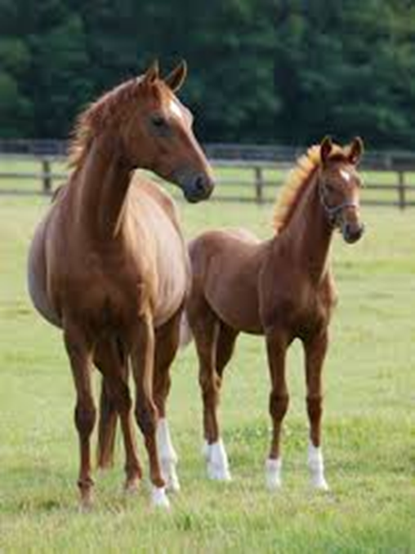
Spring is here– the coats have shed out. Is it time to breed that mare?
Before we book the stud, we need to be aware of the breeding cycle of the mare as well as the procedures to consider in breeding.

Slide 4
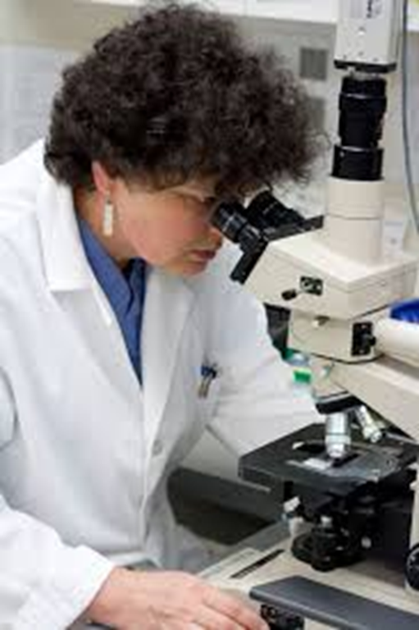
Breeding mares now has as much to do with microscopes as horses
There are also many career opportunities associated with equine reproduction

Slide 5
Objectives
Today we will:
Describe the breeding cycle of mares
Identify the methods of breeding horses
Describe the advantages and disadvantages of natural cover and artificial insemination
Research advanced methods of breeding horses

Slide 6
Seasonal Breeders
Horses are seasonal breeders
This means that their reproductive cycle is triggered by increased daylight from January-March
The cycle is typically 21 days between cycles in the spring; in the fall, when days are longer, the mare doesn’t cycle regularly
The mare typically carries the foal for 11 months; this means if we breed on April 10, our male should foal around March 10

Slide 7
The Estrus Cycle
The mare is in estrus for 3-5 days
This is the time when the mare is most receptive to breeding; Watch Estrus Behavior in Mares
Towards the end of the estrus cycle, the mare will ovulate and produce an egg
If sperm is introduced at this time, the mare will become pregnant
Once the mare is bred, we say she is “in foal”

Slide 8
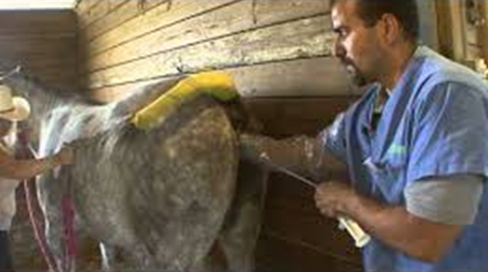
Two Breeding Methods
Natural Cover
Artificial Insemination

Slide 9
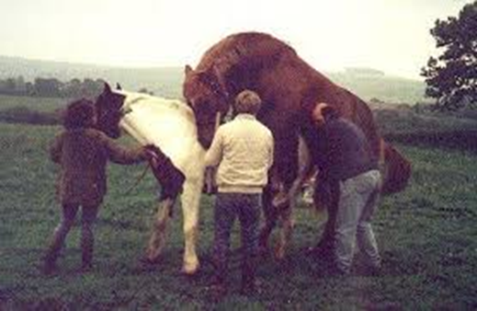
Natural Cover Breeding
For the last thousand years, natural cover was the way horses were bred
Natural cover consists of turning the mare and stallion out together and letting nature take its course
To prevent injury to the mare and stallion, we sometimes control the natural cover, restraining the horses and supervising the situation
Some breed associations like the Jockey Club, require live cover in order to register offspring

Slide 10
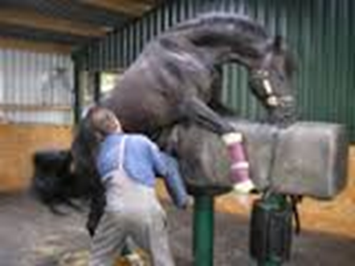
Artificial Insemination
Simply put, Artificial Insemination (AI) is
Collecting the semen from the stallion
Processing the semen
Shipping semen to the mare
Inserting the semen when the mare is in estrus
Watch Dirty Jobs Horse Breeding for all the details

Slide 11
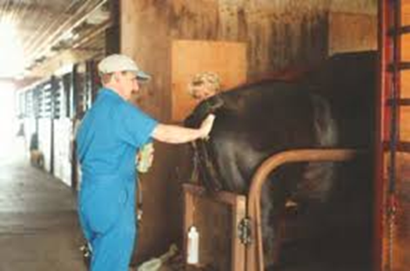
Advantages and Disadvantages
Artificial Insemination
Can breed more mares
Distance isn’t a problem as semen can be frozen and shipped
Process can be expensive
Intensive time management
Natural Cover
Low cost other than transportation
Can cause injury if not supervised
Not exactly sure when bred if pasture bred
Timing isn’t as big an issue since semen lives longer than cooled/shipped semen

Slide 12
Research Advanced Methods of Equine Breeding
Look up embryo transfer, superovulation, and cloning and report your findings to the class. What are the primary issues related to these new technologies in horses?

Slide 13
Let’s Debate– Break Into Six Groups
Pros
Embryo Transfer
Superovulation in Horses
Cloning in Horses
Cons
Embryo Transfer
Superovulation in Horses
Cloning in Horses

Slide 14
Questions for Review
How many days is the breeding cycle of the mare?
How many days is the estrus cycle of the mare?
What is the gestation period for the horse?
Describe natural cover and artificial insemination.
What are the advantages and disadvantages of natural cover and AI?
Describe the major issues with embryo transfer, superovulation, and cloning in horses.

Slide 15
Questions for Review
How many days is the breeding cycle of the mare? About 21 Days
How many days is the estrus cycle of the mare? 3-5 Days
What is the gestation period for the horse? About 11 months

Slide 16
Questions for Review
What are the advantages and disadvantages of natural cover and AI? Natural cover is cheaper and less time intensive.
Artificial insemination is more precise and allows mare owners to breed with stallions anywhere in the world.

Slide 17
Questions for Review
Describe the major issues with embryo transfer, superovulation, and cloning in horses.
Embryo Transfer– flushing the embryo and inserting it into a recipient mare; allows the dam to continue to perform or allows mares who cannot carry to produce offspring
Superovulation—multiple offspring in one breeding; requires recipient mares
Cloning—taking genetic material from one horse to create an exact offspring; AQHA is still in court over whether or not offspring should be allowed to register

Slide 18
Summary
Equine breeding is simple to understand, yet the new technologies are create complex problems for some organizations.
There are many career opportunities available in the area of equine reproduction.

Slide 19
References
Articles related to the Equine Breeding Process: http://www.thehorse.com/topics/breeding-and-reproduction/breeding-basics/breeding-process
Estrus Behaviors in Mares: https://www.youtube.com/watch?v=7cAxGqE84Jk
Superovulation: http://www.thehorse.com/articles/10709/superovulation
Cloning Research: http://vetmed.tamu.edu/equine-embryo-laboratory/cloning-research

Slide 20
Texas College and Career Readiness Standards
English Language Arts: II. Reading, A; III. Speaking, A, 1-2; B 1-3; V. Research, B, 1, a-b
Science: I. Nature of Science, A. 1; E, 2; III. Foundation Skills: Scientific Application of Communication, B. 1; C. 1, D. 2; IV. Science, Technology, and Society, A. 1, B. 1-2
Social Studies: IV: Analysis, Synthesis, and Evaluation of Information, A 1, 3, 5, 6; V. Effective Communication, A. 1-2

