Slide 1
Principles of Information Technology
  Identifying File Types, Purposes, and Extensions

Slide 3
TEKS Correlations
  (5) The student demonstrates knowledge of the different software associated with information systems. The student is expected to
    (F) demonstrate understanding of file extensions and the purpose of file types across software products;
    (H) identify appropriate use of application software;
    (L) demonstrate proper file management techniques such as creating, naming, organizing, copying, moving, and deleting files.

Slide 4
Lesson Objectives
  Define application software
  Identify a file type by looking at its extension
  Identify the type of application software needed to open a given file
  Identify the use for a given application software
  Demonstrate how to create, name, organize, copy, move, and delete files and folders

Slide 5
Application Software
  I’ve got an app for that”
  “App” is short for application software
  Application software
  a computer program that performs a specific function(s) for the user

Slide 6
Application Software
Types of applications
  Graphic application software lets you edit image files
  There are many software applications that play songs and videos
  Executable program files launch specific software or application packages

Slide 7
File Extensions
  Using the “my computer” icon or “my files” icon/folder, you can view a list of files contained on your computer
  Each file displays an icon, the filename, and an extension
  The filename is followed by a period and then an extension

Slide 8
File Extensions
  You can identify a file by its extension
  .bmp, .jpeg, .jpg, .tiff, .tif, .gif, and .png are examples of image or graphic files
  .mpeg4,.mp4, .avi, .mov, and .wmv are examples of video files

Slide 9
File Extensions
  .mp2, .mp3, .mp4 (or .mpeg4), .wav, .avi, .wma, .mid are examples of audio files
  .exe and .bat executable program files

Slide 10
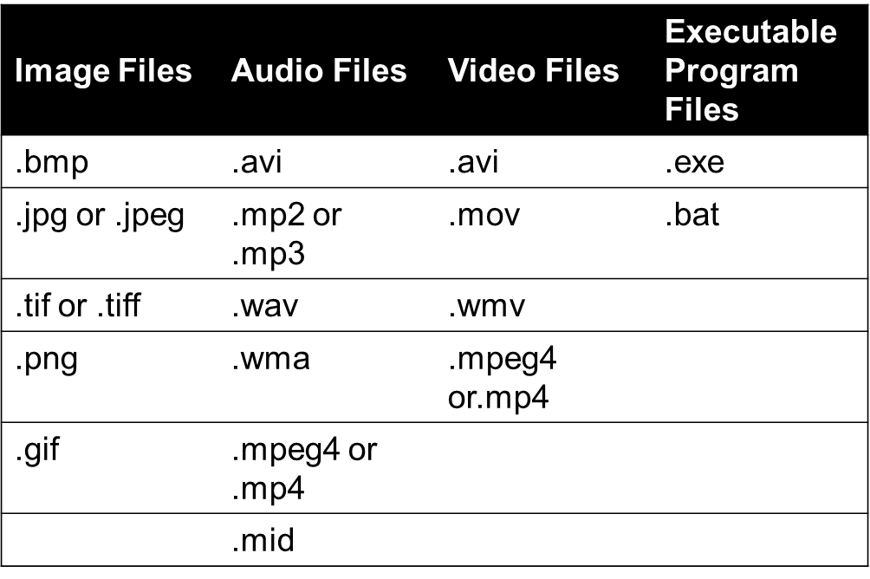
File Extensions
You can identify a file by its extension:
IT: Principles of Information Technology – Identifying File Types, Purposes, and Extensions

Slide 11
File Extensions
It is important to remember that there are many audio, video, and image file extensions that are not mentioned in this lesson. This lesson focuses on the most common file extensions.

Slide 12
Choosing the Right Application
  Choose the correct application to open your file according to its type and extension
  Every computer comes with software that can open picture, video, and audio files
  These are generally the “default” programs used when files of this type are accessed
  However, you are not limited to these programs
  There are many to choose from

Slide 13
File Manipulations
  Folders are a great way to help you organize your files
  To create a new folder
    Navigate to the disc or drive where you save your work
    Click on the File option
    Choose New from the drop down menu
    Choose Folder
    Type in the name you want to give your folder
    Use something descriptive that will help you identify the contents of the folder

Slide 14
File Manipulations
  You can create as many folders as you need
  You could create a folder named Processing Files and save all your letters and reports in this folder
  You could create folders named for each of the classes you are taking this year
  There are many different ways to organize folders and files
    Use the method according to your instructor’s directions

Slide 15
File Manipulations
  To create a copy of an existing file
    Right-click on the filename
    On the drop down menu that appears, choose Copy
    Right-click in a blank area of the screen
    On the drop down menu that appears, choose Paste
  You will see the original file and the copied file
    The copied file will have the word copy in the filename

Slide 16
File Manipulations
  To rename an existing file
    Right-click on the filename
    On the drop down menu that appears, choose Rename
    The filename will then be highlighted—just start typing the new name
    Be sure to leave the extension and the period at the end
    Strike the enter key when finished

Slide 17
File Manipulations
  To delete an existing file or folder
    Right-click on the filename or folder name
    On the drop down menu that appears, choose Delete
    You will get a delete file message asking if you are sure you want to permanently delete this file
    Click YES to delete the file

Slide 18
Lesson Summary
  Application software is a computer program that performs a specific function(s) for the user
  A file type can be identified by looking at its extension
    Example: MyDrawing.bmp is an image file
    MyVideo.wav is a video file
    My Music.mp3 is an audio file
    Setup.exe is an executable program file

Slide 19
Lesson Summary
  Various software applications perform different functions and are used for different purposes
  Folders are created and named appropriately to help organize files
  Files and folders can be created, named, renamed, moved, and deleted

