Slide 1
Animation
  Identifying Types of Animation

Slide 3
Objectives
  Identify various types of animation
  Construct a written planner for a basic flip-book animation
  Sketch and assemble a flip-book animation
  Construct a diagram/planner for a stop-motion animation
  Capture still-shot images to be used in a stop-motion animation
  Create a computer-generated stop-motion sequence using still-shot images, audio sound effects, and voiceovers

Slide 4
Animation
  A collection of images or pictures
  Each picture is only slightly different than the one before it
  Pictures are displayed in sequential order – at a rapid rate, giving an optical illusion of movement
  Persistence of Vision
    Stare at an object, then close your eyes
    You can still see it

Slide 5
Persistence of Vision
  A theory that claims the human eye retains every image, even after the brain has had an opportunity to process the image
  This timing differential causes the brain to connect objects that are stationary
  This phenomena often creates an optical illusion of motion

Slide 6
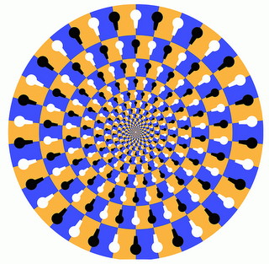
Persistence of Vision
  That is why this image seems to spin around
  Another type of optical illusion is called a zolotrope
    A display that has two sides
    The first picture is on one side
    A second picture on the opposite side
    You flip or spin the display quickly from side to side
    The eye retains each image just long enough for the brain to combine the two images and believe they are one image

Slide 7
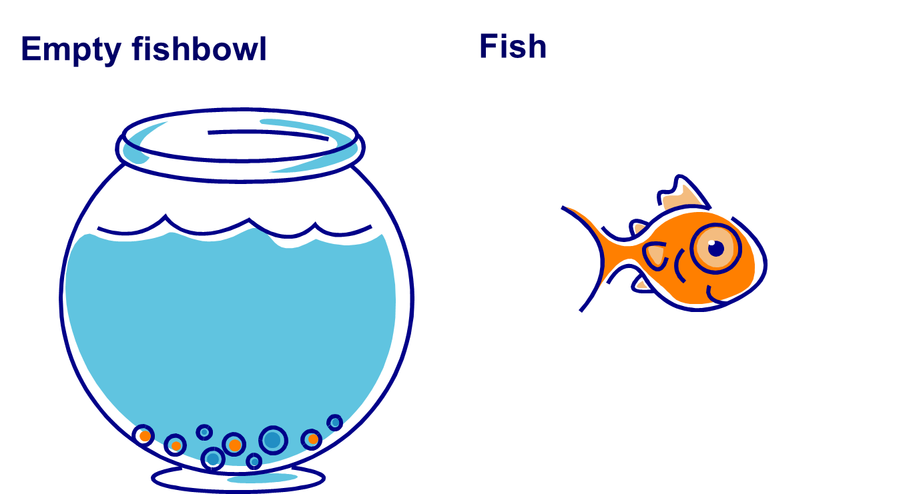
Persistence of Vision
  Zolotrope
Notes:
If we take these two objects and flash them on the middle of the screen – one at a time – at a rapid rate – it will look like the fish is in the bowl. This is due to persistence of vision. The next slide will demonstrate this.

Slide 8


Persistence of Vision
  Zolotrope
Didn’t flash fast
enough?
Let’s speed
it up and
see what happens

Slide 9

Persistence of Vision
  Zolotrope
Click here to watch another demonstration of zolotrope, bird in cage.
Notes:
http://www.youtube.com/watch?v=3sih9icgH3M&feature=related

Slide 10
Types of Animation
  Flip-Book
  A display that contains many pages, with each page being only slightly different than the next. When the pages are flipped at a rapid rate, the images appear to have movement
Notes:
http://generationranks.com/flip.jpg

Slide 11

Types of Animation
  Stop-Motion
  A display that is created by a series of photos taken of inanimate objects that are physically moved in small increments from one picture to the next

Slide 12
Types of Animation
  Cutout
  A type of stop-motion created by using 2-dimensional cut-out figures
Notes:
http://www.staffs.ac.uk

Slide 13
Types of Animation
  Silhouette
  A type of cut-out animation in which the scene is backlit so that characters/ objects are only seen as silhouettes
Notes:
http://tinyinventions.com/blog/images/lotte2.jpg

Slide 14
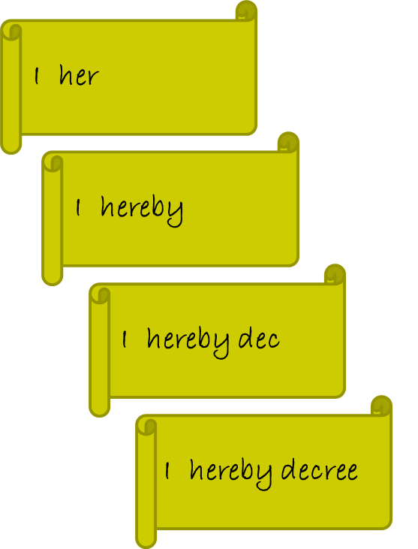
Types of Animation
  Erasure
  A type of stop- motion in which the still-shot images are taken over time as an artist manipulates an image

Slide 15
Types of Animation
  Object Animation
  A type of stop-motion animation using inanimate objects such as building blocks
Notes:
http://www.pikihia.com/wp-content/uploads/2008/08/uk1977sm.jpg
http://www.drtoy.com/images/construction/clip_image038.jpg

Slide 16
Types of Animation
  Claymation
  A type of stop- motion in which the characters are made of clay or craft dough so that they may be molded to change shape
Notes:
http://i.ytimg.com/vi/mluYB9YfzSI/0.jpg
www.bollywoodhungama.com/.../11/166/index2.html

Slide 17
Examples of Animation
  Flip-book: Girl & Bird
  Stop-Motion: Sticky Notes
  Cut-out: Time Goes By
  Silhouette: Elephant & Flower
  Erasure: Whiteboard drawing
  Object: Building Block Arcade
  Claymation: Chess game

Slide 18
Review
  Types of Animation
  Flip-book
  Stop-Motion
    Cut-out
    Silhouette
    Erasure
    Object
    Claymation

