Slide 1
Importance of the Equine Industry
  Equine Science

Slide 3
When you think of the equine industry, what thoughts come to mind?
  Horse racing, showing, trail riding, driving?

Slide 4
Horse are Expensive, BUT…
  Everyone knows that horses can be expensive.
  Why would anyone own one, knowing the costs?
  Horses can provide a wonderful recreational outlet for people.
  People have choices in how they spend their money. For some people, great pleasure is received in owning a horse.

Slide 5
Objectives
  Today we will:
  Identify the importance of the equine industry in the nation and in Texas
  Identify the economic impact of the equine industry nationally and in Texas
  Recognize equine related activities
  Determine the cost of owning of a horse
  Discuss the importance of the equine industry in your community

Slide 6
Importance of Equine Industry in the Nation
  The horse industry is a very large and important part of our national, state and local economies. It is diverse, involving agriculture, business, sport, gaming, entertainment and recreation.
  There are 9.2 million horses in the United States.
  4.6 million Americans are involved in the industry as horse owners, service providers, employees and volunteers. Tens of millions more participate as spectators.
  2 million people own horses.

Slide 7
Importance in the Nation…
  The horse industry has a direct economic effect on the U.S. of $39 billion annually.
  The industry has a $102 billion impact on the U.S. economy when the multiplier effect of spending by industry suppliers and employees is taken into account. Including off-site spending of spectators would result in an even higher figure.
  The industry directly provides 460,000 full-time equivalent (FTE) jobs.
  Spending by suppliers and employees generates additional jobs for a total employment impact of 1.4 million FTE jobs.

Slide 8
Importance in the Nation…
  The horse industry pays $1.9 billion in taxes to all levels of government.
  Approximately 34% of horse owners have a household income of less than $50,000 and 28% have an annual income of over $100,000. 46% of horse owners have an income of between $25,000 to $75,000.
  Over 70% of horse owners live in communities of 50,000 or less.
  There are horses in every state. Forty-five states have at least 20,000 horses each.

Slide 9
Importance of the Equine Industry in Texas
  The Texas horse industry produces goods and services valued at $3.0 billion.
  The national industry has a $5.2 billion impact on the Texas economy when the multiplier effect of spending by industry suppliers and employees is taken into account. Accounting for off-site spending of spectators would result in an even higher figure.
  455,600 Texans are involved in the industry as horse owners, service providers, employees, and volunteers. Even more participate as spectators.

Slide 10
Importance in Texas…
  The Texas horse industry directly provides 32,200 full-time equivalent (FTE) jobs. Spending by suppliers and employees (in Texas and other states) generates additional jobs in Texas for a total employment impact of 96,300.
  There are 979,000 horses in Texas, over 60 percent of which are involved in showing and recreation.

Slide 11
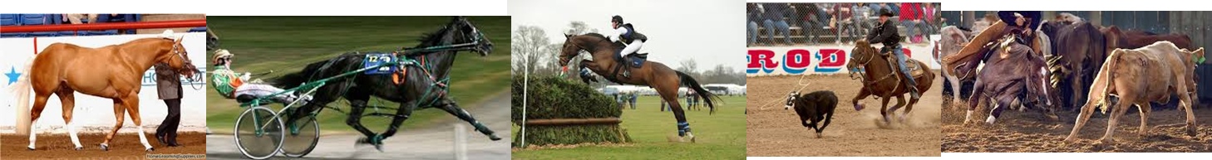
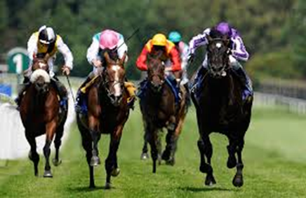
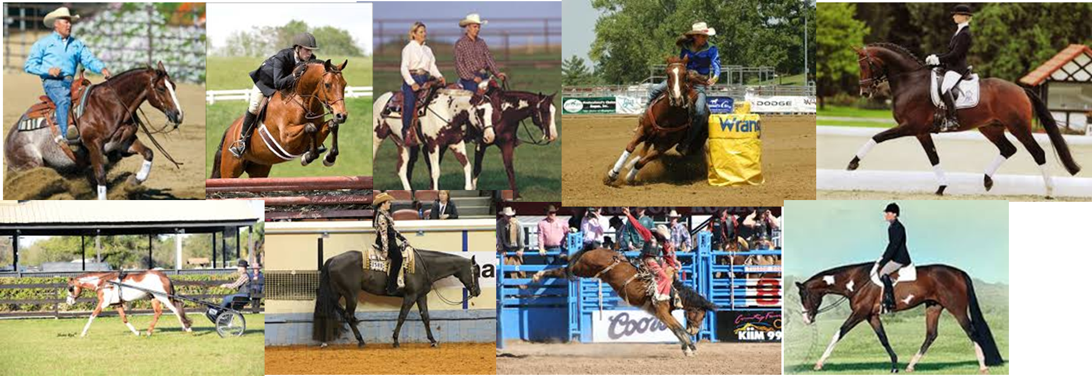
Types of Equine Related Activities
  Here are just a few equine related activities:

Slide 12
From the pictures, can you identify:
  Halter
  Western Pleasure
  Cutting
  Reining
  Racing
  Hunter Under Saddle
  Eventing
  Jumping
  Trail Riding
  Barrel Racing
  Bronc Riding
  Calf Roping
  Pleasure Driving
  Trotter Racing
  Dressage
  What others can you think of?

Slide 13
Cost of ownership
  The cost of keeping a horse varies widely depending on where you live and the level of service your stable provides. Simple pasture boarding can cost as little as $100 a month. However, stable boarding can cost $500 or more.
  Most horse owners spend about $60 to $100 per month on hay, salt and supplements – and some spend much more, particularly if they feed grain.
  Whether or not you plan to shoe your horse, you'll need to have a farrier check and trim his hooves every two months or so. This usually costs around $25 or $30. Add in shoeing, and you could pay $80 to $100 every two months.

Slide 14
Cost and Economic Impact
  Routine medical care is an additional cost of owning a horse and includes vaccinations, de-worming and annual teeth cleaning. For a healthy horse, this can cost as little as $300 a year.
  Budgeting for help or training is also important. Costs can range from $50 for a one time lesson up to full board and training of $1200/month.
  How much do you think it would cost to own a horse in your community?
  Does this cost impact the economy of your community?

Slide 15
Importance in our community…
  In groups, brainstorm the importance of the equine industry in our community.
  Think about rodeo arenas, race tracks, horse boarding facilities, shows, or other activities in your community.
  What is the estimated economic impact in our community?
  Think about the employees needed, the dollars added to our community for feed, farriers, veterinarians, hay, horse care products, etc.

Slide 16
Research the Economic Impact of the Equine Industry
  Utilizing the websites below or others you may find, conduct your own research related to the impact of the equine industry related to numbers of horses, participation, gross domestic product, Employment, etc.
  American Horse Council: http://www.horsecouncil.org/
  American Quarter Horse Association: http://www.aqha.com/About.aspx
  The Jockey Club Fact Book: http://www.jockeyclub.com/Default.asp?section=Resources&area=11
  The Jockey Club State Fact Book: http://www.jockeyclub.com/factbook/StateFactBook/Texas.pdf

Slide 17
Summary
  The equine industry provides a positive economic impact in communities, our state, and across the country.
  Horses are a wonderful form of recreation for many people in racing, showing, rodeo, or just for pleasure.

Slide 18
References
  American Horse Council: http://www.horsecouncil.org/
  American Quarter Horse Association: http://www.aqha.com/About.aspx
  The Jockey Club Fact Book: http://www.jockeyclub.com/Default.asp?section=Resources&area=11
  The Jockey Club State Fact Book: http://www.jockeyclub.com/factbook/StateFactBook/Texas.pdf

Slide 19
Texas College and Career Readiness Standards
  English Language Arts: I. Writing A. 2; II. Reading B. 1, D. 1; III. Speaking B. 2; IV. Listening B. 3; V. Research A. 1, B. 3.
  Mathematics: V. Probabilistic Reasoning B.
  Social Studies: IV. Analysis, Synthesis, and Evaluation of Information B. 3.
  Cross-Disciplinary: II. Foundational Skills A. 8, C. 1, E. 1.

