Slide 1
History of Graphic Design
  Influence of Art Styles - 20th Century

Slide 3
Brief History up to 20th Century
  Graphic design and illustration began on cave walls thousands of years ago with the drawing of everyday life. As civilizations developed so did alphabets and visual representation as a means to communicate and record history.
  Art for religion was prevalent but art for the sake of art started to emerge and different medium and design styles developed.

Slide 4
Brief History up to 20th Century
  During the 20th century, major strides in automation such as movable type and machinery reproductions impacted the availability of art for people in general.
  During the 20th century especially, the correlation to graphic design – communicating visually – become apparent. Several art movements in particular had an impact on the way graphic design and illustration is today. Let’s look a some of the major ones.

Slide 5
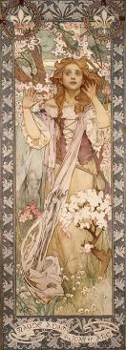
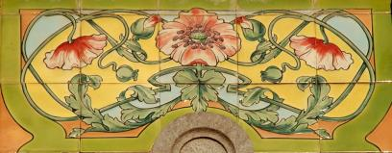
Art Nouveau, 1880-1914
  An international decorative style whose identifying visual quality is an organic, plantlike line. Freed from roots and gravity, it can either undulate with whiplash energy or flow with elegant grace as it defines, modulates, and decorates a given space.
Genval Railway Station artwork. En.wikipedia.org
Alphonse Mucha’s Joan of Arc. Commons.Wikimedia

Slide 6
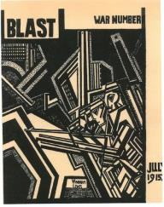
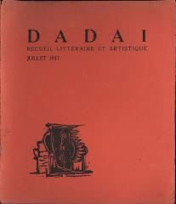
Futurism and Dadaism, 1900-1930
  Both Futurism and Dadaism were artistic and social movements that started in Europe in the early 1900s. Futurism’s main focus was to express modern concepts of the future, including speed, technology, youth and violence. While DADA ridiculed what they perceived as meaningless, and were anti-war, anti-art focused.
Artwork covers of magazine for Futurism and DADA - wikipedia

Slide 7
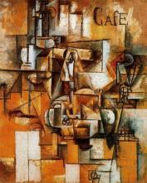
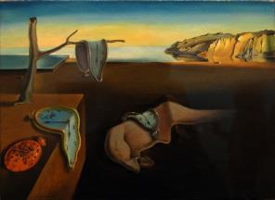
Cubism and Surrealism, 1900-1930
  Both use elements of surprise to create art. Cubism breaks apart a given object or scene and puts it back together in unconventional ways while surrealism uses unexpected juxtapositions and illogical conclusions that seeks to release the creative potential of the unconscious mind.
The pigeon pea - Pablo Picasso. wikiart
Salvadore Dali Surrealsim – wikiart

Slide 8
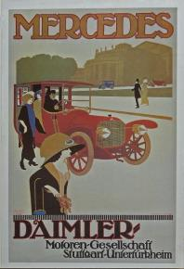
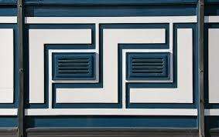
Art Deco, 1910-1930
  Art Deco is an eclectic artistic and design style that began in Paris. It was influenced by cubists and futurists. Art Deco was an ornamental style, and its lavishness is attributed to a reaction to societal pressure during World War I.
Art Deco Style Embelllishment commons.wikimedia
Mercedes poster. En.wikipedia.org

Slide 9
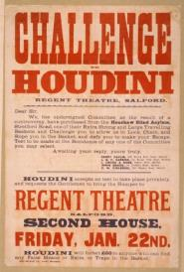
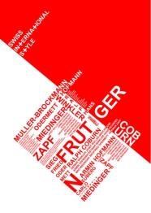
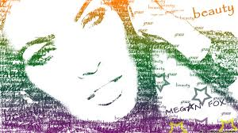
Typography, 1930-1990
  The New Typography organized by type content, rather than formal typesetting tradition. The focus was clarity above beauty. The only design was spacing, rules or bars, and boxes.
  International typography developed into an art form where there were less concerns for readability and more opportunity for artistry and design.
Picture created with descriptive words. Commons.Widimedia
Houdini poster. Flickr No restrictions.
Swiss International Style Commons.Widipedia

Slide 10
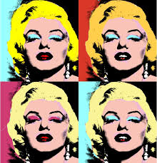
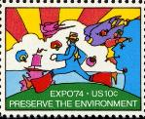
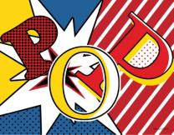
Pop Art, 1955-1980
  Pop art is an art movement that emerged in the mid 1950s. Pop Art removes the subject from its context and isolates it or combines it with other objects. It turned common place items into ICONS such as a soup can or Coca Cola bottle. Unlike one-of-a-kind layered paintings, these were created to be mass produced. Most were considered ambivalent or emotionally detached.
Pop Art Expo74 Stamp. En.wikipedia.org
Marilyn Monroe in Andy Warhol style. En.wikipedia.org
POP art comic. dt.common.streams.
StreamServer_vnews

Slide 11

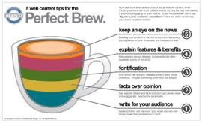
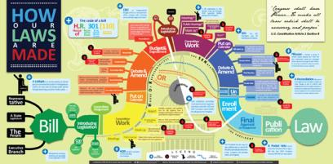

Information Visualization, 1970-present
  Data visualization is the study of the visual representation of data – meaning information that has been abstracted in some thoughtful form, and presented through graphics.
  Main goal of data visualization is to communicate often complex information clearly and effectively through graphical means.
All examples from commons.wikimedia.org

Slide 12
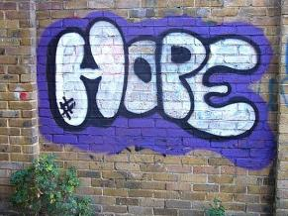
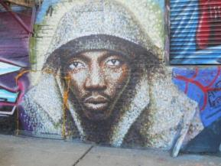
Graffiti And Street Art, 1970-present
  Graffiti is any type of public markings that may appear in the forms of simple written words to elaborate wall paintings. Graffiti has existed since ancient times, with examples dating back to Ancient Greece and the Roman Empire.
  Graffiti, often considered vandalism, may also express underlying social and political messages and a whole genre of artistic expression is based upon spray paint graffiti styles.
Hope graffiti. Free use.
F-Pointz Graffiti. Commons.wikimedia.

Slide 13
Graphic Design Today
  Influences from all of these artists can be seen in graphic design and illustration today. Due to technological advances, we live in an
  “instant information” world. This propels graphic design to the forefront due to the demand by the masses that complex information be presented visually, so as to be easily absorbed. (Think of the explanation of how to pass a bill in Congress versus infographics of what looks like a cool board game!)

Slide 14
Graphic Design Today
  Using different styles of art – whether a graphic designer uses an art nouveau flavor, pop art, surrealism or typography, – they create variety, connection and communication in an instant but interesting way!

Slide 15
Influential Artists, 2oth Century
  Dante Gabriel Rosseti
  Jules Cheret
  H. De Toulouse-Lautrec
  William Morris
  William Bradley
  Lugwig Hohlwein
  Beggarstaffs
  Salvadore Dali
  Pablo Picasso
  Peter Behrens
  Gustave Klimt
  Marcel Duchamp
  Erte
  Joos Schmidt
  Piet Mondrian
  Vasily Kandinsky
  Paul Rand
  Andy Warhol
  Plus many others!

