Slide 1
Pathophysiology

Slide 3
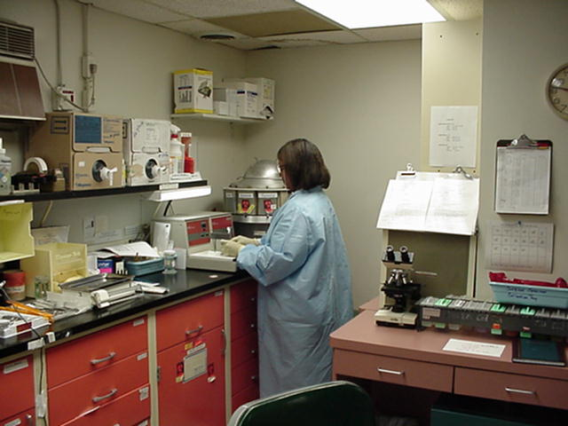
What is Pathophysiology?
  Involves the study of function that results from disease processes.

Slide 4
What is Pathology?
  Pathology is the branch of medical sciences that treats the essential nature of disease, especially the changes of structure and function in tissues and organs of the body that cause or are caused by disease.

Slide 5
Why is Pathophysiology Studied?
  In the clinical setting, pathologists, histotechnologists, and cytotechnologist study tissues and cells to establish the cause of a disease.
  Physicians use that information to form a treatment plan.

Slide 6
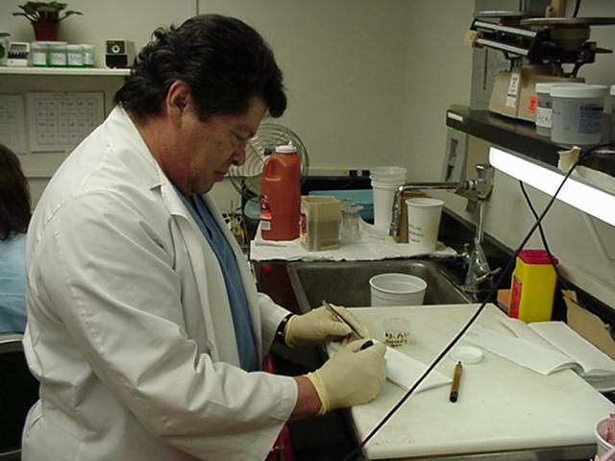
What is a Pathologist?
  A pathologist is a physician who is specifically trained and experienced in anatomical and physiological pathology.

Slide 7
What is a Histologic Technician Or Histotechnologist?
  Histologic technicians and histotechnologists prepare slides of body tissue for microscopic examination.
  Career opportunities for both are excellent in hospitals, research institutions, industrial labs, and government agencies
  A technician requires a 12-month, hospital-based on-the-job training program or an AAS degree.
  A histotechnologist requires a BS degree and one year of additional laboratory experience.

Slide 8
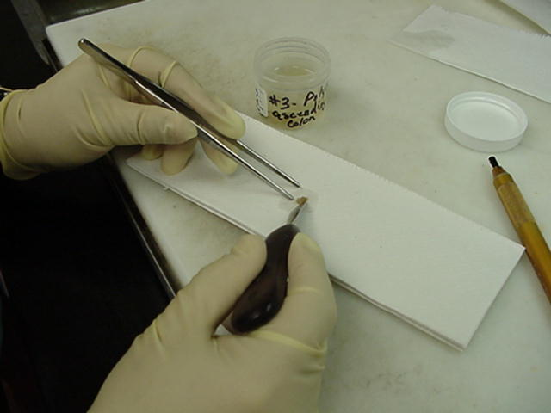
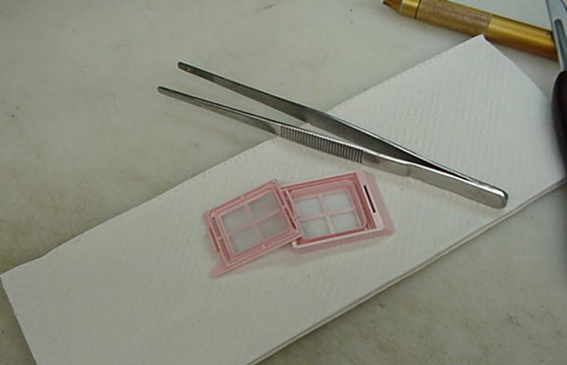
What Type of Studies are Performed in the Clinical Pathology Laboratory?
  Tissue of all types are sent to the histology department for studies into the disease process.
  The pathologist studies the tissue by doing a gross examination.
  Tissues are looked at closely and all observations are recorded.
  The tissue is then prepared for microscopic studies by placing it in a tissue cassette.

Slide 9
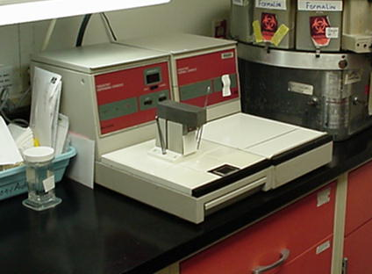
Pathophysiology
  The histotechnologist prepares the tissue for microscopic examination. This is done by using the embedding center.
  The tissue is placed in paraffin wax in order to cut thin slices of the tissue.
  Embedding center instrument:

Slide 10
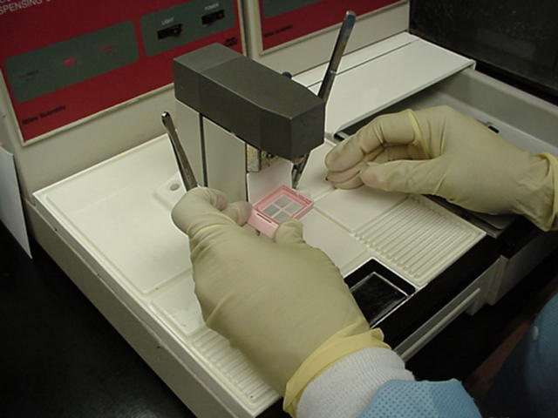
Pathophysiology
  The histotechnologist pours paraffin wax over a tissue specimen.

Slide 11
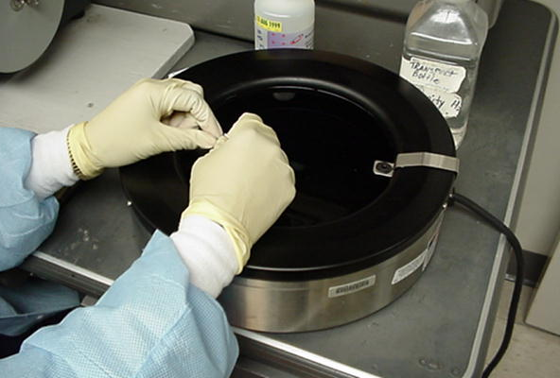
Pathophysiology
  Once the tissue is embedded in paraffin, the block of wax is cooled.
  The histotechnologist then cuts ribbon-like sections for placement on slides.
  The instrument used is called a microtome.
  A water bath is used for spreading the paraffin ribbons and sections are placed on microscope slides to be stained.

Slide 12
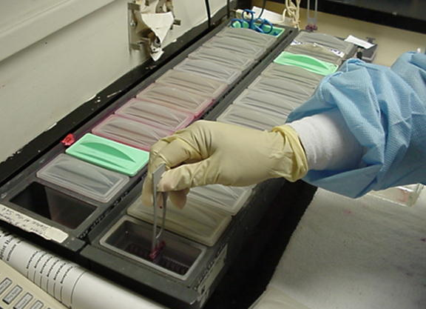
Pathophysiology
  Tissues are stained at the staining center. The basic stain for all tissues is the Hemotoxylin and Eosin (counterstain) stain.

Slide 13
Pathophysiology
  Special stains are used for particular details. They include:
    AFB-Acid Fast Bacilli Stain
    PAS-Periodic Acid Schiff Stain
    Trichrome Stain
    Iron Stain

Slide 14
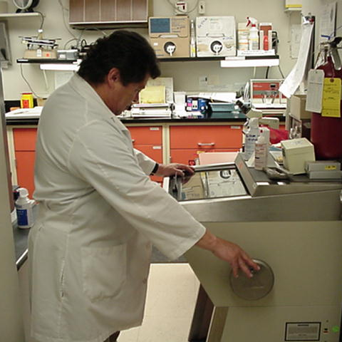
Pathophysiology
  The pathologist then studies the slide to determine pathological states within the tissues.
  A written report is then given to physician to aid him/her in the diagnosis and treatment of the patient.
  Pathologists also perform frozen sections for patients in surgery on the Cryostat.

Slide 15
Pathophysiology
  Exciting opportunities await students who want to explore the physiology of the tissues and cells under the microscope!

