Slide 1
Leadership Play Book

Slide 3
Leadership Play Book
“Together everyone achieves more.”
  – Author Unknown

Slide 4
Leadership Play Book
What makes a great team?
  Knowledge
  Cooperation
  Flexibility
  Common Goals
  Dedication
  Planning
  Effort by All

Slide 5

What makes a Great Team?
Knowledge
  Every member within the group has important information or skills to share!
  Learning is a life-long process.
  We grow as we learn.

Slide 6

What makes a Great Team?
Cooperation
  All team members must work together in harmony. Everyone has a job to do to keep the team operating smoothly.

Slide 7

What makes a Great Team?
Flexibility
  It is important for all team members to be able to adjust their ideas and to be able to set their opinions aside in order to achieve the goal the team is pursuing.

Slide 8
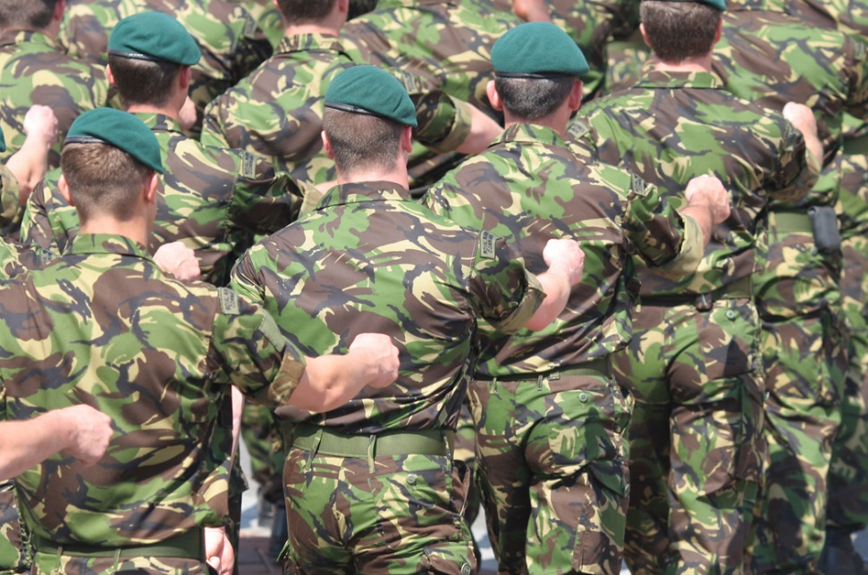
What makes a Great Team?
Common Goals
  Just like our soldiers who believe in the common goal of freedom, team members must share the same goals for the team. This makes the team stronger.

Slide 9
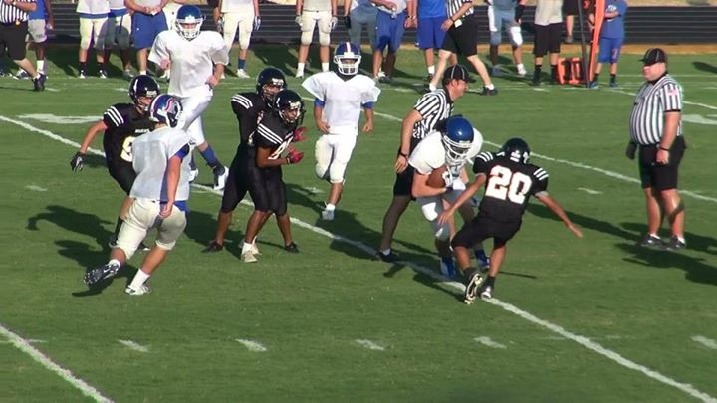
What makes a Great Team?
Dedication
  Also known as commitment; members of a great team apply their time, attention, ability, and enthusiasm. They know others are counting on them and they don’t want to disappoint them.

Slide 10
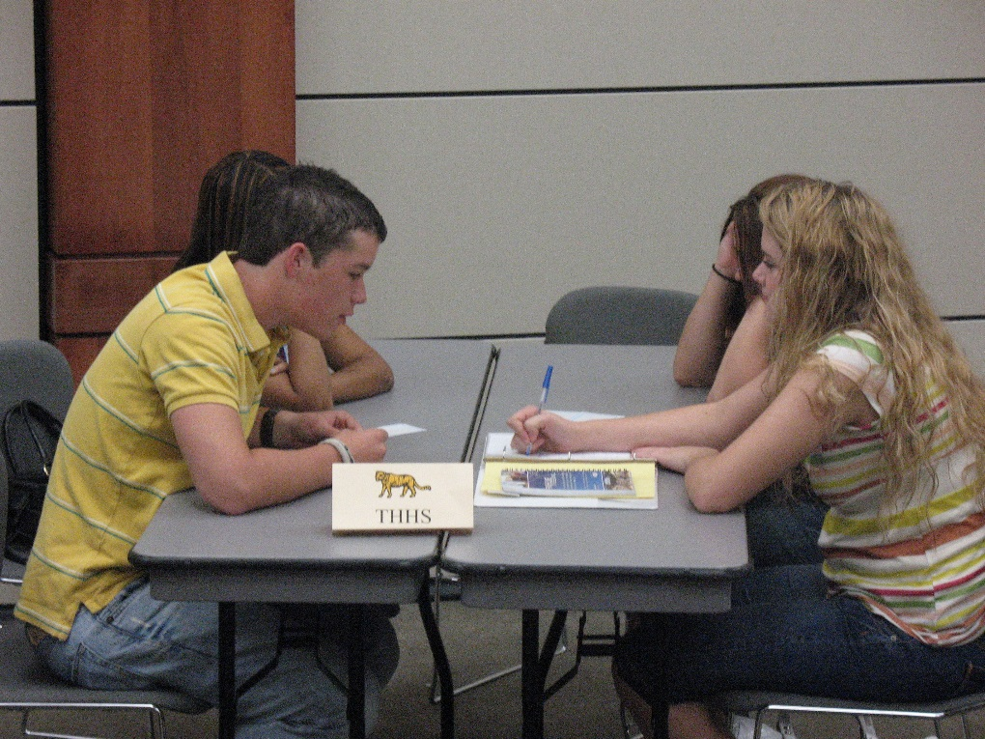
What makes a Great Team?
Planning
  A great team plans their strategy, which includes long-term and short-term goals.
  They divide the duties and responsibilities among the team members in order to operate more efficiently. Of course team members ask their colleagues for help if they need it.

Slide 11
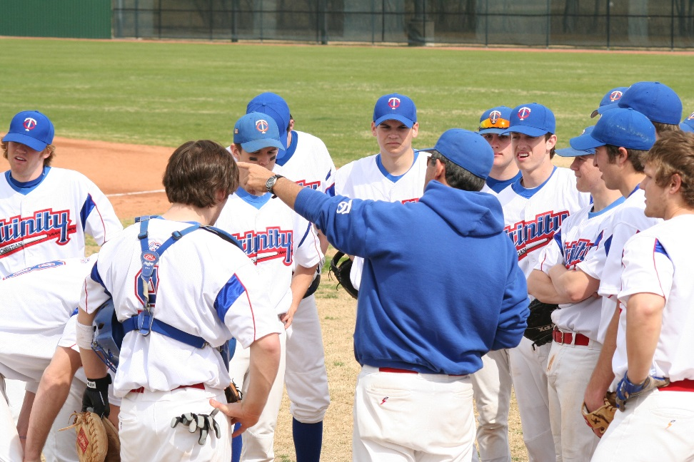
What makes a Great Team?
Effort by All
  Team members encourage each other to put forth their best. It is important for everyone to have the opportunity to contribute their ideas, skills, and talents.

Slide 12
Team Players Become Leaders
  Business ‘Teams’ recognize players who perform exceptionally well
    Advancement
    Bonus
  Being a teammate is all about showing consideration and respect toward others.
    Is there only one Dallas Cowboy who is allowed to score touchdowns?
    Is there only one Dallas Stars player who is allowed to score a goal?

Slide 13

Team Players Become Leaders
  Well managed teams have more success in achieving their goals.
  A good leader is so important!
  Name three sports team owners.
  Name three influential leaders in your life.

Slide 14
Summary
  Playbook for a GREAT team:
  Knowledge
  Cooperation
  Flexibility
  Common Goals
  Dedication
  Planning
  Effort by All
  Effective Leader

