Slide 1
Machining Skills
Flexible Manufacturing

Slide 3
Machining Skills
These are the knowledge and skills needed to operate the different types of equipment in a precision metal industry.

Slide 4
Installing Materials in Different Equipment
Metal working equipment has different methods of holding the material to be machined.
Some machines use a vise, where others have special holding devices.
The following slides will explain the machine cutting operations and holding devices used with each type of machine.

Slide 5
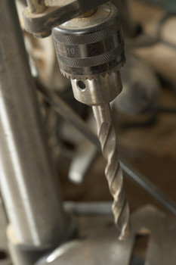
Cutting Operations: Drill Press
Drilling is the use of a shaft like tool with two or more cutting edges to make a hole.
Boring is the process of enlarging a hole.

Slide 6
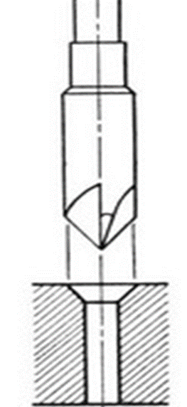
Cutting Operations: Drill Press
Countersinking is the process of enlarging a hole by chamfering the surface, allowing a screw head to sink into the material and be flush with the surface.
Counterboring is the process of enlarging a hole to insert a screwhead.

Slide 7
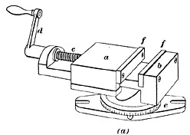
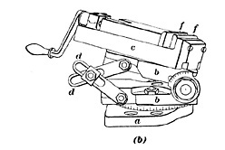
Drill Press Holding Devices
The drill press vise is used to hold the material. The vise could be stationary or angled.
Stationary Vise
Angled Vise

Slide 8
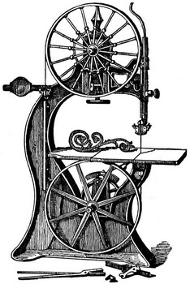
Cutting Operations: Saws
A vertical band saw is used to cut shapes into metal.
The operator will usually freehand the cuts on this machine.

Slide 9
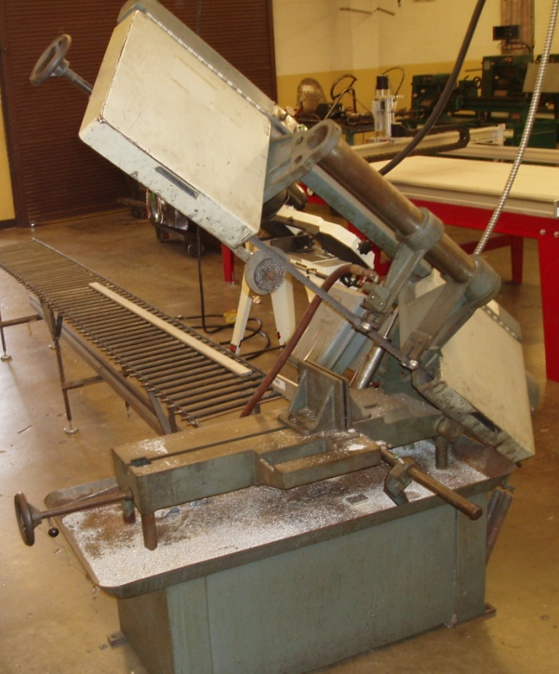
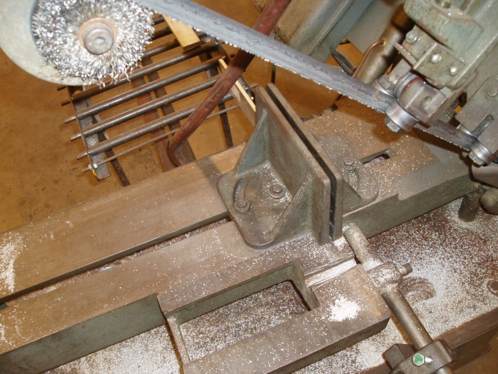
Cutting Operations: Saws
A horizontal band saw is used to cut material to length.
A vise is built into the saw for holding the material.

Slide 10
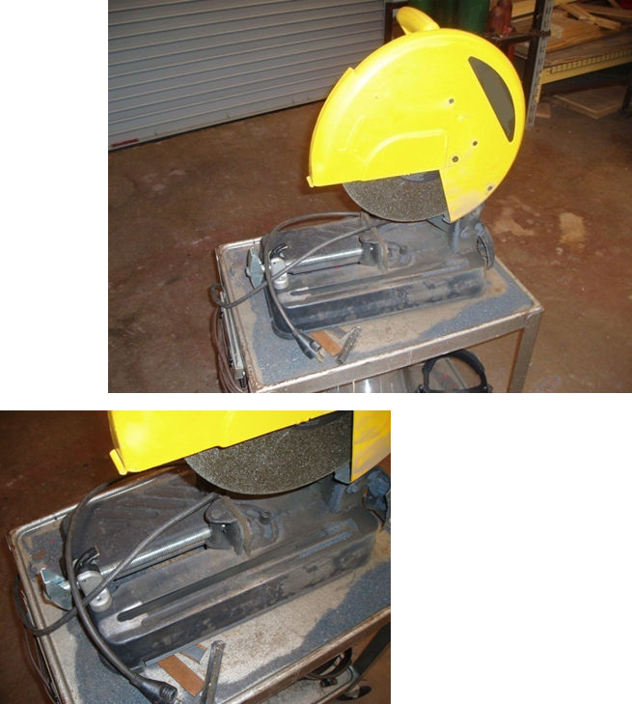
Cutting Operations: Saws
A chop saw is used to cut metal to angles and to length.
An abrasive wheel is used for the cutting medium.
A vise is built into the machine.

Slide 11
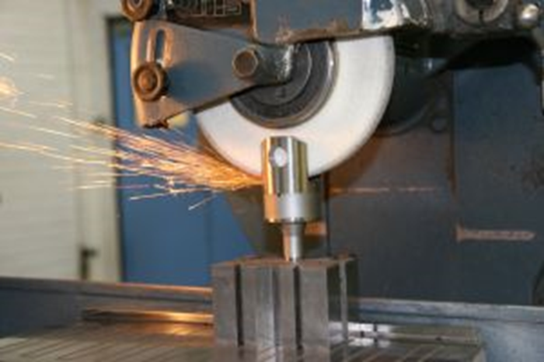
Cutting Operations: Grinders
Grinding is used to smooth, sharpen, or polish material by friction or abrasion.

Slide 12
Cutting Operations: Grinders
The grinder has a special device called a magnetic vise or hold down to hold the material down. It is shown in the bottom of the photo holding the v-blocks in place.

Slide 13
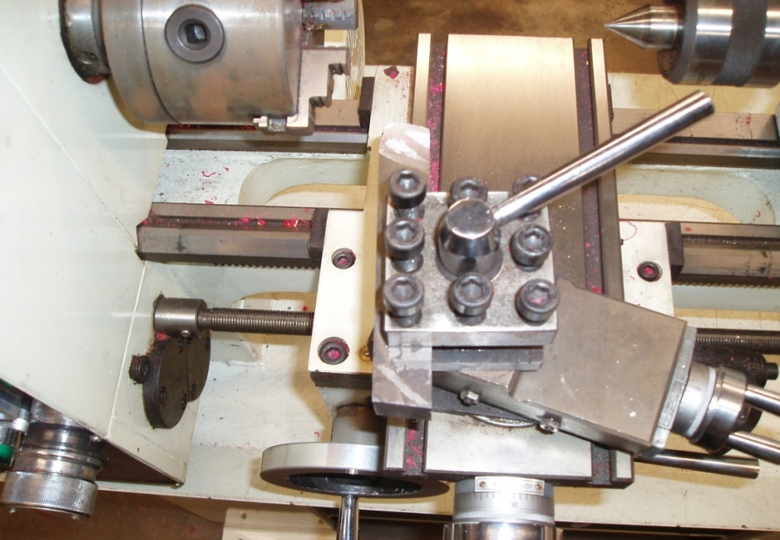
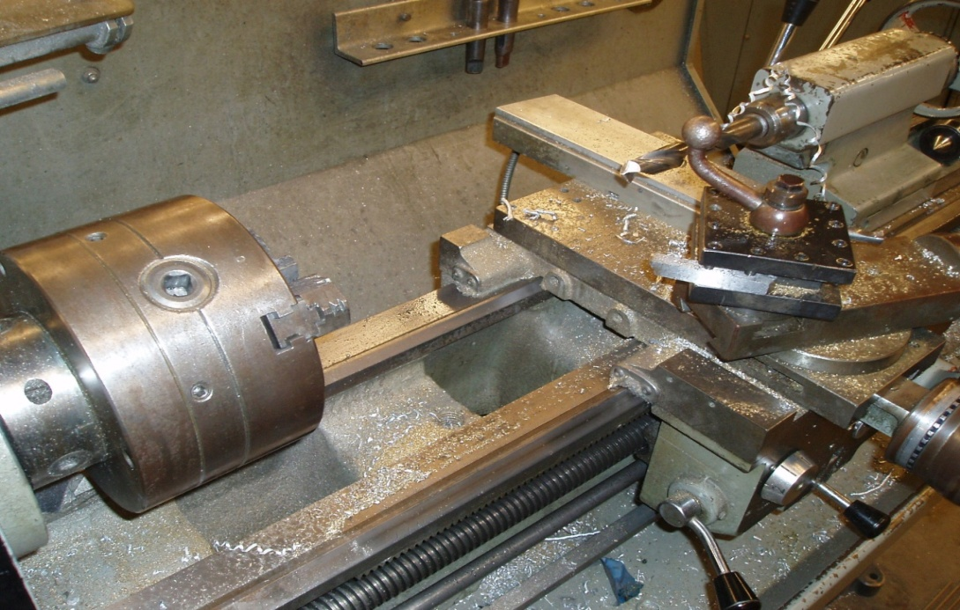
Cutting Operations: Lathe

Slide 14
Cutting Operations: Lathe
The lathe is used to remove material from a cylinder. The cylinder material is held in a chuck, the material turns and a tool is fed into it.
The following are different operations that can be done on a lathe:
turning facing parting knurling
boring threading reaming polishing

Slide 15
Cutting Operations: Lathe
Turning is cutting material off the diameter of the cylindrical piece of material.
Facing is cutting the end of the material so that the end is square (900) with the sides.
cutting tool
cutting tool

Slide 16
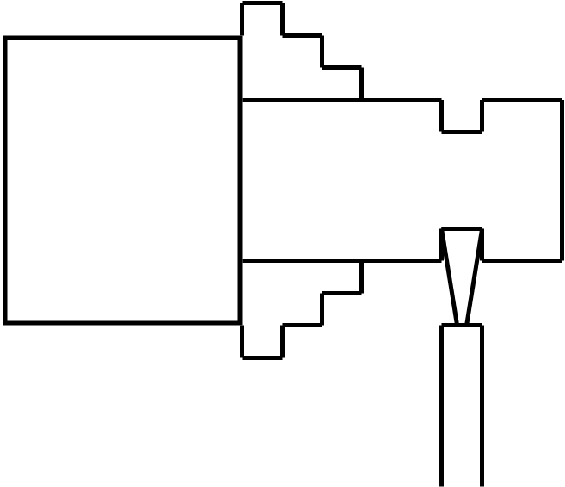
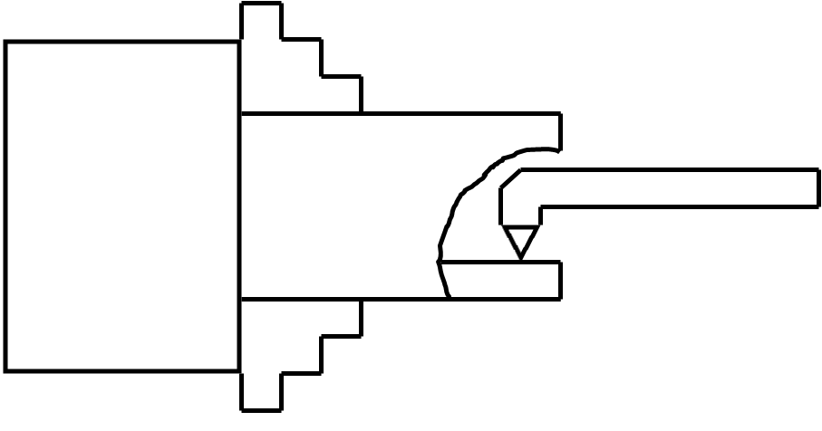
Cutting Operations: Lathe
Parting is cutting a groove into the material.
Boring is enlarging a hole inside a part.
chuck
material
material
chuck
boring bar
Parting Tool
Cutting Tool

Slide 17
Cutting Operations: Lathe
Threading is the process of cutting threads on the part.
Turning a taper is cutting the diameter smaller on one end than at the other.
chuck
chuck
material
material
cutting tool
cutting tool

Slide 18
Cutting Operations: Lathe
Drilling is the process of cutting a hole in the material with a bit.
Reaming is resizing a hole to an accurate size by the use of a reamer.
material
material
chuck
chuck
chuck
drill bit
reaming tool

Slide 19
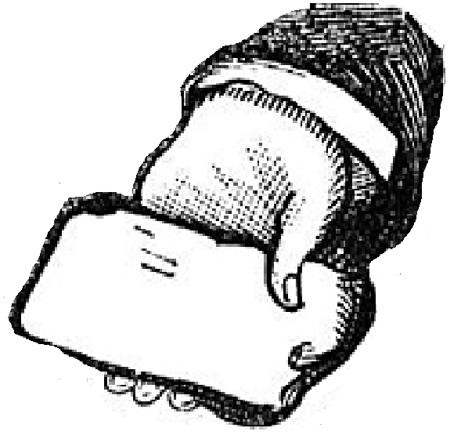
Cutting Operations: Lathe
Knurling is a manufacturing process whereby a visually attractive diamond-shaped (criss-cross) pattern is cut or rolled into metal.
Polishing is the process used to sand smooth or shine the metal.
chuck
material
chuck
material
polishing rag
knurling tool

Slide 20
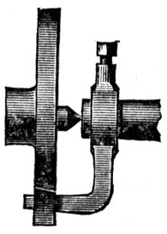
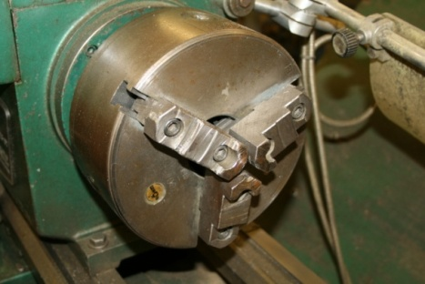
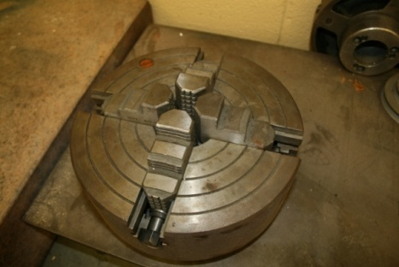
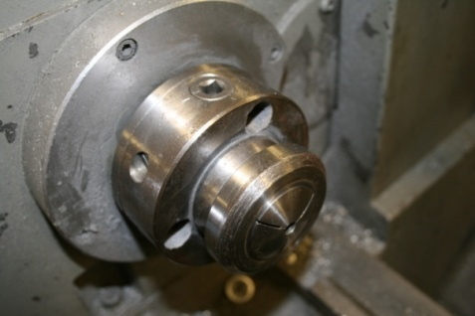
Lathe Holding Devices
A 3-jaw chuck is used of the lathe for most operations. It is self-centering and easy to use.
faceplate
dog
3-jaw Chuck
4-jaw Chuck
Collet
Faceplate and Dog

Slide 21
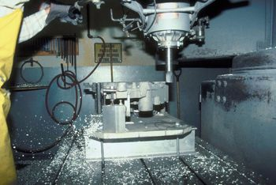
Cutting Operations: Milling Machines
The milling process is to cut away material by feeding a work piece past a rotating cutter.

Slide 22
Cutting Operations: Milling Machines
The milling machine will cut a flat surface across a piece of metal.
end mill
material
vise

Slide 23
Cutting Operations: Milling Machines
The milling machine can be adjusted to cut a bevel on the surface of the material.
end mill
material
vise

Slide 24
Cutting Operations: Milling Machines
The mill cutter can be set to angle the edge of the material. These angles are chamfers.
end mill
material
vise

Slide 25
Cutting Operations: Milling Machines
A key-seat is a slot cut in a shaft.
end mill
material
end mill
v-block
v-block
vise
material
vise

Slide 26
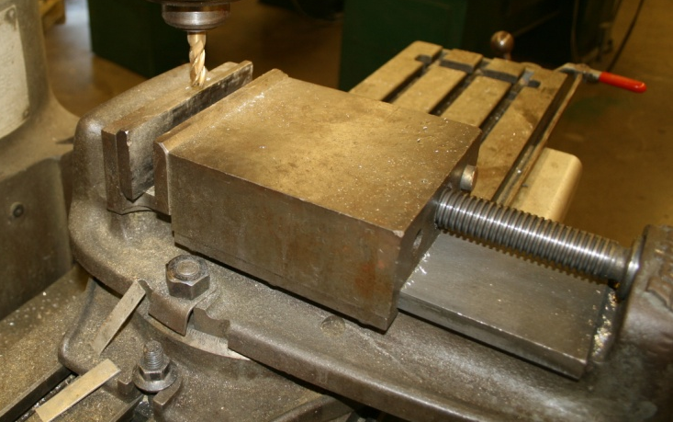
Milling Machine Holding Devices
The mill vise is the main holding device in most labs. The part can be clamped to the table by using t-bolts.
Machine Vise
Clamped to Table

Slide 27
Holding Devices
Drill Press | Band Saw | Chop Saw | Grinder | Lathe | Mill
vise | vise | vise | magnetic hold down | 3-jaw chuck | vise
angle vise | miter gauge |  |  | 4-jaw chuck | angle plate
v-blocks | v-blocks |  |  | collet | direct mounting
 | fences |  |  | faceplate and dog
 | free hand

Slide 28
Assignment: Machining Skills
The following assignments will give the student practice in using the metal lathe and milling machine.
The projects will be turned in and graded based on a project rubric.

Slide 29
Assignment: Machining Skills Step Shaft
The production of the Step Shaft will allow the student to execute facing and turning a part to specific sizes.
0.5
2
2
1.0
0.75
6
Tolerance +/- 0.05

Slide 30
Assignment: Machining Skills Screw Jack Base
Turning the Screw Jack Base allows the student to properly execute lathe procedures such as cut threads, turn tapers, drills, reams, polishes, knurls, and bores.
Tolerance +/- 0.05
Screw Jack
Base

Slide 31
Assignment: Machining Skills
Tic Tac Toe Board
Milling the plate into a Tic Tac Toe Board will allow the student to properly execute the basic milling operations.
Material:
3” X 3” X 3/8”aluminum plate
Pins:
5 – ¼” brass rod 1” in length
5 – ¼” aluminum rod 1” in length

Slide 32
Resources
www.onetonline.org
Textbooks
Goodheart/Wilcox, Manufacturing and Automation Technology.
Goodheart/Wilcox, Modern Welding, 10E Revised Edition.
Glencoe/McGraw-Hill, Technology Today and Tomorrow

