Slide 1
Maintaining Horse Health
  Equine Science

Slide 3
How do you know when you are sick?
  First you must recognize what is normal for you—then you can identify abnormal behaviors and deal with problems that arise.

Slide 4
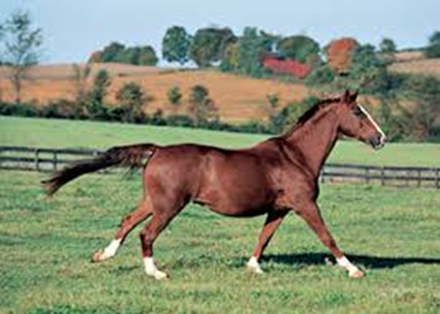
Since our horses cannot tell us when they are not feeling well, we must identify normal behaviors so we can recognize abnormal issues.
  Maintaining horse health and soundness is a big part of keeping horses healthy for the long term. Just like we change the oil in our cars, horses require routine maintenance to stay healthy.

Slide 5
Objectives
  Today we will:
  Describe “normal” behavior and characteristics
  Determine routine maintenance required for horses
  Identify common health and soundness problems

Slide 6
What is “normal” Behavior?
Can you tell the difference between a healthy and sick horse?
  Visual appraisal of the horse is fairly revealing:
    Is the coat shiny?
    Are eyes clear and bright?
    Are nostrils soft and clean?
    Is the horse able to move easily?
    Does the horse appear content?
    Are stools firm but not hard?
    Is the horse eating and drinking?
    Does the horse appear to be in good flesh, but not obese?

Slide 7
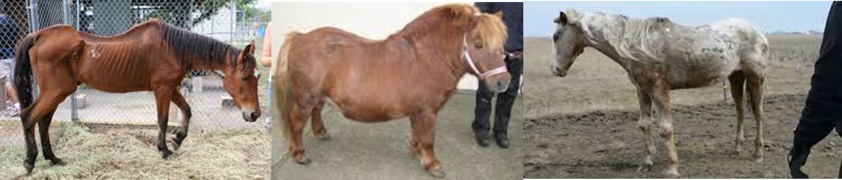
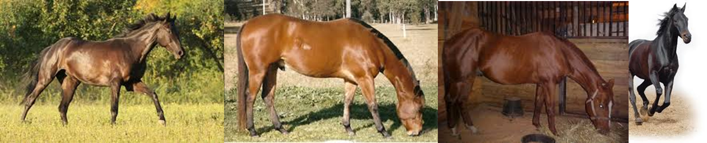
Healthy or Unhealthy?

Slide 8
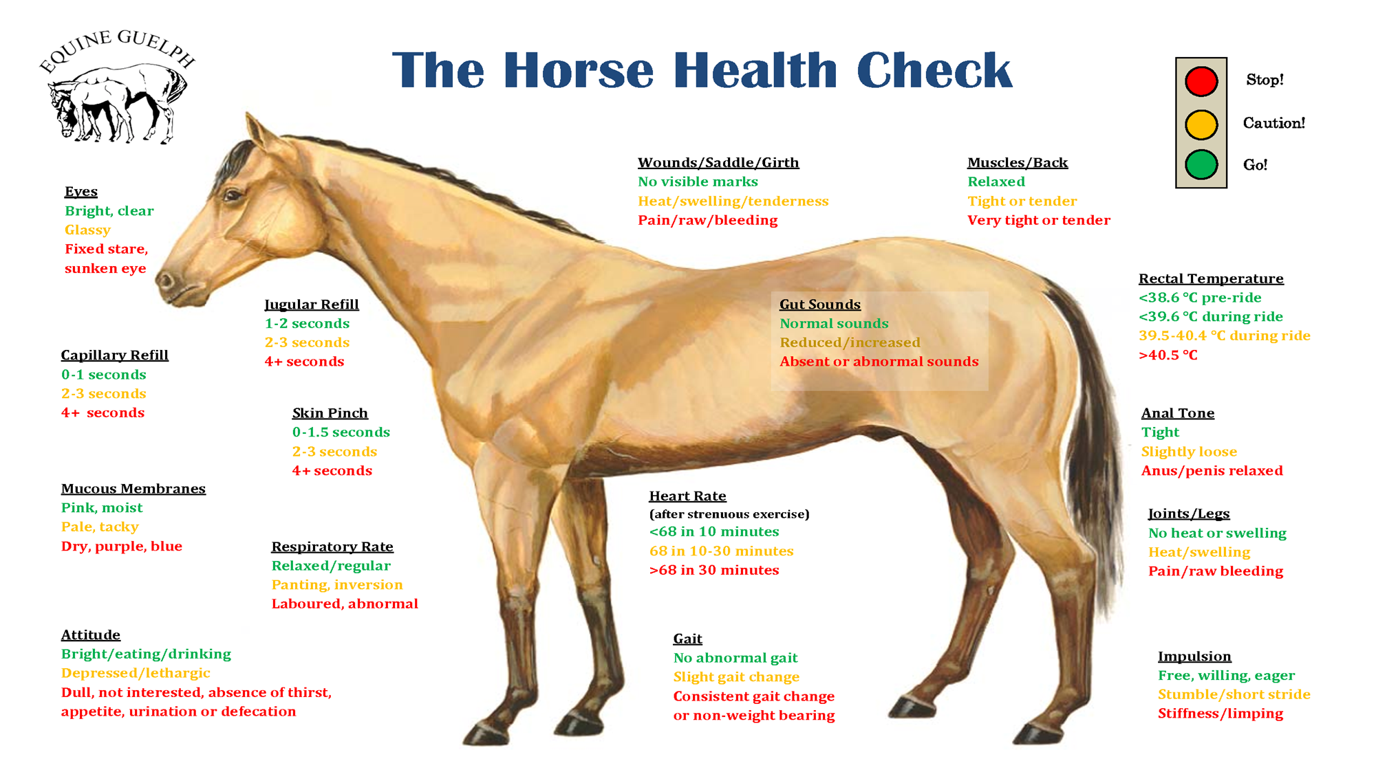

Slide 9
Routine Maintenance for Horses
  Food
  Hoof care
  Vaccinations, Veterinary Care, and Testing
  Deworming
  Shelter
  Exercise

Slide 10
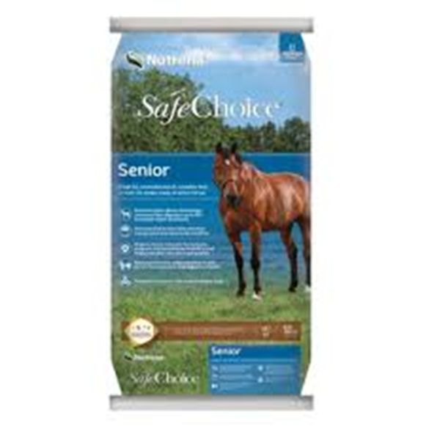
Food
  Horses need a regular supply of food.
  In most cases, they need to have hay or pasture throughout the day, with additional grain feedings twice a day.
  An average-size horse will eat about 20 lbs. of food, (hay, grass and grain combined) a day.
  Horses will drink at least eight gallons of water per day.
  Because their stomachs are relatively small and their digestive systems surprisingly delicate, ideally horses need to nibble or graze throughout the day, rather than have one or two meals a day.

Slide 11
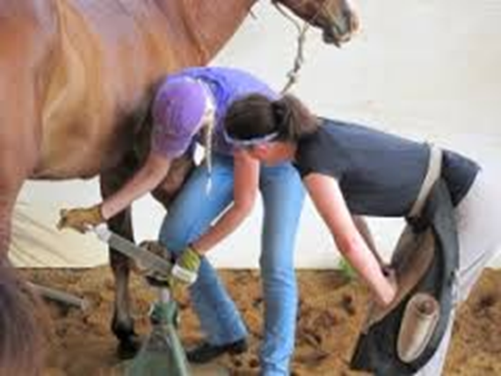
Hoof Care
  Horses need regular hoof care.
  Plan to hire a farrier (blacksmith) every six to eight weeks for routine hoof trimming and/or shoeing.
  Horses with special hoof issues may need additional care or require the consultation of a veterinarian.
  If you notice lameness issues, consult a veterinarian or farrier as soon as possible.
  Left untreated, a relatively minor issue can result in permanent lameness.

Slide 12
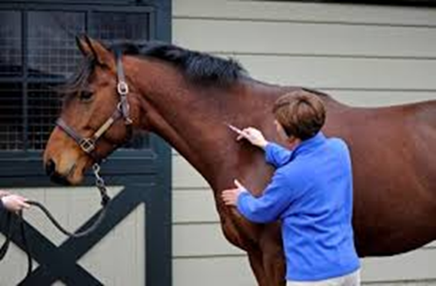
Vaccinations, Veterinary Care and Testing
  Vaccinations are an inexpensive way to ensure your horse's long term health. Most horses are vaccinated twice a year.
  Included in most vaccination programs are inoculations for: influenza (flu) rhinopneumonitis (rhino), eastern and western strains of encephalomyelitis (sleeping sickness), and tetanus. Other inoculations are available for common illnesses like rabies and equine distemper (strangles), EPM and West Nile Virus.
  The veterinarian will also provide routine dental care.
  Equine Infectious Anemia (E.I.A.) is a disease transmitted between horses by blood sucking insects. Every state has regulations regarding the requirement of documentation that horses are E.I.A. negative before they its borders. An E.I.A. test (commonly called a "Coggins" test) is required at horse shows, clinics, sales, events and campgrounds as well.

Slide 13
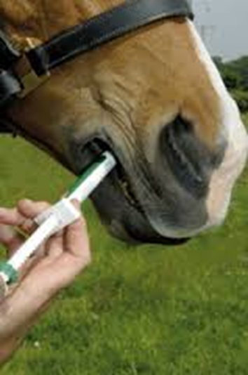
Deworming
  Since horses are constantly exposed to intestinal worms from the ground they graze on, they must be dewormed every six to eight weeks with an oral paste dewormer.
  Carrying a heavy burden of worms can cause serious illness or death in equines, so regular and timely treatment is crucial to your horse's health.
  Sometimes veterinarians will also recommend tube worming where a tube is inserted through the nostrils into the stomach to administer the dewormer.

Slide 14
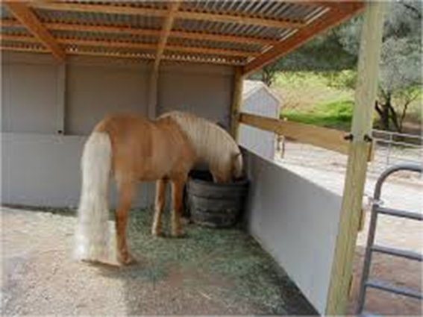
Shelter
  Horses need constant access to a dry, safe, comfortable shelter to protect them from rain, wind, and snow.
  In warm and sunny weather, the shelter you supply will provide your horse with much needed shade.
  At a minimum, you should have a well-constructed, three-sided shed into which your horse can retreat at all times.
  You will need to remove manure from the stall or shelter every day.

Slide 15
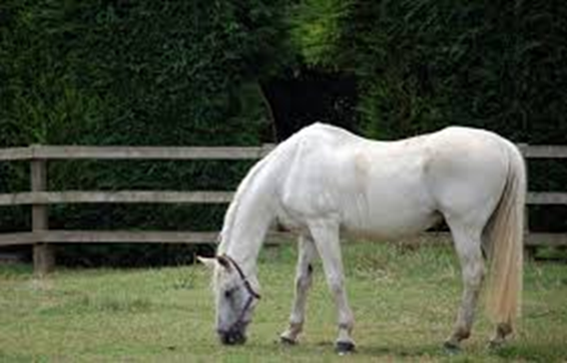
Exercise
  Horses need exercise.
  To supplement the exercise your horse will get when you ride him, he should have a paddock or pasture in which to relax and stroll.
  No horse should spend all day confined in a stall, except on a veterinarian's recommendation.
  The pasture should be bordered by safe, sturdy fencing that will keep the horse safe and secure.
  Barbed wire is not an acceptable fencing material—it has been the cause of many serious injuries.

Slide 16
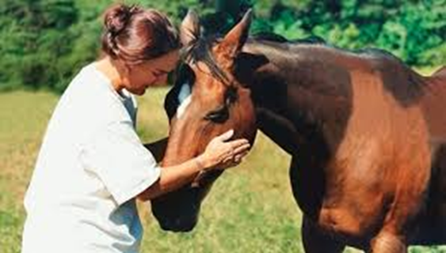
Common Issues
  Common issues include:
  Skin problems such as summer itch or sores
  Founder
  Colic
  Ankle Swelling
  Proud Flesh from a flesh wound
  Thrush in the hooves

Slide 17
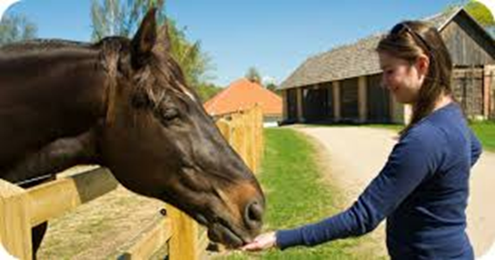
Maintaining Horse Health Activity
  For each of the following, look up information related to the disorder, how to diagnose it, and how to treat it. On a scale of 1-10 with 1 being mild and 10 being severe, identify the severity of the disorder
  Skin problems such as summer itch or sores
  Founder
  Colic
  Ankle Swelling
  Proud Flesh from a flesh wound
  Thrush in the hooves
  Equine Infectious Anemia
  Rabies

Slide 18
Questions for Review
  What is normal behavior in a horse?
  Describe a symptom that might indicate a problem.
  Name and describe a common horse health issue.

Slide 19
Questions for Review
  What is normal behavior in a horse?
    Is the coat shiny?
    Are eyes clear and bright?
    Are nostrils soft and clean?
    Is the horse able to move easily?
    Does the horse appear content?
    Are stools firm but not hard?
    Is the horse eating and drinking?
    Does the horse appear to be in good flesh, but not obese?

Slide 20
Questions for Review
  Describe a symptom that might indicate a problem.
  Example: Horse has a runny nose, is not eating, and appears to be in discomfort
  What would you do?
  Call a veterinarian

Slide 21
Questions for Review
  Name and describe a common horse health issue.
  Example: Colic is a digestive problem that can range from mild to severe. Symptoms are biting at side, pawing, little or no stool passage, and general discomfort. Treatment ranges from a muscle relaxer and walking to surgery.

Slide 22
Summary
  Just like we must maintain our own health by eating right, brushing our teeth, and getting exercise,
  Horses require basic maintenance as well.
  Taking care of small issues such as deworming and vaccinations can prevent bigger problems later.

Slide 23
References
  Recommended Equine Care: http://www.equinevetservice.com/recommended.htm
  Vital Signs of Equine: http://www.equinevetservice.com/vitalsigns.htm
  Recognizing and Managing Common Health Problems in Horses: http://aevm.tamu.edu/files/2010/06/Recognizing-and-Managing-Common-Health-Problems-of-Horses.pictures.ppt

Slide 24
Texas College and Career Readiness Standards
  English Language Arts: V. Research, B, 1.
  Science: I. Nature of Science: Scientific Ways of Learning and Thinking, E. 1-2. IV. Science, Technology and Society. A, 1.
  Social Studies: V. Effective Communication, A. 1., B, 1.
  Cross Disciplinary: I. Key Cognitive Skills, B, 1, 3.

