Slide 1
Management
  Another Piece of the Puzzle

Slide 3
Bell Work Activity
Answer the following questions on a sheet of paper.
1. Describe two experiences where you have had to manage a group of people.
2. Describe aspects of the experience that you liked. Then, describe aspects that you disliked.

Slide 4
Warm-Up Activity: Terms
There are several important terms and definitions students need to know.
Complete Management: Another Piece of the Puzzle Student Notes.
Students may work in groups.

Slide 5
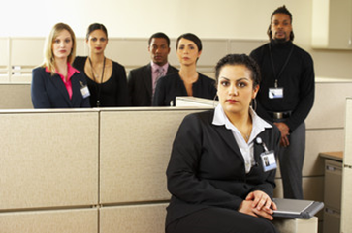
Management Structures
  Vertical Organization
    Manager performs particular department function well.
    Top management
    Middle management
    Supervisory-level
  Horizontal Organization
    Became popular due to downsizing in the 1980s and 1990s
    Self-managing teams set own goals and make own decisions
    Customer oriented
    Adopted by most car manufacturers

Slide 6
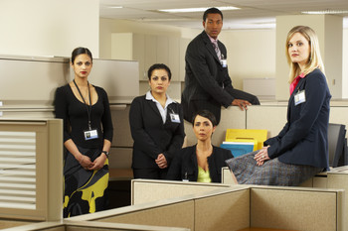
Management Functions
  Planning
    Long-range
    Short-range
  Organizing
    Arrange staff to accomplish goals
    Organizational chart
  Controlling
    Performance is measured and compared with goals
    Setting standards, areas of improvement

Slide 7
Management Functions
  Staffing
    Recruit and hire; evaluate performance
  Leading
    Communicate direction of business; commitment; motivation; drive

Slide 8
Management Styles
  Autocratic
    Makes decisions with virtually no input
    “My way or the highway”
  Chaotic
    Allows employees to make all decisions
    Can be a “circus”
  Consultative
    Gets feedback and adjusts when necessary
    Can be slow; Advisory Board can be helpful

Slide 9
Management Styles
  Democratic
    Allows majority rule; sometimes a slow process
    But it is easier to get employee’s approval
  Laissez-faire
    Manager acts as a mentor; allows employees some control
    Focus on results, not how work gets done
  Persuasive
    Makes decision, then takes time to convince employees it was good
    Spends time getting people to “buy in”

Slide 10
An Effective Manager
  Shows a “happy face”
    It is ok to smile! It’s contagious!
  Cares about others
    Encourages and looks for the good in others
    Says “thank you”
  Is considerate
    Takes interest
    Calls people by their names
    Recognizes birthdays, anniversaries, etc.
  Listens
    Asks questions
    Recalls information
  Encourages interaction
    Does not gossip
    Treats everyone equally
    Is a team player
    Is trustworthy

Slide 11

An Effective Manager
  Handles disagreements quickly and fairly
    Resolves conflict
  Communicates clearly
    Written
    Oral
  Appreciates humor at appropriate times
    Humor alleviates stress
    Timing must be appropriate
  Is empathetic
    Walks in “others’ shoes” easily
  Is not negative and does not whine
    Sets a good example
    Is not a “cry baby”

Slide 12

An Effective Manager
  Is able to give clear directions
  Has skills to train employees adequately
  Has vision
  Is consistent and fair and firm
  Acts as a good example
  Delegates responsibilities
  Fosters initiative

