Slide 1
Metal Cutting Processes
  Flexible Manufacturing

Slide 3
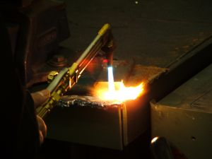
Oxygen Acetylene Cutting
  Oxygen Acetylene Cutting: the use of a torch fueled with oxygen and acetylene to heat the metal and blow the molten metal from the cut

Slide 4
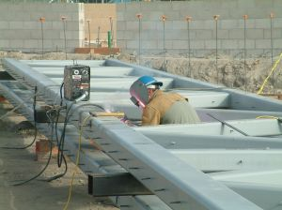
Plasma Cutting
  Plasma Cutting: the use of a blast of air or some other gas to super heat the metal and force it from the cut

Slide 5
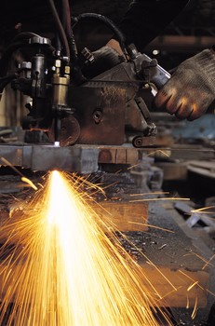
Dross
  Dross: the scum that forms on the surface of molten metal or the slag from cutting metal

Slide 6

Plasma
  Plasma: the fourth state of matter; a highly ionized gas

Slide 7


Oxygen Acetylene vs. Plasma Cutting
Oxygen Acetylene Cutting | Plasma Cutting
Heats then oxides metal | Super heats and blows metal from cut
Cuts only ferrous metal | Cuts all conductive metal including aluminum and stainless steel
Cuts thicker metal | Cuts faster
Leaves large amounts of dross | Leaves little or no dross

Slide 8
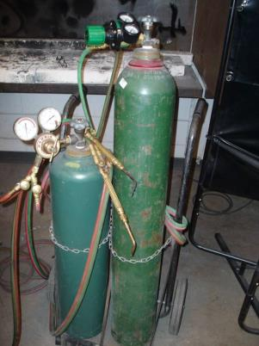
Oxygen Acetylene Cutting Parts
Oxygen Regulator
Acetylene Regulator
Oxygen Regulator Adjusting Screw
Acetylene Regulator Adjusting Screw
Oxygen Tank
Acetylene Tank
Safety Chain
Gas Lines
Cart

Slide 9
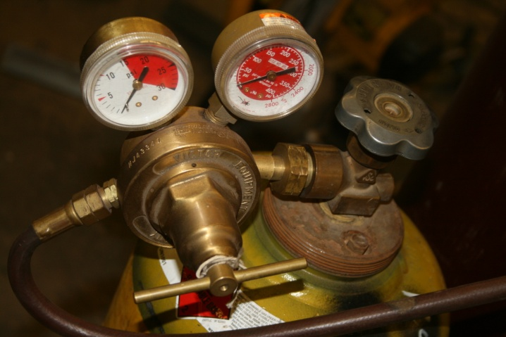
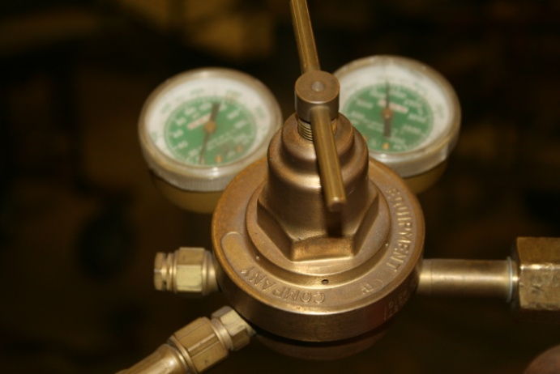
Oxygen Acetylene Regulators
Bottle Pressure Gauges
Line Pressure Gauges
Acetylene Tank
Regulator Adjusting Screws
Gas Lines
Acetylene Regulator
Oxygen Regulator

Slide 10
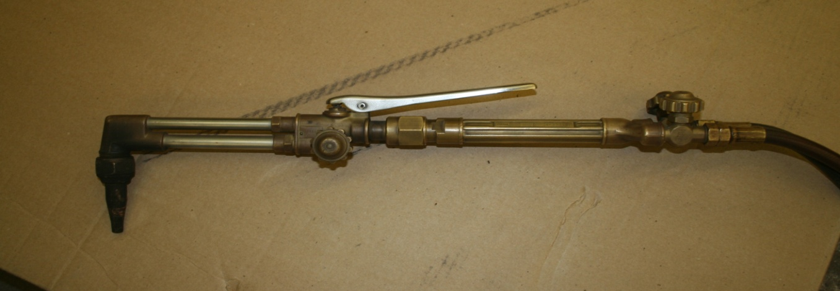
Oxygen Acetylene Cutting Torch Parts
Oxygen Blast Trigger
Cutting Torch Head
Oxygen Valve on Handle
Acetylene Valve on Handle
Cutting Head Oxygen Valve
Torch Handle

Slide 11

Oxygen Acetylene Cutting Setup
  Begin the Oxygen Acetylene Cutting by setting the regulators. Open the torch handle oxygen valve all the way. Open the cutting head oxygen valve one turn.
Open one turn
Open all the way

Slide 12
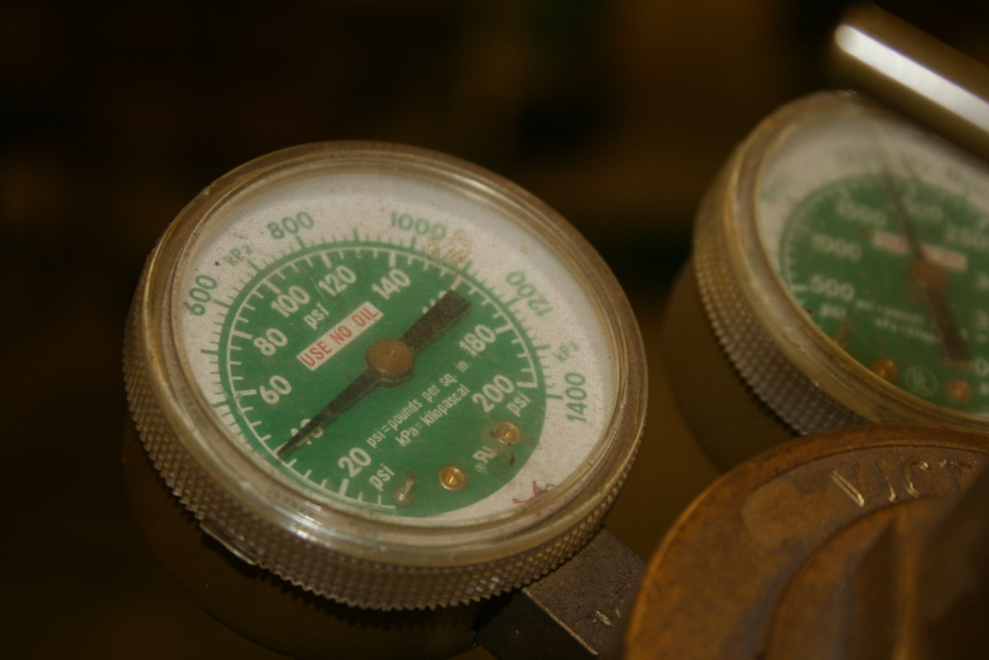
Oxygen Acetylene Cutting Setup
  Adjust the pressure on the regulator to a line pressure of 30 lbs. Close the cutting torch oxygen valve.

Slide 13

Oxygen Acetylene Cutting Setup
  Open the acetylene tank valve a 1/4 turn. This is a safety factor. If something happens, you can turn the fuel off quickly.
Tank Valve

Slide 14
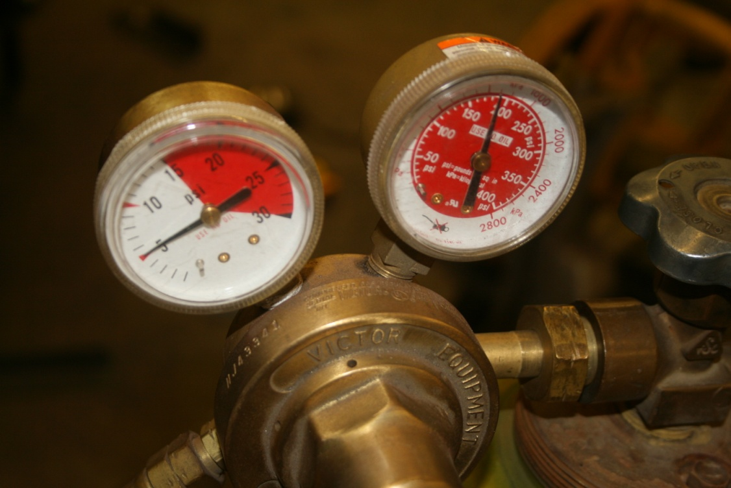
Oxygen Acetylene Cutting Setup
  Open the acetylene valve on the torch handle a 1/4 turn. Adjust the line pressure on the gauge to 5 PSI. Use the adjusting screw to set the pressure. Close the torch handle valve.
Line Pressure Gauge

Slide 15
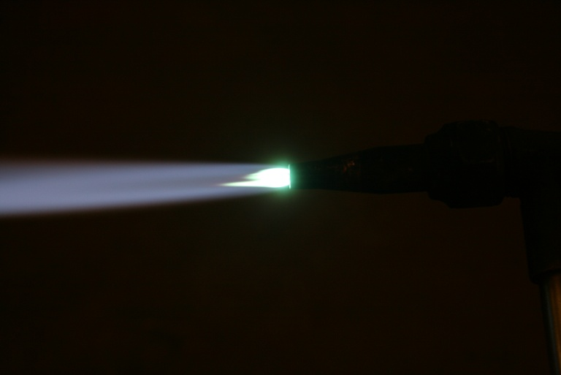
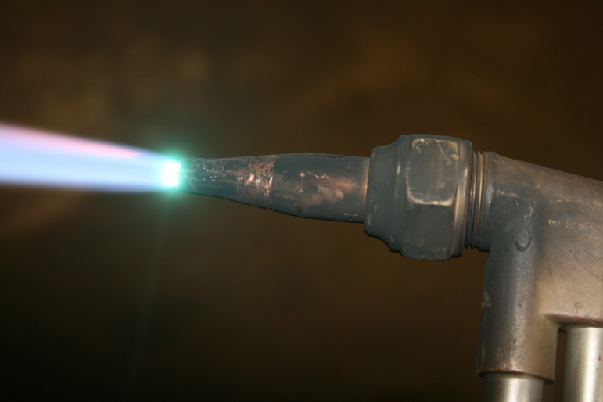
Oxygen Acetylene Cutting Setup
  Open the acetylene valve on the torch handle. Use a spark igniter to light the torch. Open the oxygen valve after the torch is lit and adjusted to a neutral flame. This flame has a bright blue flame with no light blue feathering outside the main flame.
Feathered Flame
Neutral Flame

Slide 16
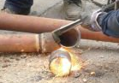
Oxygen Acetylene Cutting Setup
  Place the cutting tip about 1/8 inch away from the metal to be cut. Heat the metal to a bright red, then press the oxygen blast trigger.

Slide 17
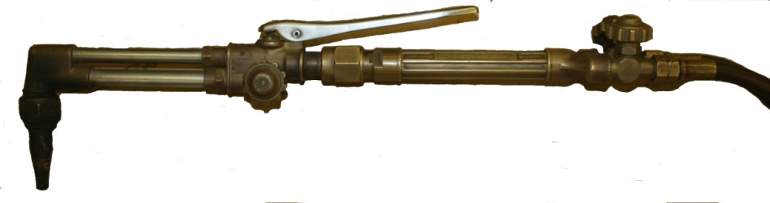
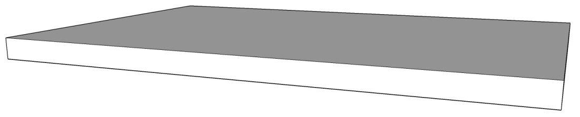
Oxygen Acetylene Cutting Operation
  The oxygen blast will increase the metal’s temperature to a molten state and it will blow the metal from the cut. Keep the torch in a vertical position and follow your guide.

Slide 18
Oxygen Acetylene Cutting Operation
  Move the cutting torch at a speed that will keep the molten metal puddle intact. If the torch is moved too fast, the metal will not be heated properly and the cutting will stop. Close the oxygen blast trigger and let the metal reheat to a bright red, then restart the cut.

Slide 19
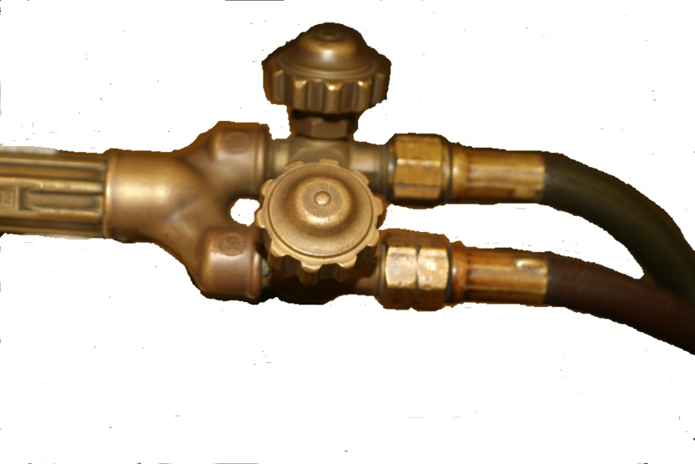
Oxygen Acetylene Cutting Operation
  At the end of the cut, tilt the torch a little to cut through the bottom of the metal. A steady movement will produce a straight cut. An unsteady movement will produce a wavy cut.
  When finished cutting with the torch, close the oxygen valve on the torch handle first. Then close the acetylene valve. This safely stops the flame.
Oxygen Valve
Acetylene Valve

Slide 20
Oxygen Acetylene Cutting Operation
  The turning off of the cutting torch when completely finished is the same process as when welding or brazing. The main valves on the tanks will be closed. After closing both tank valves, open the acetylene valve on the handle to bleed the acetylene line from the tank to the torch. The regulator will show 0 pressure on the gauges. Close the acetylene valve on the torch and unscrew the regulator adjusting screw.
  After the acetylene line is drained or purged, do the same thing to the oxygen line. Open the oxygen valve on the torch handle and drain the oxygen from the line and regulator. When the gauges read 0 pressure, loosen the regulator adjustment valve. Close the oxygen valve on the torch handle and the cutting head. Take the torch and other items to their storage place and straighten the hoses.

Slide 21
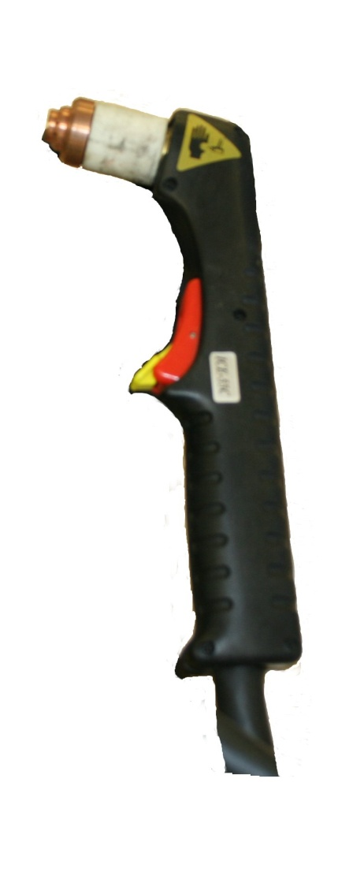
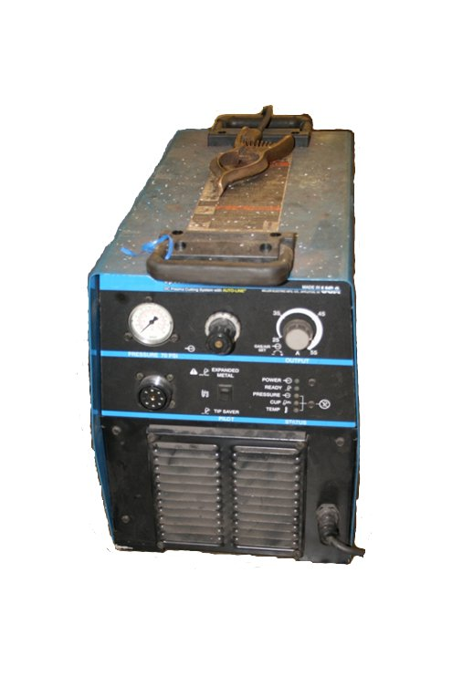
Plasma Cutting Torch

Slide 22
Plasma Cutting Power Supply Parts
Ground Clamp
Air Pressure Gauge
Amperage Control
Air Pressure Control
Machine Lights
Connection for Torch

Slide 23

Plasma Cutting Torch Parts
Handle
Cutting Tip
Trigger
Trigger Lock

Slide 24


Plasma Cutting Operation
  Place drag shield directly on the metal. The arc should be pointed straight down.
  Raise the trigger lock and press the trigger. This starts the pilot arc. Igniting the plasma arc occurs when the torch is placed on the metal.
  Place drag shield directly on the metal. The arc should be pointed straight down.
  Raise the trigger lock and press the trigger. This starts the pilot arc. Igniting the plasma arc occurs when the torch is placed on the metal.

Slide 25


Plasma Cutting Operation
  When the cutting arc starts, move tip slowly over across the metal.
  Adjust the cutting speed across the metal so the sparks go through the metal and out the bottom of the cut.

Slide 26


Plasma Cutting Operation
  When ending the cut, tilt the torch up, and cut the back corner of the plate. This makes a cleaner cut.
  Release the trigger when the tip leaves the metal. The torch will go into cool down mode and air will flow around the electrode. Pressing the trigger again will restart the arc.

Slide 27
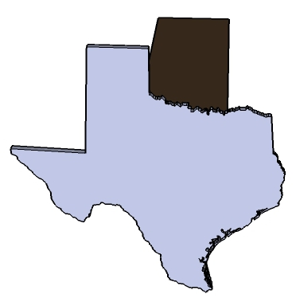
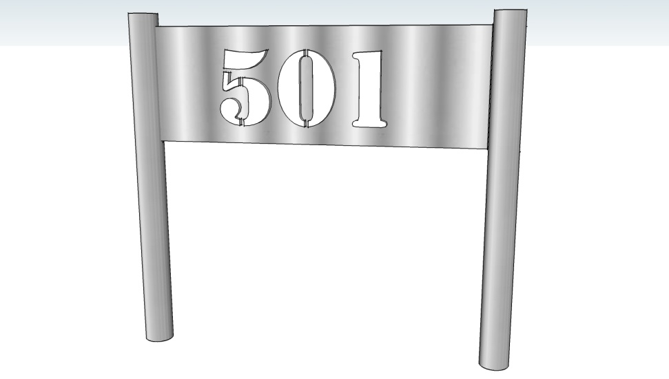
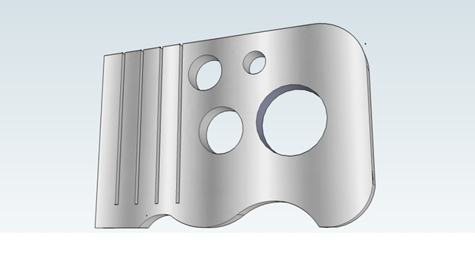

Cutting Projects

Slide 28
Cutting Projects Assignments
You will choose a project to weld. The plans and instructions can be picked up from the teacher.
REQUIRED:
Cutting Process Basic Assignment
OPTIONAL:
Receiver Hitch Tube Cover
Address Boot Scraper

Slide 29


Cutting Process Basic Assignment

Slide 30
Cutting Process Basic Assignment
4 CUTS 3 1/2” LONG
1/2” DIA.
3/4” DIA.
1 1/2” DIA.
1” RADUS
4”
1” DIA.
6”
1/4” THICKNESS PLATE 4” X 6”
USE A TORCH AND CUT THE DASH LINES
CUTTING PROCESS BASIC ASSIGNMENT
1
NAME
DATE

Slide 31
Cutting Process Basic Assignment Rubric
Visual Inspection | Fail | Pass | Points Awarded | Comments
Straight cuts | 0 Points | 1 -10 Points
Straightness | 0 Points | 1 -10 Points
Cut through | 0 Points | 1 -10 Points
Excess dross | 0 Points | 1 -10 Points
Holes | 0 Points | 1 -10 Points
Size | 0 Points | 1 -10 Points
Circle shape | 0 Points | 1 -10 Points
Edge cuts | 0 Points | 1 -10 Points
Smoothness | 0 Points | 1 -10 Points
A=80-90 B=70-79 | C=60-69 | D=50-59 Total:

Slide 32
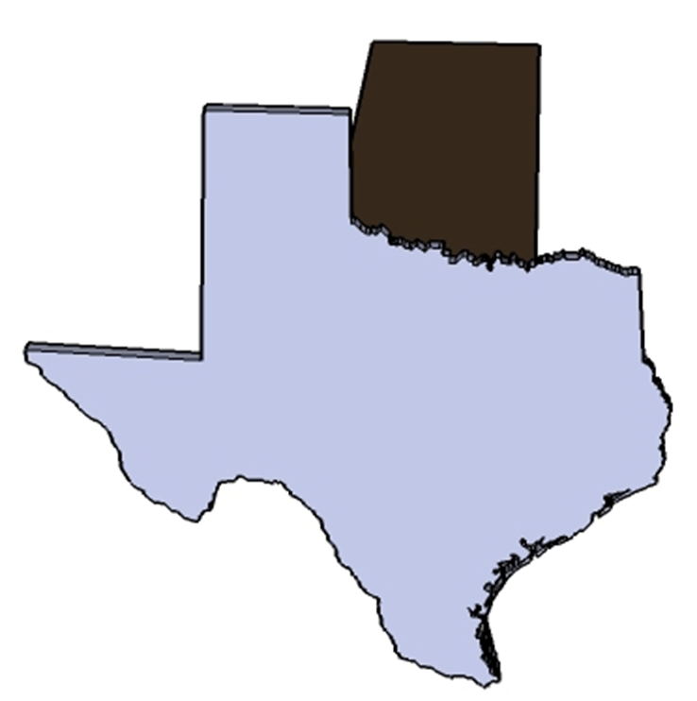
Receiver Hitch Tube Project

Slide 33
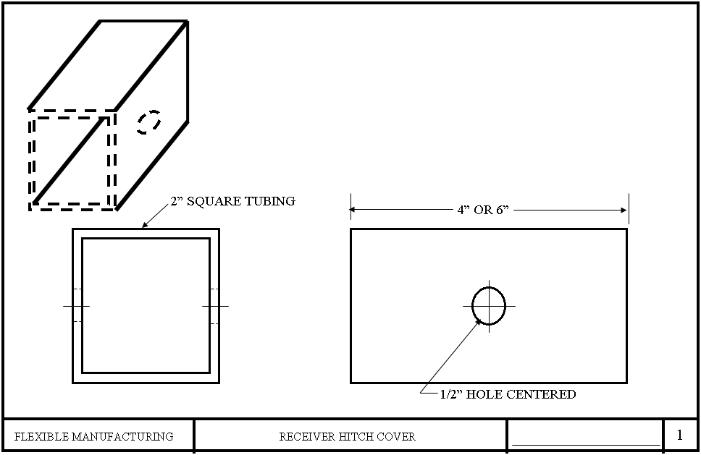
Receiver Hitch Tube Project

Slide 34
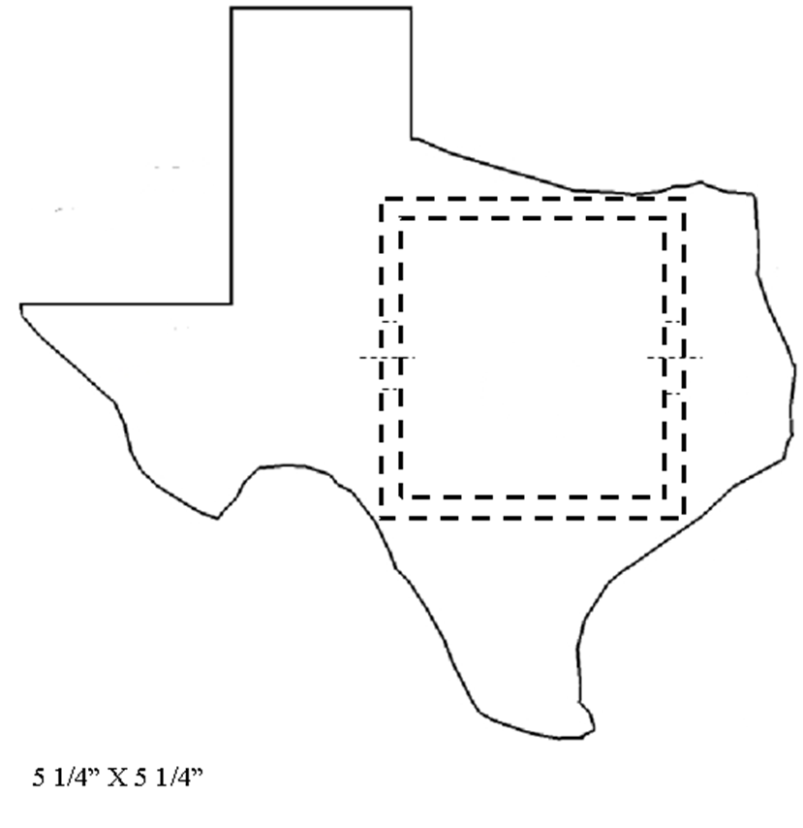

Texas Hitch Cover

Slide 35
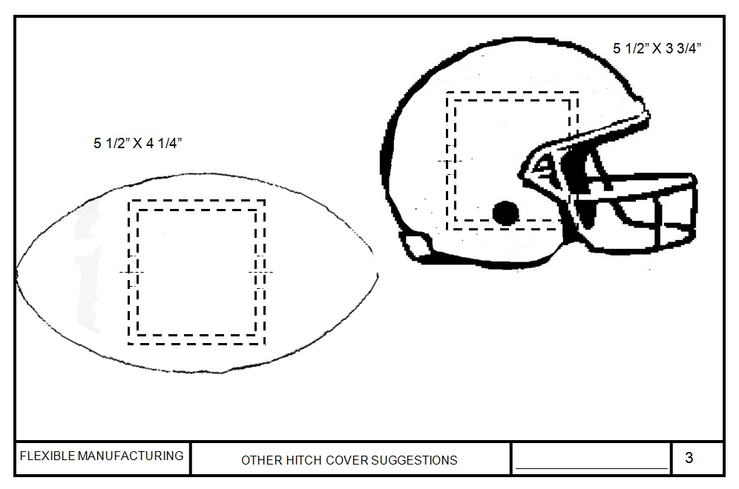
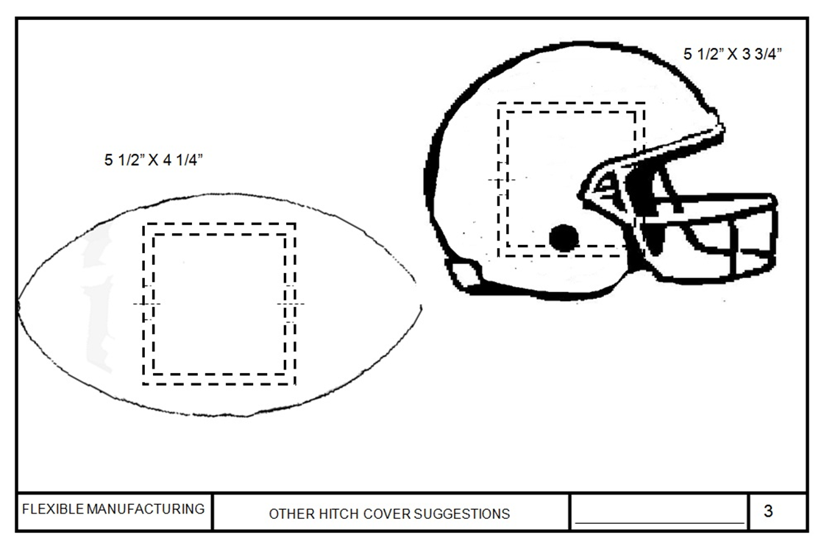
Other Hitch Cover Suggestions

Slide 36
Receiver Hitch Tube Project Rubric
Visual Inspection | Fail | Pass | Points Awarded | Comments
Design | 0 Points | 1 -10 Points
Straightness | 0 Points | 1 -10 Points
Smoothness | 0 Points | 1 -10 Points
Excess dross | 0 Points | 1 -10 Points
Hole | 0 Points | 1 -10 Points
Size | 0 Points | 1 -10 Points
Edge cuts | 0 Points | 1 -10 Points
Weld | 0 Points | 1 -10 Points
A=70-80 B=60-69 | C=50-59 | D=40-49 Total:

Slide 37
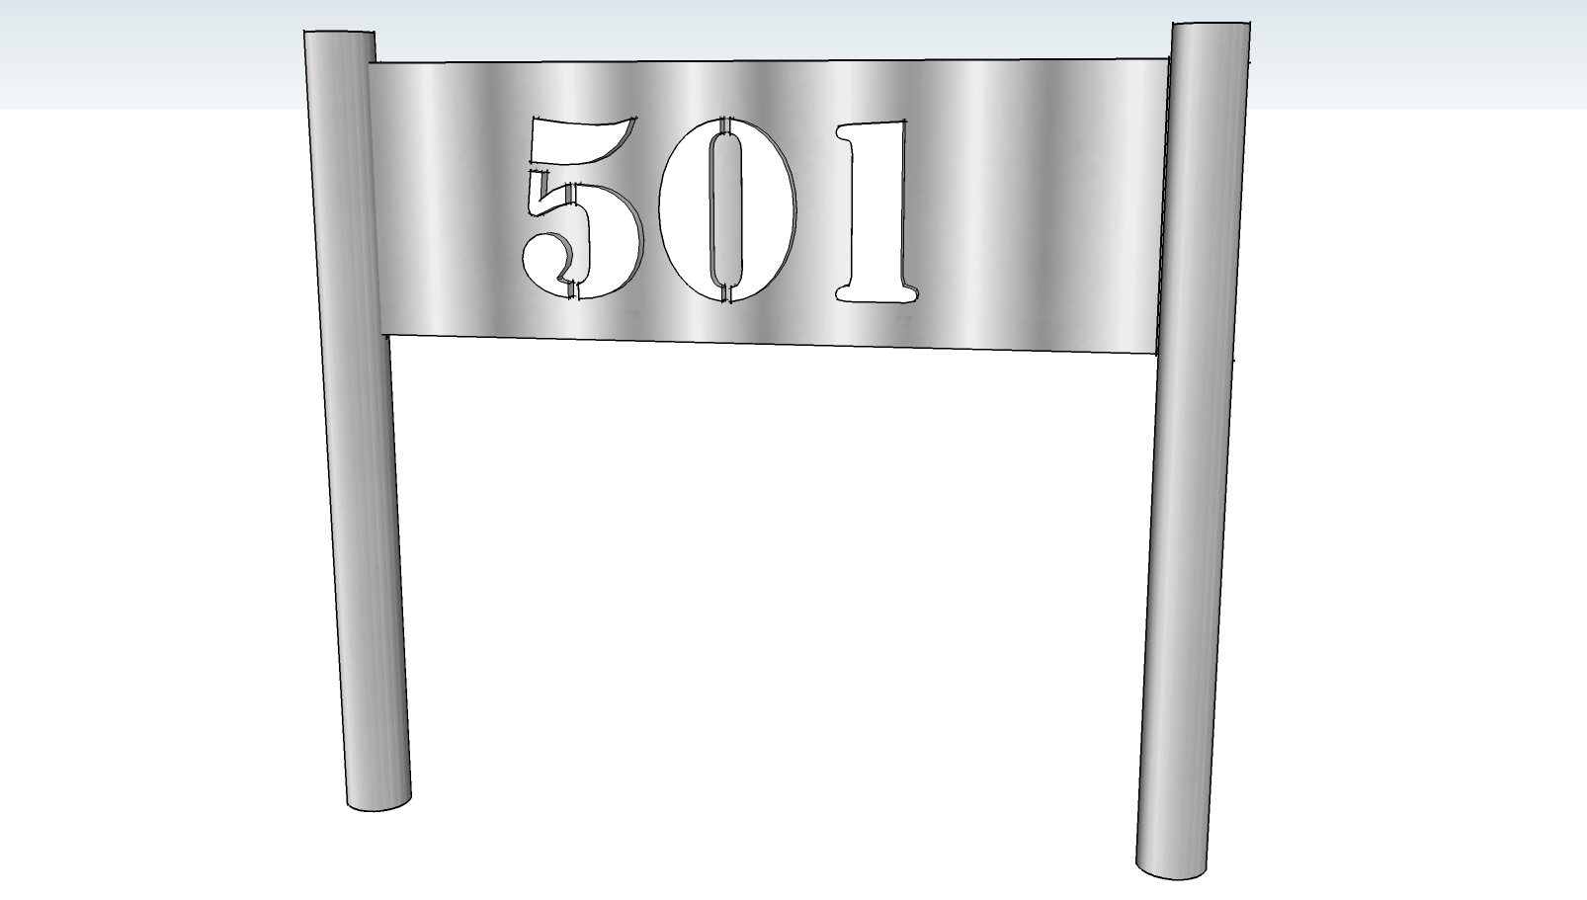
Address Boot Scraper

Slide 38
Address Boot Scraper
501
1/2” DIA. X 12” LONG HOT ROLLED RODS
1/4” x 4” WIDE PLATE
8” to 12” LONG
ADJUST FOR ADDRESS

Slide 39
Address Boot Scraper Rubric
Visual Inspection | Fail | Pass | Points Awarded | Comments
Design | 0 Points | 1 -10 Points
Straightness | 0 Points | 1 -10 Points
Smoothness | 0 Points | 1 -10 Points
Excess dross | 0 Points | 1 -10 Points
Hole | 0 Points | 1 -10 Points
Size | 0 Points | 1 -10 Points
Edge cuts | 0 Points | 1 -10 Points
Weld | 0 Points | 1 -10 Points
A=70-80 B=60-69 | C=50-59 | D=40-49 Total:

Slide 40
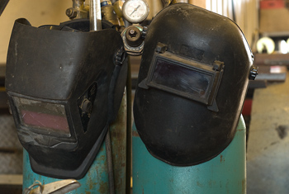
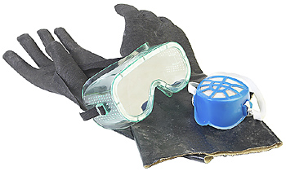
Personal Protective Equipment
  Welding goggles or hood
  Gloves
  Safety glasses when not wearing welding goggles or hood

