Slide 1
Peripheral Devices
What They Are and How They Are Used

Slide 3
Peripheral Devices
What is a Peripheral Device?
Any item connected to a computer but is secondary in relation to the CPU.
Internal – Operates inside the case
External – Operates outside the case

Slide 4
Peripheral Devices
Peripheral devices can be used for
Input – Used to receive data
Output – Used to send data
Storage – Used to store data

Slide 5
Peripheral Devices
Types of Signals:
Analog – Stream of data that we see and hear
Digital – Estimates analog data using only ones and zeros; on or off (aka the Binary System)

Slide 6
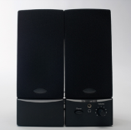
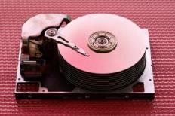
Peripheral Devices
Common Internal Devices
Input – Microphone
Output – Speakers
Storage – Hard drive, DVD+RW

Slide 7
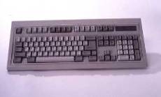
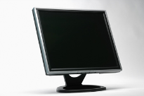
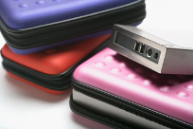
Peripheral Devices
Common External Devices
Input – Keyboard, Mouse
Output – Monitor, Printer, CNC
Storage – Hard drive, DVD+RW

Slide 8
Peripheral Devices
Specialized Peripheral Devices:
ISDN – Integrated Services Digital Network: Allows computers to communicate through telephone wires (Analog ↔ Digital)
CNC/NC – Computer Numeric Control: Computer programs control and monitor machines’operations
Robots
Mills/looms
CNC machining

Slide 9
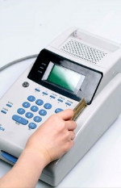
Peripheral Devices
Types of Peripheral Uses:
Business – A commercial enterprise or establishment
Price scanners
Office machines
Credit card readers
Security systems
Others?

Slide 10
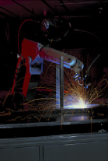
Peripheral Devices
Industry – The sector of an economy made up of manufacturing, trade and services
Manufacturing
CNC machining
Automated or robotic welding
Computer controlled warehouses
Others?

Slide 11
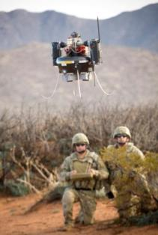
Peripheral Devices
Law Enforcement
Bomb/explosives handlers (robots)
Others?
Military
Computer-controlled surveillance aircraft
Others?
Picture from
U.S. Department of Defense
U.S. Army Photograph

Slide 12
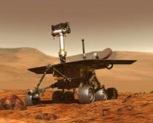
Peripheral Devices
Science
Space – Robots travel on the surfaces of moons or planets, take pictures, collect samples, etc.
Medical – Computer-controlled robotic surgery, digital X-ray screens
Others?
Picture from the National Aeronautics and Space Administration (NASA)

Slide 13
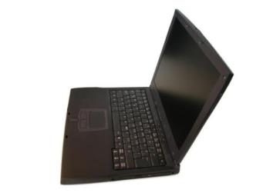
Peripheral Devices
Personal
Home computer
Security systems
Utility control

