Slide 1
Appeal and Postconviction Review
  Court Systems and Practices

Slide 3
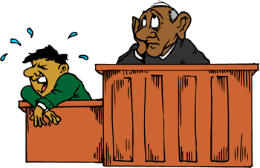
What is an Appeal?
  When defendants are found guilty of a crime in court, they have the right to appeal their case
  An appeal is a request to a higher court to review and change the decision of a lower court

Slide 4


What is an Appeal?
  The courts the defendants appeal to are known as appellate courts
  In an appeal, the defendants argue that an error occurred during their trial that affected their chances of a fair trial, or their “substantial right”

Slide 5
What is an Appeal?
  The appellate court will do one of the following:
    Order a new trial
    Let the defendant go
    Uphold the original verdict
  If the appellate court upholds the original verdict, the defendants can continue appealing their cases to higher courts

Slide 6

When Does an Appeal Occur?
  An appeal does not take place until the trial court enters a final judgment
  An appeal usually has to be filed within a short period – 7 to 10 days of the verdict

Slide 7

When Does an Appeal Occur?
  The defendants may have to file a paper called “notice to appeal very soon”
  Technically, the appeals process can begin the day of the verdict

Slide 8
When Does an Appeal Occur?
  Defendants can ask the judge to overturn the jury’s verdict
  If the verdict is by a judge and not a jury, a defendant can ask the judge to modify or withdraw his or her verdict and order a new trial

Slide 9
What are the Steps of an Appeal Process?
  Defendants file a notice of appeal
  The appellate court sets a schedule about when briefs are due and when oral arguments are to be made
  Briefs are submitted and oral arguments made
  The appellate court makes a decision after a few days, weeks, or even months

Slide 10
What Happens During an Appeal?
  The appeals process can take many months and go through more than one appellate court
  A transcript of the trial is produced

Slide 11
What Happens During an Appeal?
  The prosecution and the defense prepare briefs and respond to the each other’s briefs
  A brief typically refers to specific parts of the trial transcript and prior court decisions related to the case

Slide 12
What Happens During an Appeal?
There are usually three briefs in an appeal
  The appellant files an opening brief
  The respondent files a respondent brief
  The appellant files a reply brief

Slide 13
What Happens During an Appeal?
  After the briefs are filed, the lawyers may appear before the appellate court or the court may just make their decision based on the briefs
  If the attorneys do speak before the appellate court, the appearance may be quick and the discussion may be limited to specific questions

Slide 14

What is Needed for an Appeal?
Appellate court judges’ rulings are based only on the trial court record which includes
  A transcript of testimony
  Things admitted into evidence
  Each side’s arguments

Slide 15


What is Needed for an Appeal?
  Information that each side unsuccessfully sought to introduce into evidence
  The appellate court will not consider evidence that the trial court did not have a chance to rule on

Slide 16
What is Needed for an Appeal?
A good attorney will do the following during the trial:
  Make offers of proof by giving a summary to the judge of what the witnesses will say in case the judge rules the testimony as inadmissible
  Translate gestures into words so that appellate judges who are reading the transcript can picture what the participants in the court room are doing or being asked to do
  Make all legitimate objections and arguments so that the trial court would have had a chance to rule on the admissibility of evidence

Slide 17

What are the Reasons for Appeal?
The following are some examples on which a defendant would have grounds to appeal:
  New evidence was discovered after the trial
  The jurors engaged in misconduct
  The judge or prosecutor committed an important legal error
  The judge gave the jury improper instructions
  Scientific evidence was not available at the time of the trial that would prove the defendant innocent

Slide 18
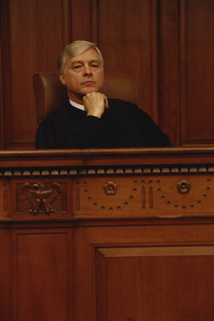
What is the Philosophy of Appellate Courts?
The courts have said that no one is entitled to a perfect trial, just a fair one
Most errors are deemed harmless by the appellate courts

Slide 19
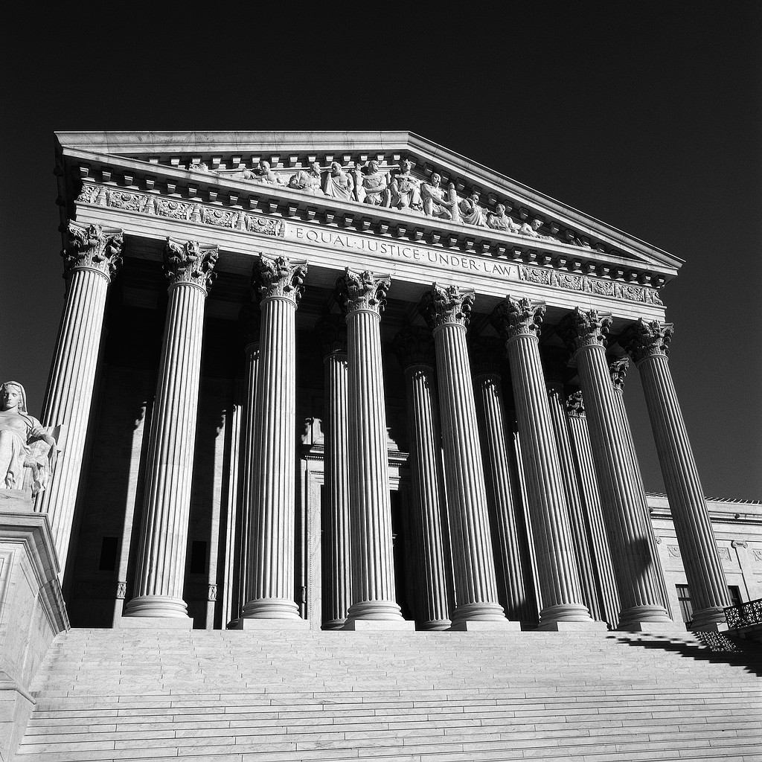
What are Writs?
A writ is an order from a higher court to a lower court or to a government official
They are used when a defendant is not entitled to appeal

Slide 20
What are Writs? (continued)
Defendants may not be entitled to appeal when
  The defense did not lodge a timely objection
  The matter of issue concerns something that goes beyond the trial record
  A final judgment has not yet occurred but a defendant needs relief at once to prevent an injustice or an unnecessary expense
  The matter is urgent
  A defendant has already unsuccessfully appealed his or her case

Slide 21
Resources
1413310532, The Criminal Law Handbook: Know Your Rights, Survive the System (11th Edition) by Paul Bergman, J.D. and Sara J. Berman, J.D.

