Slide 1
Pre-trial Process
  Court Systems and Practices

Slide 3
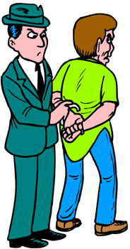
Entry into the Court System
  A person enters the court system when they are arrested
    An arrest occurs when adequate evidence exists
  Once the person is arrested, they are taken to jail and booked
    Booking consists of
      Obtaining biographical information about the defendant (name, address, date of birth, etc.)
      Fingerprinting the defendant
      Taking the defendant’s photograph (the mug shot)

Slide 4


Entry into the Court System
  A police officer (or sometimes the prosecutor) files a complaint, which is the charge
    The complaint is a written statement of the essential facts constituting a charged offense. It is made upon oath before a magistrate.
    This is also known as an affidavit
  Hearsay can be allowed in a complaint
  If a person is not in custody when an officer has his complaint signed by the judge, it then becomes a warrant for that person’s arrest

Slide 5
Visiting with the Judge
  The first appearance before the judge is called the initial appearance
  The judge
    Confirms the identity of the defendant
    Informs of various rights such as remaining silent and having an attorney
    Gives a date to show up to court for their preliminary hearing
    Advises the defendant of how much their bail is
  This happens within 24 to 48 hours of being arrested

Slide 6
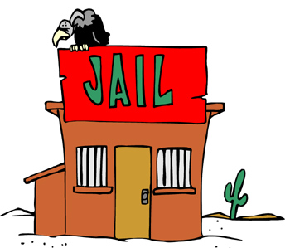
Bail
Bail is the money or property given as security for a defendant’s appearance in court
  It may be lost if the defendant does not appear at the court date
  Also know as the bond

Slide 7
Bail
  Surety Bond – when a third party agrees to pay the bond
    The defendant pays a professional bondsman 10 percent or more of the bond amount in exchange for the bondsman making the defendant’s bail
    The defendant does not get the 10 percent back
  Property Bond – when the defendant pledges a car, house, or other property to retain release
  Cash Bond – the defendant puts up his or her own cash to bail out
  Personal Recognizance – when a defendant needs only to promise to appear in court

Slide 8


Bail
The 8th Amendment does not allow bail to be excessive
  The Supreme Court has ruled that just because a defendant cannot pay the amount the court has set it is not necessarily excessive
The bail amount can depend on
  The nature of the crime
  The defendant’s criminal history
  Flight risk
  The amount of wealth the defendant has

Slide 9

Bail
Bail can be denied depending on some of the following:
  The type and nature of the crime
  Flight risk
  Protection of the victim or the defendant

Slide 10
Preliminary Hearing
  The defendant’s second appearance before a judge in which the court determines if probable cause exists to believe the accused committed the crime
  The purpose of the hearing is to have an impartial third party review the facts to be sure that probable cause exists
  The preliminary hearing is many times bypassed and the case is sent to the grand jury
  The hearing is adversarial and can serve as a source of discovery for both the prosecutor and defense

Slide 11
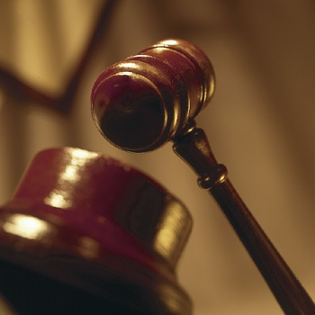
Preliminary Hearing
  Other motions to throw out illegally seized evidence, etc. are made after the preliminary hearing

Slide 12

Grand Jury
  A group of people who routinely meet to determine whether there is probable cause to believe that defendants committed the crimes they are charged with
  Grand Juries
    Are closed
    Are presented evidence by the prosecutor only
    Are secret
    Do not have the defendant present
    Have the power to subpoena witnesses to testify and give immunity from prosecution

Slide 13
Grand Jury
  If the grand jury finds that probable cause does exist, the defendant is issued a true bill of indictment, or is indicted
  If the grand jury finds that probable cause does not exist, the defendant is no billed and the case is dropped

Slide 14
Arraignment
  After formal charges have been filed, the defendant is brought to court for the arraignment
  The arraignment is the hearing at which the defendant is brought before a judge to hear charges and enter a plea
  The defendant will enter any of the following pleas:
    Not guilty
    Guilty
    Nolo contendere or no contest
      Means “I do not contest it”
      The defendant neither admits nor denies the charges, and has no intention of defending themselves

Slide 15

Arraignment
  A guilty plea must be
    Voluntarily
    And the defendant must be aware of its implications
  No plea is the same as a not guilty plea
  A plea bargain can be announced—a negotiation between a prosecutor and the defendant’s lawyer where the defendant pleas guilty for a lesser punishment so the case doesn’t go to court. This has to be approved by the court

Slide 16
Resources
  0766818314, Criminal Law and Procedure (5th Edition) by Daniel E. Hall, J.D., Ed.D.
  0821107321, Introduction to Criminal Evidence and Court Procedure (3rd Edition) by Julian R. Hanley, Wayne W. Schmidt, and Larry D. Nichols

