Slide 1
Precision Measurement
  Flexible Manufacturing

Slide 3
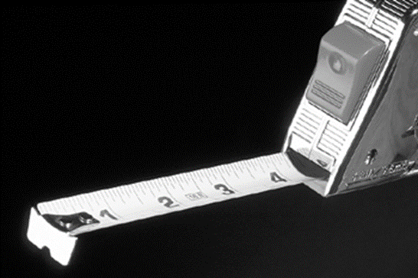
Measurement
  All measurements are based on the Customary or Metric systems.
  Manufacturing requires the ability to understand all parts of standard measurements.

Slide 4
Customary and Metric Systems
  In manufacturing the system of measure is decided; and measuring tools are purchased for that system.
  Conversions are not done on the factory floor; some plans may have both systems listed on the drawing.
  For this lesson the customary system will be the measurement of choice.

Slide 5
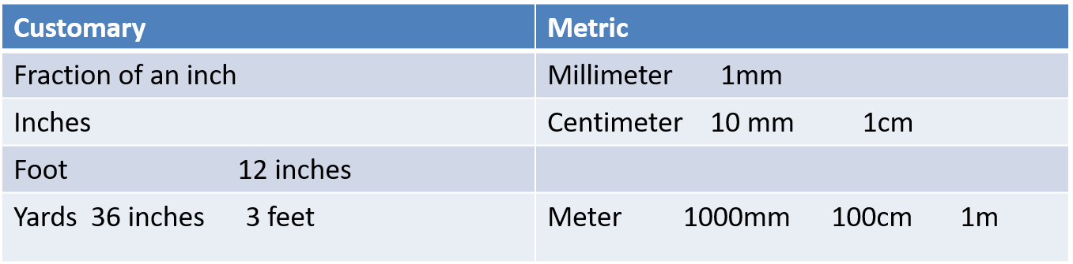
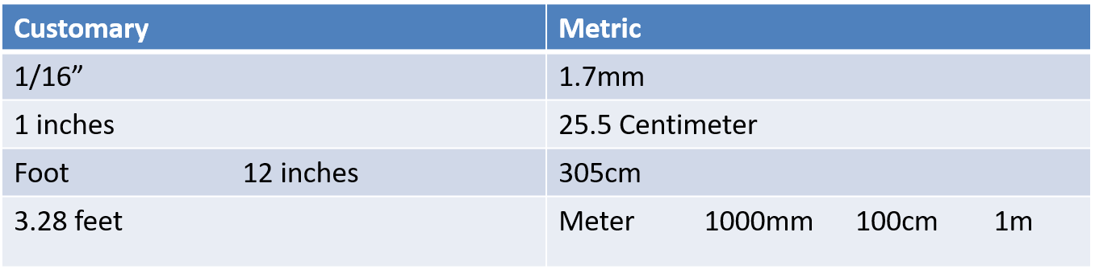
Comparison of Customary and Metric Systems

Slide 6
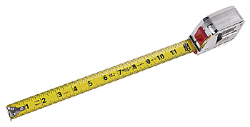
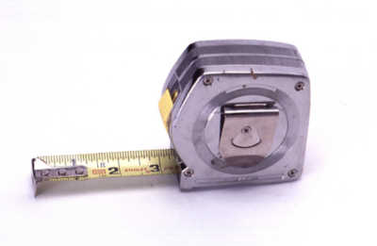
Customary System of Measurement

Slide 7
Divisions of an Inch
1/2
1 inch
1/4
3/4
1/8
3/8
5/8
7/8
1/16
3/16
5/16
7/16
9/16
11/16
13/16
15/16
1

Slide 8
Divisions Repeat
1/16
1/4
1/2
3/4
1/16
1/4
1/2
3/4
1
2
  The division repeats between the whole numbers. Just add the number to the measurement. Example ¼” and 1 ¼”

Slide 9

Reading A Ruler
  Reading a ruler is looking at the marks and finding which mark lines up with the piece being measured.
The block is
1”
1
2
3

Slide 10

Reading A Ruler
  Reading a ruler is looking at the marks and finding which mark lines up with the piece being measured.
1
2
3
The block is
2 and 3/16”

Slide 11
Reading A Ruler
  Reading a ruler is looking at the marks and finding which mark lines up with the piece being measured.
1
2
3
The block is
1 and 1/8”

Slide 12
Reading A Ruler
  Reading a ruler is looking at the marks and finding which mark lines up with the piece being measured.
1
2
3
The block is
3/4”

Slide 13
Reading A Ruler
  Reading a ruler is looking at the marks and finding which mark lines up with the piece being measured.
1
2
3
The block is
3 and 1/4”

Slide 14
More Inch Divisions
  The inch is also subdivided into 1/32nd, 1/64th and 1/128th.
  Measurements this small are hard to read on a ruler. Machinists use other measurement tools to measure these smaller dimensions.
  Measurements are changed into decimals instead of fractions.
  Some parts have to be machined to sizes smaller than the thickness of a human hair.

Slide 15
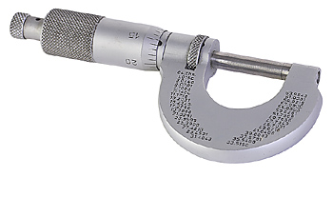
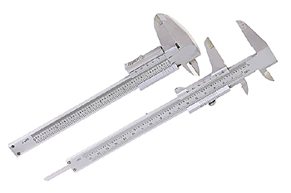
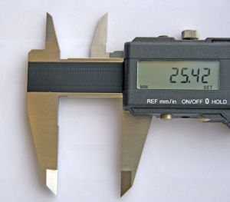
Precision Measurement Tools
Micrometer
Caliper
Digital Caliper

Slide 16
Measurement Tools
  Micrometer measures to 0.001 of an inch.
  Calipers measure to 0.001 of an inch.
  Digital Calipers measure to 0.0005 of an inch.
  Micrometers and calipers can be standard or metric system.
  Digital Calipers can be switched between the systems with the use of a button.

Slide 17
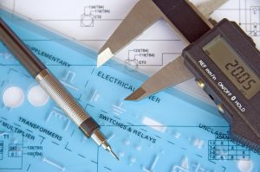
The Digital Caliper
  Measurement tool most used today.
  The caliper will measure outside, inside, depth and step dimensions.
  Can be set to decimals, metric and fractional readings.
  Easy to use and set.

Slide 18
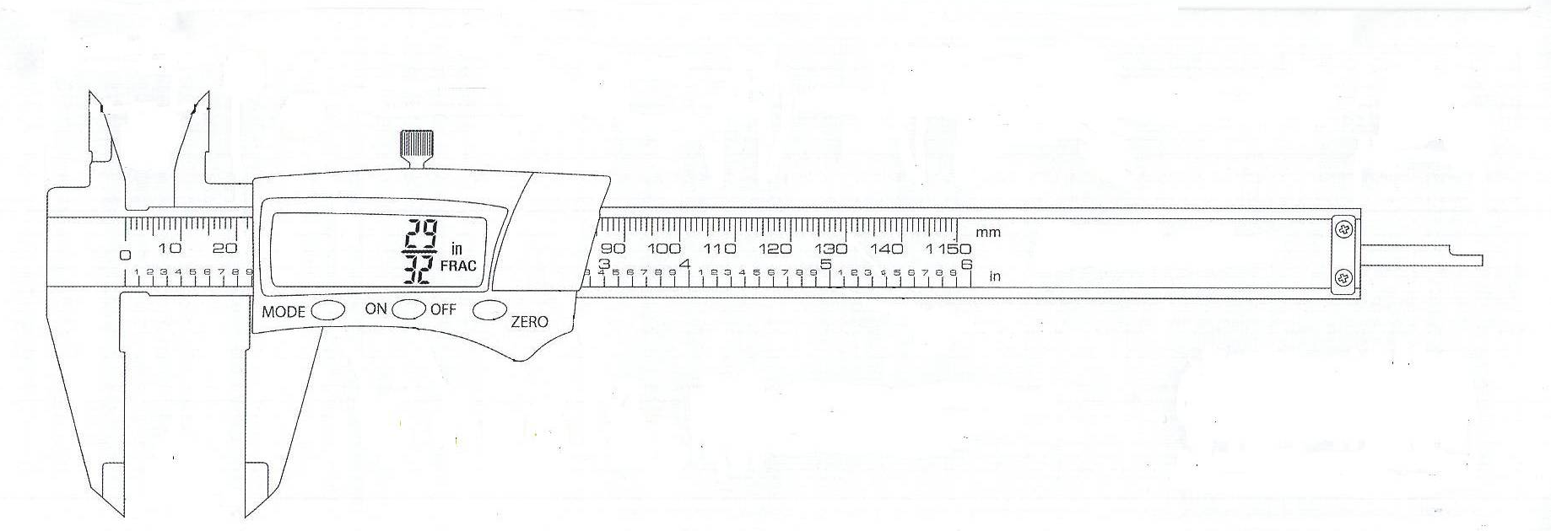
Digital Caliper Parts
Inside Jaws
Lock Knob
LCD Display
Beam Graduations
Zero Adjusting Button
Mode Button
On / Off Button
Depth Gauge
Outside Jaws

Slide 19
Digital Caliper Buttons
  On / Off Button - turns on the display
  Zero Button - sets the caliper to zero
  Mode Button - changes the display to read decimals, fractions and millimeters
  LCD Display - displays the measurement with resolution of .0005, 1/64th or 0.1 mm

Slide 20
Digital Caliper Parts
  Outside Jaws
  Inside Jaws
  Depth Gauge
  Beam Graduations
  Lock Knob

Slide 21
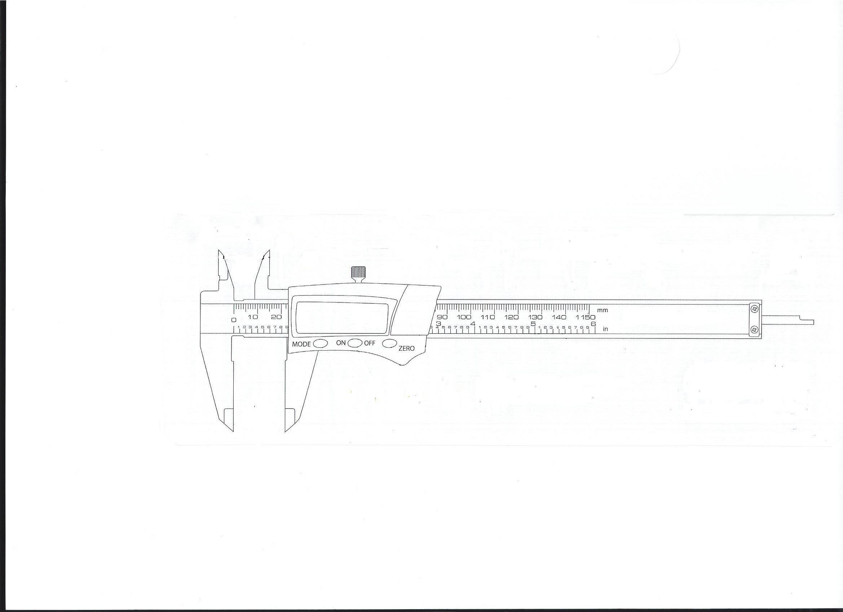
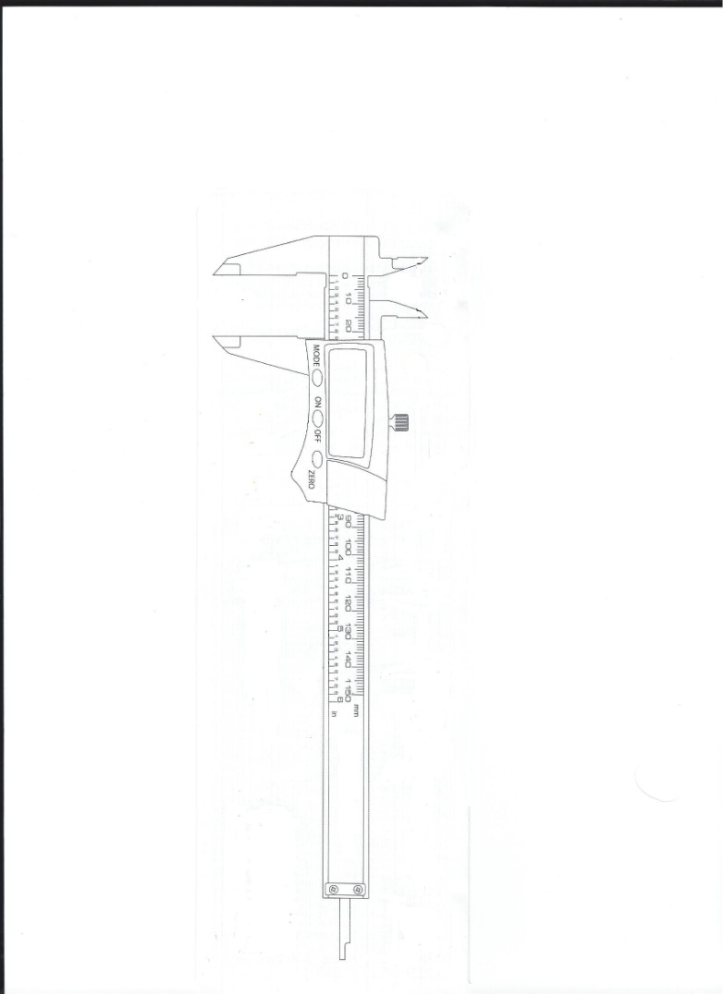
Using a Digital Caliper
Depth Measurement
15/16
Outside Measurement
1.00
Inside Measurement
1.00

Slide 22
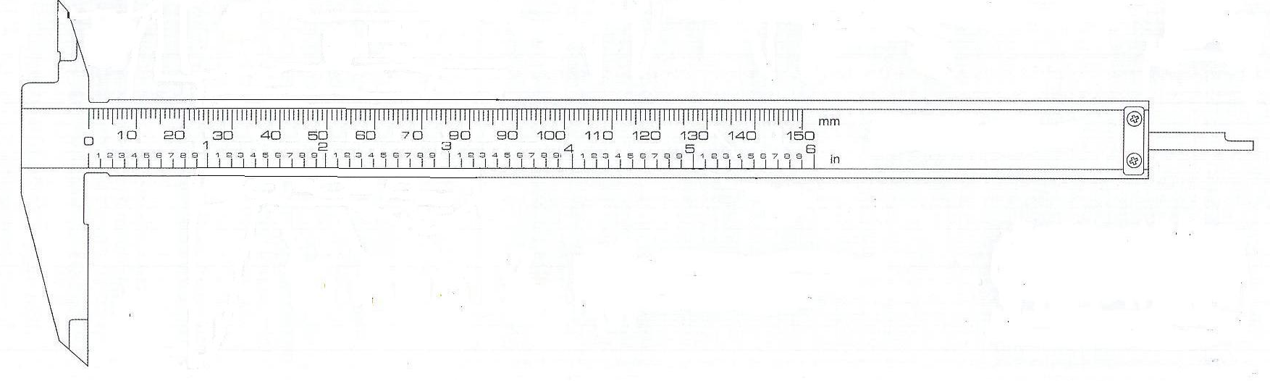


Reading a Digital Caliper
  Press the On/Off button to turn the LCD display on. Set the mode to the type of reading you want (decimal, fractional or metric).
  Place the object to be measured inside the jaws of the caliper and the display will show the measurement.
4.
.30
4.
30

Slide 23
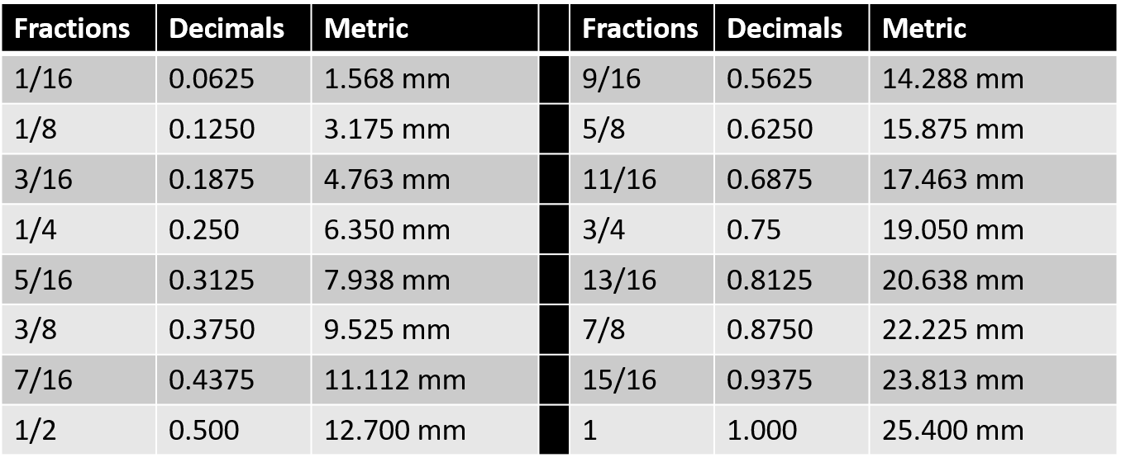
Measurements
  Plans may give measurement in fractional numbers.
  These may need to be changed to decimals.
  The following table shows some of the equivalents.

Slide 24
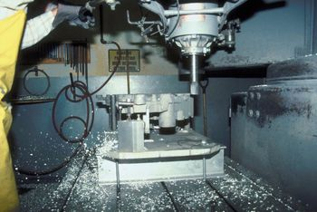
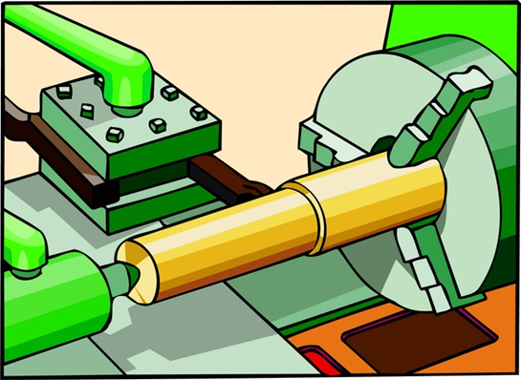
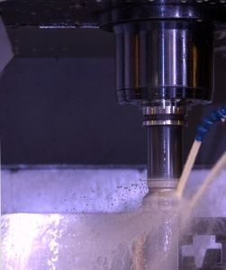
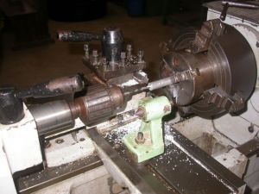
Feed and Speeds of Machining
  How deep can I cut?
  What is RPM?
  What is surface speed?

Slide 25
Feed and Speeds of Machining
  How deep can I cut?
    Depth of cut is how much the machine can cut in one pass of the cutter.
  What is RPM?
    Revolutions Per Minute is a measurement of speed.
  What is surface speed?
    This is the speed in feet per minute that is traveled as you turn something.

Slide 26
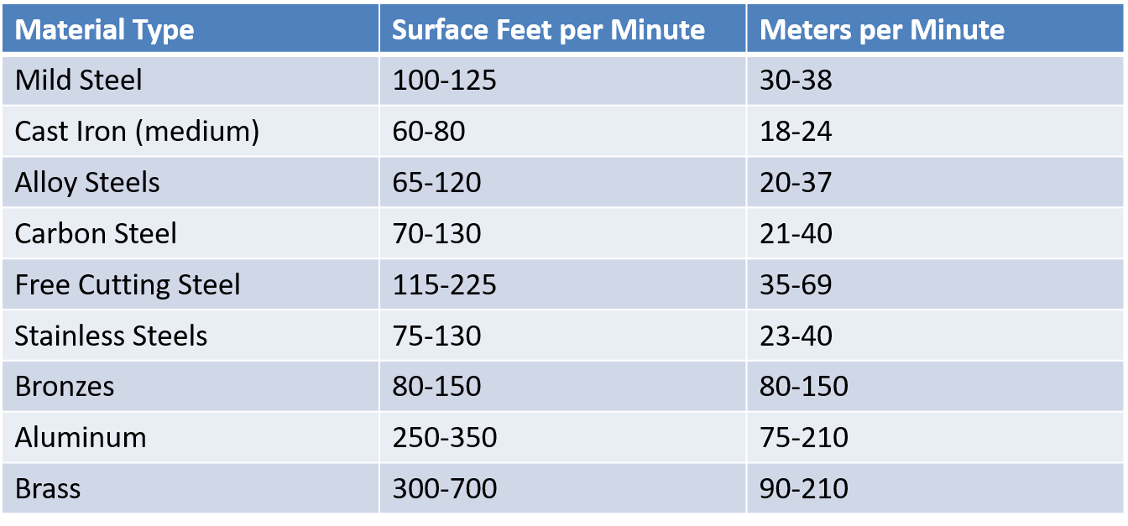
Machine Questions
  What is a Cutting Speed Chart?
    A chart that gives the speed of a cutting tool moving down the length of the material being machined.
    Cutting speed is expressed in feet per minute or meters per minute.

Slide 27
Calculating RPMs
  The lathe spindles or mill cutters rotation per minute is figured by the cutting speed on the chart and the diameter of the material or the diameter of the cutter.
  RPM = Cutting Speed (FPM) X 4 / Diameter
Cutting Speed (FPM) X 4
RPM =
Diameter

Slide 28
Math Time!!!
  The diameter of the stock is 1.5 inches and the material is aluminum.
  Cutting Speed is 250(fpm)
  Calculate the rpm needed to correctly turn the piece of stock.
      RPM = 250 x 4 / 1.5
      RPM = 1000 / 1.5
      RPM = 666.66

Slide 29
Math Time!!!
  Calculate the RPM for cutting a piece of mild steel 2.25 inches in diameter.
  Cutting Speed is 100(fpm)
    RPM = 100 x 4 / 2.25
    RPM = 400 / 2.25
    RPM = 177.77

