Slide 1
Pre-Dissection Drawing Activity
  Pathway of Blood Through Heart

Slide 3
Supplies
  3 sheets paper
  Pencil
  3 fine tip colored markers (blue, red, green)
  Optional: highlighter (pink or orange)

Slide 4
Heart is a Double Pump
Right Heart Pump
Left Heart Pump

Slide 5
Heart is a Double Pump
Right Heart Pump
Left Heart Pump

Slide 6
Right Heart Pumps Venous (Deoxygenated) Blood
Right Heart Pump
Notes:
Remind students that the pulmonary vessels are the exception to the “vein/artery” rule. Since the pulmonary vessel that comes off the right heart carries deoxygenated blood “away from” the heart it is called an artery. Likewise, the pulmonary vessels leaving the lungs are referred to as pulmonary veins since they carry oxygenated blood “to” the heart.

Slide 7
Left Heart Pumps Arterial (Oxygenated) Blood
Left Heart Pump

Slide 8
Drawing the Right Heart
Right heart

Slide 9
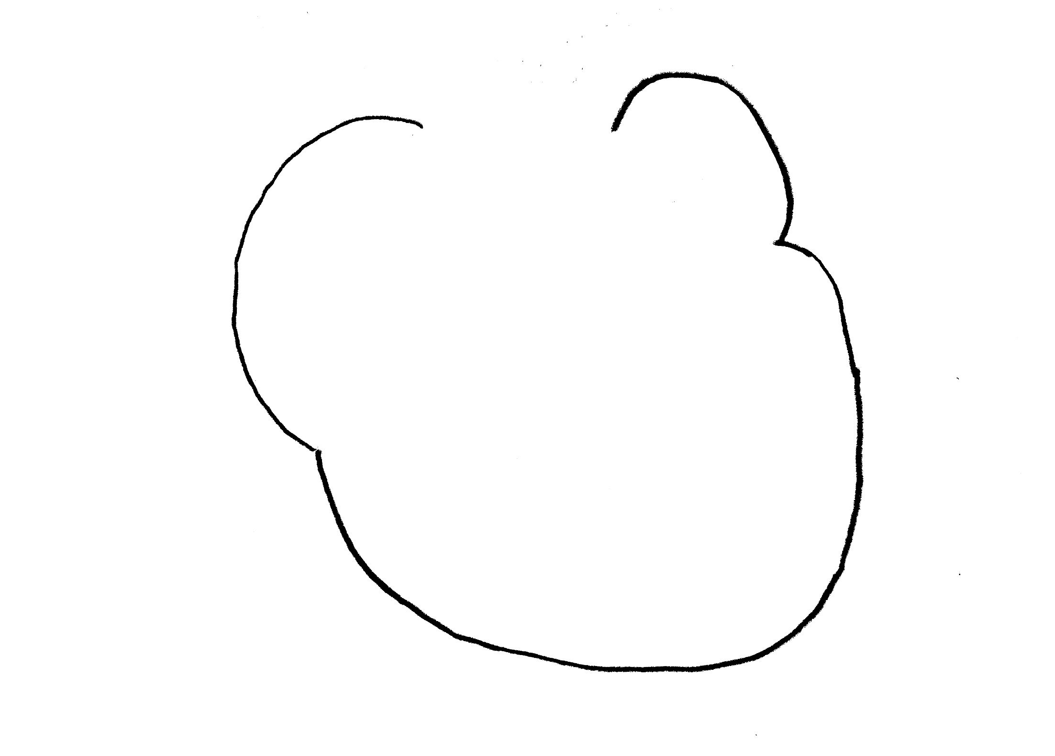
Step 1: Draw Outline of Heart
Rt. side
Lf. side
Apex
Notes:
Leave opening at the base of the heart for great vessels. Remind students that they are viewing the heart from an “anatomical” position, which is why the right heart will be on their left, etc.

Slide 10
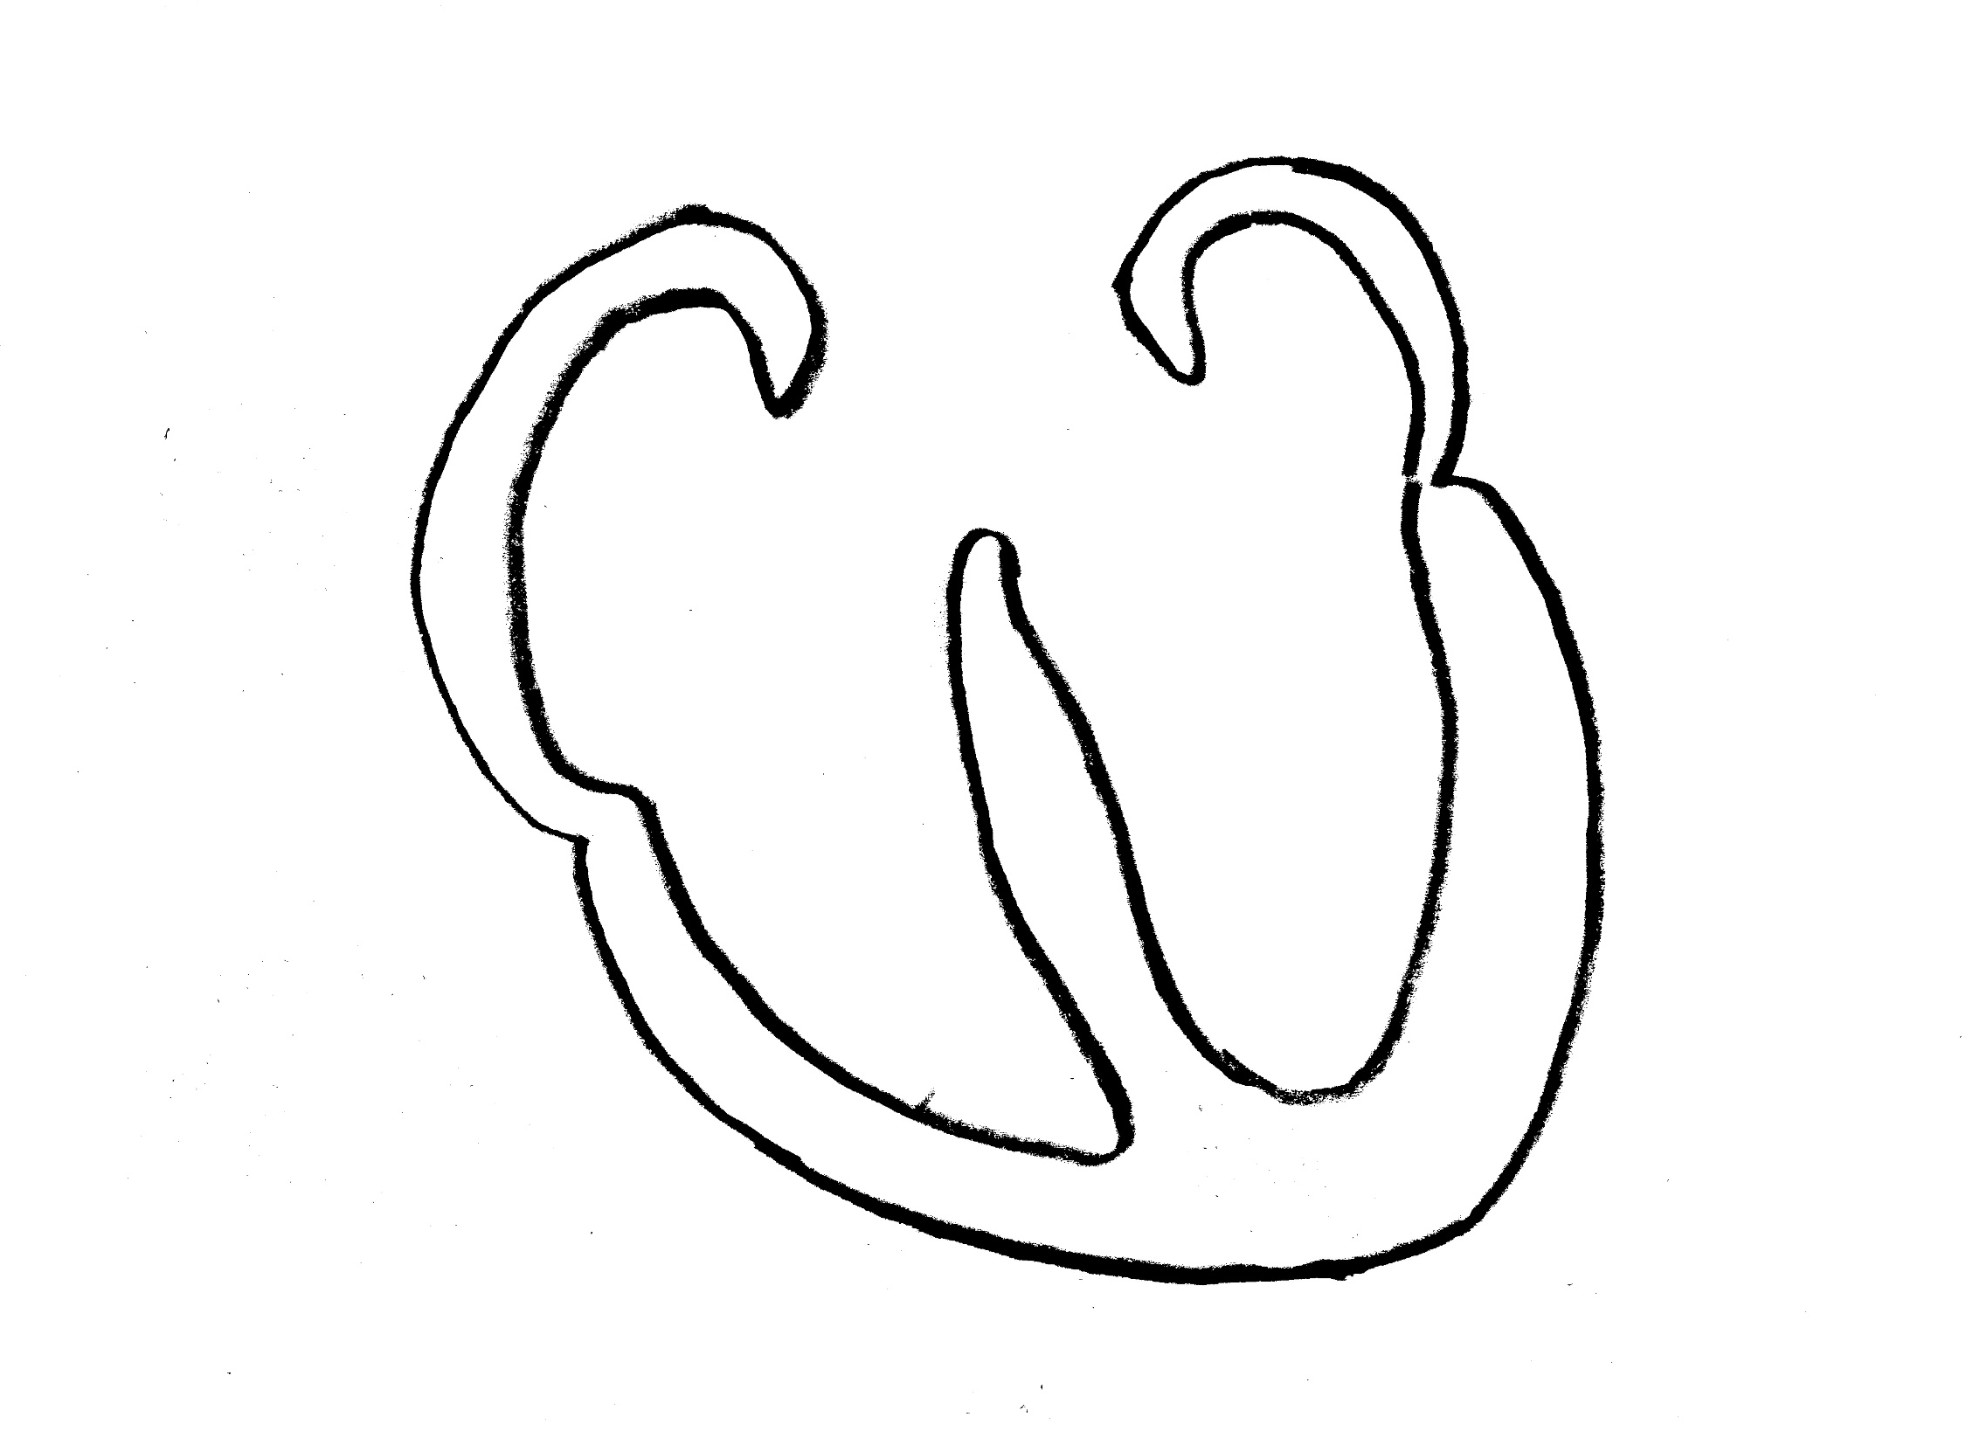
Step 2: Draw Myocardium & Septum.
Identify chambers.
Rt. side
Lf. side
LA
RA
LV
RV
Myocardium
Apex
Septum
Notes:
Blue = deoxygenated blood
Red = oxygenated blood

Slide 11
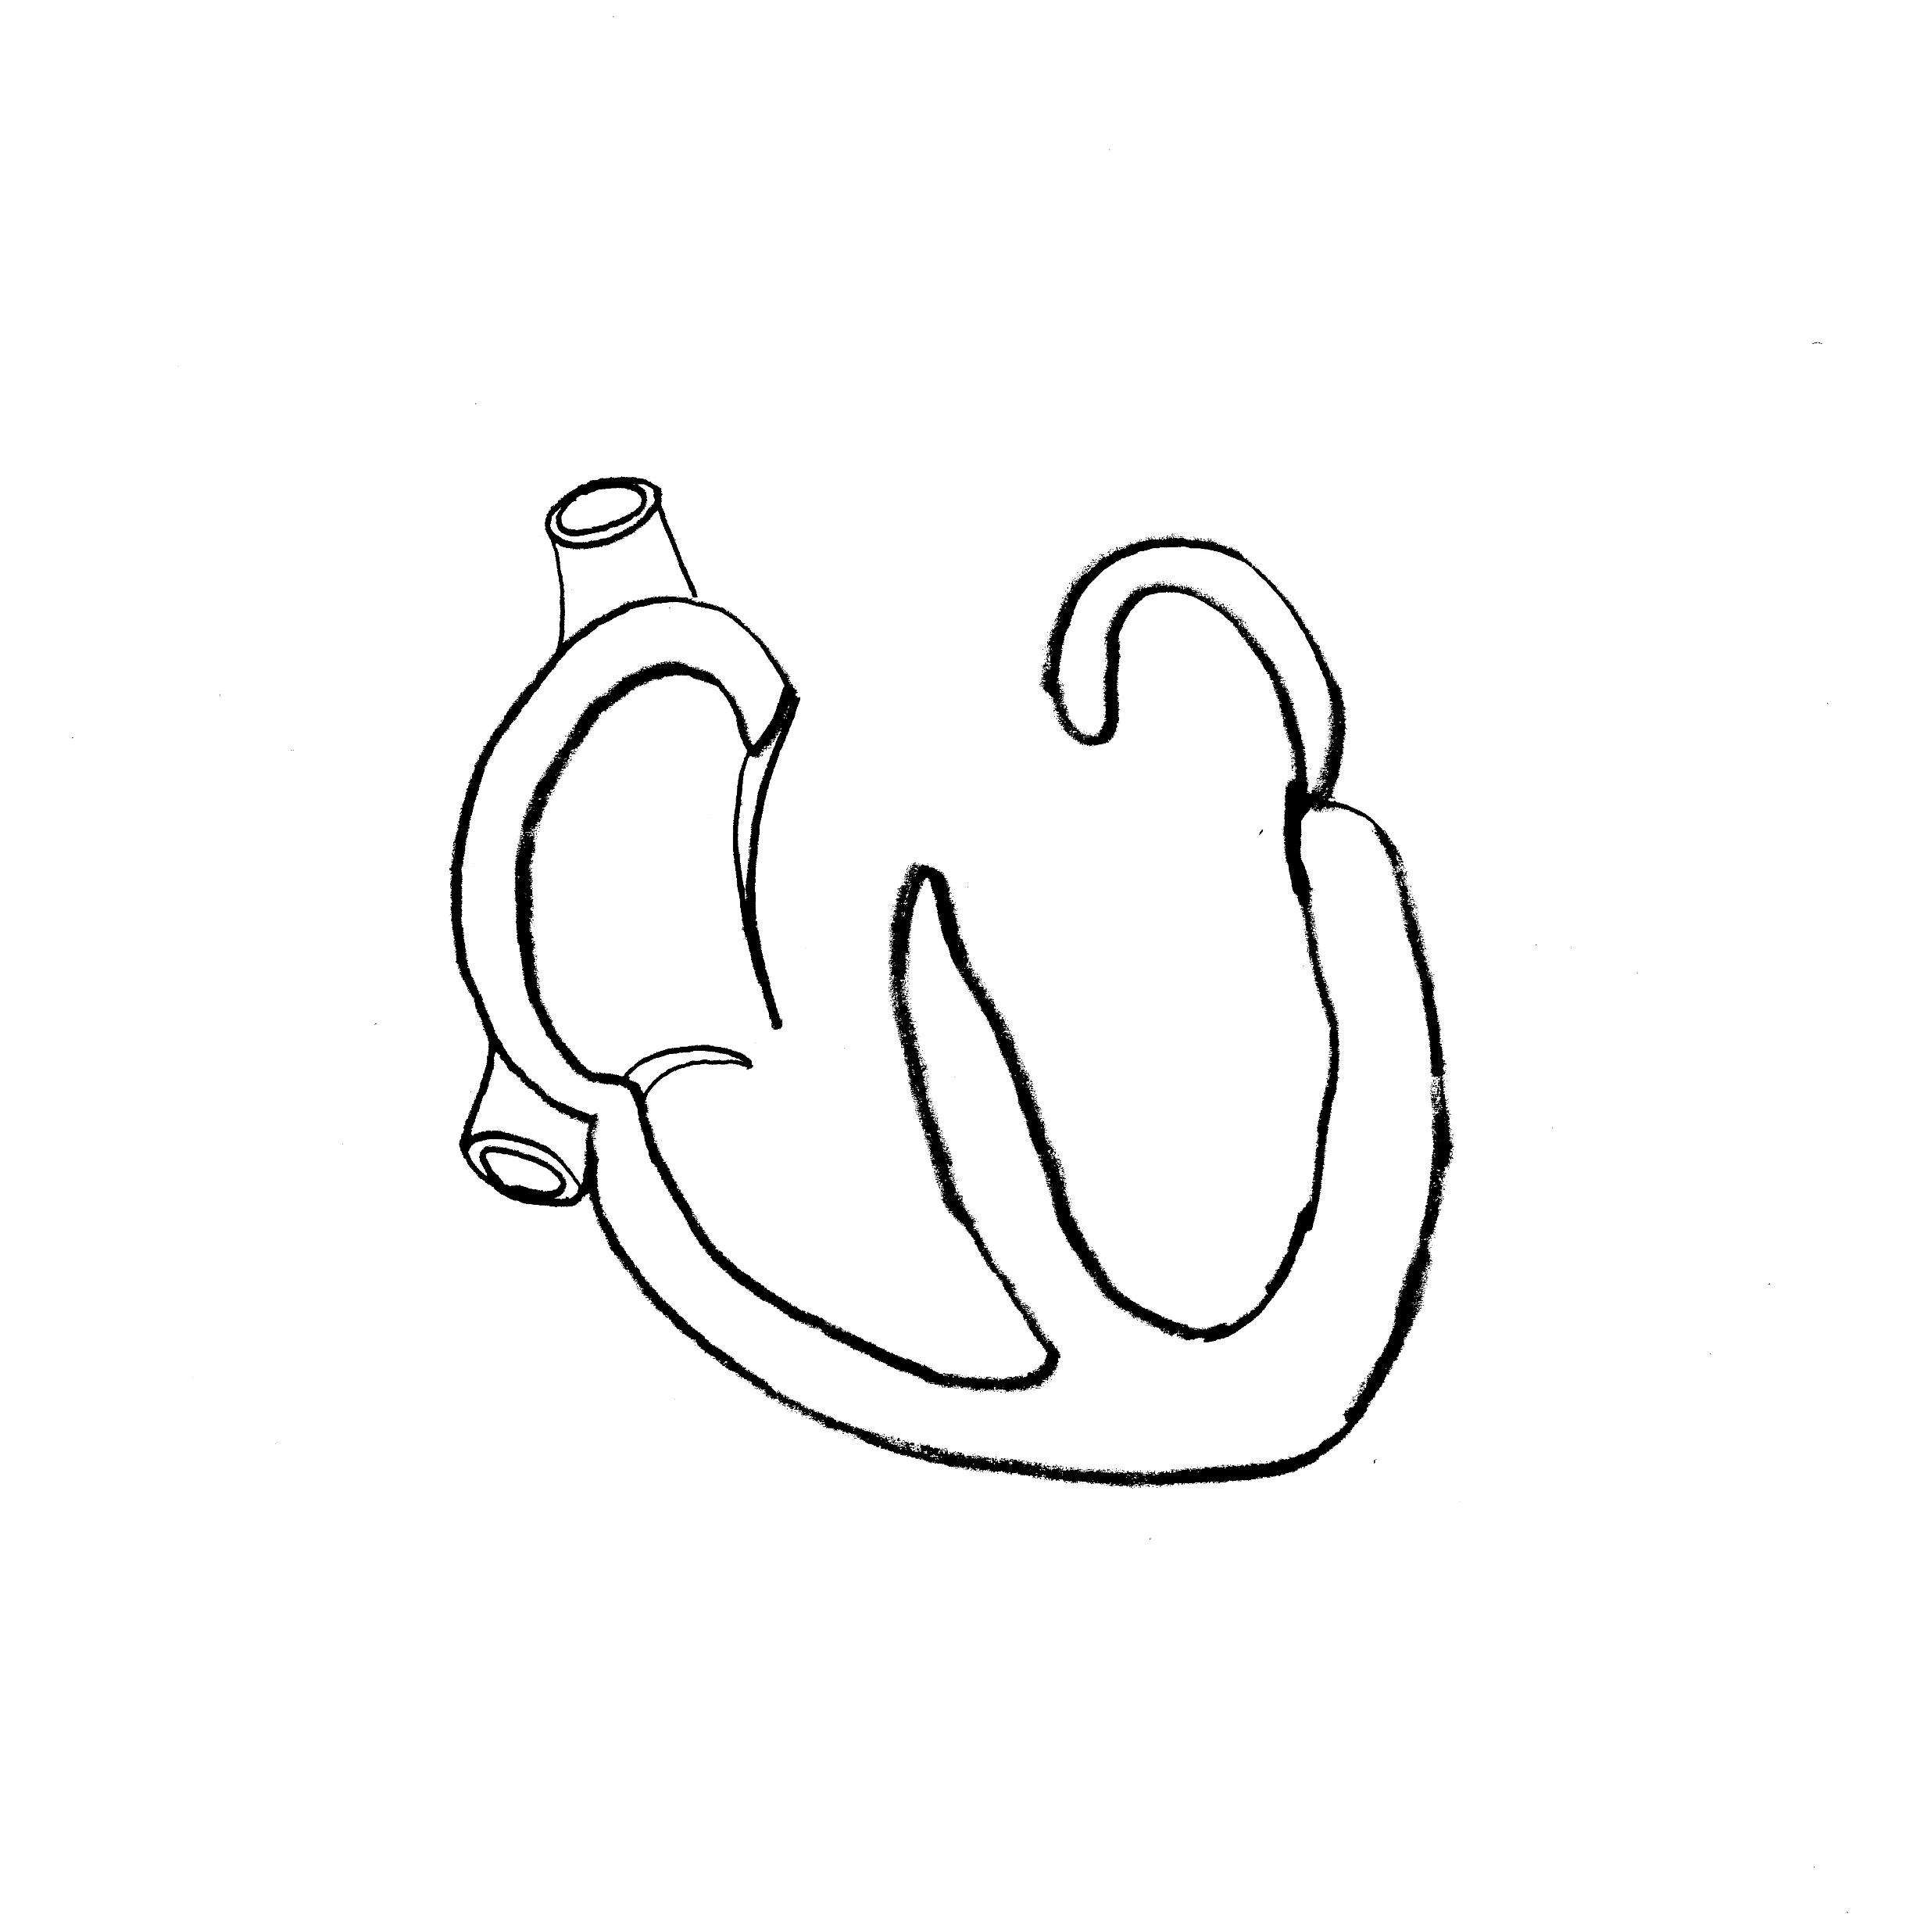
Step 3: Draw Both Superior & Inferior Vena Cavae
Rt. side
Lf. side
Superior Vena Cava
LA
RA
LV
RV
Inferior Vena Cava
Apex
Septum

Slide 12
Step 4: Draw Tricuspid Valve
Rt. Side
Lf. Side
Superior Vena Cava
LA
RA
Tricuspid Valve
LV
Inferior Vena Cava
RV
Apex
Septum

Slide 13
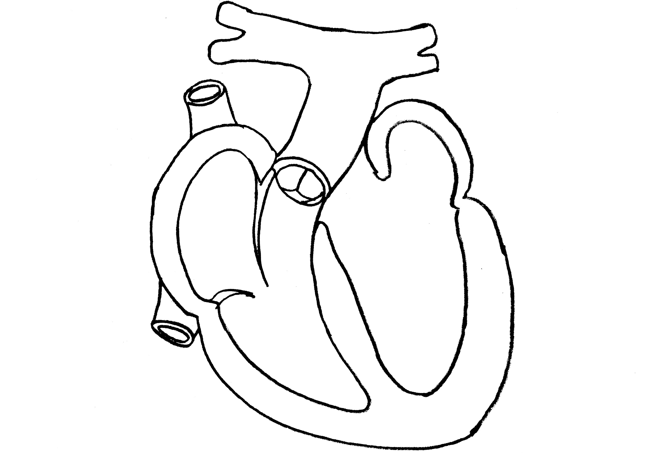
Step 5: Draw Pulmonary Artery
Rt. side
Lf. side
Superior Vena Cava
Pulmonary Artery
LA
RA
Tricuspid Valve
Inferior Vena Cava
RV
LV
Apex
Septum
Notes:
Students will note that the pulmonary trunk bifurcates so that it can transport blood to each lung.

Slide 14

Step 6: Draw Pulmonary Valve
Rt. side
Lf. side
Pulmonary Artery
Superior Vena Cava
LA
RA
Tricuspid Valve
Pulmonary Valve
Inferior Vena Cava
LV
RV
Apex
Septum

Slide 15
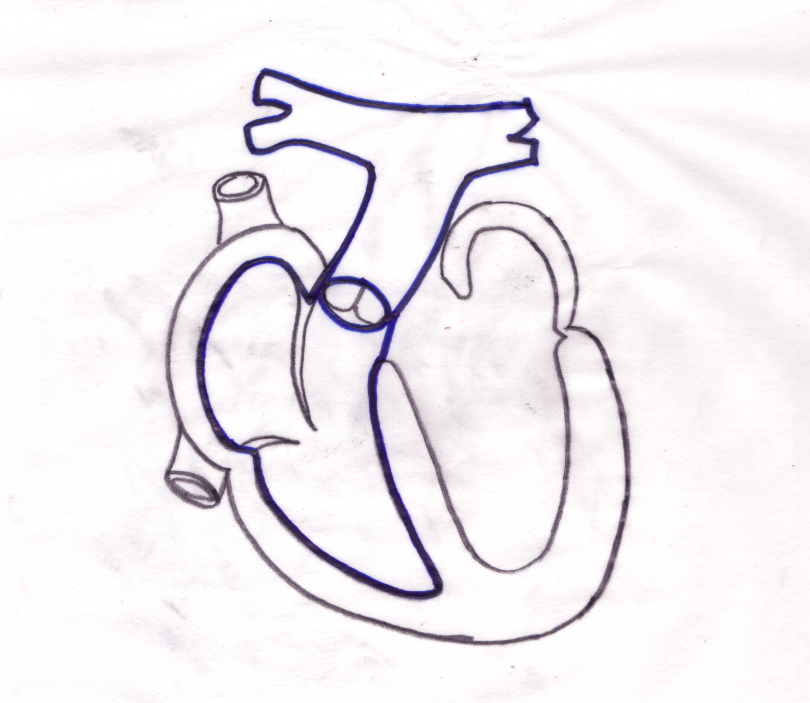
Step 7: Outline Great Vessels & Chambers in Blue
Rt. side
Lf. side
Pulmonary Artery
Superior Vena Cava
LA
RA
Pulmonary Valve
Tricuspid Valve
Inferior Vena Cava
LV
RV
Apex
Septum

Slide 16
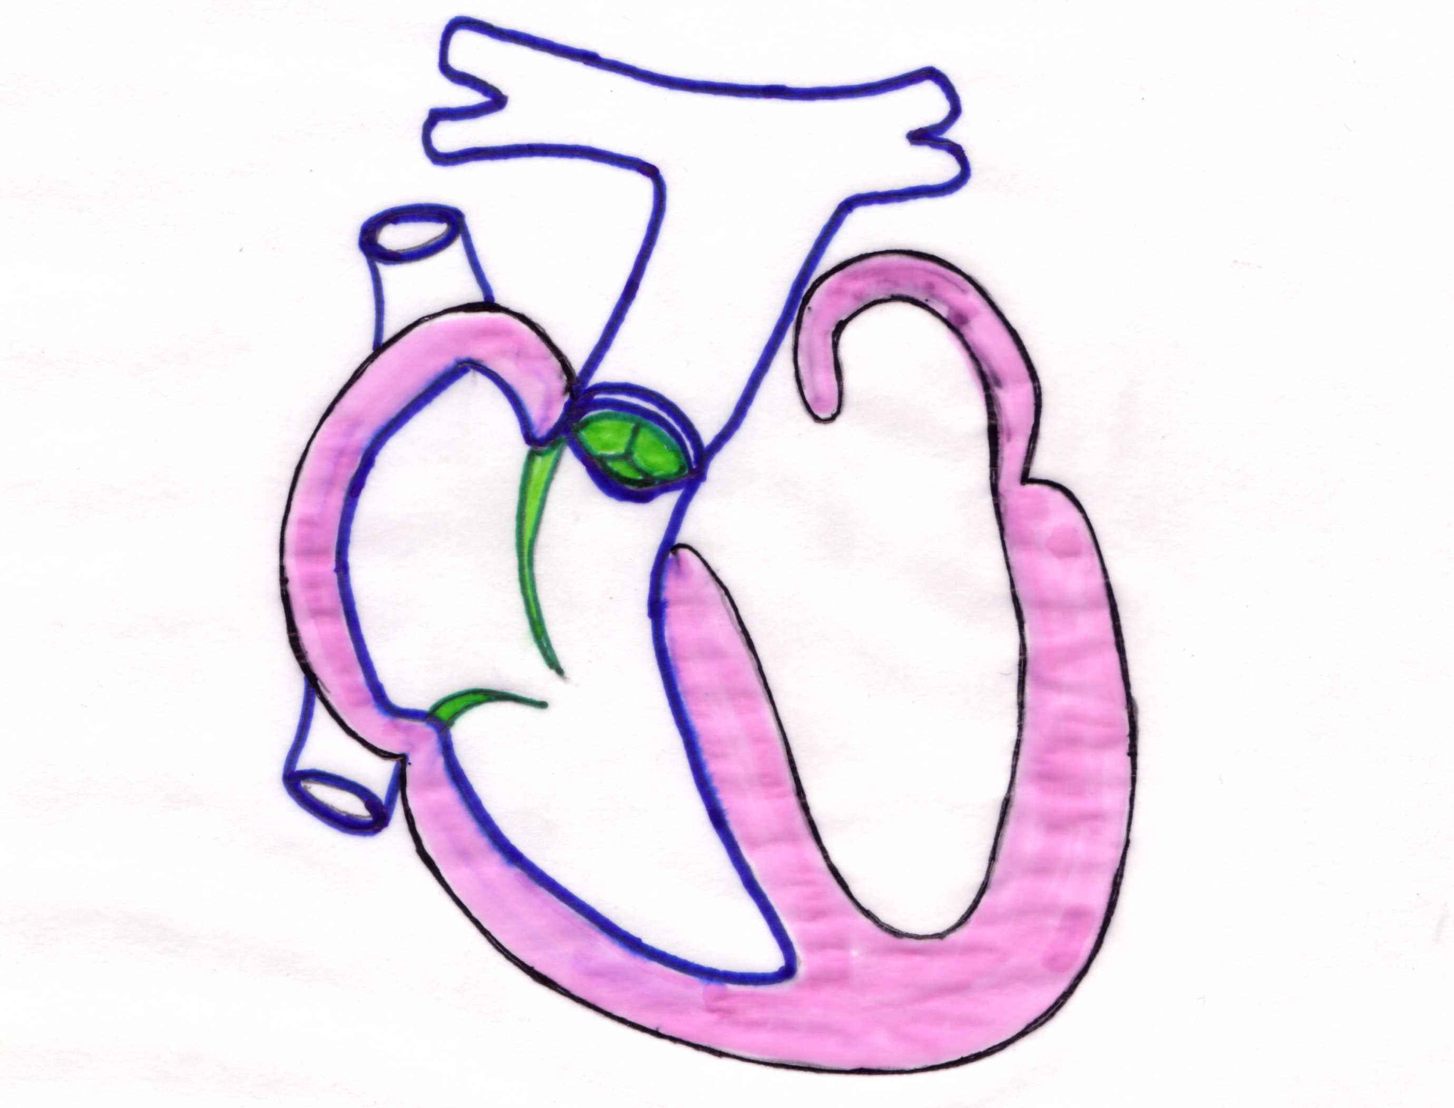
Step 8: Outline Valves In Green, Color Septum & Myocardium in Pink
Rt. Side
Lf. Side
Superior Vena Cava
Pulmonary Artery
LA
RA
Pulmonary Valve
Tricuspid Valve
Inferior Vena Cava
RV
LV
Apex
Septum

Slide 17

Step 9: Indicate Pathway of Blood Through Right Heart with Arrows
Rt. side
Lf. side
Superior Vena Cava
Pulmonary Artery
LA
RA
Pulmonary Valve
Tricuspid Valve
Inferior Vena Cava
LV
RV
Apex
Septum
Notes:
After exiting the right ventricle, blood is transported via the pulmonary artery to the right and left lungs for gas exchange.

Slide 18
Drawing the Left Heart
Left heart

Slide 19
Step 1: Draw Outline of Heart
Rt. Side
Lf. Side
Apex

Slide 20
Step 2: Draw the myocardium and septum
Rt. Side
Lf. Side
LA
RA
LV
RV
Myocardium
Septum
Apex

Slide 21
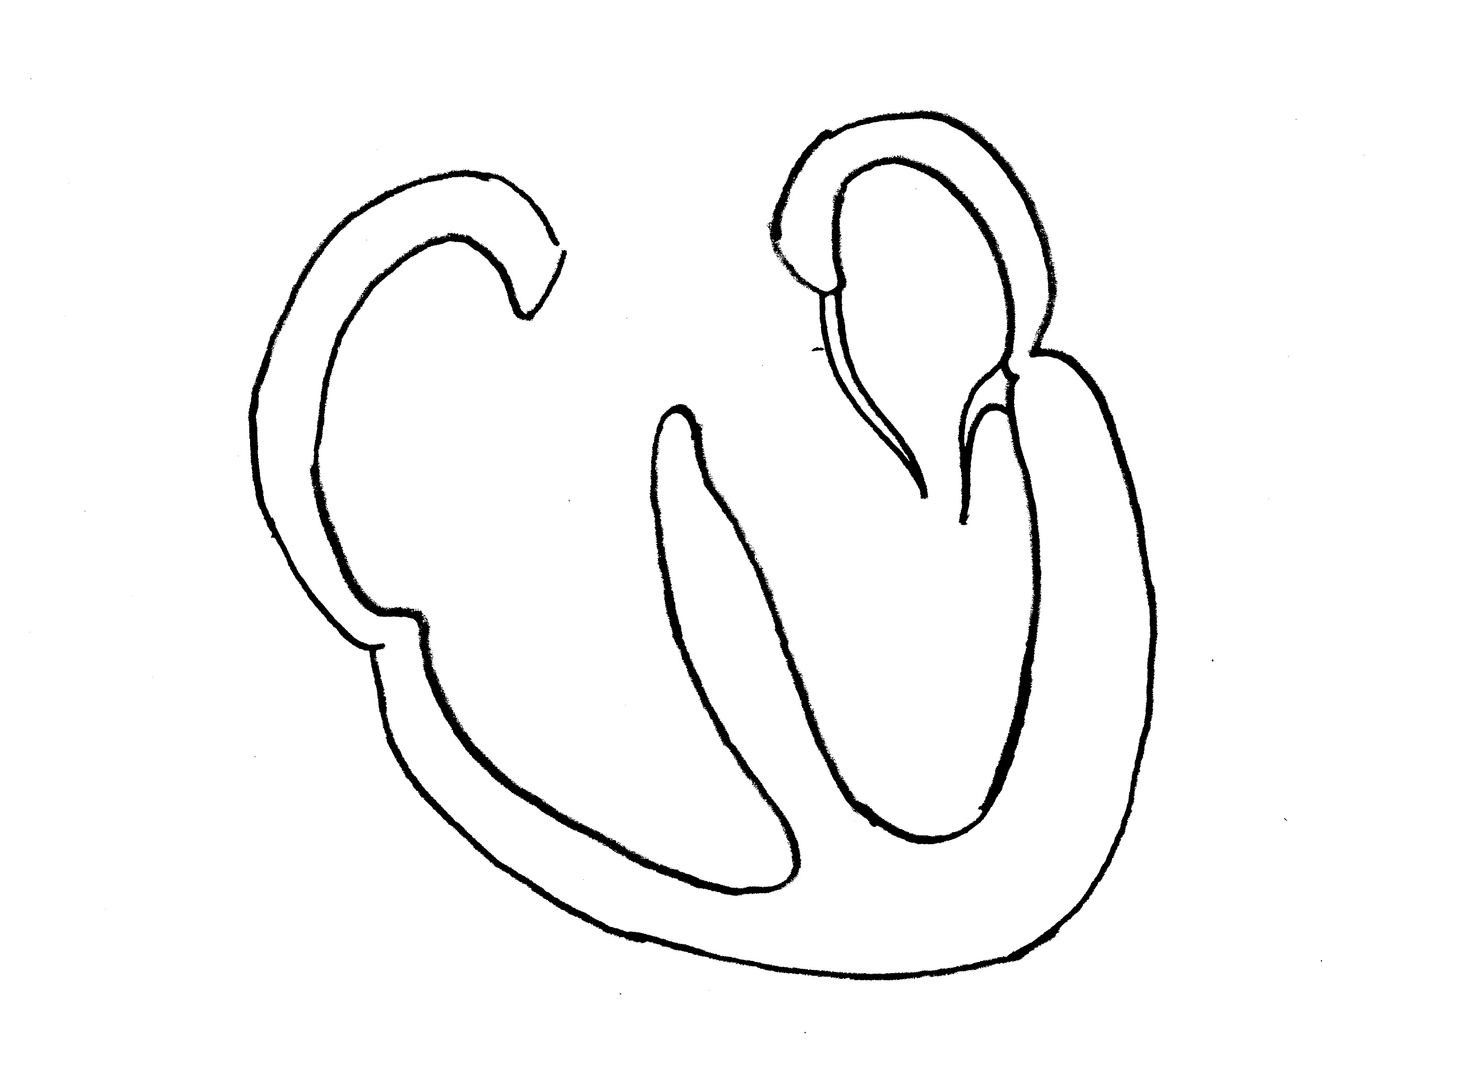
Step 3: Draw Mitral Valve
Rt. Side
Lf. Side
LA
RA
Mitral Valve
LV
RV
Myocardium
Apex
Septum

Slide 22
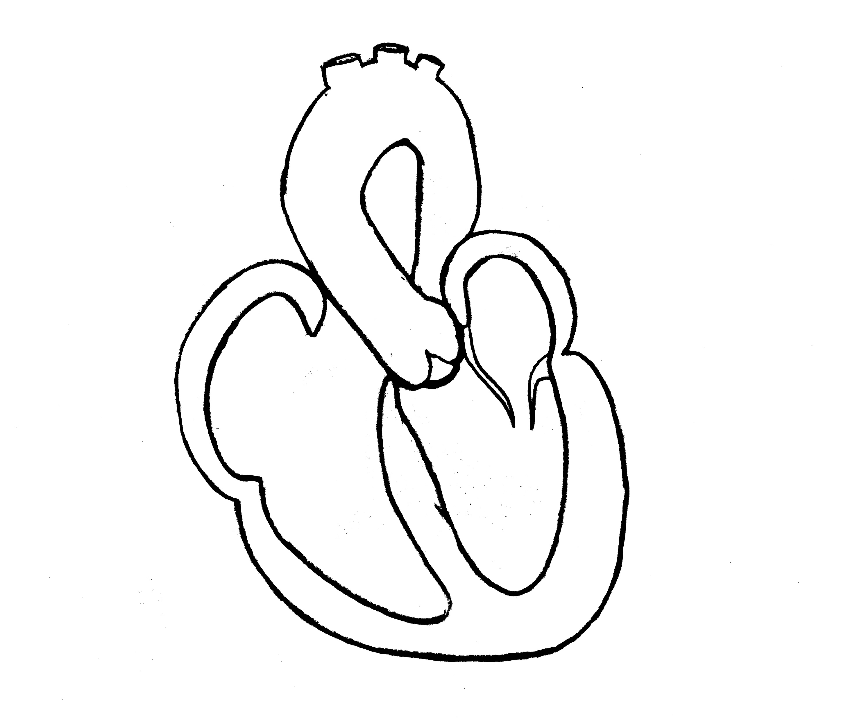
Step 4: Draw Aorta
Rt. Side
Lf. Side
Aorta
LA
RA
Mitral Valve
Myocardium
LV
RV
Septum
Apex

Slide 23

Step 5: Draw Aortic Valve
Rt. Side
Lf. Side
Aorta
LA
RA
Mitral Valve
Aortic Valve
Myocardium
LV
RV
Septum
Apex

Slide 24
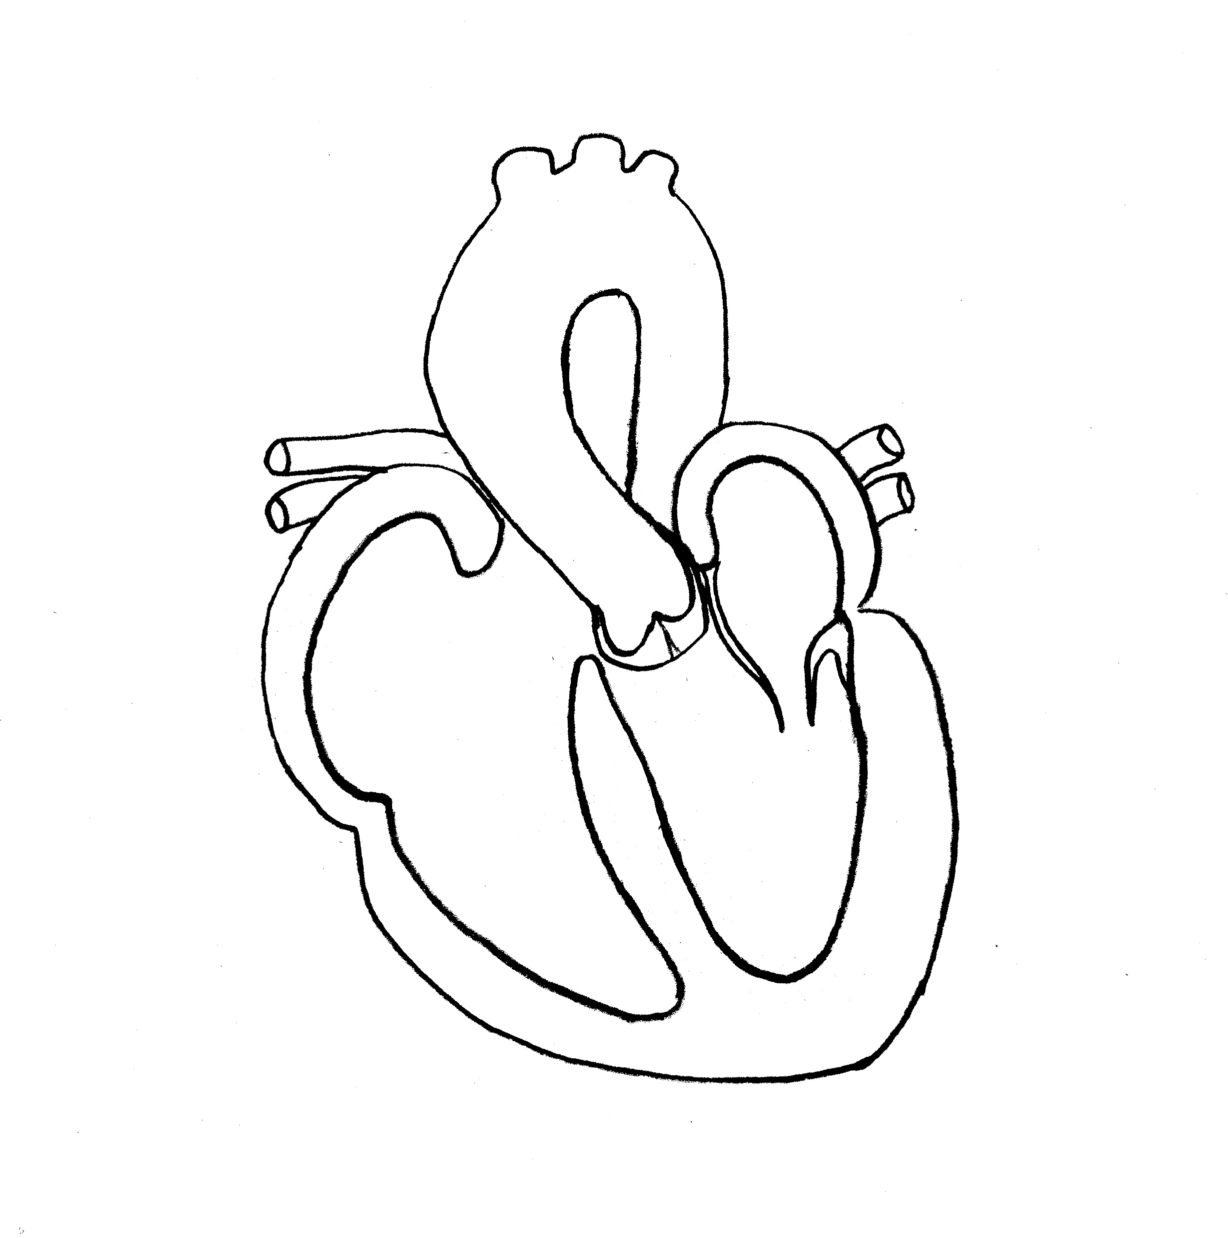
Step 6: Draw Pulmonary Veins
Rt. Side
Lf. Side
Aorta
Pulmonary Veins
Pulmonary Veins
LA
RA
Mitral Valve
Aortic Valve
Myocardium
LV
RV
Septum
Apex

Slide 25
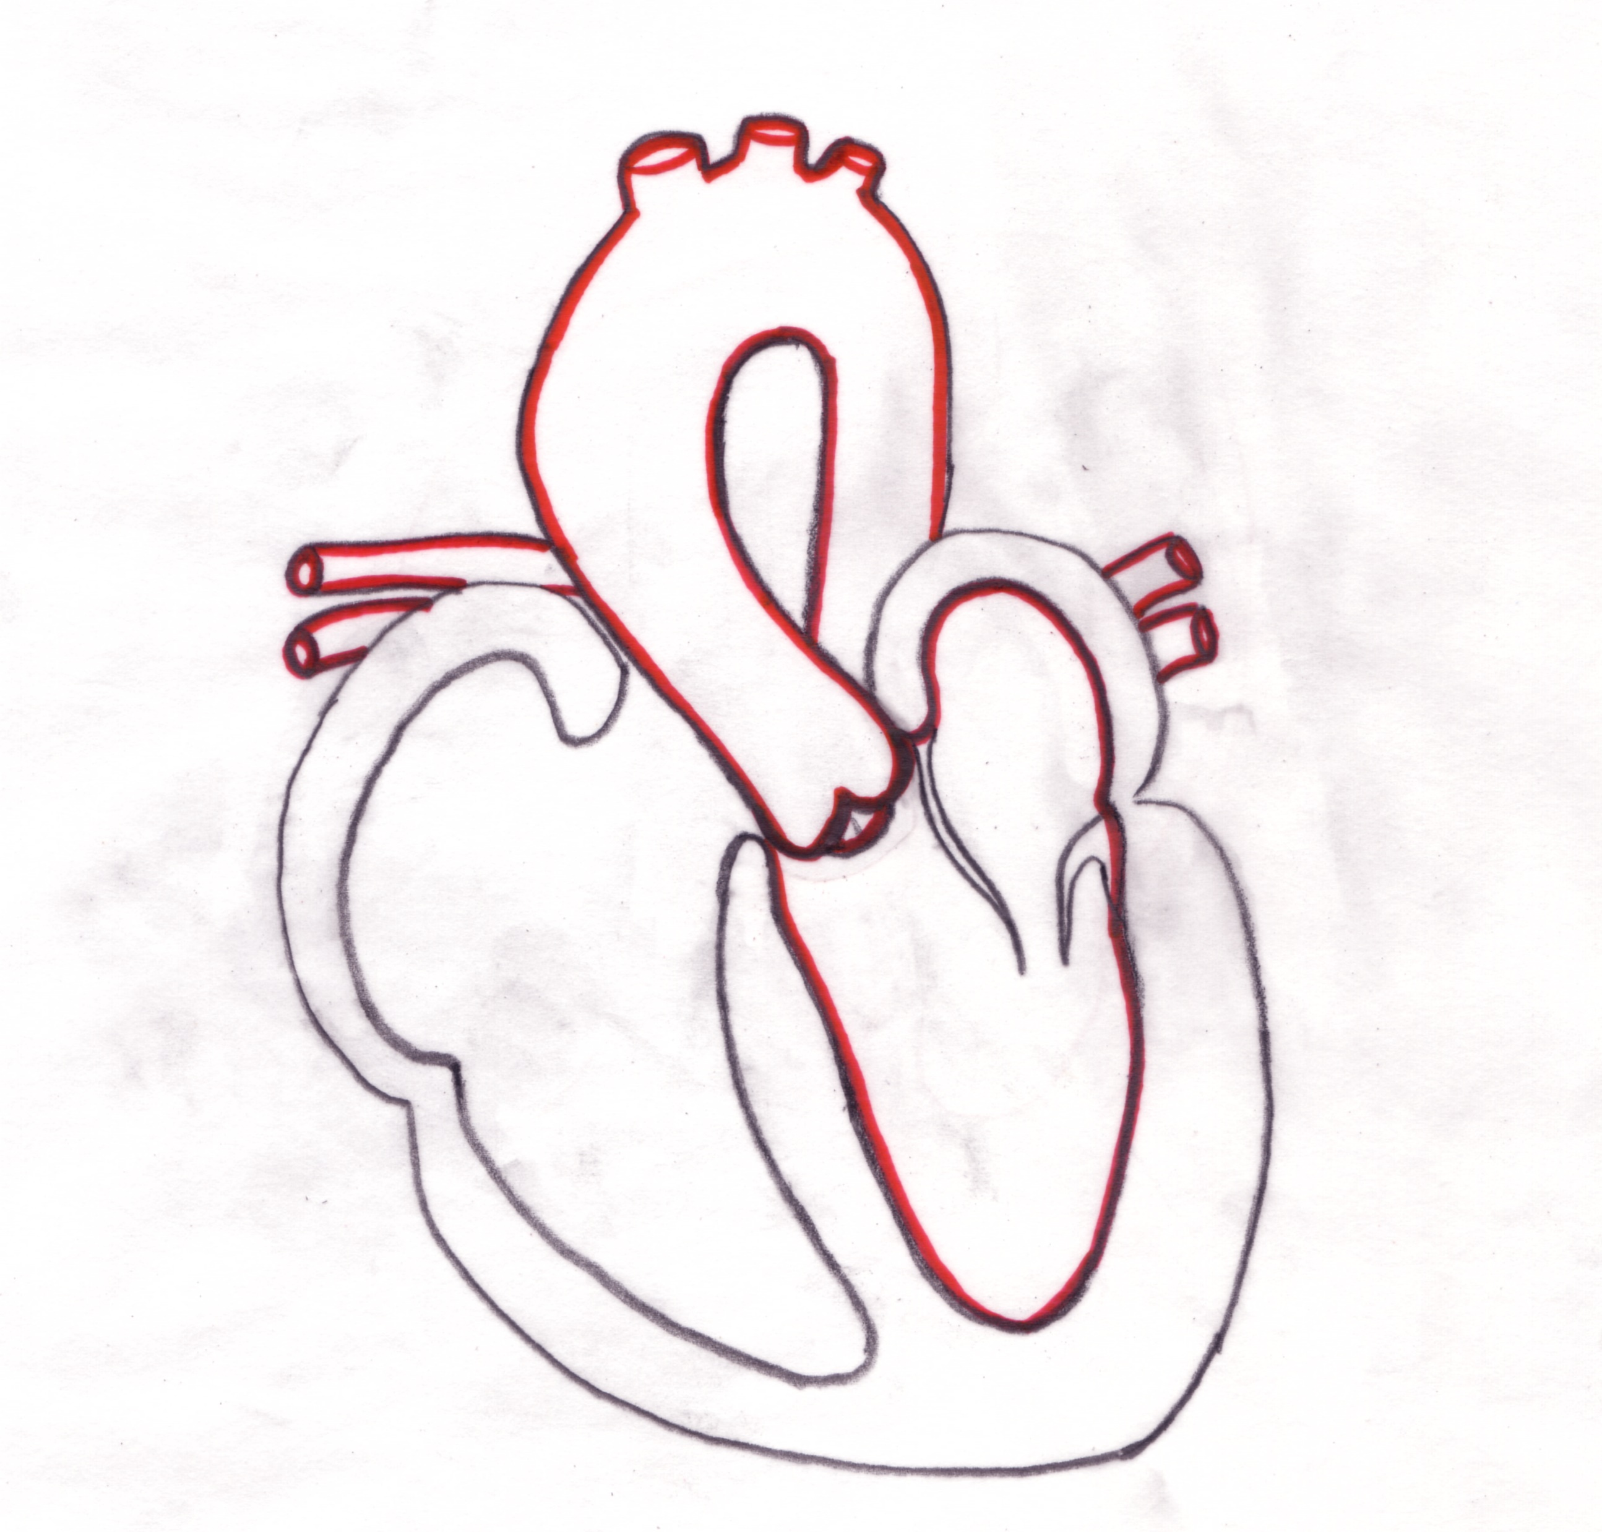
Step 7: Outline Great Vessels & Chambers in Red
Rt. Side
Lf. Side
Aorta
Pulmonary Veins
Pulmonary Veins
LA
RA
Mitral Valve
Aortic Valve
Myocardium
LV
RV
Apex
Septum

Slide 26
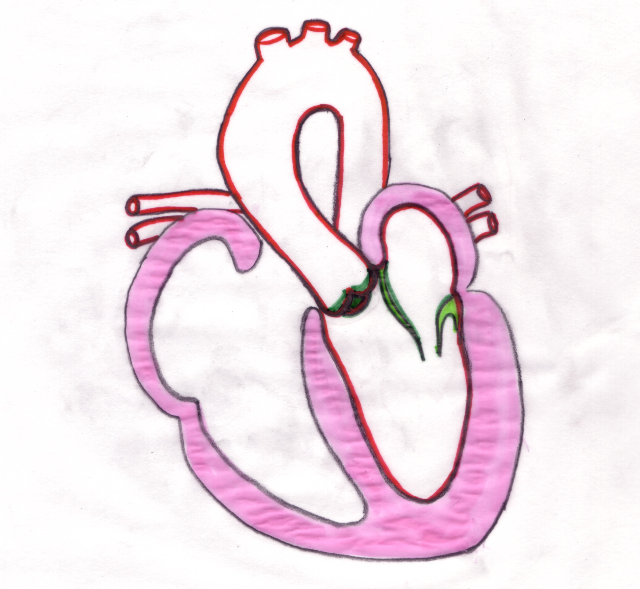
Step 7: Outline valves in green.
Color septum & myocardium in pink.
Rt. Side
Lf. Side
Pulmonary Veins
Aorta
Pulmonary Veins
LA
Mitral Valve
RA
Aortic Valve
LV
Myocardium
RV
Septum
Apex

Slide 27
Step 7: Indicate pathway of blood through left heart with arrows.
Rt. Side
Lf. Side
Pulmonary Veins
Aorta
Pulmonary Veins
LA
Mitral Valve
RA
Aortic Valve
Myocardium
RV
LV
Septum
Apex

Slide 28
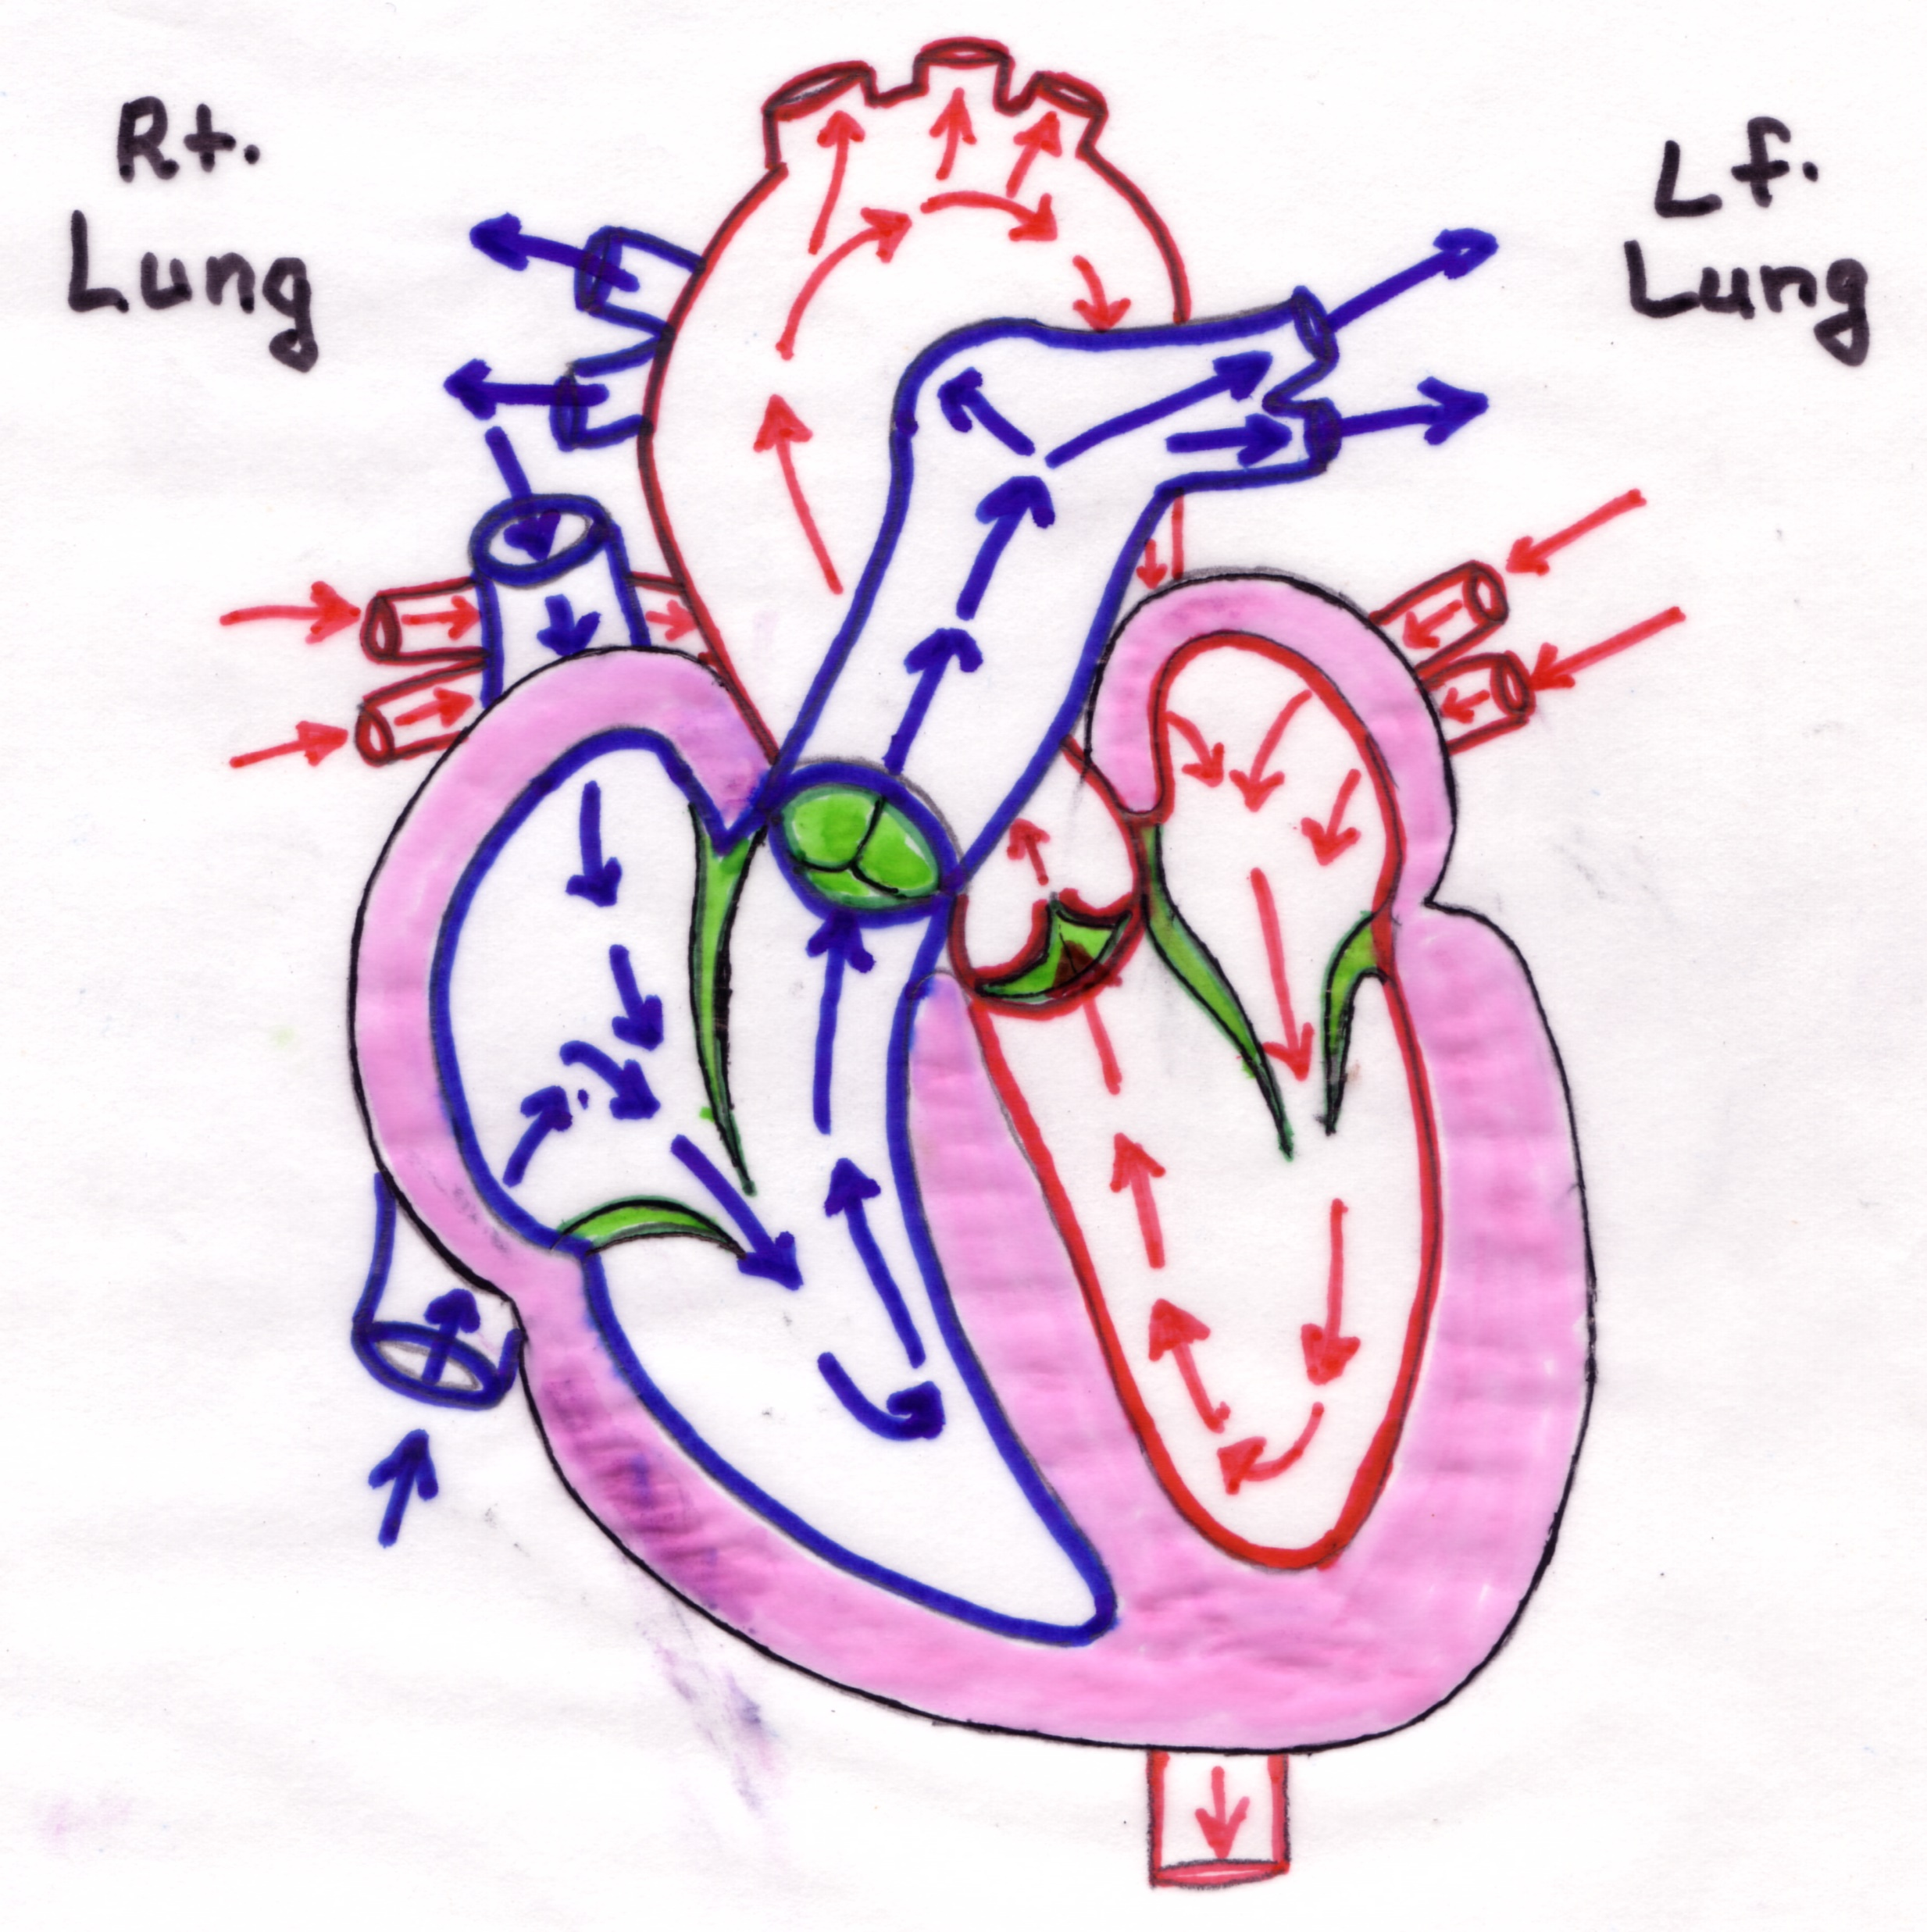
Final Step: Draw entire heart
Notes:
Venous blood travels back to the heart via the vena cavae. Blood from the lower body enters the heart by way of the inferior vena cava and blood from the head and upper body empty by way of the superior vena cava. Both vena cavae drain into the right atrium. Blood exits the right atrium through the tricuspid valve into the right ventricle. The right ventricle pumps the blood through the pulmonary valve into the pulmonary artery. The pulmonary artery bifurcates, one going to the lobes of the right lung and the other to the left lung. While in the lungs, a gas exchange takes places. After the CO²/Oxygen exchange, newly oxygenated blood travels back to the heart via pulmonary veins. The pulmonary veins empty into the left atrium. Blood exits the left atrium through the mitral valve into the left ventricle. The left ventricle pumps blood through the aortic valve into the aorta where the blood is transported to all parts of the body. After the blood releases oxygen and nutrients to body tissues, it travels back to the heart and begins it’s journey again.

Slide 29
Cool “Heart Sites”
  NOVA-Cut to the Heart: http://www.pbs.org/wgbh/nova/heart/heartmap.html
  Go With the Flow (Awesome site that includes lesson plans) http://www.smm.org/heart/lessons/lesson6.thm
  Virtual Hospital’s Cardiac Catheterization: Introduction http://www.vh.org/Patients/IHB/IntMed/Cardio/Cath/Info.html

