Slide 1
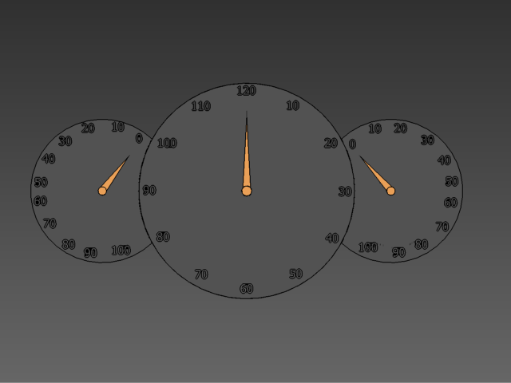
Concepts of Engineering and technology
Airplane Design
Copyright © Texas Education Agency, 2012. All rights reserved.

Slide 2
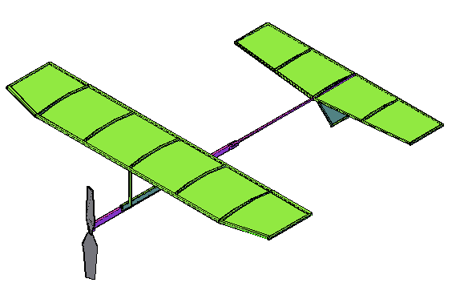
Challenge 1
Create a rubber band wind-up airplane that has a stable flight and travels a decent distance.
Compete against your fellow classmates!
Dugnorth.com
Copyright © Texas Education Agency, 2012. All rights reserved.

Slide 3
Test Airplanes
Either in a hallway or open area, test your created airplane.
Did it fly straight?
Did it stall?
Did it dive?
How far did it travel and why?
Copyright © Texas Education Agency, 2012. All rights reserved.

Slide 4
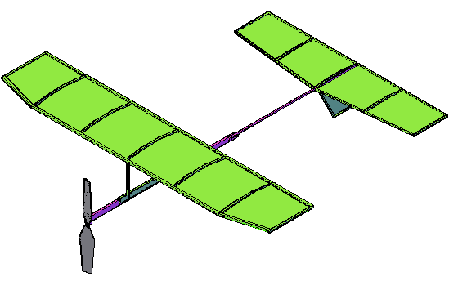
Make Modifications
Modify your airplane based on the problems seen in your initial test flight
Test!!
Once again, ask yourself why your plane flew the way it did.
Copyright © Texas Education Agency, 2012. All rights reserved.

Slide 5
Hints
Common problems
  Plane will dip or stall
  Plane does not fly straight
  Plane does not fly far
Copyright © Texas Education Agency, 2012. All rights reserved.

Slide 6
Plane Correction Tips
If plane is nose diving, consider adding weight to the back of the plane or taking off weight from the front of the plane.
If plane is gliding upwards, add weight to the front of the plane (this will push the plane’s center of mass further back, closer to the center of pressure).
If plane doesn’t fly as far as you want it to, try taking off weight or cutting down on air resistance.
Copyright © Texas Education Agency, 2012. All rights reserved.

Slide 7

Challenge 2
Modify your plane so that is spirals.
Copyright © Texas Education Agency, 2012. All rights reserved.

Slide 8
Hints
Modify fins and/or wings
Try not to unbalance the plane when doing so.
Copyright © Texas Education Agency, 2012. All rights reserved.

Slide 9
Evaluation
Write a paper explaining what factors were most influential in the rubber band plane’s flight. Why did a few planes travel incredibly far? Why did the planes that dove or stalled do so? This report should be at least one half of a page.
Copyright © Texas Education Agency, 2012. All rights reserved.

