Slide 1
Principles of AAVTC
  Elements of Art

Slide 3

Elements of Art
Color
TEXTURE
Value
shape

Slide 4
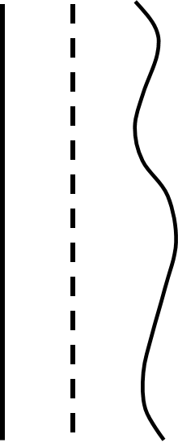
Line
  The path of a moving point
  It is longer than it is wide
  Refers to various types of mark making
  May not be continuous or physically connected
  Can be actual or implied

Slide 5
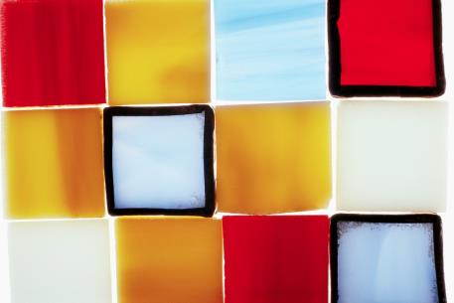
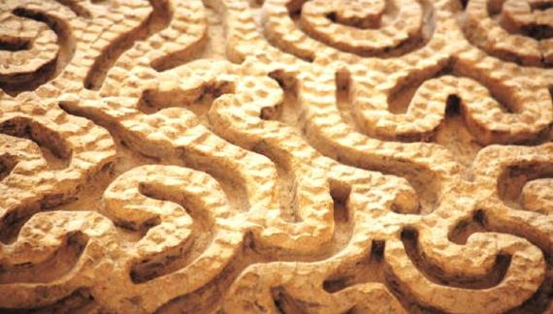
Shape
  An area of two-dimensional space
  Defined by edges or lines
  Can be geometric or organic

Slide 6
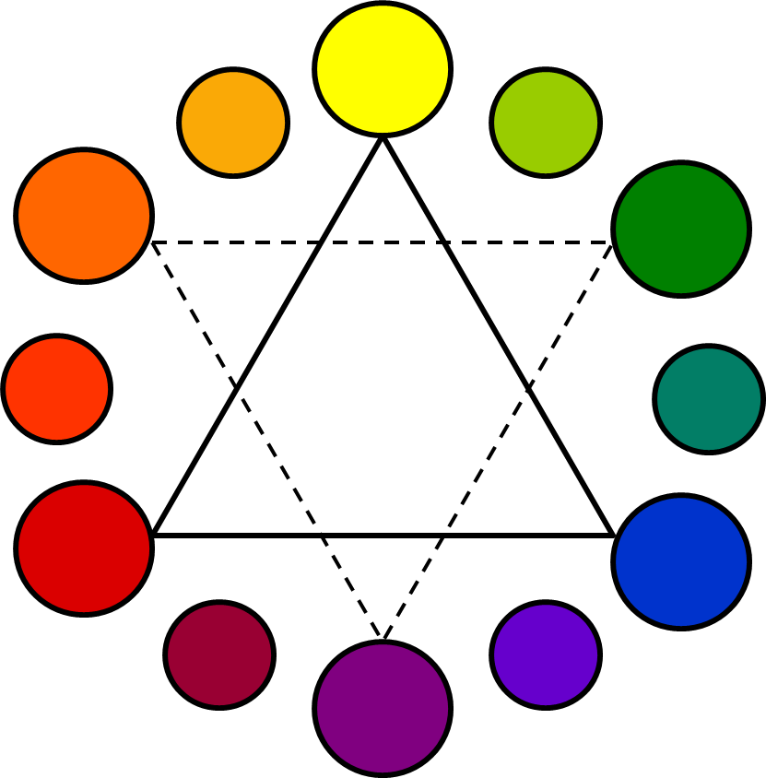
Color
  Primary
  Secondary
  Tertiary
  Cool
  Warm
  Complementary
  Analogous

Slide 7

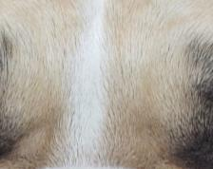


Texture
  The quality of a surface
  Can be actual
  Can be implied

Slide 8
Value
  Refers to relative lightness or darkness of a color
  Black, white, and all shades of grey in between
  Tints, Tones, Shades

