Slide 1
Principles of Architecture & Construction
  How much is this house?

Slide 3
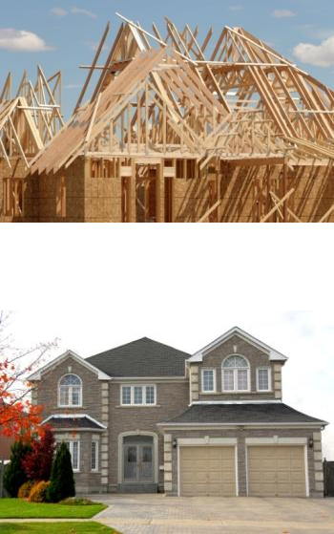
Cost Estimating
  Before a house is built, there is usually an estimate created for the cost of the home
  This is helpful in many ways, to the client who is purchasing the home and the builder who needs to plan the construction
  There is no exact method, that is why it is called “estimating”
  We will look at a few methods used in the industry

Slide 4

Square Foot Method
  This is a method of cost estimating by finding the area of a home
  This is usually found by multiplying the length of the house by the width
  Garages, porches, basements, etc. , are figured separately
  You would use the current square foot cost, but half of that cost for the garage and such areas
  Note that wall thickness is included in this method

Slide 5
Square Foot Example
  Let’s say a house is 24’ x 60’ and has a garage of 20’ x 20’
  The area of living would be 1,440 sq. ft. and the garage space would be 400 sq. ft.
  Let’s assume a cost per square foot of $50
  Then, area of living is 1,440 x 50 = $72,000
  Garage, 400 x 25 = $10,000
  So the estimated cost would be $82,000
  Note: price does not include the land value

Slide 6

Cubic Foot Method
  This is a method of cost estimating by finding the area of a home, then multiplying by the height to find the estimated volume of home
  This method will find the area, but then multiply by the height
  The height is from the basement floor to the ceiling, including attic area
  Attic area is figured using half the rise
  Rise is measured from the ceiling to the ridge of the roof

Slide 7

Cubic Foot Example
  Again, 24’ x 60’ house, with 20’ x 20’ garage
  1,440 sq. ft. living area with height of 8’
  1,440 x 8 = 11, 520 cu. ft. without attic
  Attic rise is 4 ft., then 1,440 x 2 = 2,800 cu. ft.
  11,520 + 2,800 = 14,440 cu. ft.
  Assume cost per cubic foot is $5, then 14,440 x 5 = $72,200
  Garage is 400 x 8 = 3,200 cu. ft., attic is 400 x 1 ½ (rise is 3 ft.) = 600 cu. ft.
  3,200 + 600 = 3,800 x 2 ½ = $9,500
  $72,200 + $9,500 = $81,700

Slide 8

More Accurate Methods
  The above methods are good for a rough estimate
  There are ways of getting a more accurate estimate
  These methods take additional time and may not be worth the effort in some cases
  Each case must be evaluated to determine what type of estimate is required

Slide 9
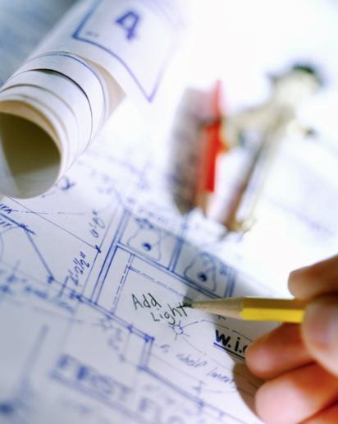
Construction Drawings
  Architectural drawings that layout exactly how the house should be built, also known as “CD’s”
  Much information can be found on the construction drawings
  If these are studied you can determine just about everything you would need for the home to be built
  These will usually include specifications for the materials and finishes

Slide 10

Specifications
  Are an explicit set of requirements to be satisfied by a material, product, or service. Also known as “specs”
  Usually the architect has a certain vision for a home and along with the CD’s, the specs will help to satisfy this vision
  Specs are written in a certain format and usually have alternative materials listed in case the first choice cannot be obtained

Slide 11
Materials
  Are things needed for doing or making something
  After materials are determined from the CDs and specs, they can be listed out using a certain form
  The cost of certain materials can vary depending on time of year, economy, location, supply, etc.
  This can become the most involved part of this process and the most difficult
  With experience you can learn the types of things to be wary of in estimating

Slide 12

Labor
  Is productive work, especially physical work done for wages
  Labor costs can vary depending on time of year, economy, and the type of work needed
  Sometimes, the home may call for a very specific type of labor; this can significantly raise the cost
  Truly skilled labor can be hard to find and can be expensive
  This is a very important factor to be considered in an accurate estimate

Slide 13

Permits
  A legal document giving official permission to do something
  These are usually issued by the city or county where the home is being built
  There are various types of permits for various types of work
  Permits vary greatly from city to city and county to county
  Most permits are fairly affordable (under $400) but depending on the type of work needed can rise in cost
  This is an issue that has to be researched for the area where the home is to be built

Slide 14

Insurance
  This is a promise of reimbursement in the case of loss; paid to people or companies so concerned about hazards that they have made prepayments to an entity
  Some builders require a certain level of insurance coverage. This can raise the cost
  Again, depending on the type of work, location, needs of the home, these can all raise this cost of construction

Slide 15

Final Costs
  After all these factors are considered and added up, then you can develop a more accurate estimate for the home
  You can see that there is a lot more work involved for this type of process
  There are people who are experts in this area
  Either method used, these are good tools to know and become familiar with in this field

Slide 16

Work Time!
  Time to apply your new found knowledge and figure out the cost of a house using one of the above mentioned methods

