Slide 1
Principles of Architecture & Construction
  Loaded Tower Lesson

Slide 3
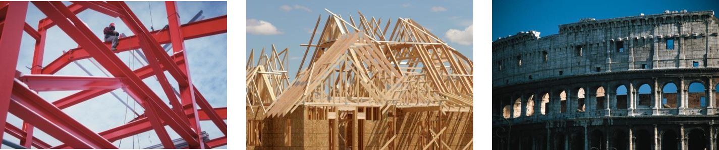
Structures
  A structure usually refers to any large, man-made object permanently fixed to Earth's surface, as a result of construction.
  Structures can be made from different materials such as steel, wood, or stone.

Slide 4
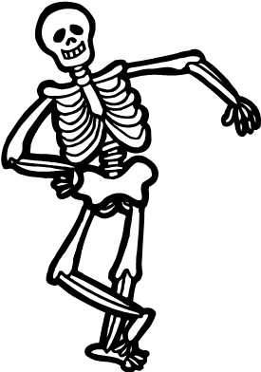
Structures
  Think of a structure like a skeleton.
  A skeleton is usually inside or hidden and it gives anchor for other materials and items to be built upon.
  For this skeleton to work properly, everything has a place and a function.
  And it must all be put together correctly.

Slide 5
Basic Engineering Principles and Terms
  Tension: The action of being stretched to stiffness
  Compression: The action of being pressed or squeezed
  Weight: A load with a certain heaviness, a specific force due to gravity
  Support: To hold up or serve as a foundation
  Tensile Strength: the greatest stress a substance can bear without tearing apart
  Joint: A place or part at which two or more things are joined
  Rigidity: The physical property of being stiff and resisting bending
  Failure: Refers to loss of the load-carrying capacity of a component or member within a structure

Slide 6
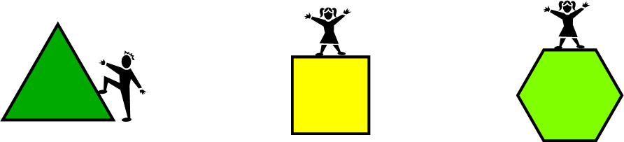
Basic Geometric Shapes
  Triangles: rigidity of the triangular shapes can support weight securely
  Squares: can support weight, but can twist and collapse if not supported
  Polygons: like squares, can support some weight, but will twist and collapse if not supported.

Slide 7
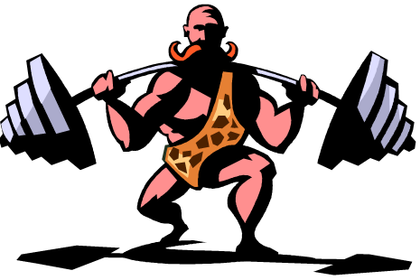
Loads
  Loads are weights that are exerted or forced onto an object. In our case, a structure.
  Loads are basically divided into 2 categories.

Slide 8
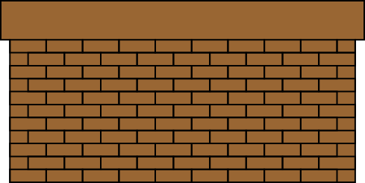
Dead Loads
  These are loads that are always there.
  Usually permanent structures. The walls are a good example.
  Can you identify dead loads around your classroom?

Slide 9

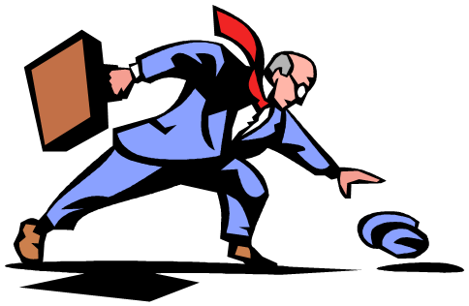
Live Loads
  These are loads that are variable or always changing.
  People or wind are good examples.
  Can you identify live loads around your classroom?

Slide 10
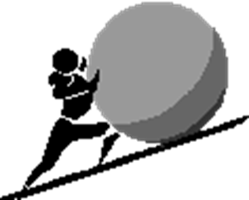

Forces
  Forces can cause physical change
  This can affect a load or structure in many ways
  You are a structure, what happens when you stand up perfectly straight and stiff and some pushes you?
  What if you are sitting and someone sits on you?
  What if you are in a car and the wind is blowing hard, it pushes the car. This is a force.

Slide 11

Tower Time
  Utilize the knowledge learned and build a small tower using the materials given
  After the allotted time, the tower will be tested to see how much weight it can hold before structural failure
  Good luck!

