Slide 1
Principles of IT
  Phones To Go Case Study:
  Advanced Spreadsheet Functions

Slide 3
Objectives
  Use Lookup Tables
  Use and Construct
    Conditional Statement functions
    Nested Formulas
  Create and Modify Charts
  Sort and Filter Data in Spreadsheet Software

Slide 4
Spreadsheets
  Now that you know the basics about spreadsheets, it is time to explore some of the more advanced and powerful features of this software.
  Spreadsheet technology is used daily as a powerful tool in most big businesses around the world.

Slide 5
Conditional Functions
If you ever need your spreadsheet software to make a choice, the conditional function can do that for you. This function can be broken down into parts and combined with other formulas.
The parts of conditional function are
  =IF(Logic Test, What to do if TRUE, What to do if FALSE)
  =IF(Temperature > 90, “Way too Hot”, “Just Hot”)

Slide 6
Conditional Function Practice
    If your family told you that they would throw a party for every class that you scored higher than a 90 in, what would that conditional statement look like? Use the information in the picture to see if you can create your conditional statement for your History class.
 | 1 | 2 | 3 | 4
A | Class | Grade
B | History | 84
C | Math | 95
D | Science | 68
E | Band | 74
F | Art | 100
G | English | 88
H | Computers | 95

Slide 7
Conditional Statement
What did you come up with?
  If you came up with
    =IF(2B>90, “Party”, “No Party”)
Then you are CORRECT!

Slide 8
Conditional Count Function
The conditional count function counts the number of cells in a range that meet certain criteria.
  For example, you may want to count the number of people attending a birthday party so you would know how many party favors to get.
Last Name | First Name | Attending?
Gutierrez | Larry | Yes
Harrison | Kate | No
Kong | Jeremy | Yes
Lambert | Courtney | Yes
Lopez | Juan | Yes
Monroe | Bailey | No
Nguyen | Thomas | Yes
Shepard | Jerry | Yes
Sung | Apple | No
 | Attending: | 6

Slide 9
Reference Tables
Reference tables can look up values in a table for you. This saves time and keeps you from having to enter data repeatedly for every single equation.
  For example, if your parents were to reward you for good grades in all your classes, you can have the spreadsheet software calculate what your reward would be by creating a single formula.
Class Grade
“C” | 0
“B” | $5.00
“A” | $10.00
  You don’t have to enter in the reward amount for every grade; your spreadsheet software can do that work for you.

Slide 10
Lookup Function Parts
Both the Vertical LOOKUP and Horizontal LOOKUP work the same.
  Vertical LOOKUP just looks up in a vertical table (like the one you just saw).
  Horizontal LOOKUP looks up in a horizontal table.
The function is broken down into parts:
  Lookup Value: What are you looking up?
  Table_Array : Where is this lookup table located?
  Column Index Number : Which column has the answer?
  =VLOOKUP(Lookup Value, Table_Array, Col_Index_Number)
  =HLOOKUP(Lookup Value, Table_Array, Col_Index_Number)

Slide 11
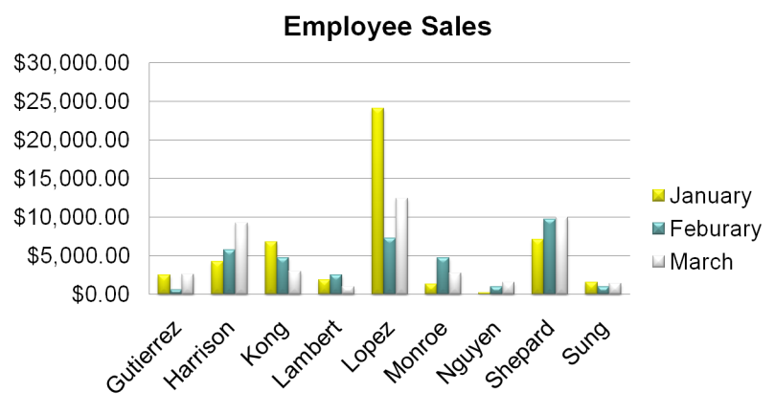
Charts

Slide 12
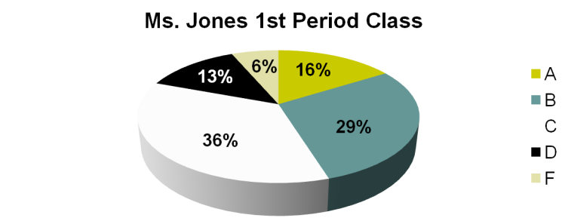
Pie Charts
These show each slice as a part of the whole. A good use of a pie chart is to show the percentage of grades a teacher may give out.

Slide 13
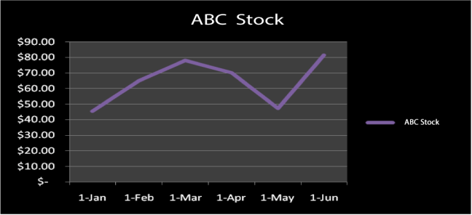
Line Charts
These charts are a great way to chart out data over time. A good example would be charting stock prices over a period of time.

Slide 14
Managing Data
Sometimes you have a lot of data that needs to be sorted, searched through, or reordered. Luckily, spreadsheet software is the perfect tool for that.

Slide 15
Sorting Data
  To sort data, select the data you want to include in your sort by highlighting the cells. Be sure to include all associated data cells in your highlighting.
  Depending on your software, you should see one or more boxes allowing you to customize your sort.
  A simple sort would be from smallest to largest.

Slide 16
Filter
Sometimes, when you have a huge amount of data, sorting is just not enough. Spreadsheet software can filter and hide data that you do not want to see.
  For example, if you have 10,000 names in your spreadsheet, and you only want to see the people with the last name of Smith, you can hide all the people who do not have the last name Smith.

Slide 17
Filters Continued…
  Continuing with the Smith example, if you were to see all the people with that last name in the state of in Texas, the list would still be more than you could manage.
  Fortunately, with spreadsheet software you can add filters so that you would only see the people with the last name Smith who live in the Austin area. Now, you have a much more manageable list of information.

Slide 18
Conclusion
Let’s see if we can apply what we have learned in the Phones To Go Lesson.

