Slide 1
Principles of Information Technology
  Introduction to Software and Information Systems

Slide 3
Course Objectives
  Define terms associated with software and information systems
  Identify how the terms relate and function
  Demonstrate how software and information systems work together giving instructions to computers

Slide 4

Software
Software is the complete set of programs, documentation and procedures associated with a computer system
  System software controls integrate and manage the components of a computer system
  Application software are programs used to perform specific tasks such as word processing, spreadsheets and presentation graphics

Slide 5

Information Systems
Information System is a computer application that helps you create, control, store, locate and access data (information)
  Ex. e-mail, grading programs, social networking websites, micro-blogging networks
  Acts as an interface between people and technology

Slide 6
Information Systems
Compilers is a translator that converts source code into instructions (object code) that the computer can understand so it can execute a specific function
Source Code
Source Code
Source Code
Object
Code
Object
Code
Object
Code
Linker
Executable

Slide 7
Information Systems
Interpreter is a computer program that takes the source translation and executes the specific function step by step
Compilers and Interpreters are the main ways that programming languages are used to perform certain functions
Source Code
Interpreter
Executable
1.
2.
3.

Slide 8
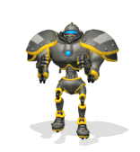
Information Systems
String is a sequence of characters or finite sequence of symbols
  Strings are important and useful data types used in programming languages
  Ex. robot.jump();

Slide 9
Information Systems
Character is a unit of information that corresponds to a form of computer language
  Examples are letters, punctuation marks (“.”), numerical digits, symbols and whitespace
Integer is a quantity represented by a sequence of digits
  Date: sequence of integers typically used for month, day, and year
  Ex. 07/04/2015

Slide 10
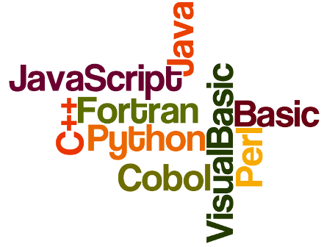
Information Systems
  Computer Language is a formal language designed to communicate instructions to a computer

