Slide 1
Principles of Information Technology
  Introduction to Desktop Publishing

Slide 3
What is Desktop Publishing?
  Desktop Publishing is the art of using computers to lay out text and graphics for printing in magazines, newsletters, brochures, business cards, and much more

Slide 4
Always Remember!
  There are FOUR elements of design
CONTRAST
ALIGNMENT
REPETITION
PROXIMITY

Slide 5
Contrast
  Contrast is defined as the degree of noticeable differences
  How do you provide contrast?
    Fonts
    Size
    Color

Slide 6
Ways to provide contrast
  Adding a small amount of color
  Changing the type of font (typography)
  Adjusting alignment
  Left justified
  Right justified
  Centered

Slide 7


Color Contrast

Slide 8
Alignment
  Refers to lining up the top, bottom, sides, or middle of text or graphic elements on a page.
  Changing the alignment of a document can make a BIG difference.

Slide 9


Alignment Examples

Slide 10
Repetition
  Repeating certain concepts to create a pattern
  Most repetition in Desktop Publishing is never noticed
  Viewers naturally like patterns

Slide 11
Repeat. Repeat. Repeat.
  Color
    Use the same color scheme throughout the entire document
  Font
    Use the same font on all headings
    Subheadings should also be the same font
    Remain consistent
  Shapes
    If stars are used in bullets, do not switch to circles mid document
  Sizes
    Different sizes can send mixed messages if used inappropriately

Slide 12
Proximity
  Proximity is the spatial relationship between two or more items
  Proximity to each other results in viewers forming correlations
  Do not allow viewers to make false correlations because of the use of proximity

Slide 13

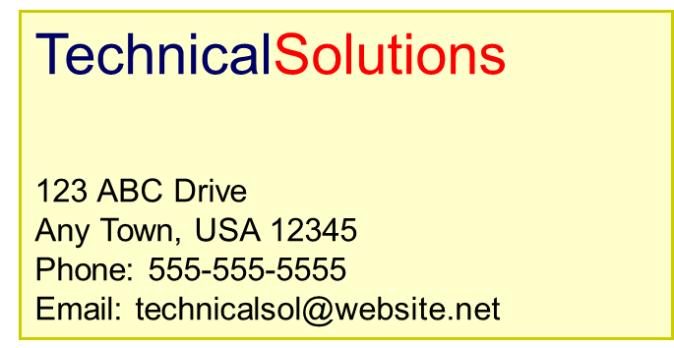

Proximity at its best!
Simply adjusting the placement of the company motto provides viewers with a correlation between the name and the motto

Slide 14
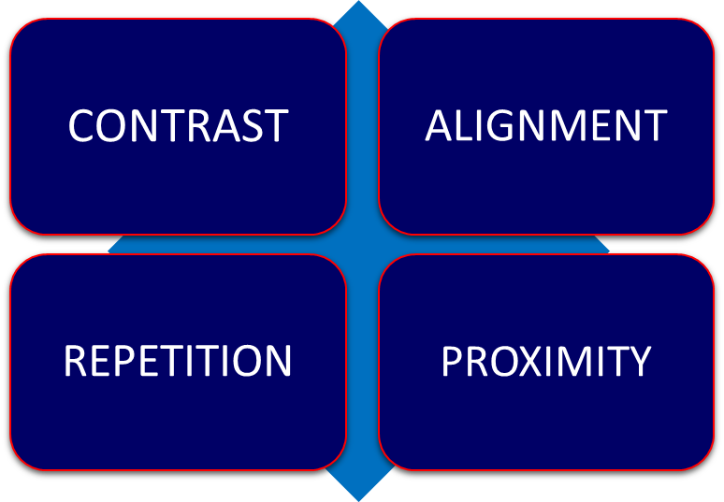
NEVER FORGET
  There are FOUR elements of design

