Slide 1
Problem Loan Management
  Banking and Financial Services

Slide 3
What is a “PROBLEM” Loan?
  A loan that is in default – when a borrower does not meet the loan obligations, such as:
    Regularly making late payments, that is, not on or before the due date
    Not making payments on a loan

Slide 4
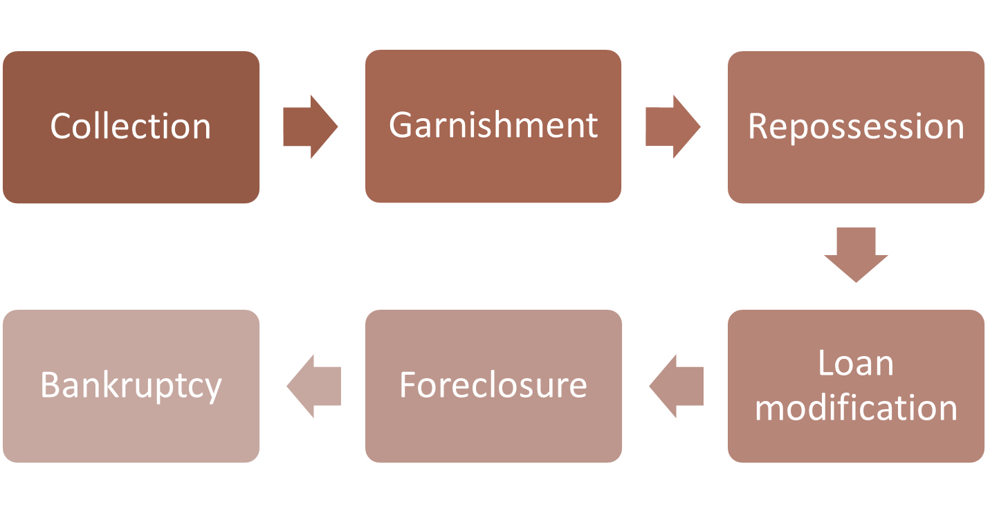
Options for Problem Loans

Slide 5
Collection
  Collection- when payments are not made on a loan and efforts must be made to collect the debt owed.
  A loan can be transferred to another department within the lending institution or, to an outside source who will attempt to collect as much of the loan funds as possible.

Slide 6
Garnishment
  Portion of a borrower’s salary is automatically withdrawn to help to repay debts
  Requires a court order
  According to Title III of the Consumer Credit Protection Act, garnishment may not exceed:
    25% of the week’s disposable income, or
    “The amount by which his disposable earnings for that week exceed the Federal minimum hourly wage . . . whichever is less”
  Stops if the borrower files bankruptcy

Slide 7
Repossession
  When a lender takes possession of an asset that has a loan attached to it
  Lender can sell asset and use funds to repay the loan

Slide 8
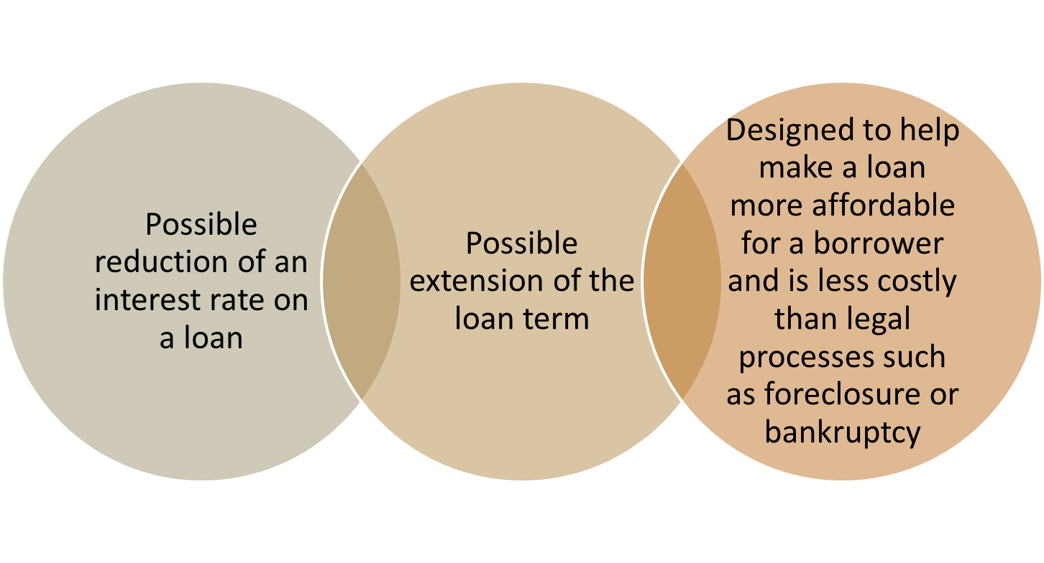
Loan Modification

Slide 9
Foreclosure
  Occurs as a result of non-payment of a loan
  Legal proceeding that removes the property rights of an owner
  Usually refers to real estate such as homes, buildings or land
  Short sale– can preclude a foreclosure by selling property for less than what is owed, but reduces costs of a potential foreclosure
  Real-estate owned– when a bank cannot sell a property at a foreclosure sale and has to try to sell it itself

Slide 10
Bankruptcy
  Legal proceeding designed to reduce or eliminate a borrower’s debt
  Sometimes referred to as a second financial chance by allowing a borrower to have a “clean slate”
  “Stays,” or stops, foreclosure proceedings temporarily

Slide 11
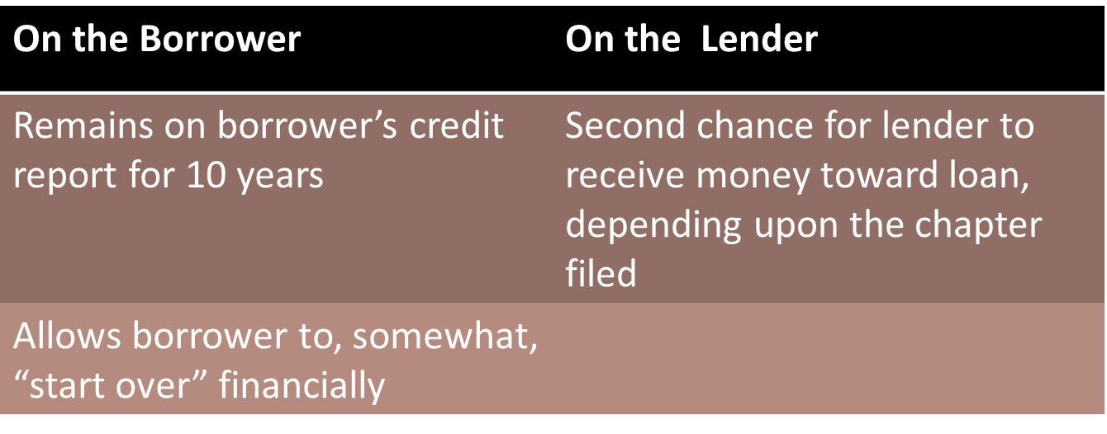
Effects of Bankruptcy

Slide 12
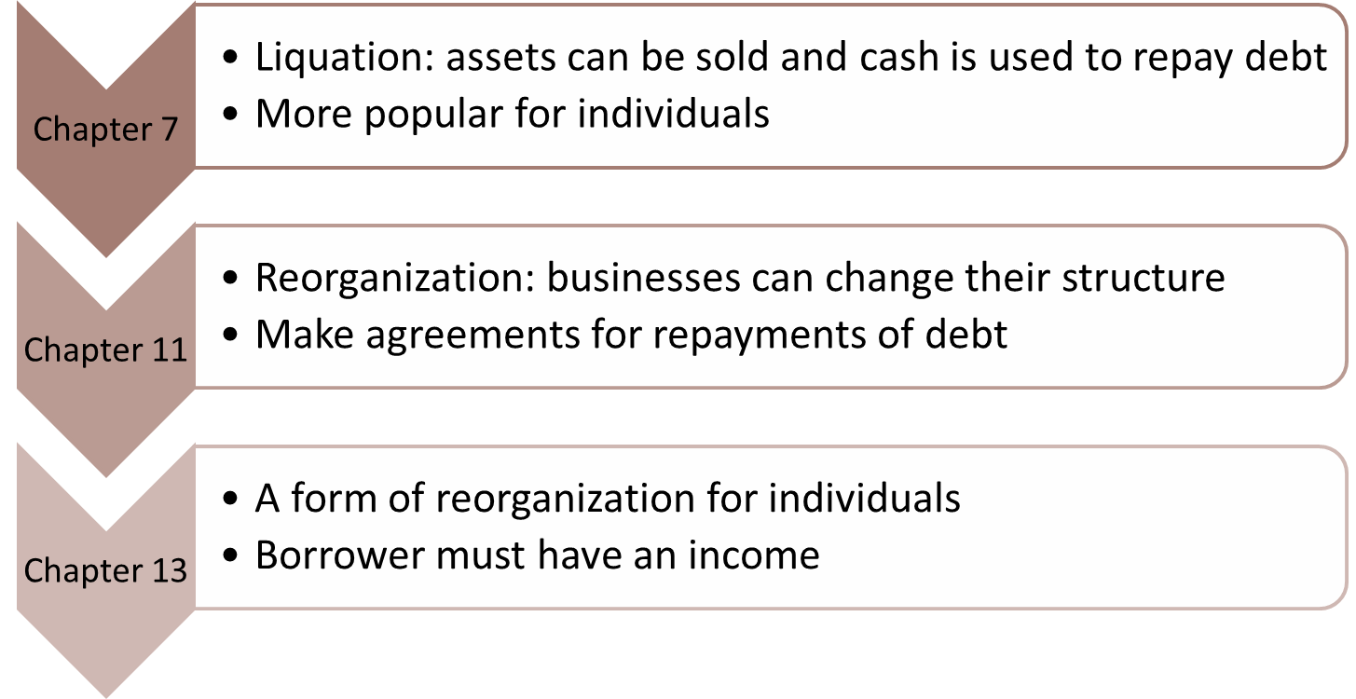
Types of Bankruptcy

Slide 13
Credit Counseling/Debt Consolidation
  Credit counseling
    Budgeting workshops
    Counselors contacting creditors
    May renegotiate credit terms
    May charge fees for their services
  Debt consolidation
    Can be high-interest loans
    Combine all of your debt into one loan
    May charge fees for their services

Slide 14
Independent Practice Assignments
  Case Study Assignment #1 – Provide students with scenarios of different problem loan situations. In pairs, have them decide upon the most favorable resolution of their situation as it relates to the details presented in each case. They will create a presentation using visuals as appropriate.
  Famous Bankruptcies Assignment #2 – Students will conduct research to locate famous people in the news who have filed bankruptcy. They will select one and write a one-page report including the following information: when the bankruptcy was filed, what chapter (7, 11, 13), what happened in the bankruptcy (for example, was property sold? did creditors get the money they were owed), and any other information they feel is important. Proper writing conventions should be followed.
  Financial Crisis Brochure Assignment #3 – Students will research causes of the financial crisis of 2008 that were related to real estate lending and prepare an informative brochure detailing their findings. They should include concepts such as subprime lending and bailouts of major financial institutions, as well as what has been done since then to prevent another crisis. Proper mechanics should be used as well as graphics where appropriate.

