Slide 1
PSYCHOSOCIAL ASPECTS OF AGING
  AGING IN AMERICA

Slide 3
OLD AGE AND THE ELDERLY HAVE A VARIETY OF EXPECTATIONS AND NAMES. . . .FEW ARE POSITIVE
  GEEZER
  BORING
  OLD BATTLE-AX
  USELESS
  OUT OF TOUCH
  SMELLY
  SENILE
  RESPECTED
  DEMENTED
  TWILIGHT YEARS
  EMPTY YEARS
  GOLDEN YEARS
  TIME OF OUR LIFE
  TIME OF LOSS
  TIME OF PAIN
  DEPENDENT
  DEMANDING
  LOSS OF AUTONOMY

Slide 4
THESE CAN ALL REPRESENT ELDERLY PEOPLE WHOM WE KNOW, BUT THEY
DON’T REPRESENT ALL ELDERLY
  Elderly are as diverse a group as any other age group
  The affect of aging on each person’s life is dependent upon that unique individual
  some generalizations can be made about attitudes of aging based on a person’s cultural background. . . . . . .

Slide 5
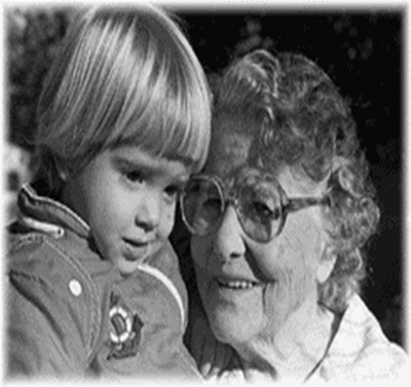
EUROPEAN-AMERICAN CULTURE AND AGING
  Growing old is generally feared
  Elderly are not often respected nor revered
  Nuclear families do not include the elderly
  Ageism at times is practiced
  Elderly often seen as sick, senile, and useless

Slide 6

ASIAN/AMERICAN CULTURES REACT DIFFERENTLY TO ELDERLY
  Have great respect for the aged
  extended families include elderly
  Big family decisions required everyone’s input

Slide 7
HISPANICS FUNCTION WITHIN STRONG EXTENDED FAMILY UNITS, TOO
  Very similar to Asian families in their devotion to extended family
  Elderly have tremendous influence over family decisions

Slide 8
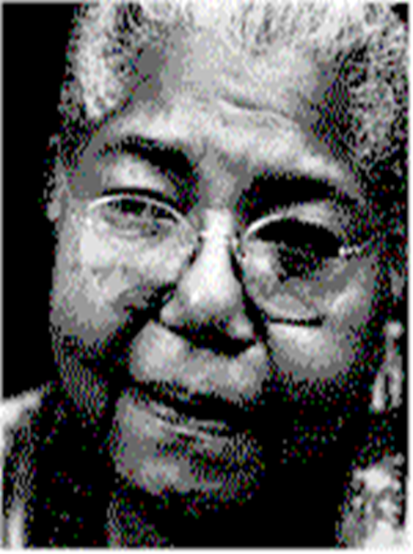
AFRICAN-AMERICAN FAMILIES HAVE DIFFERENT DYNAMICS
  Grandparents often raise their grandchildren
  The extended family often includes church members

Slide 9
MYTHS OF AGING
  INVESTIGATING - MYTHS THAT EXIST IN AMERICAN CULTURE

Slide 10
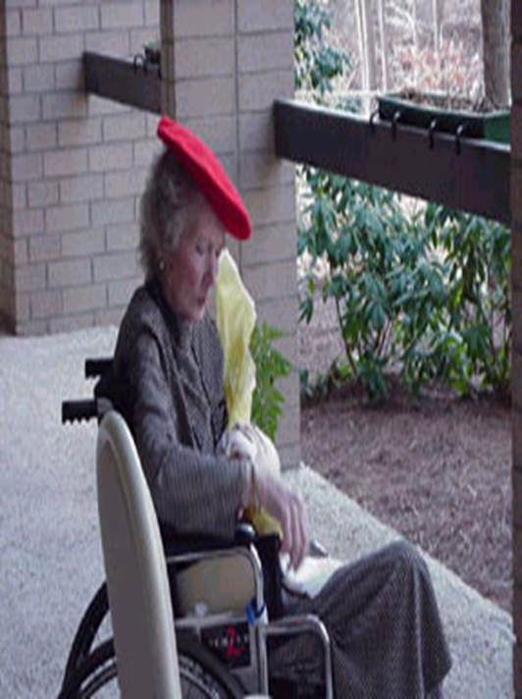
MYTH 1: AGE BRINGS ILLNESS AND DISABILITY
  Over past few decades chronic disease less common
  3/4 of those 75 - 84 years old report no disability
  Twin studies show only 1/3 of elderly’s health problems due to heredity
  Age brings greater risk of disease

Slide 11
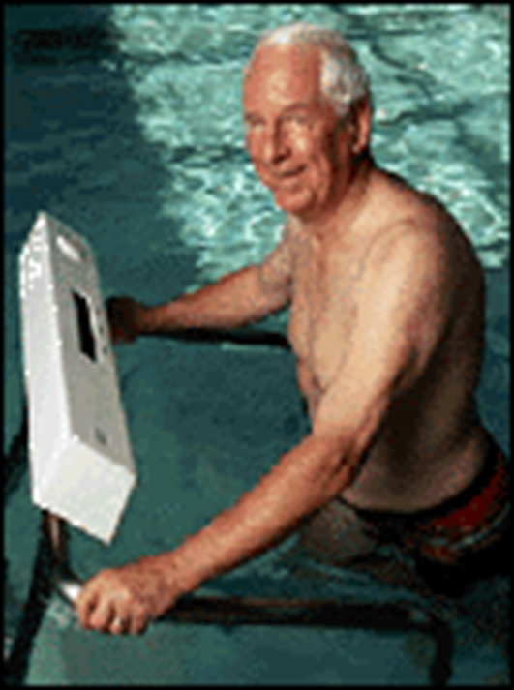
MYTH 2: CHANGE OF HABITS WHEN ONE IS OLDER RESULTS IN NO PHYSICAL BENEFIT
  Change in habits adds years
  Cardiovascular fitness is up 10 - 30% with aerobics
  Strength of 80 - 90 year olds tripled with body building
  Exercise cuts death rate 25 - 50%
  Osteoporosis less with strengthening exercises

Slide 12
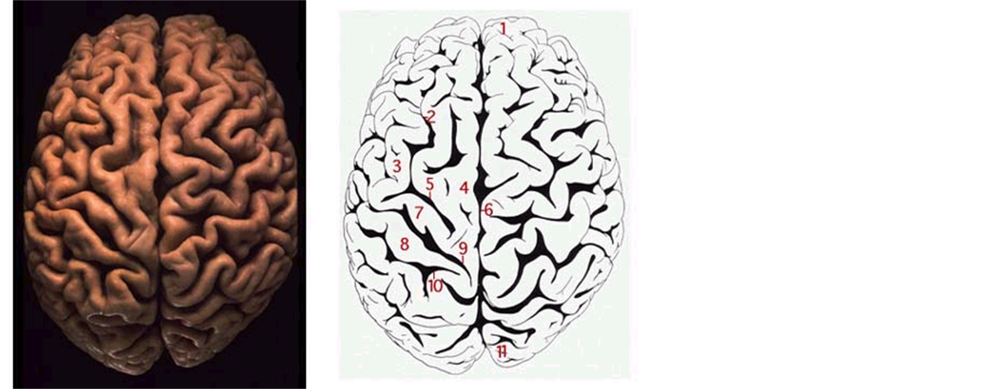
MYTH 3: AGING MEANS REDUCTION IN MENTAL SHARPNESS
  20% of elderly suffer from Alzheimers
  50% have some cognitive decline
  Decline often limited to storing new information
  Performance, recognition, recall shows little decline
  Overall decline mild
  Mental and physical exercise help

Slide 13
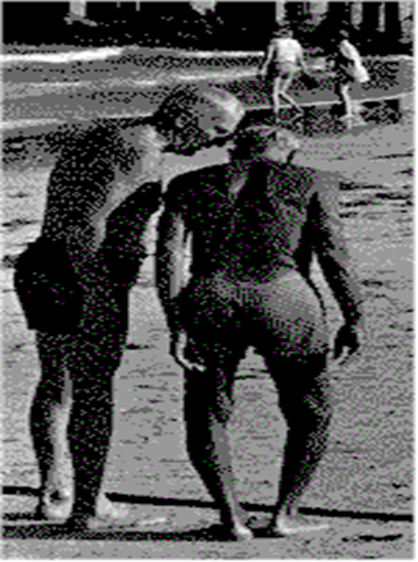
MYTH 4: BEING OLD EQUALS BEING SAD, LONELY, NONPRODUCTIVE
  5% of elderly live in institutions
  1/3 of seniors are employed
  1/3 volunteer regularly
  8 - 15% report loneliness, depending on survey
  Isolated elderly have 2-4 times higher death rate

Slide 14
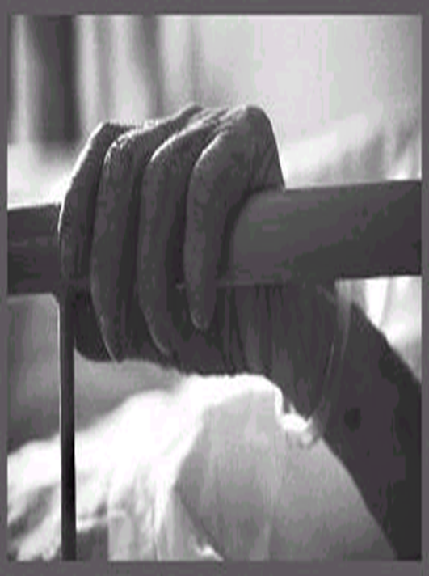
MYTH 5: DEPRESSION AND SUICIDE IN ELDERLY
  Depression present, but not often diagnosed in elderly
  Depression blamed for increased suicide rate in elderly
  White males over 65 at greatest risk
  Women attempt more suicide, men succeed three times more often
  Elderly suicide is twice the national average

Slide 15
MYTH 6: ELDERLY ARE NOT INTERESTED IN SEX AND COULD NOT PERFORM IF THEY WERE
  79% of men 70 - 90 and 69% of women either masturbated or had sexual contact
  86% expressed interest in sex
  2/3 of married respondents said a sexual relationship made life meaningful
  72% said 75 year-old men and women were sexy

Slide 16
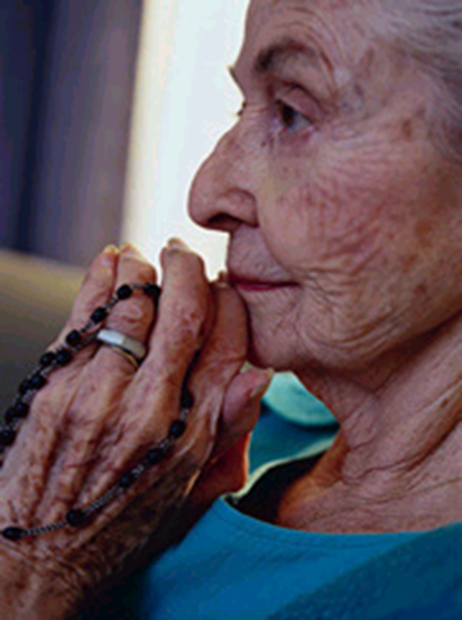
MYTH 7: RELIGIOUS BELIEFS INCREASE - FEAR OF DEATH DECREASES
  65% acknowledge an increase in religious belief
  59% report a decrease in fear of death
  32% report an increase in fear of death

Slide 17
MYTH 8: OLDER PEOPLE RARELY TAKE BATHS OR WASH CLOTHES
  84% of surveyed deny this
  Elderly come from a time when daily bathing was not practiced
  As people age their need for daily/frequent baths decreases - less perspiration/less oil. Hitting the high spots is enough

Slide 18
MYTH 9: OLD PEOPLE ARE VICTIMS OF CRIME
  52% stated they were victims
  39% denied this to be a problem

Slide 19
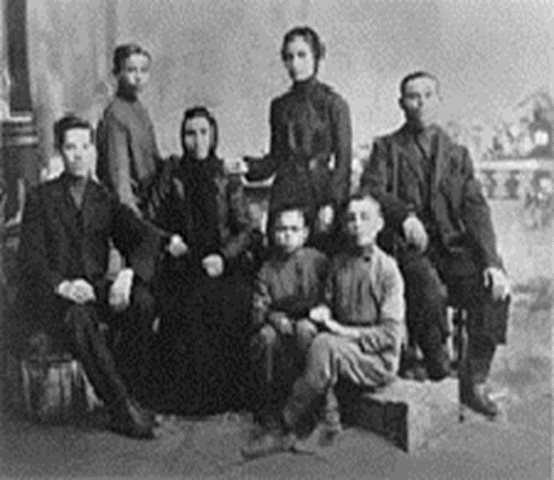
MYTH 10: ELDERLY ONLY WANT TO TALK ABOUT THE PAST
  68% denied this
  Participation in meaningful activities invites successful aging
  Most elderly are active and well-informed

Slide 20
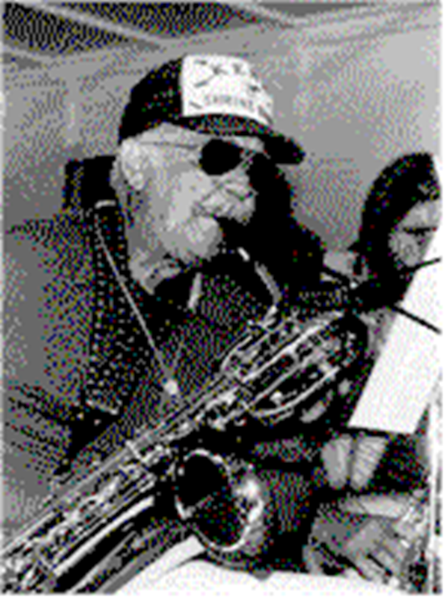
MYTH 11: PEOPLE BECOME RIGID AND NARROW-MINDED WITH AGE
  Personality traits remain relatively consistent
  Anthropologists believe that the “self” is ageless
  Elderly report little change in self-image with age

Slide 21
WHAT IS SUCCESSFUL AGING?
  Basically, it is finding purpose and acceptance with life as it is - with little regret or remorse

Slide 22
“WARNING” BY: JENNY JOSEPH
  (A poem indicating that attitude has much to do with successful aging)
  When I am an old woman I shall wear purple
  With a red hat which doesn’t suit me
  And I shall spend my pension on brandy and summer gloves
  And satin sandals, and say we’ve no money for butter.
  I shall sit down on the pavement when I am tired
  And gobble up samples in shops and press alarm bells
  and run my stick along the public railings
  And make up for the sobriety of my youth.
  I shall go out in my slippers in the rain and pick the flowers in
  other people’s gardens and learn to spit.

Slide 23
FIVE FCTORS OF SUCCESSFUL AGING
  LIFE SATISFACTION: rewarding, few regrets, positive attitude about past and future
  SOCIAL SUPPORT SYSTEM: network of family and friends
  GOOD PHYSICAL AND MENTAL HEALTH
  FINANCIAL SECURITY
  PERSONAL CONTROL OVER ONE’S LIFE: independence, dignity, and self-worth

