Slide 1
Purposes of the Law
  Court Systems and Practices

Slide 3

Jurisprudence
  The philosophy of law
  The science and study of the law

Slide 4

Law
  A body of rules of conduct
  Prescribed by a legitimate authority
  Form of a statute
  Mandates certain forms of behaviors

Slide 5

Law
What do laws do?
  Maintain order in society
  Regulate human interaction
  Enforce moral beliefs
  Define the economic environment

Slide 6

Law
What do laws do?
  Enhance predictability
  Support the powerful
  Promote orderly social change
  Sustain individual rights

Slide 7

Law
What do laws do?
  Redress wrongs
  Identify wrongdoers
  Mandate punishment and retribution

Slide 8

Rule of Law
Supremacy of law
  Standards of behavior are established by laws and not by dictators or religious leaders
  No person is above the law
  Everyone is subject to the law
  Everyone can be held accountable in court for their actions

Slide 9
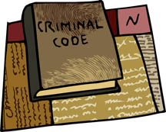
Limitations of the Law
  Legality: laws defining crimes and penalties must be made public before being enforced
    Made public by publishing laws
    Puts the members of society on notice

Slide 10
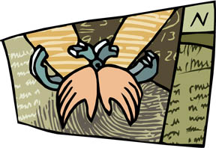
Limitations of the Law
  Ex post facto: “not after the fact”
  Persons cannot be punished for actions committed before the law prohibiting the behavior was passed
Notes:
Example: Timothy Leary (psychology professor) experimented with and advocated the use of LSD prior to laws making possession or use of LSD illegal. Charges could not be brought against him after the laws were enacted. After enactment of the laws, he continued use. Then he was arrested – but charges were limited to instances of his possession and use of LSD after the drug law was published.

Slide 11

Limitations of the Law
  Void for Vagueness: the definitions of laws must be clear and reasonable, specifying prohibited behaviors; otherwise, those laws are illegal
  A law must say what it means and mean what it says.
Notes:
Example: A New Jersey law that made it a crime to be a member of a gang was struck down because the court declared that the word gang was too vague.

Slide 12

Limitations of the Law
  Void for Overbreadth: laws are illegal if they are stated so broadly as to prohibit legal activities as well as the illegal behavior
  Go too far
Notes:
Example: The city of New York made it illegal to panhandle or beg on a New York subway because it frightened passengers. The law is not vague, but could also be applied to the prohibition of free speech activities – which are protected under the U.S. Constitution.

Slide 13
Limitations of the Law
  Due Process: the government must treat people equally and fairly before the law.
  Substantive - limits the power of governments to create crimes unless there is compelling, substantial, public interest in regulating or prohibiting the conduct
  Procedural Due Process – the requirement that the government must follow established procedures and treat defendants equally

Slide 14
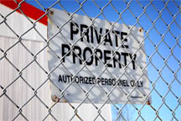
Limitations of the Law
  Right to Privacy: laws cannot violate the reasonable personal privacy of citizens
Notes:
Ex: U.S. Supreme Court has struck down laws that made it a crime for married couples to use contraceptives.

Slide 15
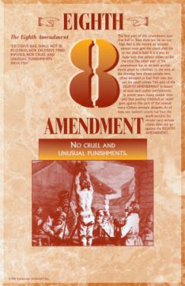
Limitations of the Law
  Cruel and Unusual Punishment: punishment that violates the principle of proportionality and is considered too harsh for the crime committed
  Prohibited by the Eighth Amendment
Notes:
Ex: the use of corporal punishment in prison is cruel and unusual punishment prohibited by the U.S. Supreme Court

Slide 16
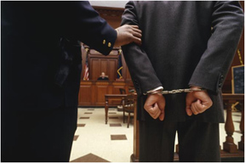
Purpose of Laws
  Protect and Punish: Legal function of the law
  1. Control Crime
    Protects the public’s safety
    Produces order
  Protect and Punish: Legal function of the law
2. Deterrence of Illegal Behavior
    Identifies illegal behaviors
    Describes punishments for behavior
    Two types of criminal deterrence
      Individual
      General

Slide 17

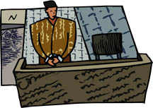
Purpose of Laws
  Protect and Punish: Legal function of the law
3. Punishment Regulation
    Safeguard against
      Arbitrary punishment
      Excessive punishment
  Determinate Sentencing
  Protect and Punish: Legal function of the law
  4. nulla poena sine lege
    “no punishment without law”

Slide 18

Purpose of Laws
  Maintain and Teach: social function of the law
      Social Control - efforts by society to regulate the behavior of its members
      Social Order – all legal systems maintain and protect it
      Social Change – the process by which ideas and practices are modified, either actively or passively through natural forces or deliberate social actions

Slide 19

Functions of Laws
Defines Crime
  any act that the government has declared to be an offense against the public good, declared by statute to be a crime, and which is prosecuted in a criminal proceeding

Slide 20
Functions of Laws
Defines Criminal Acts
  mala in se - acts that are crimes because they are inherently evil.
  mala prohibita- acts that are prohibited because they are defined as crimes by law, not because the act is harmful or inherently evil.

Slide 21
Functions of Laws
Elements of a crime
  Actus reus – the actions of the person committing a crime as defined by law
  Mens rea – the state of mind and intent of the person committing the actus reus
  Concurrence – the completeness of the crime – bringing together the actus reus and mens rea.

Slide 22
RESOURCES
  The Courts and Criminal Procedure, Instructional Materials Service, Trade and Industry Education
  0131189794 Criminal Courts: Structure, Process, & Issues (2nd Edition), Dean John Champion, Richard D. Hartley, & Gary A. Rabe
  Do an Internet search for dad charged with murdering reluctant bride.

