Slide 1
Real Estate Lending
  Banking and Financial Services

Slide 3

What is Real Estate?
  Real estate – land and what is on it, under it, and above it
  Mortgage – a loan to purchase real estate
Notes:
Real estate not only includes what we think of most often, such as houses and buildings, but also land and even what is underneath the land, such as the mineral rights that have value. When you apply for a loan to buy real estate, you are applying for a mortgage. This is usually the largest loan that people have in their lives.

Slide 4
Types of Loans – Primary Mortgage Market
Conventional
FHA
VA
Notes:
Three types of loans are available for borrowers. Conventional has the strictest requirements, but has no loan limits (depending upon your credit). FHA and VA loans are guaranteed by the government, so their requirements are somewhat less stringent than conventional loans.

Slide 5
Characteristics of Conventional Loans
  Require minimum credit score
  Not as many fees as with FHA and VA loans
  Sellers can only contribute up to 3% of closing costs
  PMI only required for loans greater than 80%
  loan-to-value
    PMI: Private Mortgage Insurance; protects the loan in the event of default
    Loan to Value: the loan amount divided by the value of property
  Down payment of at least 20% required in many cases
  Loan not insured by the government
Notes:
Conventional loans require higher credit scores and usually at least a 20% down payment, mainly because they are not guaranteed by the government. Private Mortgage Insurance is required to protect the loan if the loan amount is at least 80% of the property’s value. While requirements are more strict, there are less fees than with FHA and VA loans and the interest rate is typically less.

Slide 6
Characteristics of FHA Loans
  Loans insured by the government
  Less strict requirements for borrowers
  Lower down payment
  Limits on amount borrowed
  Loans only on four units or less
  PMI required but less percentage than Conventional loans
Notes:
FHA loans are insured by the government. There may be more fees and a higher interest rate; however, the requirements are less strict and the down payment can be much lower. There are limits on the amount borrowed.

Slide 7
Characteristics of VA Loans
  Loans guaranteed by the government
  Loans only for veterans who qualify and possibly spouses
  You must be able to afford the home you’re proposing to finance
  No down payment required
  No PMI insurance required
Notes:
VA loans are made available for qualifying veterans. As long as this requirement is met, there are very little, if any, other requirements. You must be able to afford the home you’re proposing to finance, no down payment or PMI required. These loans are also guaranteed by the government.

Slide 8
Mortgage Programs
Government-backed
FHA
VA
Government-sponsored
Fannie Mae
Freddie Mac
Ginnie Mae
Notes:
Several mortgage programs are available to borrowers. There is a difference between government-backed and government-sponsored programs. For example, FHA and VA can insure loans to borrowers (that lenders make) that are government-backed, and Ginnie Mac pools these loans together to create mortgage-backed securities that can be sold to investors. These securities are also government-backed. Government-sponsored means that the loans are not guaranteed. Fannie Mae and Freddie Mac were created as private corporations by the government but for a public service. They do not make loans–they buy loans from lenders and pool them into securities as well.

Slide 9
Mortgage Programs – Government-Backed
  FHA– Federal Housing Administration; guarantees home loans
    Requires up to a 3% down payment
    Does not make loans but it backs loans
    Requires mortgage insurance premiums
  V – Veteran’s Administration; also guarantees loans, but to qualified veterans
  Ginnie Mae– Government National Mortgage Association
    Backs loans made by FHA and VA
    Packages those loans into securities, called mortgage-backed securities and sells them as bonds
Notes:
FHA and VA insure and guarantee loans that are made by lenders. Ginnie Mae packages these loans together with loans of similar characteristics and sells them as bonds to investors.

Slide 10
Mortgage Programs – Government-Sponsored
  Two publicly-traded corporations that purchase mortgages from lenders and pay the lenders to continue to service the mortgages, i.e., collect payments
    Fannie Mae– Federal National Mortgage Association
    Freddie Mac– Federal Home Loan Mortgage Corporation
  They do not make or originate loans
Notes:
Fannie Mae and Freddie Mac do not make loans, but they also purchase loans and sell them as securities. The difference between them and Ginnie Mae is that they are not government-backed or insured programs. These two companies are publicly traded companies, although Freddie Mac has been in receivership (meaning the company filed for bankruptcy) some time ago.

Slide 11
Fannie versus Freddie
Fannie Mae
Allows borrowers to own up to 10 properties
For rental property loans; must have 2 months reserves
Freddie Mac
Allows borrowers to own up to 4 properties
For rental property loans; must have 6 months reserves
Allows for a 3% down payment
Requires at least 5% down payment
Notes:
Fannie and Freddie are similar in many areas but differ in some of the specifics. Fannie allows borrowers to own up to ten properties compared to Freddie’s max of four. Fannie requires less in cash reserves than Freddie does. Fannie’s down payment minimum is less than that of Freddie Mac’s.

Slide 12
Mortgage Markets
Primary | Secondary
Where the loan is originally made | Purchases loans from lenders in the primary market
Lender and borrower interact | Fannie Mae & Freddie Mac buy loans but do not typically interact with the borrowers
Services loans that are sold to the secondary market and are paid a fee | Some loans are kept in-house; others are packaged with loans that have similar interest rates, terms, etc. and sold to investors
Notes:
Primary and secondary mortgage markets differ in several ways. In the primary market, the lender and borrower interact to actually make the loan. In the secondary market, loans are purchased but typically have no interaction with the borrower. The lenders who make the loans service the loans, that is, they collect payments and handle any taxes or other loan-related issues. When the loans are purchased in the secondary market, most are packaged together to be sold to investors, but some will remain in-house.

Slide 13
Consumer Protections
  Truth in Lending Act of 1968– shows the true costs of borrowing money
    Discloses the interest rate of the loan
    Discloses the total finance charge
  Fair Credit Reporting Act of 1970
    Individuals should be told why they have been denied credit
    Individuals must be told who has access to their information
    Individuals have the right to dispute inaccurate or false information
  Equal Credit Opportunity Act of 1974
    Prevents discrimination when applying for a loan, on the basis of:
      Gender, religion, race, age, national origin, marital status
Notes:
Laws were enacted to protect potential borrowers when they apply for loans and are still in effect today. The Truth in Lending Act shows the true costs of borrowing (including all finance charges) and must be disclosed to the borrower. The Fair Credit Reporting Act requires that individuals must be told why they have been denied credit and to correct any errors on their credit reports. The Equal Credit Opportunity Act prevents discrimination on anything that has nothing to do with a borrower’s ability to repay the loan for which they are applying.

Slide 14
Consumer Protections
  Real Estate Settlement Procedures Act of 1974
    Lender required to give borrowers a “good faith estimate” of their closing costs for a mortgage loan
    Revised in 2013 (some provisions follow):
      Payments should be applied promptly
      Complaints, such as for improper fees, shall be handled promptly
      If a borrower has to have insurance forcibly placed on their property, at least 45 days notice must be given and the cost should be reasonable
Notes:
The Real Estate Settlement Procedures Act or RESPA requires lenders to provide a Good Faith Estimate of closing costs prior to closing a mortgage loan, so the borrower can see all potential costs and fees. Some recent revisions include provisions for crediting payments promptly and handling customer complaints promptly as well.

Slide 15
Costs of Real Estate Loans
  APR – annual percentage rate; actual interest percent paid during the life of a loan
  Finance charges – the total dollar amount of fees and interest paid on a loan
  Closing costs – fees paid when a loan is approved, includes taxes, recording fees, title fees, realtor fees, inspection fees, appraisal fees, etc.
Notes:
Several types of costs are associated with real estate loans. The APR is the annual percentage interest rate that is paid on the loan. The finance charges are the total dollar amount of interest and fees on a loan. The closing costs included recording fees, title fees, realtor fees, and other fees (such as appraisal fees).

Slide 16
Interest Rates
  Fixed Rate
    Same rate for the term of the loan
    Payment stays the same
    Easier for bank to make income projections
    Interest rate may be higher than adjustable-rate
  Adjustable-Rate
    Rate can change at periodic, irregular intervals
    Usually a lower rate than a fixed rate loan
    Usually has a cap, a limit on the increased monthly payment or a limit on the interest rate increase
Notes:
Regarding the interest rate on a loan, there are two types: fixed and adjustable. A fixed rate does not change, so neither does the payment. It is easier for a bank to make projections when it knows a rate will be constant; however, the rate may be higher than an adjustable rate. An adjustable rate can change several times, the time interval specified in the loan documents. The rate may be lower, but it can increase. Usually there is a cap which is either a limit on the payment amount or on the interest rate.

Slide 17
What is an Equity Loan?
  Also known as a Home Equity Loan
  A loan that can be made for a customer to raise additional cash
  Based upon the amount of equity in your property
  Does count as collateral because it is based on the value of the property
  Lender earns interest and fees on this type of loan in addition to the interest on fees on the original mortgage loan
Notes:
Home equity loans are based on a percentage of the equity in your property. The funds can be used for extra cash for larger purchases such as remodeling, college tuition, or debt consolidation. A lender earns interest and fees on this loan in addition to the original mortgage loan on the property if it has not been paid off yet.

Slide 18
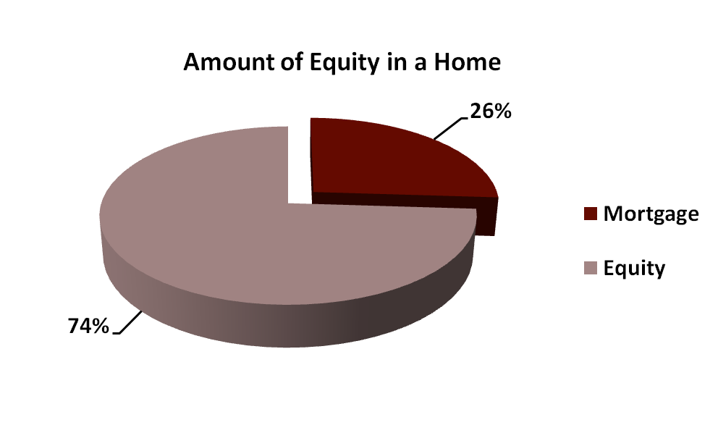
Equity Loans
  Equity – the difference between the value of a property and the amount owed on the property, and the loan amount
Mortgage | $65,000
Equity | $185,000
Notes:
This example demonstrates a mortgage loan of $250,000 mortgage that has been paid down so now there is a balance on the mortgage loan of $65,000. Therefore, the amount of equity is equal to 250,000 – 65,000, which is $185,000.

Slide 19
What is Loan Servicing?
  Payments are made according to the terms of the loan
  Payments are reported by lender to Credit Reporting Agencies
  Servicing can affect the borrower’s credit
Notes:
Loan servicing is basically what a lender does regularly as long as there is a loan. The lender collects and processes the payments, which are reported to credit reporting agencies; therefore, a borrower’s credit can be affected if a) your payment is made late or, b) the lender does not process the payment promptly as it should.

Slide 20
Property Valuation
  To use the property as collateral for a loan, lenders must make sure the property is worth at least the amount being borrowed.
  Appraisal – the process of assessing the value of a property
  Approaches to valuation
    Cost approach – the idea of what a property would cost if it were replaced, that is, the cost of any structures and improvements on the property as well as landscaping
    Market data approach – looking at the sales of properties that are similar, or comparable, to the subject property, making cost allowances for differences in the properties
Notes:
The loan-to-value was mentioned earlier and this slide discusses “value.” A lender wants to make sure their loan is covered by the value of the property, or its collateral. An appraisal is done, either by the cost approach, which considers replacement cost, or market data approach, which considers actual recent sales prices of comparable properties.

Slide 21
Independent Practice Assignments
  Mortgage Interest Rate Assignment #1 – Individually, students will research three different lenders to determine what their mortgage interest rates currently are for different terms. They will create a diagram of their choice (Venn diagram, table, etc.) displaying fixed and adjustable interest rates for different loan terms. Then they will select which one they would choose if they were applying for a loan and explain their reasoning. This can be done on a computer or by hand.

Slide 22
Independent Practice Assignments
  House for Sale Assignment #2 – Have students conduct online research for homes for sale in their area. They should locate at least four homes for sale. They will create a word processing table with columns that display the sale price, number of bedrooms, number of bathrooms, the garage size (2-car, 3-car, etc.) and amenities such as a pool. Then they will highlight each item that is the same on all four. They will then come up with their own price that they think is accurate based on their findings.

Slide 23
Independent Practice Assignments
  Mortgage Loan versus Home Equity Loan Assignment #3 – Students will create a diagram that displays the similarities and differences between a mortgage loan and a home equity loan. They will also conduct research as to the main purposes for getting a home equity loan and include a paragraph stating their findings and which purposes they see as the most important reason to get a home equity loan.

