Slide 1
Red Blood Cell Morphology

Slide 3
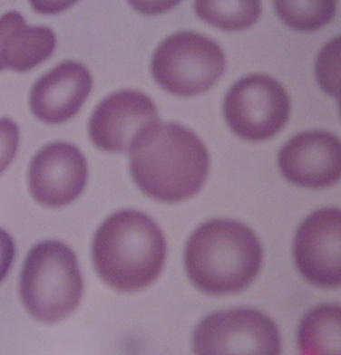
Normal Red Blood Cells

Slide 4
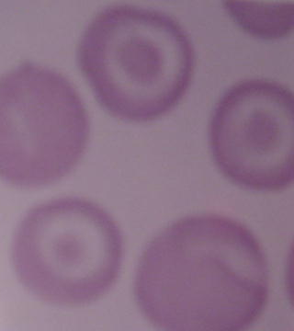
Sickle Cell Anemia
  You will see the following types of cells in a patient with sickle cell anemia, Hemoglobin SS.
  Target cells are also known as codocytes.
    They resemble a bull’s eye.
    These cells are indicative of an anemia state.

Slide 5
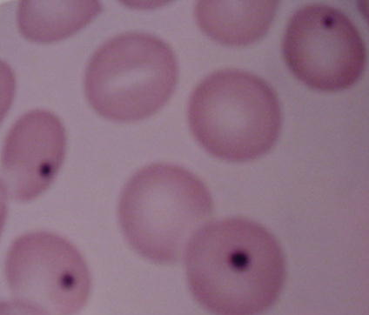
Sickle Cell Anemia
  Howell-Jolly bodies may be seen in sickle cell anemia.
    These bodies are DNA that stain dark purple within the red blood cell.

Slide 6
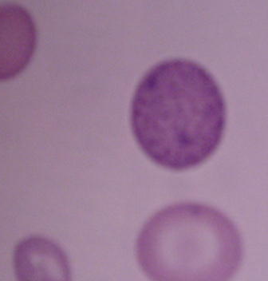
Basophilic Stippling
  Basophilic stippling is granules of RNA seen within the red blood cell.
    The granules stain blue to purple.

Slide 7
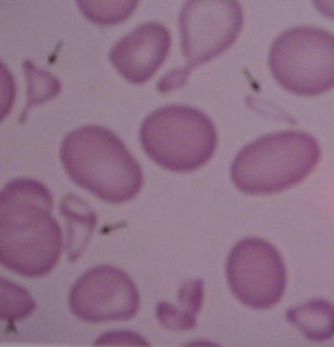
Schizocytes
  Schizocytes are fragmented red blood cells present on the peripheral smear of sickle cell anemia.
    They are many shapes and sizes and may have pointed extremities.

Slide 8
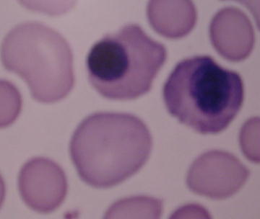
Nucleated Red Blood Cells
  These red blood cells are released from the bone marrow early into the blood stream, due to the need for oxygen.
  Normal red blood cells do not contain a nucleus on a peripheral smear.

Slide 9
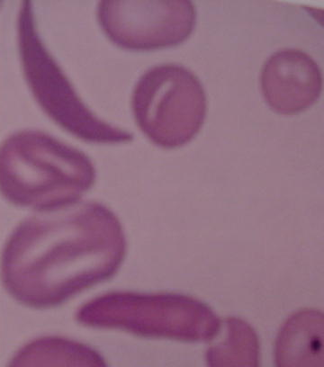
Sickle Cell Anemia
  Note the sickle shaped red blood cell.

Slide 10
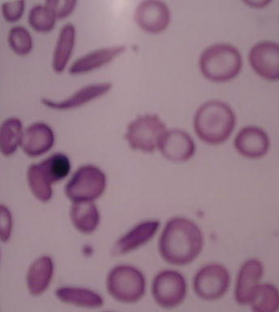
Sickle Cell Crisis

