Slide 1
Rules of Discovery and Privileged Communications
  Court Systems and Practices

Slide 3

Discovery
  The process of exchanging information between the prosecution and defense
  This allows defendants to know exactly what will be used against them in trial and prevents surprises to the government at trial

Slide 4
The following slides present the federal rules and constitutional requirements for discovery

Slide 5
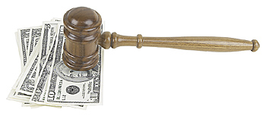
Bill of Particulars
  A detailed, formal, written statement of charges or claims by a plaintiff or the prosecutor, given upon the defendant’s formal request to the court for more detailed information
  This is intended to provide a defendant with details about the charges that are necessary for preparation for trial

Slide 6

Statements of the Defendant
  Upon request, the government must allow the defendant to inspect, copy, or photograph all prior relevant written and recorded statements made by the defendant
  This includes
    Statements the defendant made to the grand jury
    Oral evidence that the police may testify about concerning what the defendant said
  Only statements that the prosecution intends to use at trial are discoverable

Slide 7

Criminal Record of the Defendant
  Prosecutors must furnish a copy of the defendant’s criminal record

Slide 8

Documents and Tangible Objects
  Defendants are entitled to inspect and copy photographs, books, tangible objects, papers, buildings, and places of the government if
    The item is material to preparation for the defendant’s defense
    The item is going to be used by the government at the trial
    The item was obtained from, or belongs to, the defendant
  Defendants must allow the government to inspect their belongings only if used at trial

Slide 9

Scientific Reports and Tests
  All scientific reports and tests in the possession of the government must be turned over to the defendant if requested
  This includes
    Conclusions of mental examinations of defendant
    Autopsy reports
    Drug tests
    Fingerprint analysis
    Blood tests
    DNA tests
    Ballistic tests
    Other related examinations

Slide 10

Statements of Witnesses/Jencks Act
  A defendant can review a prior written or recorded statement after the witness has testified
  This allows the defendant to see if the witness’ testimony is inconsistent with what they told police before the trial

Slide 11

Deposition
  A deposition is oral testimony given under oath, not in court
  Depositions are frequently given in civil cases
  What was said in the deposition can be used in court when there are “exceptional circumstances”
    For example, if a person who gave the deposition was unable to testify at the trial

Slide 12

Brady Doctrine
  Exculpatory evidence of the defendant must be provided by the prosecution
  Exculpatory evidence tends to prove a defendant’s innocence
    This could be in the form of information that comes up in another trial where someone admits they committed the crime the defendant is charged with

Slide 13
Alibis
  An alibis is a defendant’s account of what they were doing when the crime they are charged with occurred to show that they did not commit the crime
  The defense has to give prior notice of the defendant’s alibi so the prosecution can investigate its legitimacy and any witnesses related to it

Slide 14

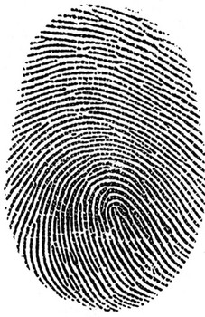


Fingerprints, Handwriting, Photographs
  Fingerprinting and photographing the defendant can be constitutionally required in all felony cases
  The defendant can be ordered to give examples of handwriting, blood samples, and the likes

Slide 15

Privileged Communications
  Some communications between certain types of people are confidential and cannot be revealed in any court proceedings
  This includes relationships –
    Marital Privilege
    Medical Privilege
    Legal Privilege
    Divinity Privilege
    Official Privilege

Slide 16

Marital Privilege
  Communication between husband and wife is confidential
  The marriage must be valid
  There is an exception to this privilege if one commits a crime against his or her spouse

Slide 17


Medical Privilege
  Communication between a doctor and patient are confidential
  This generally applies to all matters within the hospital
  Only the patient can break confidentiality
  The patient can lose this privilege if they “open the door” by introducing evidence concerning their physical or mental condition

Slide 18

Legal Privilege
  Whenever legal advice is sought from a lawyer, the communication is considered confidential and permanently protected from disclosure, unless the client consents to its disclosure
  Confidential communication includes words, conversations, or letters
  An exception to the legal privilege exist if the lawyer is a party to a crime or a participant in a conspiracy, or if the communication itself is criminal

Slide 19


Divinity Privilege
  Communication between a clergyman and an individual are protected if the he or she is consulting the clergyman professionally

Slide 20
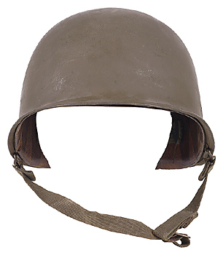
Official Privilege
  The government has a privilege not to disclose confidential matters of state, particularly military secrets
  This privilege also applies to continuing investigations of a criminal nature

Slide 21

Exemptions to Freedom of Information Laws
  Freedom of information laws allow the public access to government records
  There are nine exemptions to the federal Freedom of Information Act
  If a request for information falls into one of the nine exemptions, the government may withhold disclosure

Slide 22
Exemptions to Freedom of Information Laws
  One of the exemptions provides that law enforcement records may be withheld if disclosure will
    Interfere with enforcement proceedings
    Deprive a person of a fair trial or an impartial adjudication
    Constitute an unwarranted invasion of personal privacy
    Disclose the identity of a confidential source
    Disclose investigative techniques and procedures
    Endanger the life or physical safety of law enforcement personnel

Slide 23
Resources
  0766818314, Criminal Law and Procedure (5th Edition) by Daniel E. Hall, J.D., Ed.D.
  0821107321, Introduction to Criminal Evidence and Court Procedure (3rd Edition) by Julian R. Hanley, Wayne W. Schmidt, and Larry D. Nichols

