Slide 1
Screw Threads

Slide 3
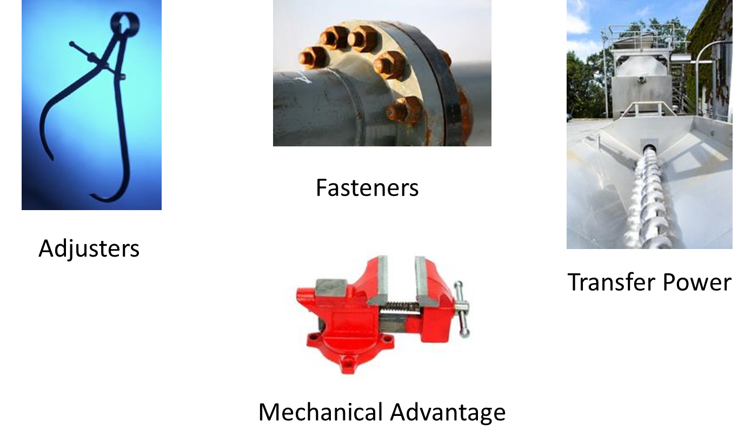
Screw Thread Uses

Slide 4
Screw Thread Uses
  Fastener – (bolts, nuts, and screws) used to hold parts together
  Movement – (lathe lead screw) transmits twisting power to straight line motion
  Mechanical advantage – (vise and clamp screws) increases force to hold items
  Adjustments – allows parts to be moved

Slide 5
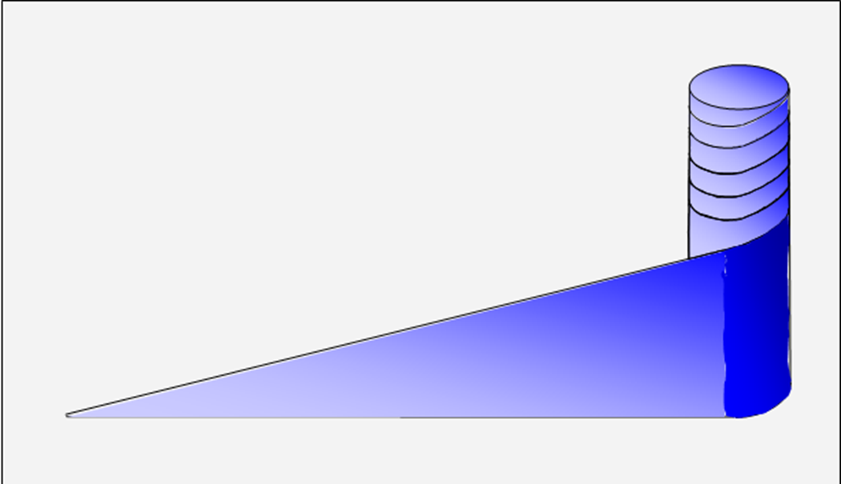
Simple Definition of a Thread
  A screw thread is a wedge wrapped around a cylinder

Slide 6
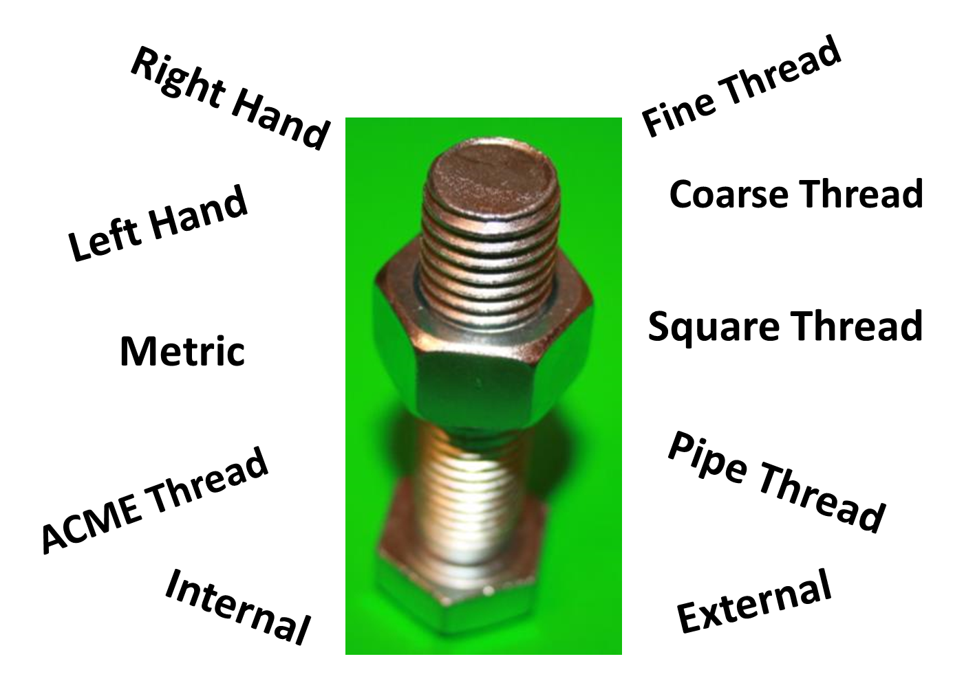

Slide 7
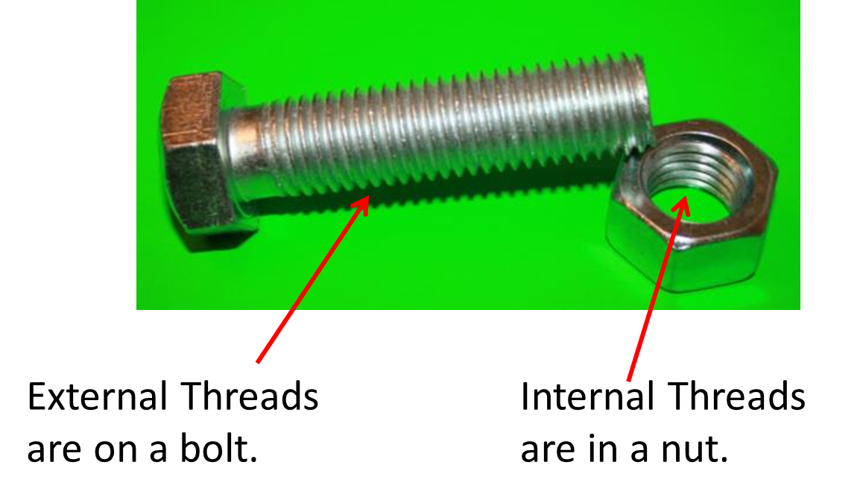
External and Internal Threads

Slide 8
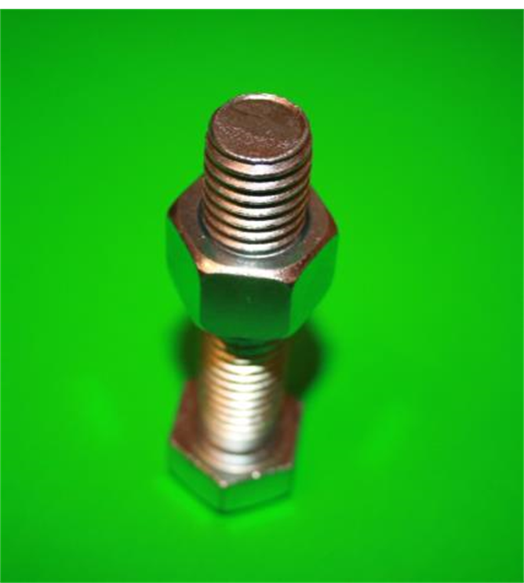
Right-Handed Bolt
  All bolts and nuts are right handed unless marked
  Right-handed threads tighten by turning clockwise
  Left-handed threads tighten by turning counter-clockwise

Slide 9
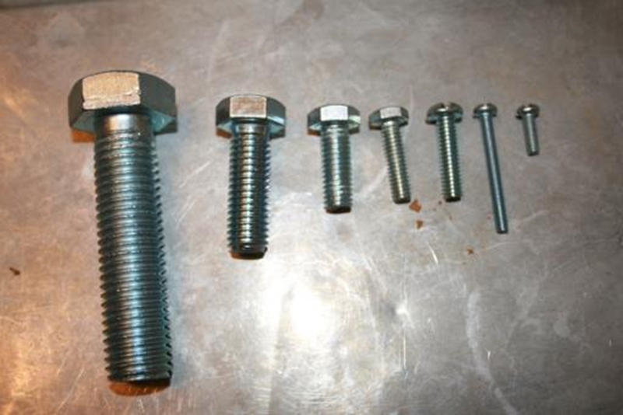
Thread Size
  Threads are sized by the diameter of the bolt and the number of threads per inch

Slide 10
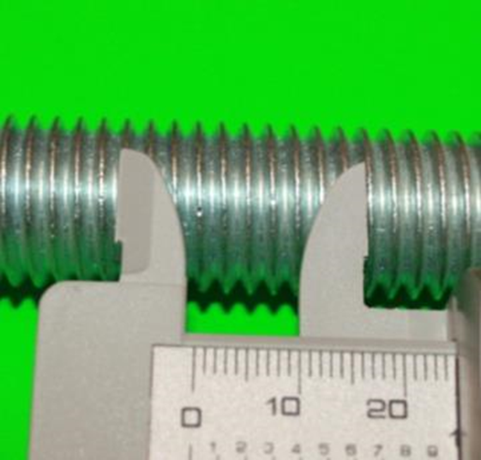
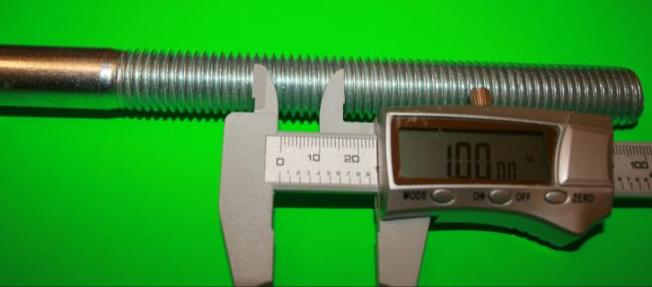
Threads per Inch
  A ¾” – 10 bolt has 10 threads per inch

Slide 11
Standard Thread Sizes
Coarse Threads
¼” – 20
³∕₈” – 16
⁷∕₁₆” – 14
½” – 13
⁹∕₁₆” – 12
⅝” – 11
¾” – 10
Fine Threads
¼” – 28
³∕₈” – 24
⁷∕₁₆” – 20
½” – 20
⁹∕₁₆” – 18
⅝” – 18
¾” – 16

Slide 12
Metric Threads
  Metric threads are sized by diameter and thread pitch in millimeters
  The coarse metric threads use only the diameter size (example, M10).
  The fine metric threads will have the diameter and pitch size stated (example, M10 X 1.25)

Slide 13
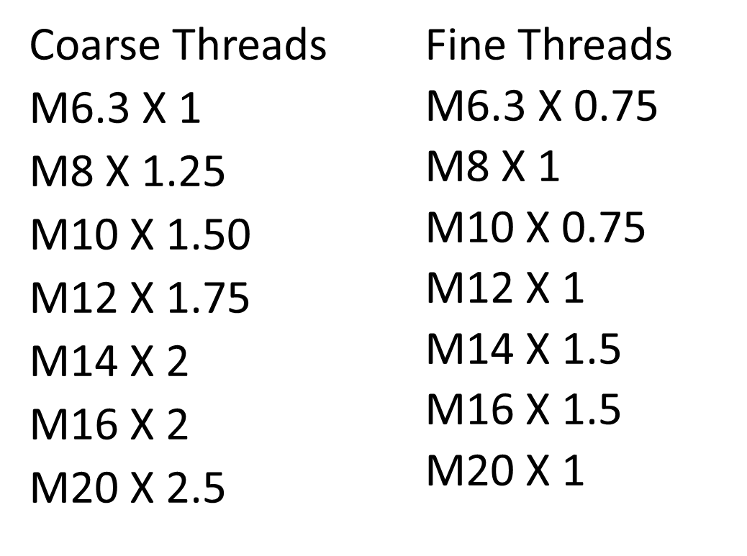
Standard Metric Sizes

Slide 14
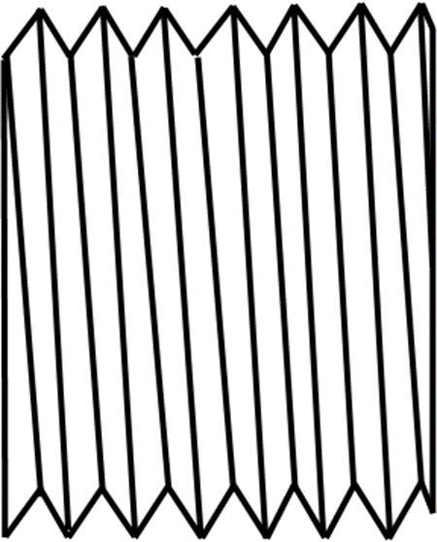
Types of Threads
  Standard threads are V-style with 60° angles

Slide 15
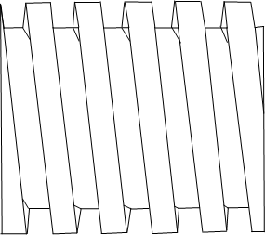
Types of Threads
  Square Threads are square in shape, with the same width and depth

Slide 16
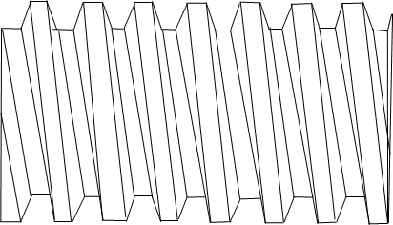
Types of Threads
  ACME Threads are like square threads, but with a 29° angle on the sides; they’re used to transfer power

Slide 17
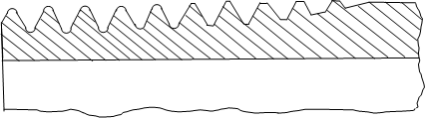
Types of Threads
  Pipe Threads are tapered; the back is shallower than the front of the thread

Slide 18
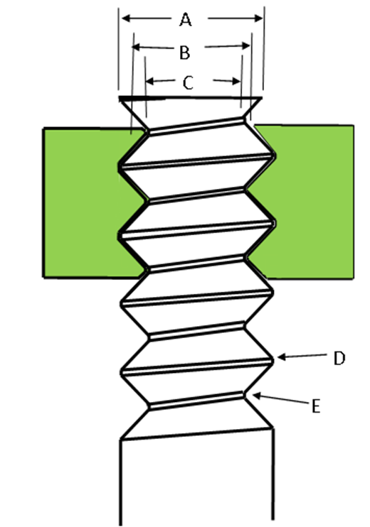
Basic Thread Terminology
  A. Major Diameter
  B. Pitch Diameter
  C. Minor Diameter
  D. Crest
  E. Root

Slide 19
Basic Thread Terminology
  A. Major Diameter- the largest diameter of a bolt at the crest, or the diameter of the roots of a nut
  B. Pitch Diameter- the diameter halfway between the major diameter and minor diameter
  C. Minor Diameter- the small diameter of a bolt at the root, or the diameter of the crest of a nut

Slide 20
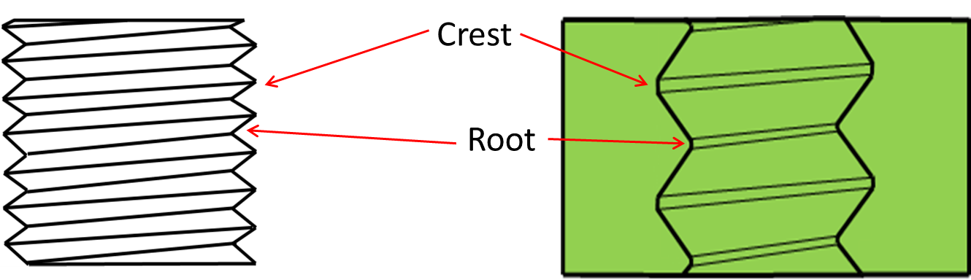
Basic Thread Terminology
  D. Crest- the top surface where the two sides of the threads meet
  E. Root- the bottom surface where the two sides of the threads meet

Slide 21
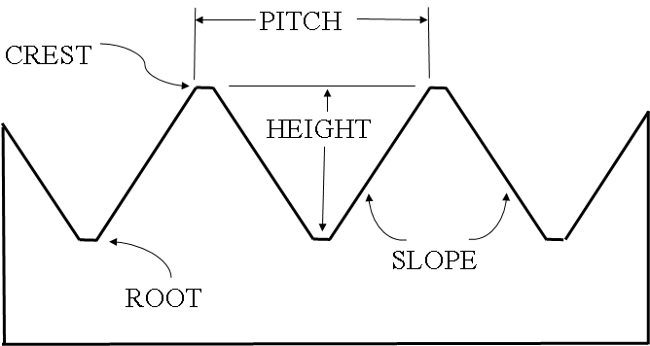
Basic Thread Terminology

Slide 22
Basic Thread Terminology
  Pitch- the distance between thread crests of the thread
  Height- the measurement from the root of the thread to the crest of the thread
  Slope- the angle of the side of the thread

Slide 23
Assessment
  Quiz
  Cut 10 different sizes of internal and external screw threads using a set of tap and die, or lathe and tap

