Slide 2
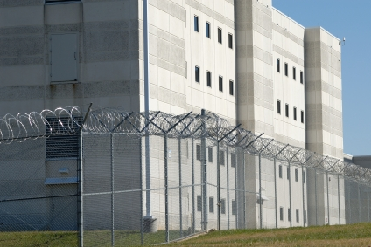

External Controls
  A correctional facility’s physical features that make up its perimeter and support structures
  Examples:
    Anywhere inmates have access
    Tower gates
    Fences
    Walls
    Detection systems
    Catwalks/run-arounds

Slide 3
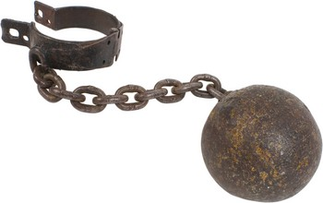
Inspections
  Inspections help prevent
  Hazards
  Assaults
  Contraband concealment
  Disturbances
  Escapes
  Security breaches
  Facility Alterations

Slide 4
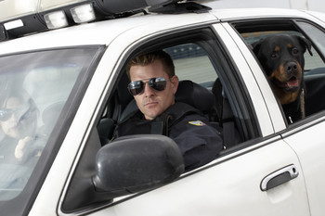
Pedestrian and Vehicular Traffic
  May only enter and leave at designated points
  Should be located close to each other
  Gates separate public access portions of the administration
  All visitors and employees must
    Pass through a security entrance
    Have proper identification
    Be processed into the facility

Slide 5
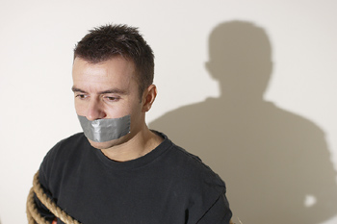
Hostage Policy
  No hostage has any authority
  No inmate will be released while holding someone hostage (visitor, employee, or another inmate)
  Be a casual observer
  Tunnels penetrating the perimeter are concerns
    Secure them with grills
    Use closed-circuit TV
    Use motion detectors
    Drain pipes must have a small diameter

Slide 6
Lighting
  Light the perimeter
  Place interior lights to eliminate blind spots in the shadow of buildings
  Use high intensity, high mast lighting
    Provides lighting level and coverage
    Safer for staff
    Reduces inmates’ ability to move at night

Slide 7
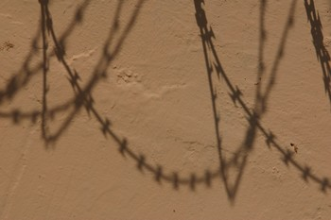
Outside-assisted Escape Attempts
  They take a predictable form
    A visitor brings in a weapon, disguise and/or other contraband
  Be aware of situations outside the perimeter
    Helicopter
    Firing at towers

Slide 8
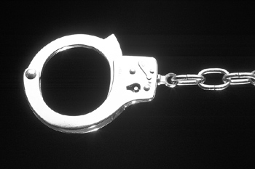
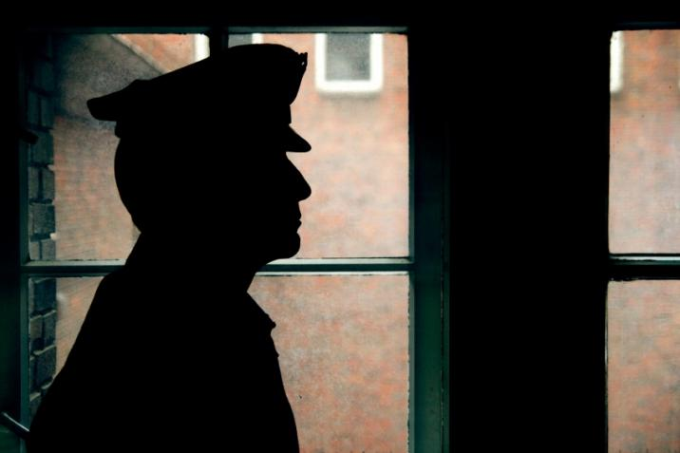
Internal Controls
  Staff must account for the inmates
    Follow procedures in the written security manual
    Perform security inspections and inmate counts
    Control weapons, chemical agents, keys, and tools
    Attend yearly training
  A visible supervisor helps a facility stay well-managed.

Slide 9
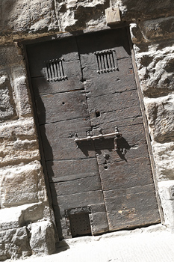
Design Issues
  Central Control
    Outside of the secure perimeter
    Away from direct inmate activity
    Most secure location (completely invulnerable to inmate attack)
    Center of all communication
    Is staffed 24 hours a day
    Takes inmate counts
    Issues and inventories keys
    Coordinates internal and perimeter security networks

Slide 10

Design Issues
  Central Control
    Monitors
      Key traffic points
      Fire alarms
      Smoke and thermal detection
      Radios and computers
      And more

Slide 11
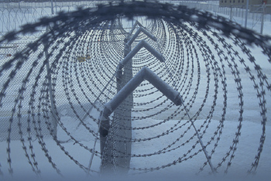
Internal Movement
Control can be facilitated by
  Cutoff fences
  Checkpoints
  Closed-circuit cameras

Slide 12
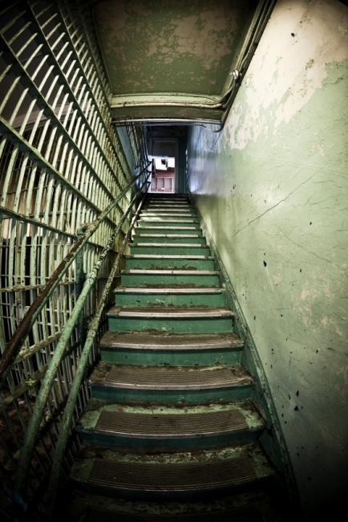
Entrances
  Used to monitor and control inmate traffic
    Mirrors
    Closed-circuit television
  Location is key
    External physical features greatly affect the internal ones
  Examples
    Windows
    Doors
    Stairwells
    Elevators

Slide 13
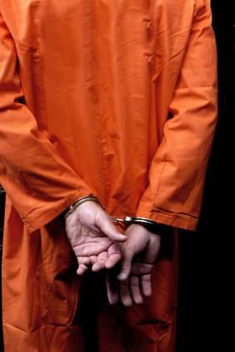
Inmate Accountability
  Involves
    Movement control
    Pass systems
    Census checks
    Record systems
  Requires a count each shift
    Before and after typical working hours
    After any mass movement
    At bedtime
    During the night (two or more)
  Each inmate must actually be seen

Slide 14
Outcounts
  Inmates
    Assemble in a general area
    Must be out when a count is done
  Staff
    Must submit inmates names and numbers
    Call control center with numbers
    Report to the count officer, who is accountable

Slide 15
Inmate Movement
  Staff
    Verify the inmates description
    Check the count onboard each time the vehicle stops or starts
    Use restraints (varies with inmate classification)
    Use a combination of pass systems

Slide 16
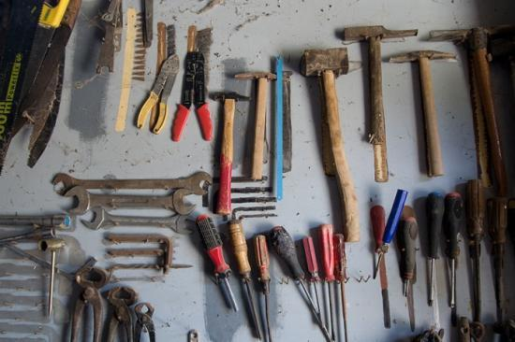
Tools
  Control
    Tools must be accounted for at all times
    Every item is contraband
    Need a tool control officer
    Inventory is checked daily
  Classifications
    Class A (extremely dangerous)
    Class B (Hazardous)
    Class C (Non-Hazardous)
  Storage
    Shadow boards
    Identifying marks
    Receipt for each tool in use
    Class A tools must be locked in a secure room

Slide 17
Food Service Items
  Keep Class A items locked on a shadow board in the room of use
  Do not use any food with alcoholic base
  Keep yeast, nutmeg, and sugar in a locked area, or do not use

Slide 18
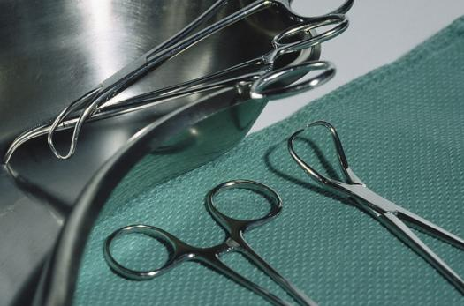
Hospital Items
  Consider and store surgical tools as Class A
  Keep bulk items in a vault (Emergencies only)

Slide 19
Searches and Contraband
  Searches are frequent and unannounced
    Inmates, property, and quarters
    Other areas of the facility
  Searches
    Help detect contraband
    Help prevent disturbances
  Contraband
    Can be sold or traded
    Aids escape attempts
    Destroys property
    Endangers human life
    Violate the institution’s rules
  Need a written search policy and well-trained staff

Slide 20
Inmate Searches
Officers during pat downs
  Require inmates to
    Remove hats
    Unbutton jackets
    Empty pockets
  Avoid using unnecessary force
  Work from behind
  Examine all the subject’s articles

Slide 21
Inmate Searches
Officers during pat downs
  Follow these steps:
    Run hands under the inmate’s shirt collar
    Down the upper part of each arm to the wrists
    Along the undersides of arms to the armpits
    Down from the shirt front to the belt
    Run thumbs around the inside of the belt (front to back)
    Run hands down the front of legs to shoe tops
    Then up the backside of legs
    Down the back from the shirt collar to the waist

Slide 22
Body Searches
Officer’s duties
  Perform only in a private area
  Stand behind the inmate
  Tell the inmate to remove all clothing, dentures, and prostheses and move away from them
  Search the clothing
  Inspect the inmates entire body visually for contraband
    Mouth, armpits, feet, toes, and between buttocks
  Only inspect body cavities with reasonable belief the inmate is carrying contraband

Slide 23
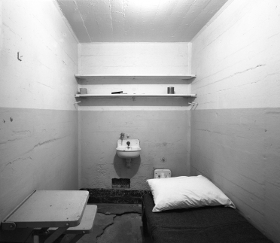
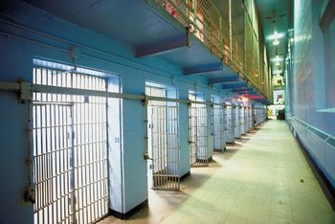
Housing Unit Searches
  Do without warning
  Conduct with two officers
  Search before being occupied by new inmates
  Be careful of needles
  A few obvious hiding places
    Holes and cracks in wall, floor, and ceiling
    Lighting and wall fixtures
    Washbowl, toilet, plumbing stacks
    Shelves, drawers, and medicine cabinets and their contents

Slide 24
Vehicle Searches
  Search all vehicles and machinery when entering or leaving
  Inspect all the passenger compartments
  Use mirrors to inspect the undercarriage
  Search the contents of commercial vehicles

Slide 25
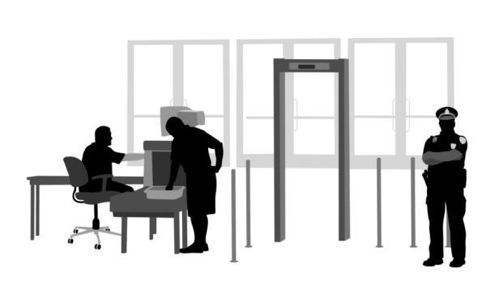
Visitation Searches
  Search visitors before entering
  Use metal detectors
  Search all packages

Slide 26
Keys
  Emergency Keys
  Allows staff rapid access to every part of the facility to respond to a crisis
  Should look the same as other keys
  Restricted Keys
  Laundry and clothing issue areas
  Business office
  Personnel office
  The Commissary
  Warehouses
  Administration offices
  Armory
  Control center

Slide 27
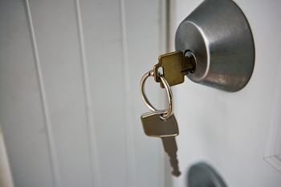
Key Handling
  Do not leave keys in the lock
  Never take entrance keys inside the facility
  Never allow inmates contact with armory keys
  Never allow grand master key in open circulation inside the institution

Slide 28
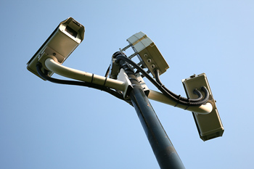
Security Inspections
  Search all physical security features
  Check for compromised security features
  Follow maintenance procedures
  Confirm security equipment is fully operational
  Document all of this

Slide 29
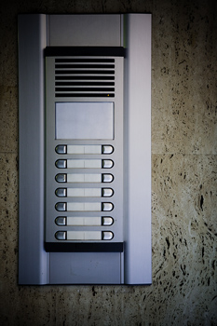
Communications
  Effective communication is key for officers to function
  Equipment used
    Radios
    Tower intercoms
    Personal body alarms
    Closed-circuit television

Slide 30
Handling High Security Inmates
  High Security Inmates
    Held in special housing units
    Require extra supervision
  Tower officers must know who they are

Slide 31
Special Supervision Units
  These areas confine inmates who
    Are extremely dangerous
    Cannot be held safely in the general population of any regular institution.
  Examples
    Protective custody
    Witness security
    Death Row

Slide 32
Summary
Every correctional unit has protocols and policies in place to maintain the security of the facility and handle emergency situations.
It is important for a correctional officer to know these things for their safety and the safety of the other officers and inmates.

Slide 33
Resource
Correctional Officer Resource Guide (3rd edition), American Correctional Association

