Slide 1
Select Equipment for Horses
Equine Science

Slide 3
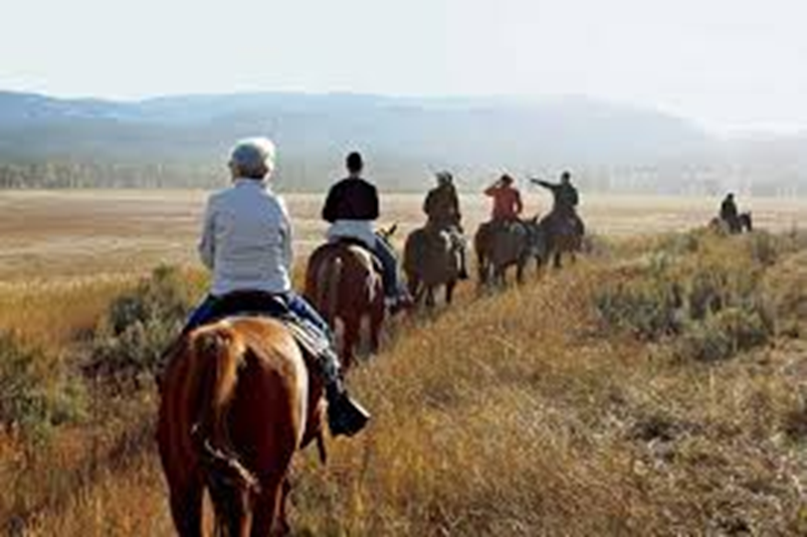
Before you hit the trail on the horse, what must happen before you leave the barn?
Haltering, Grooming, Saddling, Bridling

Slide 4
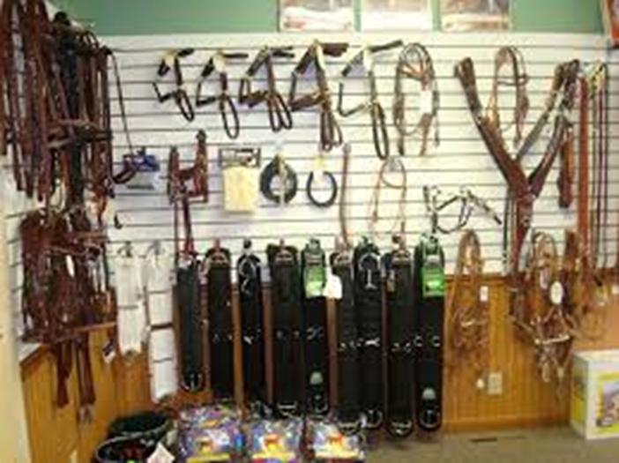
Equipment Required
Today we will discuss the equipment required for a horse.
Recognizing the importance and cost of good equipment is an aspect of horse ownership that we should all be familiar.

Slide 5
Objectives
Today we will:
Identify the importance of selecting appropriate and safe equipment for horses
Describe the parts of halter and lead rope
Describe grooming equipment
Describe the parts of a saddle
Describe the parts of a bridle
Demonstrate proper use of halters, saddles, and bridles
Analyze the cost of equipment required for horses

Slide 6
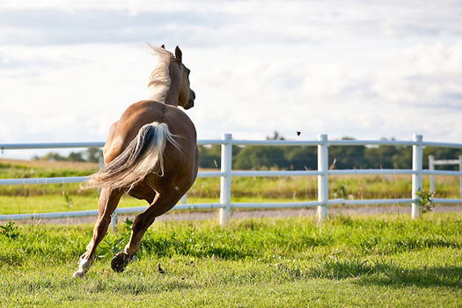
Importance of Selecting Appropriate Equipment for Horses
Horses are flight animals.
This means that when scared or threatened, their instinct is to run from the threat.
The flight instinct has implications for the equipment we use—safety is the primary goal when dealing with an animal 10 times your weight.

Slide 7
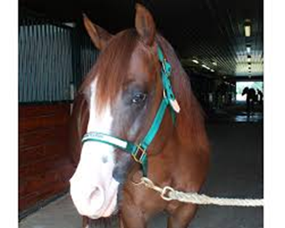
Halter and Lead Rope
Everyday halters are typically nylon or leather with brass or steel hardware; sometimes rope halters are also used.
Be sure the halter is in good condition with no fraying, decaying, or weak spots
Lead ropes are typically cotton or nylon. Nylon is stronger, but can burn your hand more easily if the horse pulls away.
Halters should fit the horse comfortably. Avoid halters that are too large or too small.
We halter and lead from the left side of the horse.
Watch Haltering a Horse

Slide 8
Parts of a Halter

Slide 9
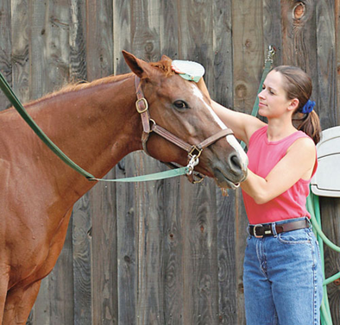
Grooming Supplies
Once the horse is haltered, we will need to groom it.
Daily grooming consists of picking out the hooves, currying and brushing the body, mane, and tail.
Grooming is important to keep the horse healthy and allows you do develop positive rapport with the horse on the ground.
Watch Grooming Tips for Show and Performance Horses

Slide 10
Grooming Supplies

Slide 11
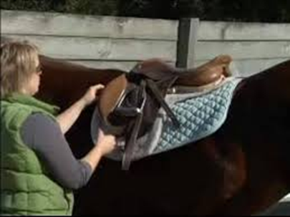
Saddling a Horse
Once the horse is groomed, it is time to saddle.
There are two basic types of saddles, English and Western.
The type of saddle you use will depend upon the type of riding or events you plan to do.
Each saddle is unique and care should be taken to ensure that the saddle fits the horse properly and that all equipment is safe and clean.
A burr under the saddle pad can make for a very unpleasant ride!
Watch How to Saddle a Horse (Western) and Saddle a Horse (English)

Slide 12
Parts of the Saddle

Slide 13
Bridling a Horse
The bridle is the last piece of equipment to go on the horse before riding.
Care should be taken to ensure proper fit of the bit and bridle on the horse.
When unsure which bit to use, it is best to start with snaffle bit (broken mouth piece, round or D ring, with no curb chain).
Watch How to Bridle a Horse (Western) and Bridle a Horse (English)

Slide 14
Parts of the Bridle

Slide 15
Horse Equipment Research Project
Pick a type of horse you would like to own (English or Western).
Make a list of the grooming, leading, and saddling equipment you would need.
Estimate what you believe each item will cost.
Then look on websites to determine the actual cost of each item.
Feel free to look for used items to help with your budget.
How far off was your estimate compared to the actual cost? Prepare a list with pictures, prices, and total expenditures.

Slide 16
Questions for Review
Why is it important that equipment be in good condition when working with horses?
What are halters typically made from?
What side do we halter, bridle, and saddle from primarily?
What are the two riding styles we discussed?

Slide 17
Questions for Review
Why is it important that equipment be in good condition when working with horses? Horses are flight animals, so we need to be prepared if they become frightened.
What are halters typically made from? Nylon or leather, sometimes rope.
What side do we halter, bridle, and saddle from primarily? Left side
What are the two riding styles we discussed? English and Western

Slide 18
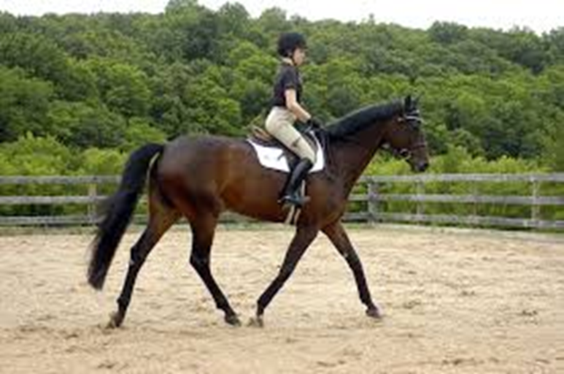
Summary
Proper equipment is an essential part of horse ownership.
Determining the cost of equipment should help you realize the commitment of horse ownership.

Slide 19
References
Haltering a horse: https://www.youtube.com/watch?v=0CABQdO1XAg
Grooming Tips for Show and Performance Horses: https://www.youtube.com/watch?v=rSff3XQpz8Q
How to Saddle a Horse (Western): https://www.youtube.com/watch?v=dshzBh6roZ4
How to Saddle a Horse (English): https://www.youtube.com/watch?v=4-p2Ya0nt54
How to Bridle a Horse (Western): https://www.youtube.com/watch?v=b1kUzNw1iUg
How to Bridle a Horse (English): https://www.youtube.com/watch?v=fQYSQk0atsc
Grooming Your Horse: http://www.thehorse.com/articles/10028/grooming-your-horse-deep-down-clean
State Line Tack: http://www.statelinetack.com/
Chicks Discount Saddlery: http://www.chicksaddlery.com/
Tack Trader.com: http://www.tacktrader.com/

Slide 20
Texas College and Career Readiness Standards
English Language Arts: II. Reading, A; III. Speaking, A, 1-2; B 1-3; V. Research, B, 1, a-b
Social Studies: IV: Analysis, Synthesis, and Evaluation of Information, A 1, 3, 5, 6; V. Effective Communication, A. 1-2
Mathematics: I. Number Operations, B, 1, C, 1; VIII. Problem Solving and Reasoning, A, 1-4, C,1-2; X. Connections, B, 1-3.

