Slide 1
Select Facilities for Horses
  Equine Science

Slide 3
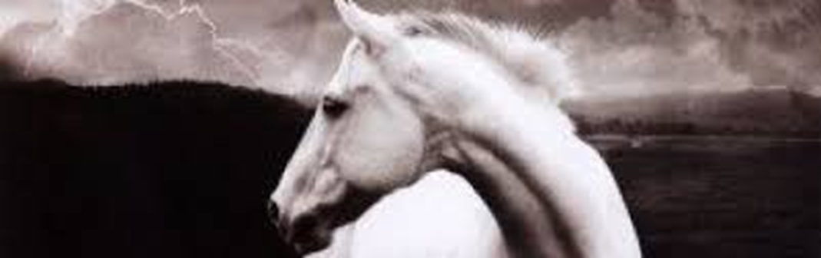
A big storm rolls in.
It is raining, thundering and lightning.
Is your horse safe?
  When we consider facilities for horses, we must think about safety first.

Slide 4
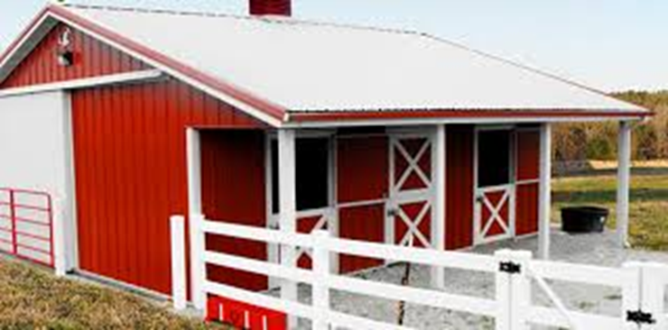
  Horses need shelter at times, but are primarily a grazing animal.
  Turn out time is also very important.
  Just because we picture the cute little barn with our horse safe inside, doesn’t mean he needs to live there permanently.

Slide 5
Objectives
  Today we will:
    Describe the physical needs and characteristics of horses related to facilities
    Describe housing and fencing for horses
    Design a horse facility

Slide 6
Needs of Horses Related to Facilities
  Remember when we discussed horses as flight animals?
  This means that when they are frightened, their instinct is to flee the situation
  Because of this, we must carefully design housing and fencing that is safe in the event the horse becomes frightened.
  They are also grazing animals. This means that their digestive system is well suited to constant grazing situations.
  If we plan to stall them, we must provide plenty of hay and roughage.

Slide 7
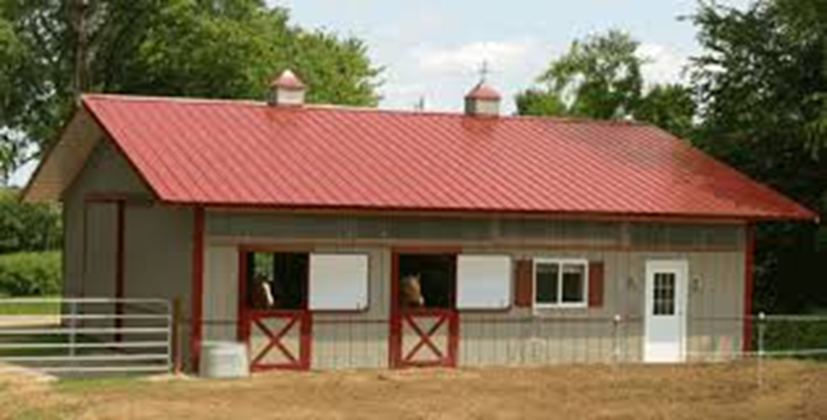
Horse Housing and Fencing

Slide 8
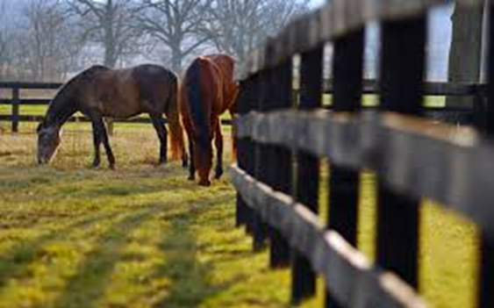
Housing for Horses—Simple to Fancy
  When we think about what horse needs, a fancy barn may come to mind.
  Actually, horses should only be stalled in a barn when necessary. Typically this means when they are preparing for race or competition or when ill.
  Horses are made to graze—this means that a good pasture, with a shelter and safe fencing is certainly adequate for most horses.

Slide 9
Stalling a Horse
  If we plan to stall the horse, it is important to be aware of the following:
    Space—the horse needs a minimum of 12x12 feet of stall space
    Height—the height of the barn should be a minimum of 9 feet tall, taller if we have bigger horses
    Safe—walls of the stall should be free from sharp objects, solid so no legs can get stuck, and have plenty of ventilation
    Clean – the stalls should have fresh bedding (such as pine shavings) that are cleaned at least once per day.
    Turn out time—all horses should have access to turn out time for exercise and health.

Slide 10
Turning Out a Horse
  If we plan to turn out the horse, it is important to be aware of the following:
    Space—the pasture needs to be large enough that the horse can walk around freely
    Safe and Clean—the pasture should be free from debris, holes, and the fencing material should be horse ready. Wood, pipe, vinyl, slick wire, and horse wire are appropriate fencing materials. Use hot wire/tape with caution; avoid fencing with barbed wire
    Shelter– pasture areas should have a shelter so that horses can escape rain, wind, sun, or other inclement weather. A shed with three sides and a roof is typically adequate for most climates

Slide 11
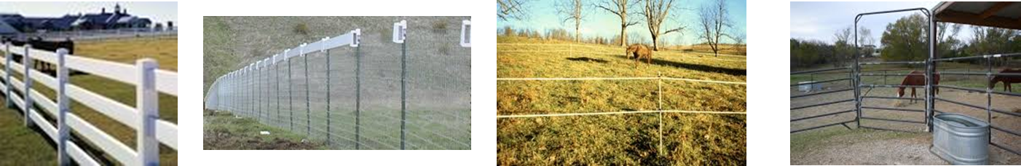
Horse Facilities Project
  Using the resources provided, the internet or other resources, design a facility for horses. Be sure to include the fencing for turn out, barns, and sheds. Be detailed in your descriptions including the materials you choose to use as well as dimensions, etc. Here are some examples you might consider:

Slide 12
Questions for Review
  Why are horses prone to flee when afraid?
  Why do horses need shelter?
  What is the primary factor considered in developing horse facilities?
  Which type of fencing should we avoid?

Slide 13
Questions for Review
  Why are horses prone to flee when afraid?
  They are flight animals that run from their prey or when frightened.
  Why do horses need shelter?
  Horses need shelter from storms, sun, etc.
  What is the primary factor considered in developing horse facilities?
  Safety
  Which type of fencing should we avoid?
  Barbed Wire

Slide 14
Summary
  Safety is the primary consideration when developing any horse facility
  We have already learned that there is no such thing as a “cheap” horse; protecting our investment through the facilities we use is important.
  Whether we have a simple or fancy facility, the basic principles for safety, cleanliness, and space remain the same.

Slide 15
References and Other Resources
  Penn State Extension Horse Facility Design and Construction: http://extension.psu.edu/animals/equine/horse-facilities
  Penn State Extension Horse Stables: http://extension.psu.edu/animals/equine/horse-facilities/horse-stables
  Planning Horse Facilities: http://www.horsekeeping.com/horse_facilities/planning_horse_facilities.htm
  Our First Horse: Facilities (by Purdue University): https://www.youtube.com/watch?v=MzLdEde6Ryc

Slide 16
Texas College and Career Readiness Standards
  English Language Arts: II. Reading, B, 1-3.

