Slide 1
Sentencing and Punishment
  Court Systems and Practices

Slide 3



Sentencing
  When people are found guilty of the crime they are accused of, the next phase of the criminal justice system is sentencing
  There are different types of sentencing options which range from fines, probation, community service, and incarceration
  Sentencing may be done by a jury or a judge

Slide 4

When Sentencing Occurs
  Sentencing may occur right away or after the judge has had a presentence report
  A presentence report is an investigation that may be done by a probation officer between the conviction and sentencing date of a defendant

Slide 5

When Sentencing Occurs
  A presentence report includes
    The circumstances of the offense
    The defendant’s personal history and criminal record
    A victim impact statement

Slide 6

Presentence Report
  It is the duty of a good defense attorney to make sure the probation officer hears about positive aspects of the defendant

Slide 7
Presentence Report
  The probation officer might meet with the defendant to discuss the defendant’s
    Presentence report
    Version of the criminal act
    Reason for the crime
    Prior criminal record
    Personal and family history
    Education and employment history
    Health, and potential alcohol and drug abuse
    Financial status
    Military record

Slide 8
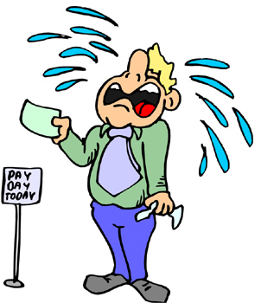
Presentence Report
  Defendants should be prepared to answer the probation officer’s questions in the most favorable light possible and show remorse for their actions
  Defendants usually have access to the report but not always to the recommendations made in the report

Slide 9
Presentence Report
A defendant’s attorney can do the following during a presentence report to help the case:
  Research alternate sentences to suggest to the probation officer
  Assist a defendant with finding a job or enrolling in a drug rehab program in order to improve his or her profile
  Meet with the probation officer to present helpful information
  Prepare a written statement explaining why a defendant should receive a light sentence
  Have a private presentence report done for a hefty fee

Slide 10

Sentencing Hearing
  At the sentencing hearing, defendants can have witnesses testify to their good character and rehabilitative efforts
  Defendants have a right of allocution where they speak on their own behalf before the judge

Slide 11
Sentencing Hearing
  No one can speak on a defendant’s behalf, but defendants can work with their attorneys beforehand to prepare a statement
  The punishment has to be within the range that the law has specified for the category of the crime
  Defendants may get credit for time served if they were incarcerated before their trial
  The sentence may take effect right away or at a future time; this is determined by the court

Slide 12
Probation
  Defendants might be eligible for probation
  Probation is an alternative punishment to incarceration where defendants remain free while meeting certain requirements determined by the judge
  When assigning defendants probation, the judge will consider
    A defendant’s criminal record
    The seriousness and violence of the crime
    Whether a defendant is a danger to society
    Whether a defendant is willing to make restitution to the victim
    What culpability the victim had in the crime

Slide 13
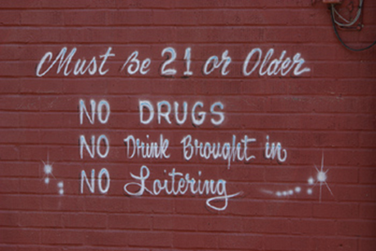
Probation
  Defendants are responsible for reporting to a probation officer
  If defendants violate their terms of probation as reported by the probation officer to the court, they will then be incarcerated

Slide 14

Probation
  Before this occurs, defendants may have a probation revocation hearing where the defense and prosecution will show evidence as to why or why not the defendants should receive the punishment determined by the judge
  Defendants are entitled to a written notification of the time, place, and reason for the hearing
  The burden of proof is less and the judge does not have to follow strict rules of evidence during the hearing

Slide 15
Probation
  If the violation of probation is a defendant being charged with a new crime, the probation revocation hearing may occur after the trial for that crime
  Defendants may be able to take a plea deal that covers both the new offense and the probation violation

Slide 16

Alternative Sentencing
Judges can also hand out various types of sentencing such as community service, fines, retribution, and other innovative types of punishment

Slide 17

Appeals
If the defendants do not agree with the conviction or the sentence, they can file an appeal to higher court for a new verdict or a new trial
These appeals are usually filed by the defense attorney since the defendants must begin serving their sentence

Slide 18
Resources
1413310532, The Criminal Law Handbook: Know Your Rights, Survive the System (11th Edition) by Paul Bergman, J.D. and Sara J. Berman, J.D.

