Slide 1
Sheet Metal Development

Slide 3
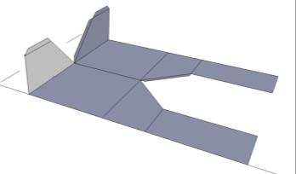
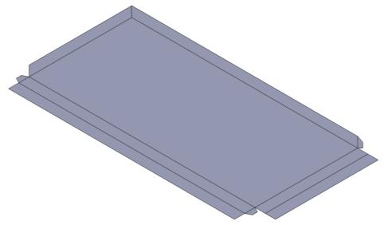
Fold
  The location for a bend in the metal -

Slide 4
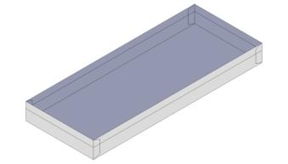
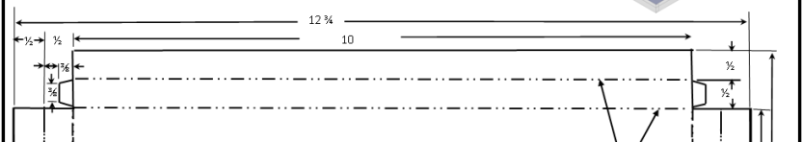
Hem
  A fold along the edge of the metal to strengthen the edge and to give it smooth edges -

Slide 5
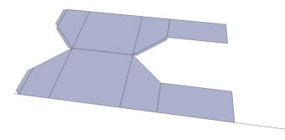
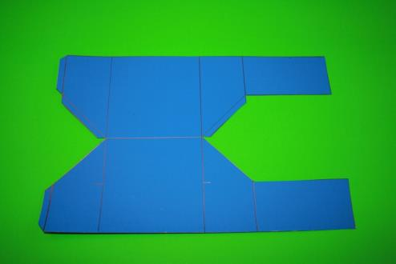
Layout
  Transferring the size and shape of the object to material to be cut and shaped-

Slide 6
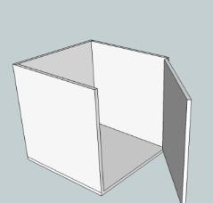
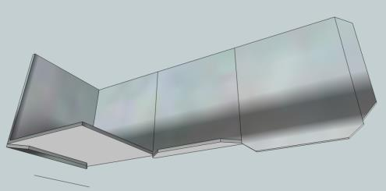
Reverse Engineering
  Taking a product and looking at how it is produced and then remaking it -

Slide 7
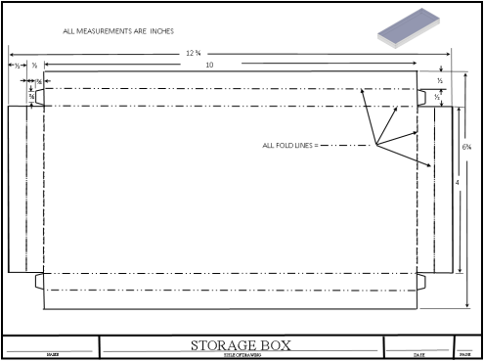
Sheet Metal Development
  Shows a sheet metal project or product in a flat view -

Slide 8
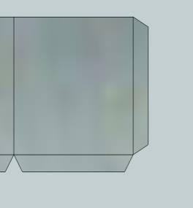
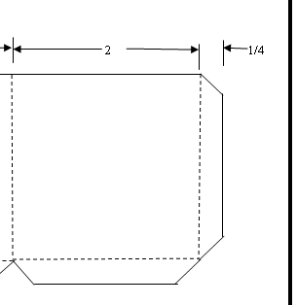
Tab
  A small flat strip used for fastening

Slide 9
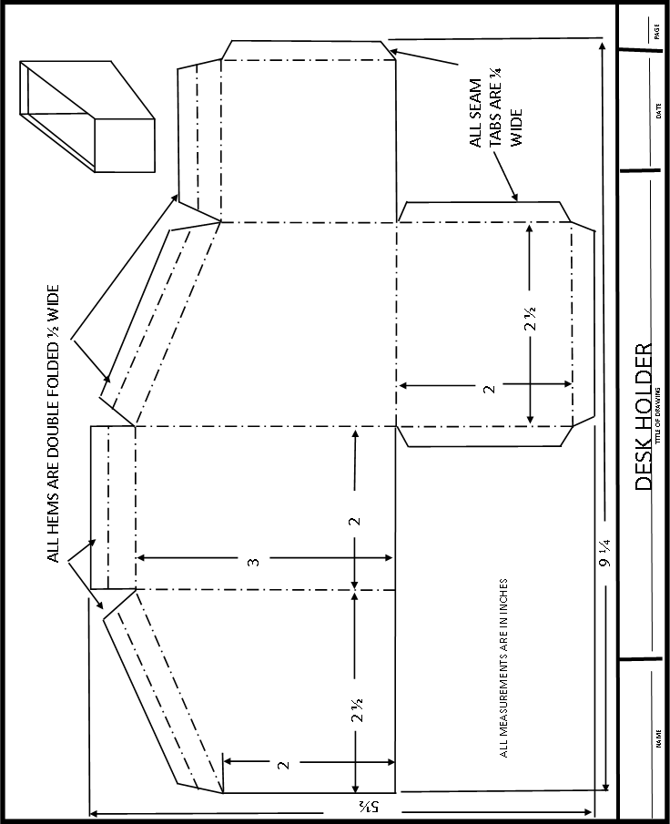

Slide 10
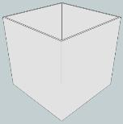
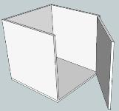
Reverse Engineering of a Box
  Lay out a small box
  Unfold the box

Slide 11
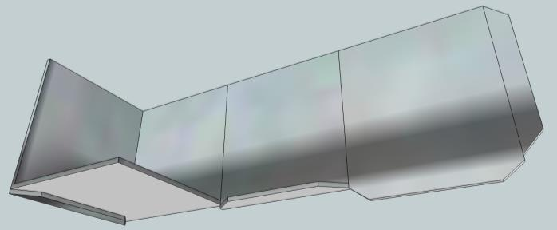
Box Being Unfolded
Tabs folded
Tabs to be folded

Slide 12
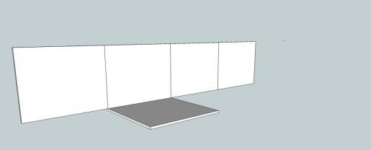

Unfolding the Box

Slide 13

Unfolding the Box
  These are the sides and bottom of the box that has been unfolded.
  The box would have to be taped together on the edges to assemble it.

Slide 14
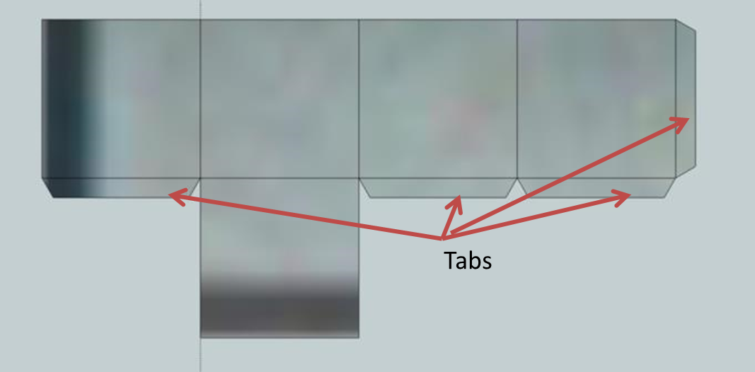
Development
  The box that will be produced will have tabs on some edges so that the box can be glued together instead of being taped.

Slide 15
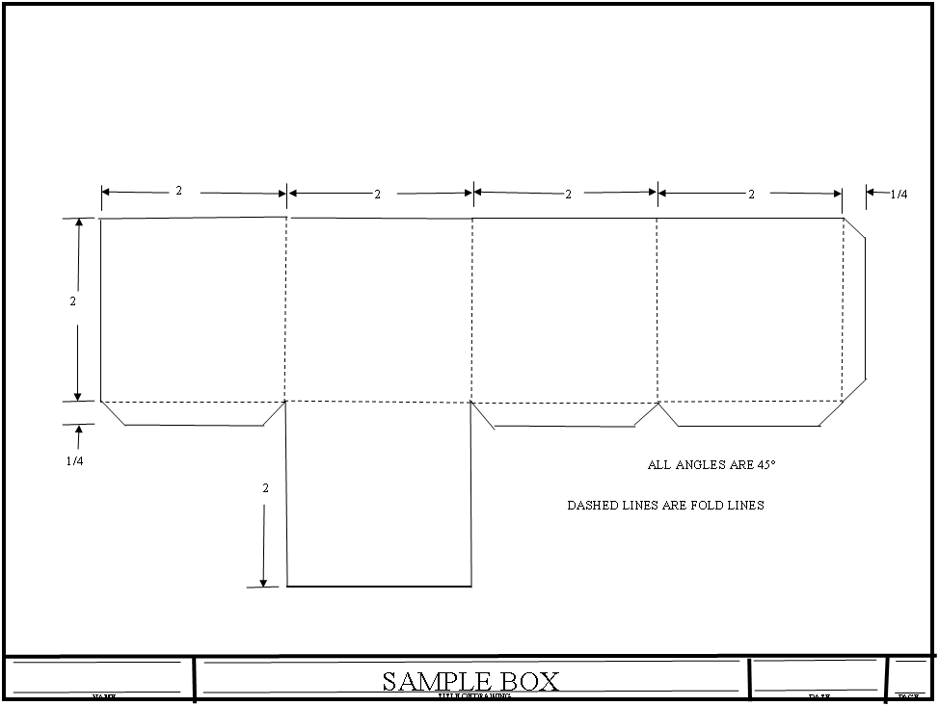
Development Drawing of the Box

Slide 16
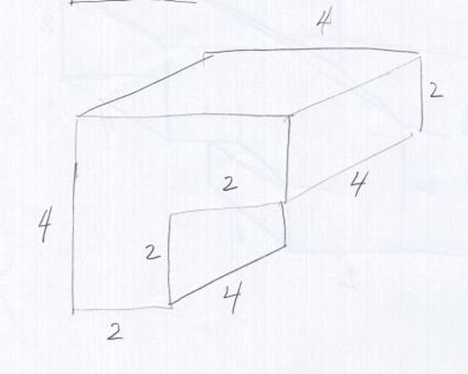
Problem
  Your boss comes in and asks you to draw a sheet metal development for a 90 degree elbow. He gives you a sketch to use as a guide.

Slide 17
Design Questions
  What is the overall size of the elbow?
    4 in X 4 in X 4 in long
  What is the duct size?
    2 in X 4 in
  What size piece of metal will have to be used to make the elbow?
    8 in X 12 ¼ in

Slide 18
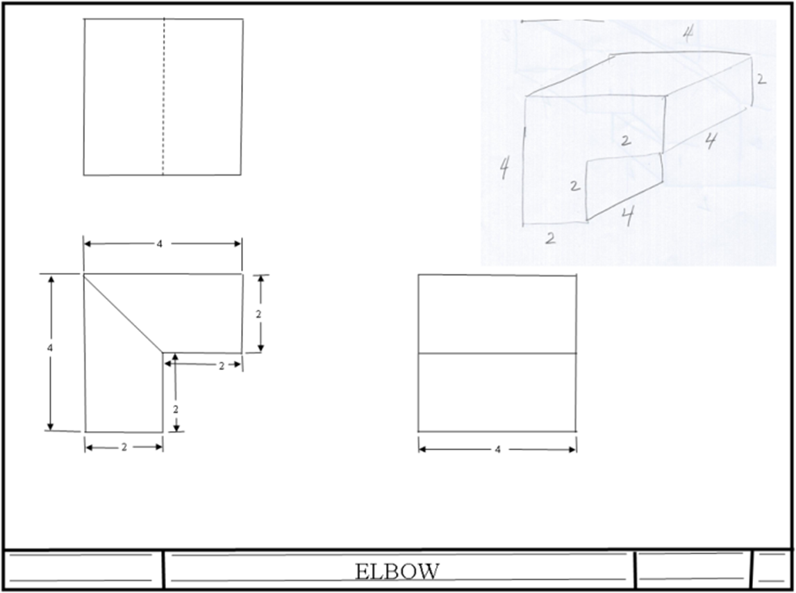
Making a Three View Drawing

Slide 19
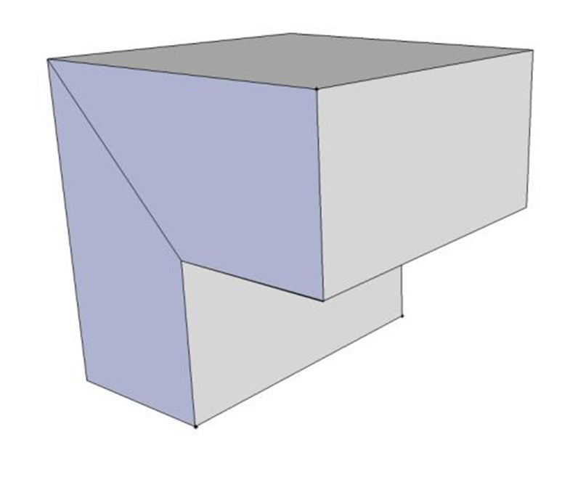
Pictorial of the Elbow

Slide 20
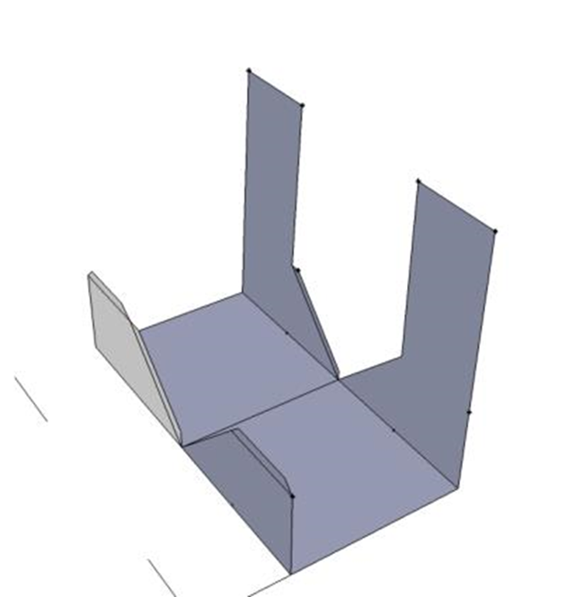
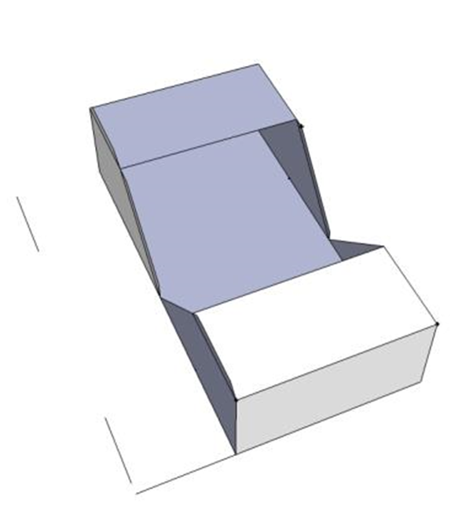
Unfolding of Elbow

Slide 21
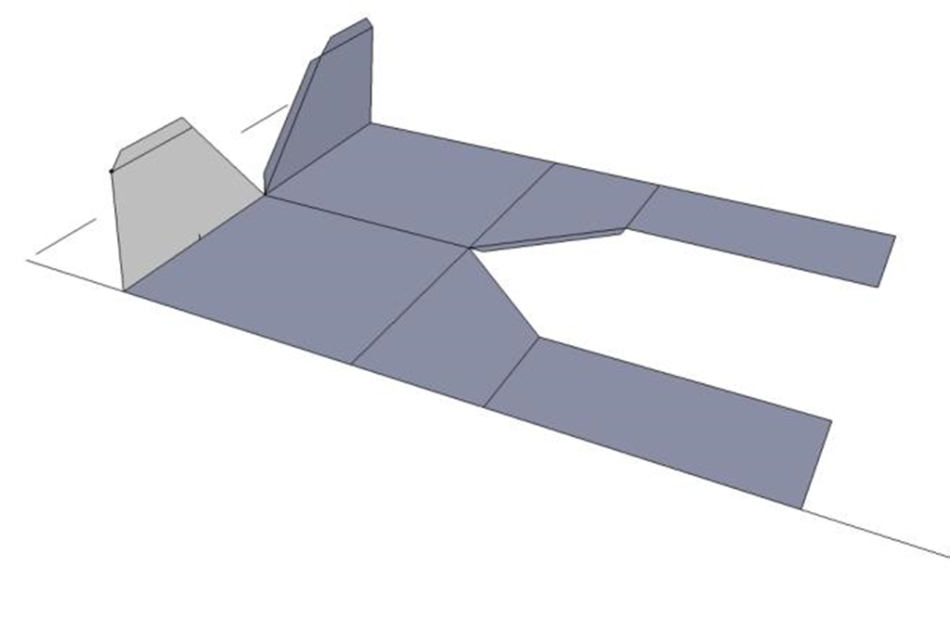
Unfolding of Elbow

Slide 22

Unfolding of Elbow

Slide 23
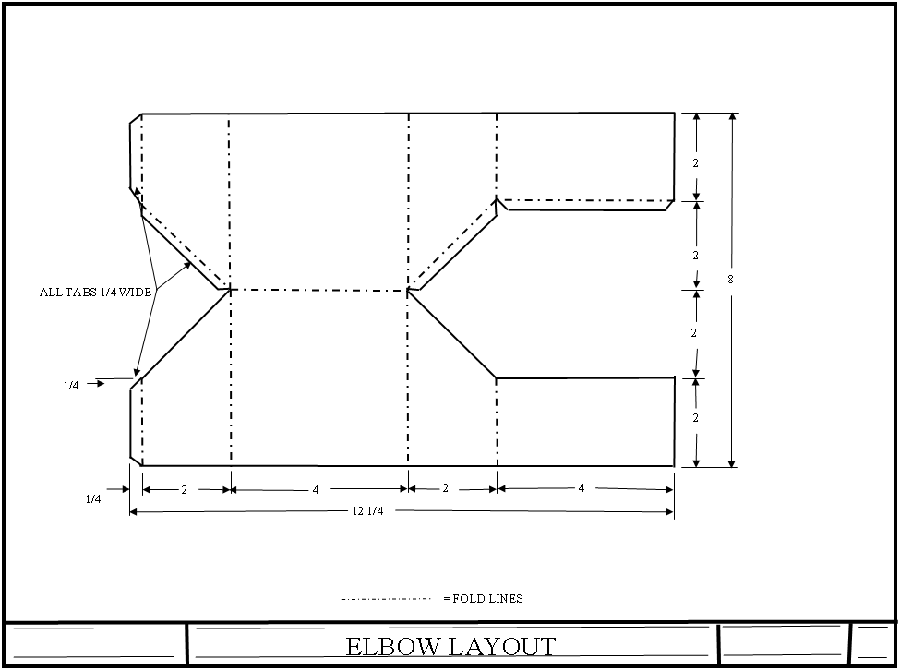
Elbow Layout / Development Plan

Slide 24
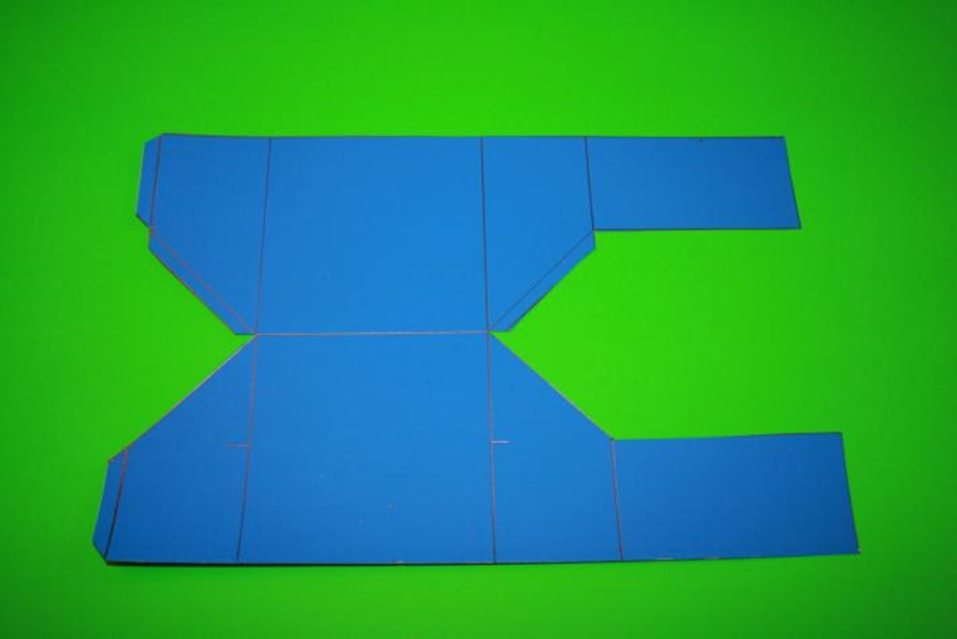
Elbow Ready for Development

Slide 25
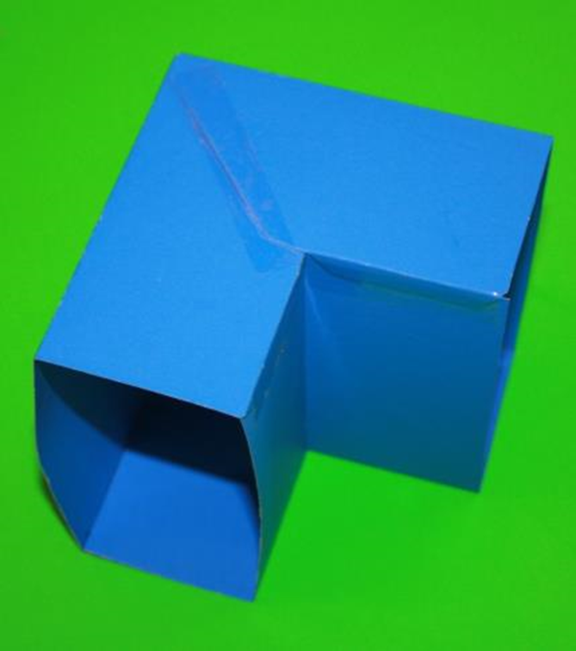
Elbow Assembled

Slide 26
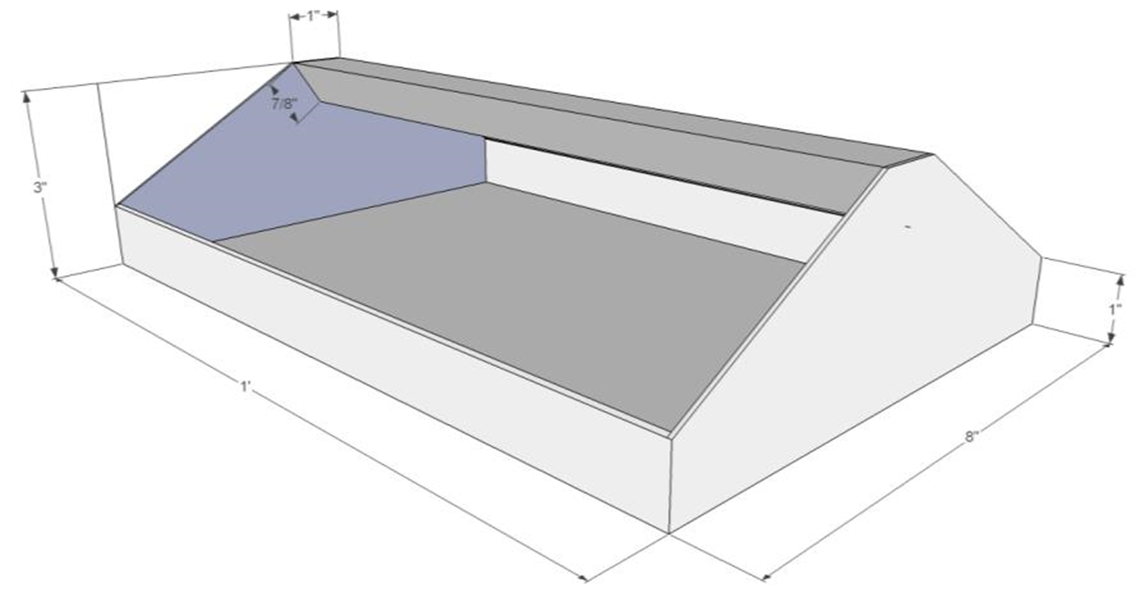
Tool Tray

Slide 27
Assignment
  You will reverse engineer the tool tray.
  The tray will be made out of four pieces of 18 to 20 gauge metal material.
  The bottom and sides will be from one piece.
  There will be two ends.
  There will be a handle.

Slide 28
Assignment
  All helms and tabs will be ½ inch.
  The handle will be made in a V shape with helms on the inside and tabs bent outwards.
  Bottom and sides will have helms and tabs.
  Ends will be flat.
  Pop rivets or spot welds will be used to connect all pieces together.

Slide 29
Assignment
  What size will the pieces of sheet metal be to make the tool tray?
  Bottom and sides = 11 in X 13 in
  Ends = 3 in X 8 in
  Handle = 3 in X 13 in

