Slide 1
Skeletal System
Structure and Function

Slide 3
Functions
Support: body structure and shape
Protection: vital organs surrounded
Movement/Anchorage of Muscles
Mineral Storage: calcium & phosphorus
Blood Formation

Slide 4
Bone Composition
Collagen: chief organic constituent (protein)
Inorganic Calcium Salts: Vitamin D essential for absorption

Slide 5
Cells
Osteoblasts: bone building, bone repairing cells in the periosteum
Osteocytes: osteoblast embedded within the bone matrix
Osteoclasts: cells that cause absorption of bone

Slide 6
Periosteum
Dense, fibrous membrane covering bone
Contains blood vessels
Essential for bone cell survival and bone formation

Slide 7
Types of Bones Based on Composition: Compact Bone
Very Dense, Stress Bearing
Haversian Systems
Lamellae: concentric cylinder shaped calcified structure
Lacunae: small lakes containing tissue fluid
Osteocytes: facilitate exchange of calcium between blood and bone
Canaliculi: canals connecting the lacunae together and to the haversian canal which carries nutrients/wastes

Slide 8
Cancellous Bone
Light, Spongy
Low Stress Areas Where Weight of Bone Would Be a Problem
Found at Ends of Long Bones, Ribs, Sternum, Hips, Vertebrae, Cranium
No Haversian Systems
Web-Like Arrangement

Slide 9
Classification of Bones According to Shape
Long Bones
Short Bones
Flat Bones
Irregular Bones
Sesamoid Bones

Slide 10
Long Bones
Extremities
Femur, tibia, fibula, humerus, ulna, radius, clavicle
Levers
Epiphysis: at the ends; covered with hyaline cartilage for articulating bones; cancellous bone
Diaphysis: shaft, covered with periosteum for bone growth, repair, nutrition; medullary canal with yellow and red marrow; endosteum lining; compact bone

Slide 11
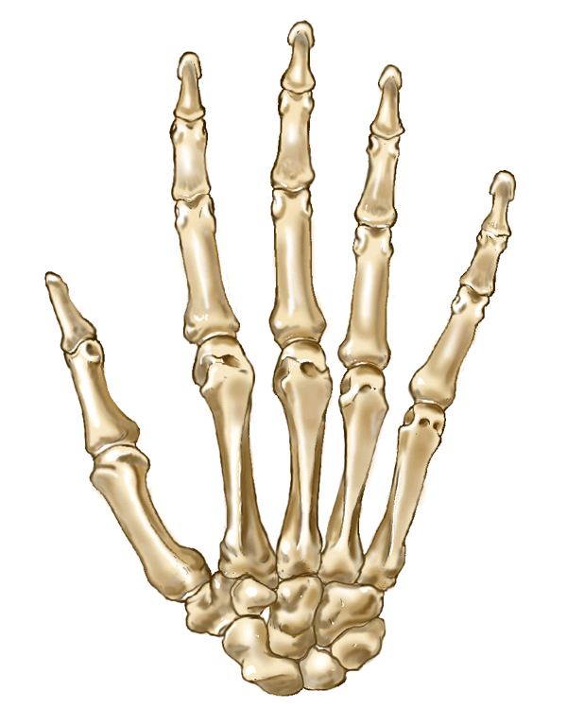
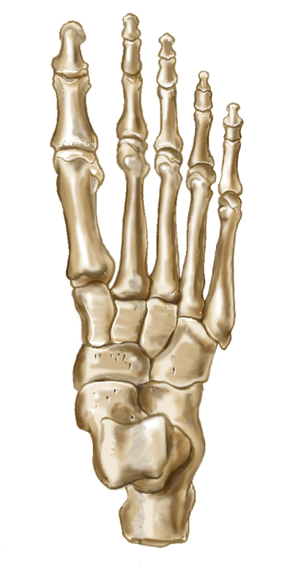
Short Bones
Cube-shaped
Allows flexible movement
Cancellous bone covered by compact bone
Carpals, tarsals, metacarpals, metatarsals, phalanges

Slide 12
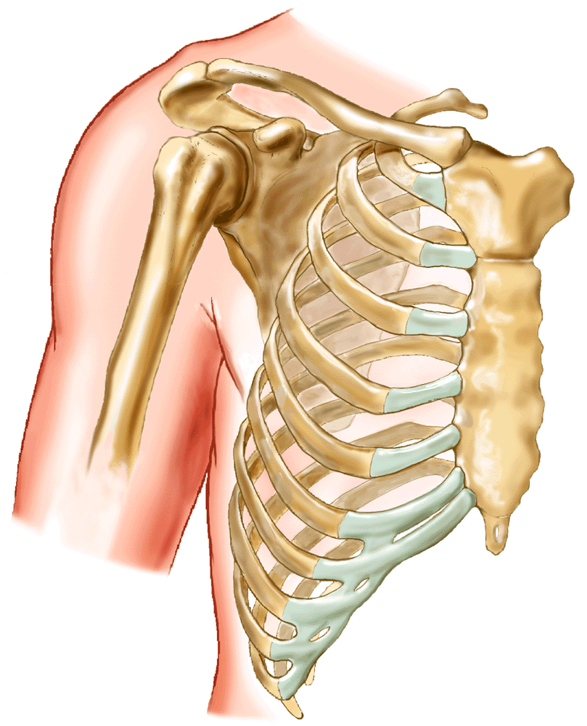
Flat Bones
Flat Plates
Protect Vital Organs
Provide Broad Surface Area for Attachment of Muscles
Cranial Bones, Facial Bones, Scapula, Sternum

Slide 13
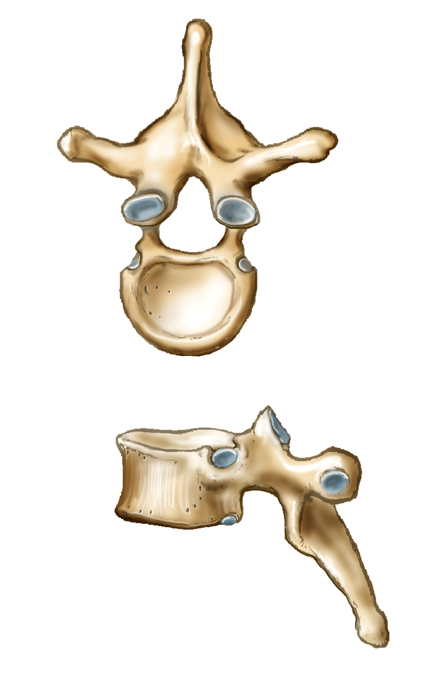
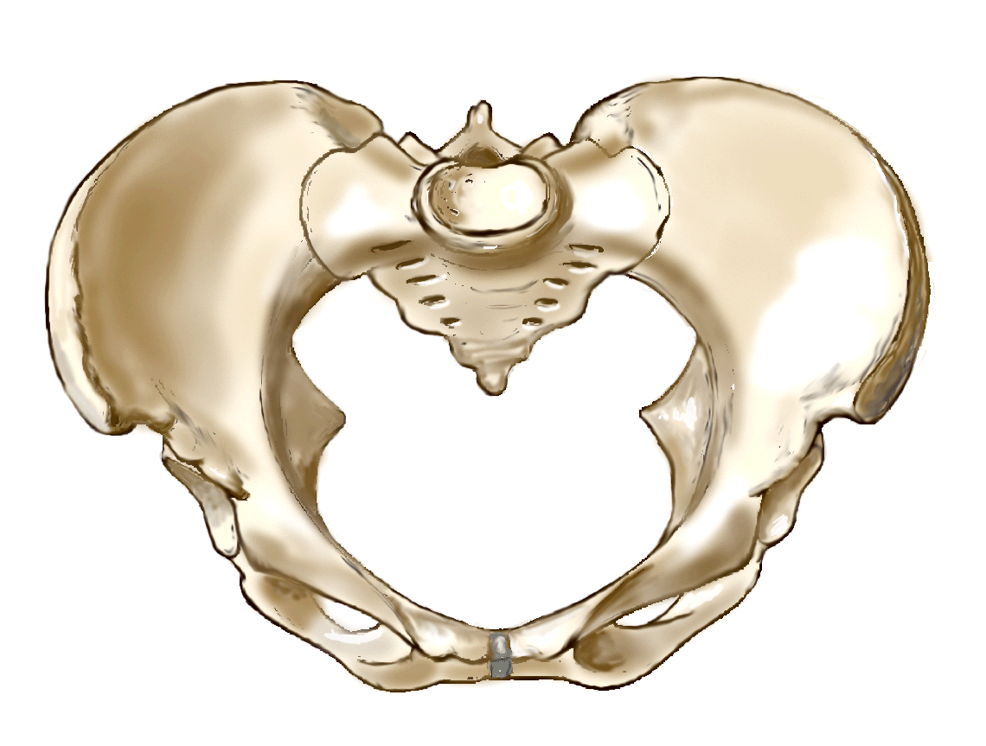
Irregular Bones
Peculiarly Shaped to Provide Support and Protection with Flexibility
Vertebrae, Ribs, Ear, Hip, Hyoid

Slide 14
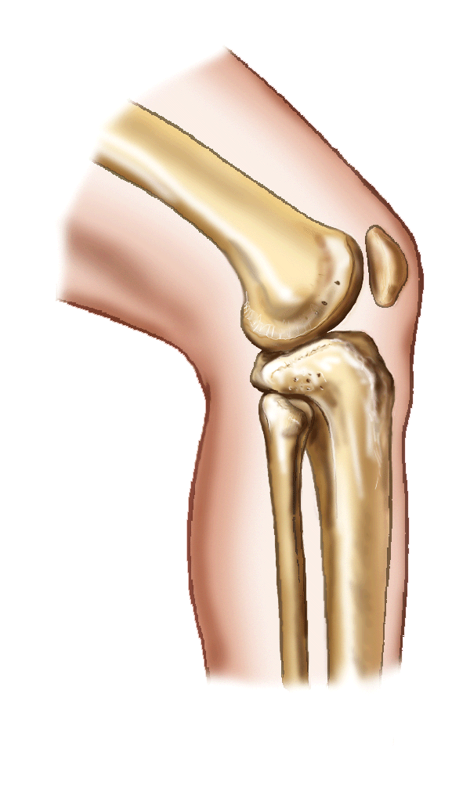
Sesamoid Bones
Extra Bones Found in Certain Tendons (i.e., patella)

Slide 15
Bone Formation
Initially collagen fibers secreted by fibroblasts
Cartilage deposited between the fibers
Skeleton fully formed by 2nd month of fetal development (all cartilage)
Ossification begins after 8th week of fetal development
Childhood and adolescence: ossification exceeds bone loss
Early adulthood through middle age: ossification equals bone loss
After age 35: bone loss exceeds ossification

Slide 16
Skull Bone Formation
Begins as fibrous membrane
Ossification center in the middle of the membrane
Ossification begins in the middle and radiates out
Ossification not complete at birth
Fontanels (soft spots): molding of head during birth and allow for brain growth

Slide 17
Formation of Other Bones
Begin as hyaline cartilage
Short bones: one ossification center in middle and proceeds to periphery
Long bones: three ossification centers (at each end and in the middle); ossification from each end toward the center and from the center towards each end

Slide 18
Bone Growth
Grow in length at the epiphyseal line
Grow in width by addition of bone to the surface
Controlled by anterior pituitary (GH)

Slide 19
Bone Markings - Purpose
Join one bone to another
Provide a surface for attachment of muscles
Create an opening for passage of blood vessels and nerves
Use as landmarks

Slide 20
Bone Markings
Process: bony prominence or projection
Condyle: a rounded knuckle-like prominence usually at a point of articulation
Epicondyle: small projection
Head: rounded articulating process at the end of a bone
Spine: a sharp, slender projection
Tubercle: a small rounded process
Tuberosity: a large rounded process

Slide 21
Bone Markings
Trochanter: a large process for muscle attachment
Fossa: a depression or a hollow
Foramen: a hole
Crest: a sharp ridge
Line: a less prominent ridge of a bone than a crest
Meatus: a tube-like passage
Sinus/antrum: a cavity within a bone

Slide 22
Bone Markings
Depression: a hollow-region or opening
Fissure: narrow, slit-like opening
Sulcus: a groove
Facet: a small area on a bone

Slide 23
Bone Marrow - Yellow
Medullary Cavity of Long Bones
Fat Storage

Slide 24
Bone Marrow - Red
Hematopoietic Tissue
In cancellous bone in children
In adults: cancellous bone of vertebrae, hips, sternum, ribs, cranial bones, proximal ends of femur and humerus
Forms RBCs, platelets, some WBCs and destroys old RBCs and some foreign materials

Slide 25
Axial Skeleton
Skull (22 Bones)
Ear (12 Bones) & Hyoid
Vertebral Column (26 Bones)

Slide 26
Skull - Cranium
Houses and protects the brain
Frontal: forms forehead and orbits of eyes
Ethmoid: forms roof of nasal cavity
Parietal: right & left; form sides and roof of skull
Temporal: right & left; forms temple, cheek, ear openings

Slide 27
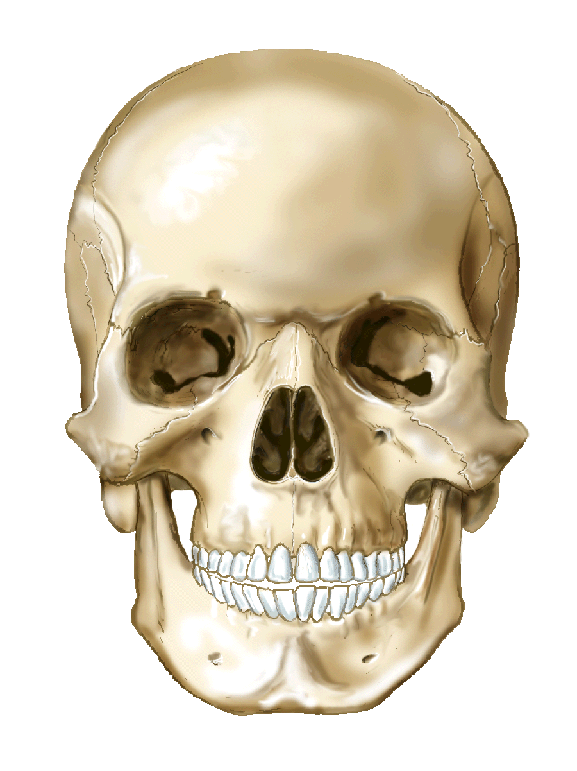
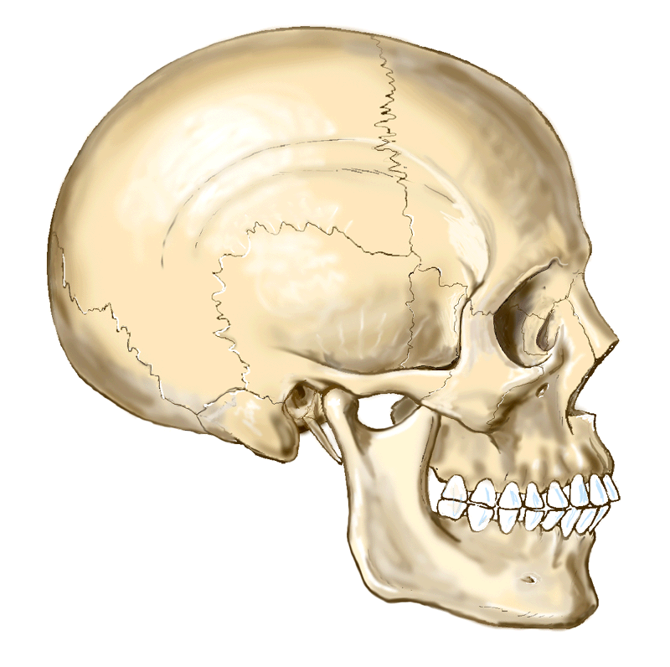
Skull - Cranium
Occipital: back of skull; inferior portion has foramen magnum (opening for spinal cord) and 2 condyles to articulate with atlas
Sphenoid: fills space between orbital plates; depression called sella turcica holds the pituitary gland; bat shaped

Slide 28
Cranial Sutures
Unite the bones of the cranium
As the child grow, irregular bands of connective tissue ossifies and turns into hard bone
Abnormalities: microcephalus (premature fusion), hydrocephalus (delayed fusion → increases intracranial pressure)

Slide 29
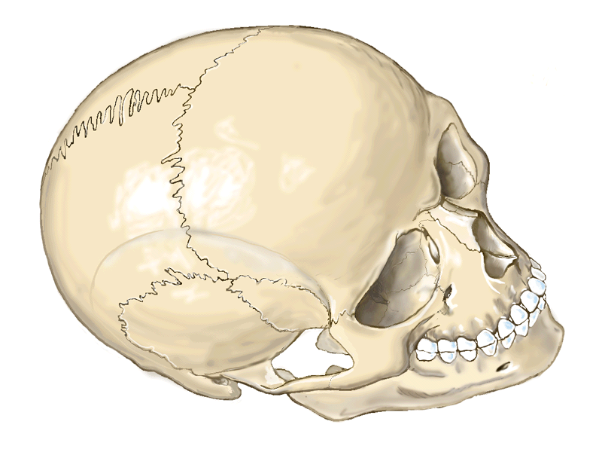
Cranial Sutures
Coronal Suture: between the frontal and parietal bones
Sagittal Suture: between right and left parietal bones
Lambdoidal Suture: between the parietal and occipital bones
Squamous Suture: between temporal and parietal bones

Slide 30
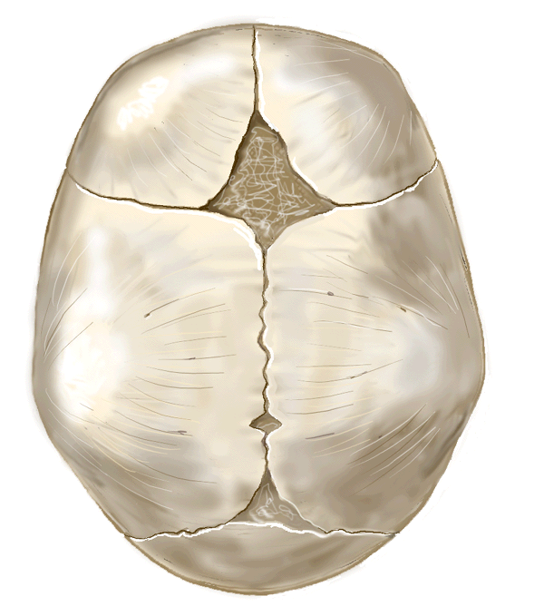
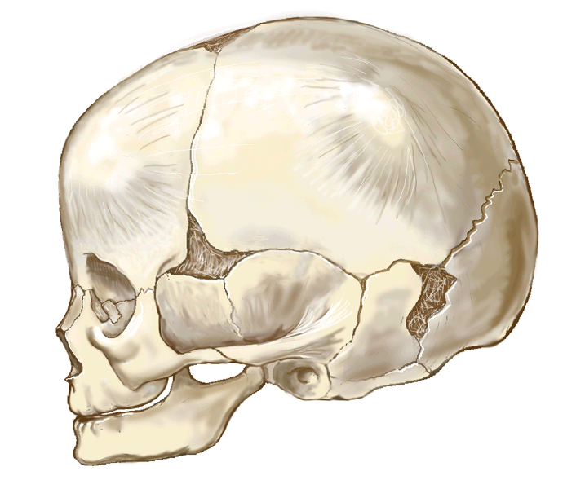
Fontanels
Fusion of the cranial bones is not complete at birth
Space between the bones remains
Anterior (Bregmatic): “soft spot”, closes at 18 months
Posterior (Occipital): triangular, closes at 2 – 3 months
Anteriolateral (Sphenoidal): at 2 temples, closes at 2 – 3 months
Posterolateral (Mastoidal): 2 behind ears, closes at 1 year

Slide 31
Facial Bones
Guard and support eyes, ears, nose, mouth
Nasal bones (2): form bridge of nose
Vomer: forms central nasal septum
Maxillary (2): upper jaw bone; fusion before birth; forms roof of mouth, walls of nose, floor of orbitals
Mandible: lower jaw bone; largest bone of face

Slide 32
Facial Bones
Zygoma (2): cheek bones
Lacrimal (2): small bones form medial wall of each eye socket
Palatine (2): forms back roof of mouth and floor of nose
Inferior turbinate (2): forms curved ledge inside side wall of nose

Slide 33
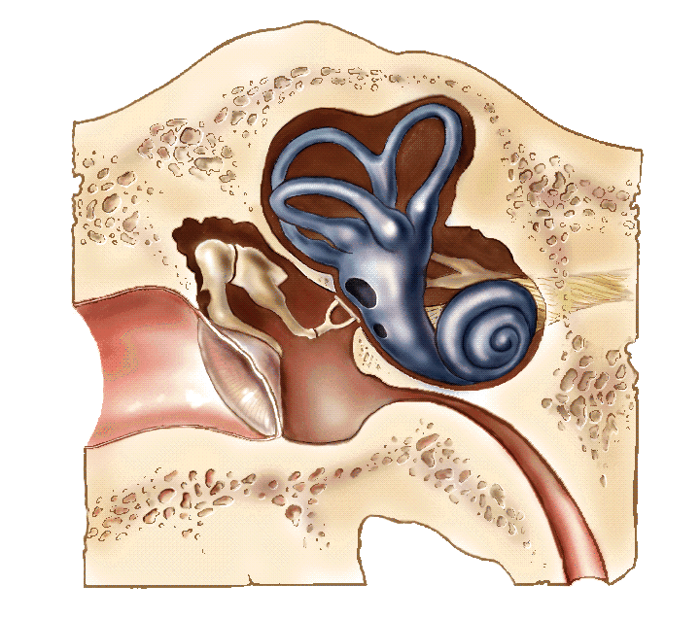
Ear Bones
Malleus (2): the hammer
Incus (2): the anvil
Stapes (2): the stirrup

Slide 34
Hyoid Bone
U-shaped bone
In neck
At base of tongue
Only bone in body that does NOT articulate with another bone

Slide 35
Cranial Sinuses
Cavities within the cranium
Resonance chambers for voice
Decrease weight of skull
Lined with mucous membrane
Frontal sinuses (2): above eyebrows, open into nasal cavity
Ethmoid sinuses (2): between the eyes
Spenoidal sinus (1): posterior to ethmoidal sinus, opens into nasopharynx
Maxillary sinus (2): on either side of the nose, opens into the lateral wall of the nasal cavity

Slide 36
Vertebral Column - Functions
Supports trunk and neck
Protects spinal cord
Multiple joint spaces allow for bending and twisting

Slide 37
Curves
Allow for resilience and spring for walking
Thoracic: present at birth
Sacral: bow back
Cervical: begins at 3 months when infant first begins to lift head
Lumbar: begins when child first walks

Slide 38
Vertebrae
26
Separated by intervertebral disk to cushion joints for movement
Body: thick, disk-shaped anterior portion
Arch: encloses space for spinal cord; 3 processes for muscle attachment (spinous process – dorsally directed, 2 transverse processes)
Articular processes: provide for articulation with other vertebrae (2 superior and 2 inferior)
Pedicles (2): originate from body of vertebrae notched to allow spinal cord nerves to pass
Lamina: posterior wall of vertebrae, weakest point

Slide 39
Vertebral Sections
Cervical - 7 bones
Thoracic – 12 bones
Lumbar – 5 bones
Sacral – 5 fused bones
Coccyx – 3 – 4 fused bones

Slide 40
Thorax
25 bones and cartilage
Sternum, costal cartilage, ribs
Walls covered by skin and muscles
Floor formed by the diaphragm

Slide 41
Functions
Protect and support heart and lungs
Supports bones of pectoral girdle
Plays leading role in respiration
Ribs and sternum aid in RBC formation

Slide 42
Sternum
Breast bone
Sword and handle shaped
Manubrium: handle, notched for 1st 7 costal cartilages, articulates with acromium end of clavicle and 1st rib
Body: blade, notched for 1st 7 costal cartilages
Xiphoid process: tip, attachment site for diaphragm

Slide 43
Costal Cartilage
Hyaline cartilage
Connect ribs to sternum in 1 – 7 and to anterior ribs in 8 - 10

Slide 44
Ribs
12 pairs
Attached posteriorly with vertebrae and anteriorly with costal cartilage
True ribs: 1st seven pairs of ribs
False ribs: 8 – 12 (11 and 12 are floating)

Slide 45
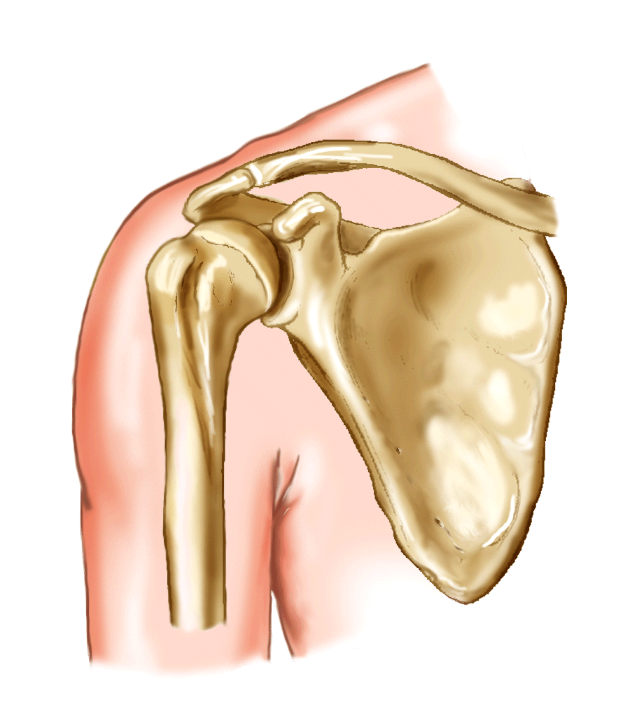
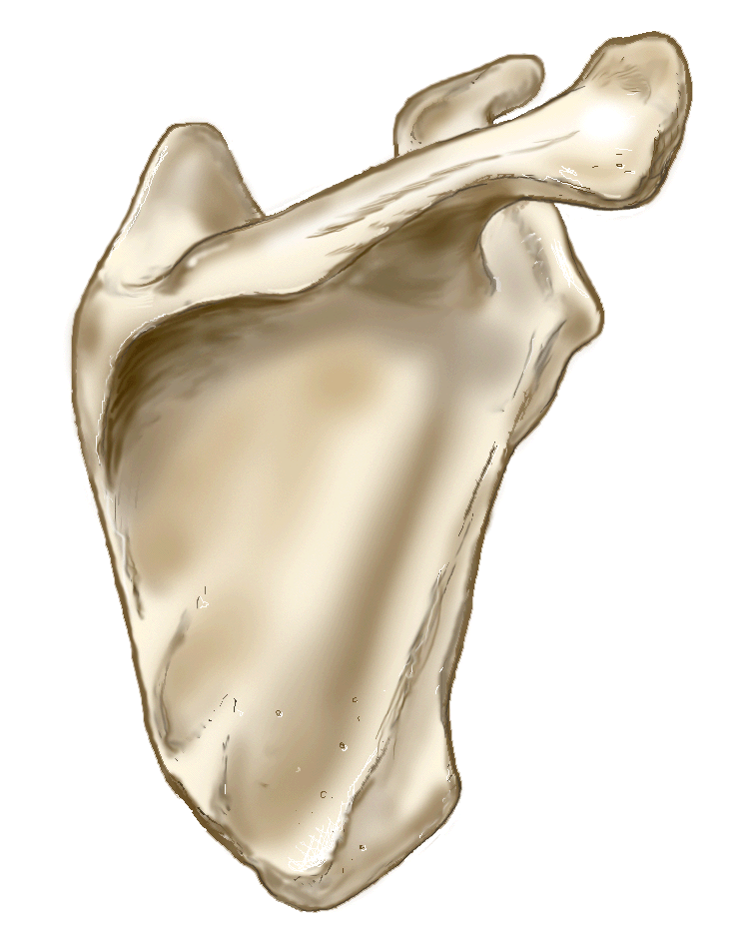
Appendicular Skeleton – 126 Bones
Shoulder Girdle
Clavicles (2): collar bones
Scapulas (2): shoulder blades

Slide 46
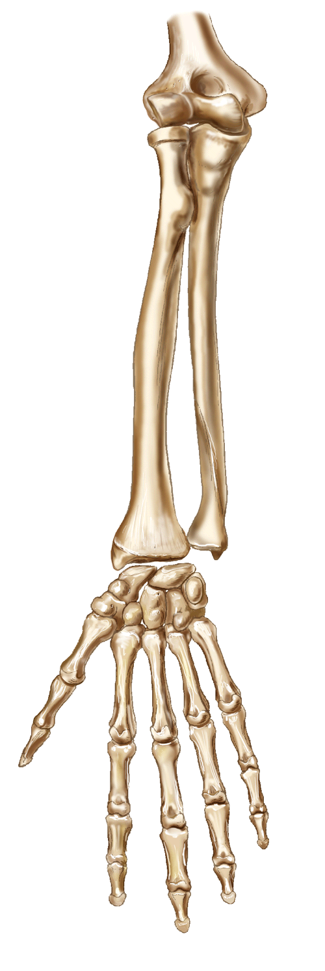
Upper Extremities
Humerus: upper arm
Radius: thumb side of forearm
Ulna: little finger side of forearm
Carpals (8): wrist bones
Metacarpals (5): hand bones
Phalanges (14): finger bones

Slide 47
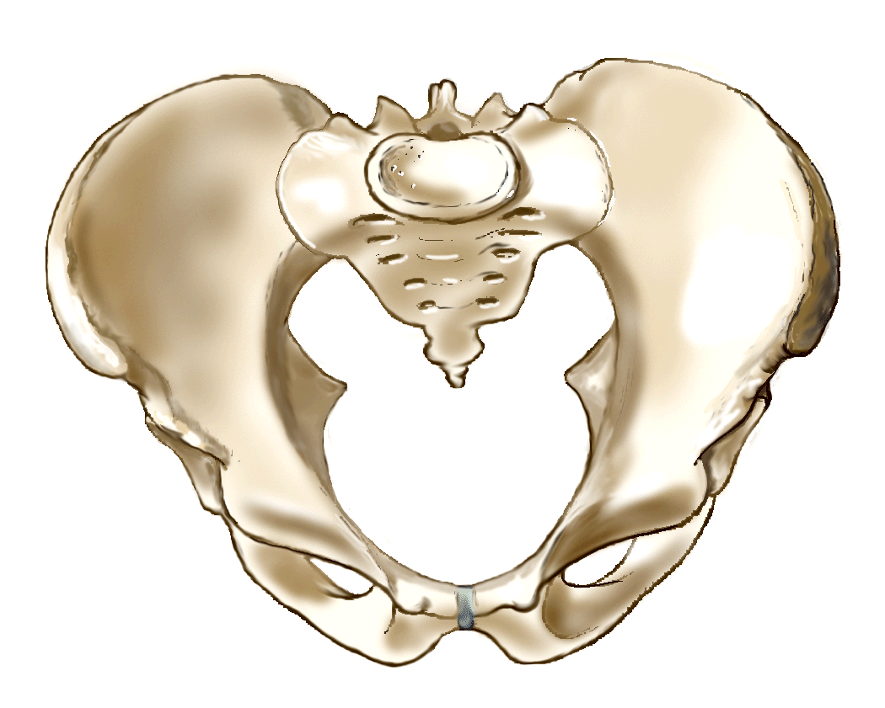
Pelvic Girdle
Os Coxae (2): contains the acetabulum (hip socket)
3 components: ilium, ischium, pubis
Also, contains the saccrum

Slide 48
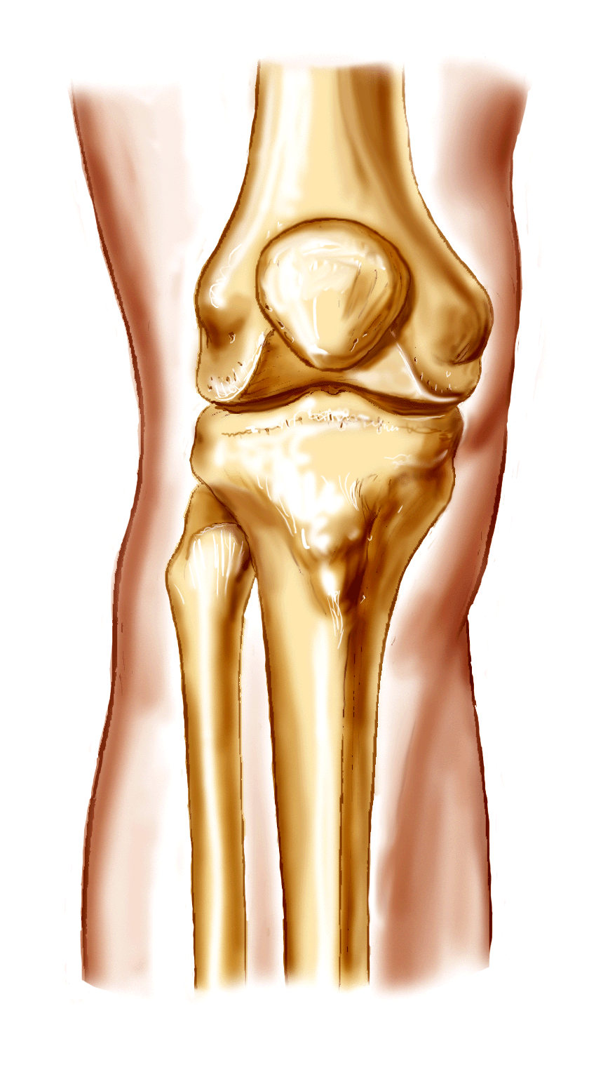
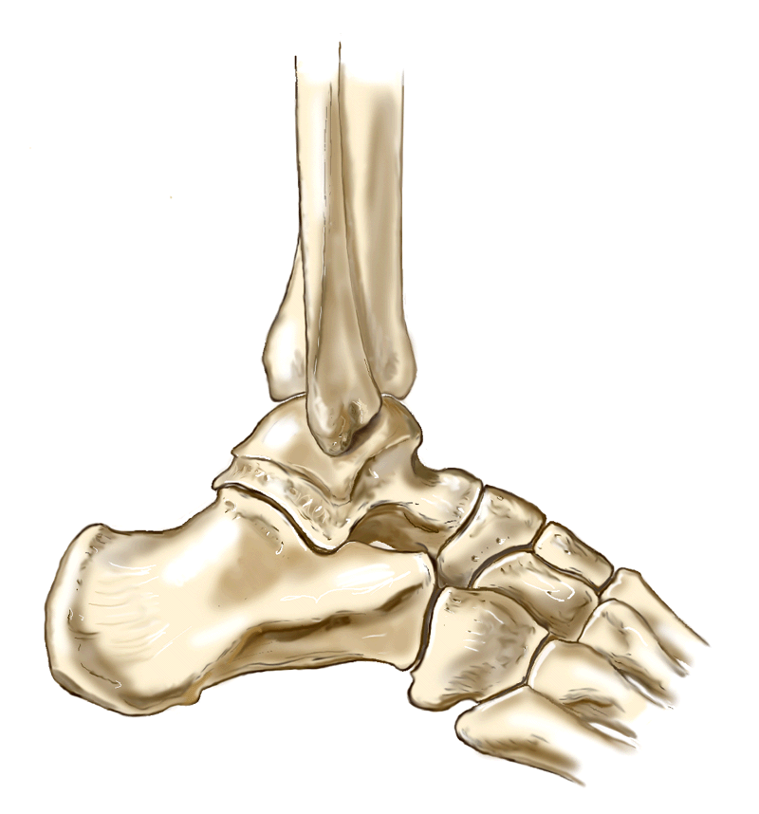
Lower Extremities
Femur: thigh bone
Patella: kneecap
Tibia: shin bone
Fibula: lateral bone of lower leg
Tarsals (7): ankle bones; talus and calcaneus
Metatarsals (5): foot bones
Phalanges (14): toe bones; great toe = halux

Slide 49
Articulations
Synarthrotic: immovable
Amophiarthrotic: limited movement i.e.pubic symphysis, vertebral joints, sacroiliac joint
Diarthrotic: freely movable

Slide 50
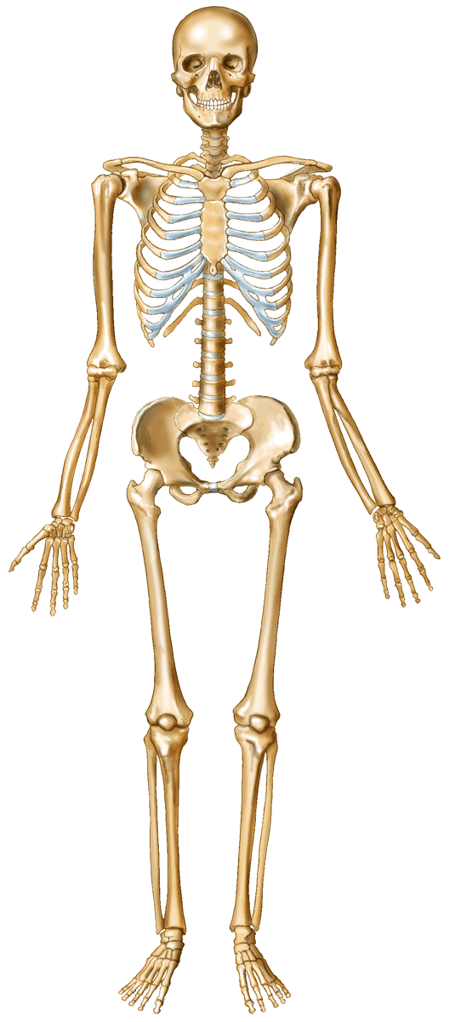
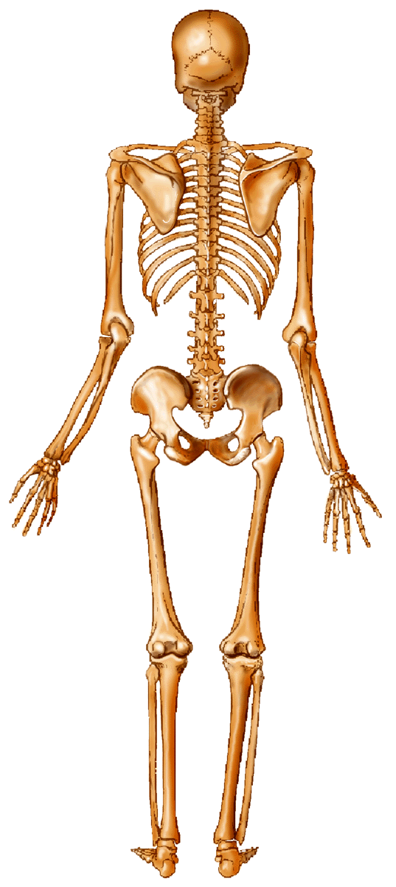
The Framework

