Slide 1
Statistical and Data Analysis of Rare, Threatened, and Endangered Wildlife
  Mathematical Applications in Agriculture c 6 C

Slide 3
Rare? Threatened? Endangered?
  What do they mean…?
  Using the notecards provided and your group create a definition that fits each of the following terms:
    Rare
    Threatened
    Endangered

Slide 4
Rare? Threatened? Endangered?
  What do they mean…?
    Endangered species – a species that has been identified as likely to become extinct
    Rare species – a species that is very uncommon, scarce, or infrequently encountered, usually fewer than 10,000
    Threatened species – a species that is likely to become endangered in the foreseeable future

Slide 5
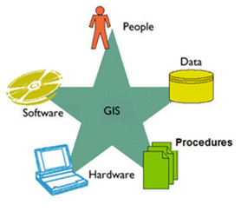
Geographic Information Systems (GIS)
  What is it?
    A system used to store, analyze, and graphically display tabular data that is able to be represented spatially
    GIS Components:
      Hardware: Computer, GPS receivers, etc…
      GIS software
      Data
      GIS Analyst (person to analyze/interpret the data)
      Workflow, Output (map, computation, etc..)

Slide 6
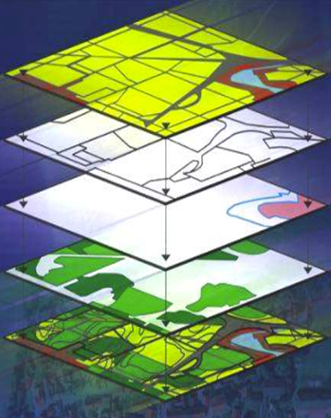
Geographic Information Systems (GIS)
  Data Analysis
    Can arrange layers of spatial data to identify and interpret spatial relationships
    Layer represents a geographic feature
  Relevance to data analysis
    Site location
    Population densities
    Land use patterns
    Sustainability
    Risk management

Slide 7
Using Web-Based GIS to Analyze Species on Texas’ Rare, Threatened, Endangered List
  The website
    http://tpwd.texas.gov/gis/rtest/
  How can I use it?
    Follow along as the teacher models what to do
    Refer to lab instructional materials

