Slide 1
Audio Video Production
  TV/Film Makeup Application

Slide 3
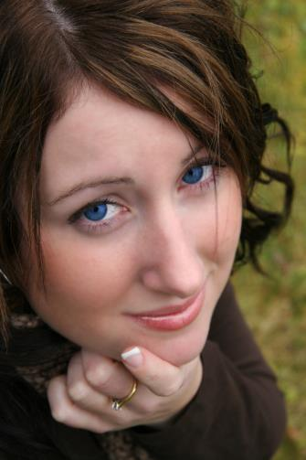
TV/Film Makeup Application
  Terminology
  Materials/supplies
  Makeup categories
  What do I do with this stuff?

Slide 4
Terminology
  Makeup Artist
    An artist who works in the medium of makeup and hair.
  Makeup
    The decorations placed directly on the skin or hair of an actor for cosmetic or artistic effect.
  Foundation
    A flesh-toned cosmetic applied to the face to create an even, uniform color to the complexion, and, sometimes, to change the natural skin tone. Foundation applied to the body is generally referred to as body paint.

Slide 5
Terminology
  Applicator
    Powder puffs or sponges used to transfer makeup from container to talent.
  Brush
    Used to apply, blend, or contour powder product on the talent.

Slide 6
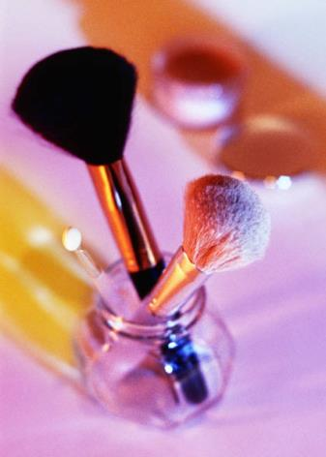
Materials and Supplies
  Light/medium/dark foundations
  Blushes
  Powders
  Lip colors
  Eye shadows
  Mascara
  Brushes
  Makeup sponges
  Cotton swabs
  Tissues
  Makeup remover facial wipes
  Carry case for makeup materials

Slide 7
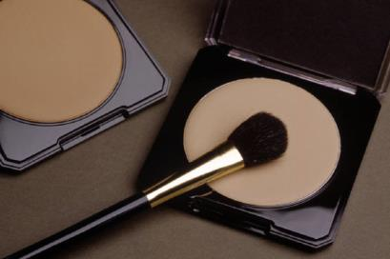
Makeup Categories
  Basic:
    Designed to compensate for undesirable changes in appearance due to lighting and camera technology.
  Corrective:
    Downplaying flaws by contouring and highlighting.

Slide 8
Basic Makeup Application
  Combat shine with POWDER.
  A transparent powder can be used to dull down some of the facial sheen.
  Apply with a soft bristle brush or powder puff.
  Powder can be used on the shoulders and bald heads as well as on the face.

Slide 9
Basic Makeup Application
  Notes prior to applying makeup:
    Apply and check makeup under the same lighting conditions you will be shooting under.
    Use disposable applicators to avoid transferring any skin conditions from one person to another.

Slide 10
Basic Makeup Application
  Notes prior to applying makeup:
    Refrain from dipping applicators into containers to avoid contamination.
    Clean brushes occasionally with hair shampoo or a commercial cleaner.

Slide 11
Basic Makeup Application
  Foundation: Select a shade that matches skin tone as close as possible, unless trying to darken or lighten.
  Apply with a moist foam rubber sponge.
  Tan lines can be filled in as well.

Slide 12
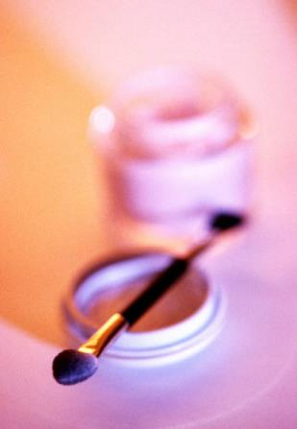
Basic Makeup Application
  Eye shadow: Powder or cake type holds up better under studio lights.
  Add depth and size to the eye by using a darker shade.
  Lighten and ‘open’ heavy-lidded eyes with a dot of ivory or yellow under the eyebrow.

Slide 13
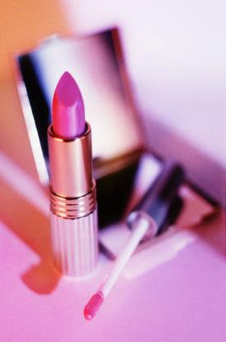
Basic Makeup Application
  Lipstick: Choose a color that will harmonize with skin coloration and wardrobe.
  An applicator, such as a lip brush, should not be used between talents to avoid cross-contamination.
  Blot lips with a tissue to avoid unnatural shine.

Slide 14
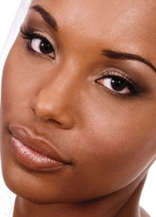
Basic Makeup Application
  Darker Skin Tones: Appropriate shades of makeup are available for darker skin tones, but generally can be used more sparingly.
  With very dark skin, the tonal reflectance level can drop so low that a loss of form and dimension result. A drop of baby oil or glycerin can preserve the highlights.

Slide 15
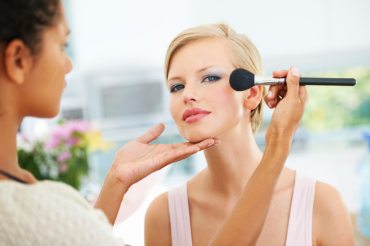
Basic Makeup Application
  Corrective Makeup:
    Start with the foundation and blend in shades of makeup that are either darker or lighter.

Slide 16
Basic Makeup Application
  In contouring, a darker shade of makeup than the foundation or base is used to downplay features, such as a high forehead or an overly prominent nose.
  Contouring can also be used to add depth to flatter areas such as the cheeks.

Slide 17
Basic Makeup Application
  In highlighting, the object is to pull the viewers’ eye toward certain facial features or areas. Use a shade of makeup that is lighter than the foundation.
  Lighten shadowy areas under the eyes and lower lip that may appear darker on camera.

Slide 18
Makeup Removal
  Due to the natural look of women’s makeup, many decide to leave it on after the shoot is over.
  Men generally request to have their makeup removed. Facial wipes are efficient and readily available.

