Slide 1
Taking Fingerprints
  (Tenprint)

Slide 3

Review
  What are prints used for?
  A variety of purposes including:
    Solving crimes.
    Identity confirmation (passport, cashing checks, etc.).
    Determining the identity of the deceased.
    Entrance control for buildings and rooms.
    Clearance for employment.

Slide 4
Numbers Assigned to Digits

Slide 5
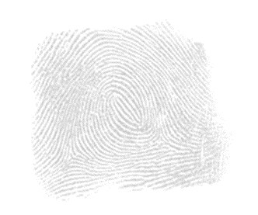
Factors Affecting Fingerprints
Negative affects:
  Allowing subjects to “print themselves.”
  Excessive pressure.
  Not enough pressure.
  Perspiration, or wet fingers.
  Sickness and disease.

Slide 6
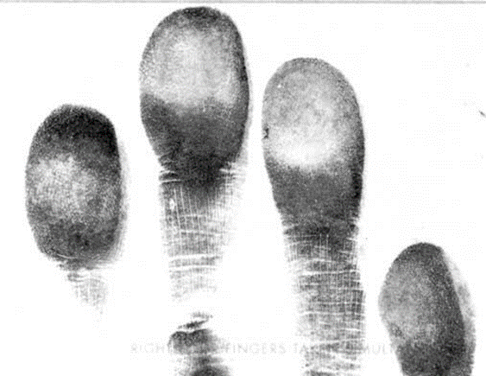
Taking Legible Prints
  Be confident!
  Practice, Practice, Practice!

Slide 7
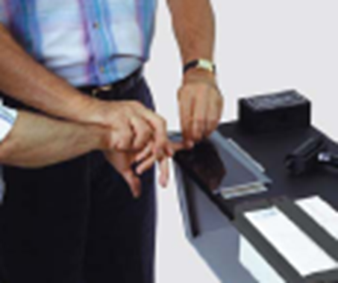
Required Supplies
  Ink pad, or ink and roller.
  Tenprint card (purchased or self-made).
  Area for printing, or standing (purchased).
  Hand soap and clean-up supplies.

Slide 8
Step 1: Communicate
  Tell the subject:
    You are going to take his/her prints.
    To relax his/her hands.
    To let you do all the work.

Slide 9

Step 1: Communicate
  When they try to assist:
    Stop.
    Advise them again.
    Ask them to let you control their hands.
    Stop and reiterate this as necessary.

Slide 10
Step 2: Rolled Prints
Ink slab and roller
  Roll just enough ink on the slab.
  Roll each finger from the thumb to the pinkie on the slab.
  Roll fingers, one-by-one, onto the Tenprint card, without pressing down.
  Print should be wide and not resemble typical finger sizes.

Slide 11
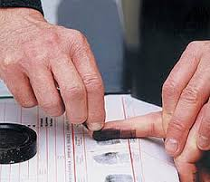
Step 3: Plain Impressions
  Ink them from the top down until the fingers lay flat.
  Do the left and then the right fingers.
  Ink the thumbs.

Slide 12
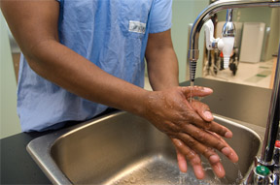
Step 4: Clean Up
When removing ink from fingers:
  Soap MUST be rubbed in well.
  Move the print card.

Slide 13

Special Situations
Examples:
  Amputations.
  Bandaged Fingers or Hands.
  Scars.
  Deformities.
  Worn Fingerprints.
  Extra Fingers.
  Webbed Fingers.

