Slide 1
Telephone Skills

Slide 3
Answering the Phone
  Follow guidelines presented in the policy and procedure manual for the health care facility
    Usually name and office name
  Answer promptly, be courteous, calm, pleasant, and give the caller full attention
    Caller should feel that their call is important

Slide 4

Answering the Phone
  Identify the purpose of the call
  Emergency calls require immediate attention

Slide 5
Types of Calls
  Administrative calls
    Appointments
    Questions concerning office hours, policies, and fees
    Referral requests
    Billing/insurance questions
    Lab/test results
    Hospital reports/updates
    Sales
    Complaints

Slide 6
Clinical Issues
  Calls from other health care providers, referrals
  Client requests to discuss tests results
  Prescription renewal requests
  Clients seeking advise

Slide 7
Effective Telephone Tips
  Speak directly into the mouthpiece so listener can hear easily
  Use a normal tone of voice and speak at a natural pace
  Annunciating words

Slide 8
Effective Telephone Tips
  Be courteous
  Use “please” and “thank you”
  Be clear and concise using short, simple, descriptive words
  Avoid the use of slang and in-house terms or abbreviations (use language the caller understands)
  Use the caller’s name during the conversation
  Ask questions to check for understanding
  Let caller hang up first

Slide 9
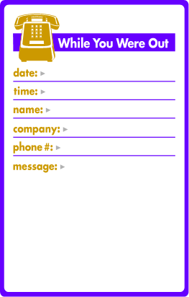
Messages
  Proper documentation is required for legal protection
  Records of telephone calls may also be included in client’s file as a component of the medical record

Slide 10
Messages
  Incoming calls
    Date and time of call
    Caller’s name and phone number
      Repeat for verification
    Name of person message is for
    Action to be taken
      (Please call, will call back)
  Record the message accurately
  Name or initials of person taking the call
  Maintain confidentiality
  Do not repeat confidential information over the phone in the presence of other clients

Slide 11
Messages
  Outgoing calls
    Plan the call
      Have all necessary information available
    Confirm the correct number before making the call
    Allow sufficient time for someone to answer the phone
      (Especially when calling the elderly, disabled, or post-surgical patient)
    State your name and reason for calling

