Slide 1
The History of Modern Manufacturing

Slide 3
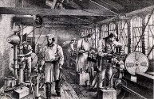
Modern Manufacturing
  Modern Manufacturing started with Henry Ford’s use of the assembly line and arranging equipment close to that line.
  Improvements to this industrial process is ongoing, even today.

Slide 4
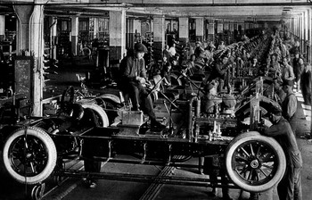
Modern Manufacturing
  Henry Ford developed the assembly line to produce Model T cars at a cheap price.
  His development of a plant where the equipment is located near the line increased the production rate and started modern manufacturing.

Slide 5
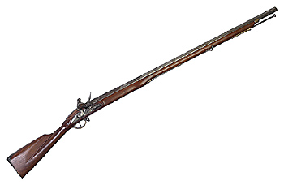
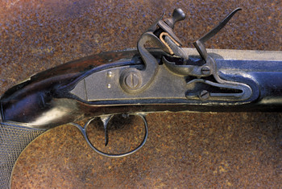
Modern Manufacturing
  Eli Whitney started the use of interchangeable parts to manufacture guns for the US government.

Slide 6
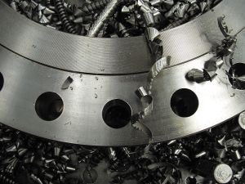
Modern Manufacturing
  Sakichi Toyoda, founder of Toyota visited the Ford Rouge plant and took the ideas of Ford back to Japan.
  He and his company improved the methods of the Toyota Production System.

Slide 7
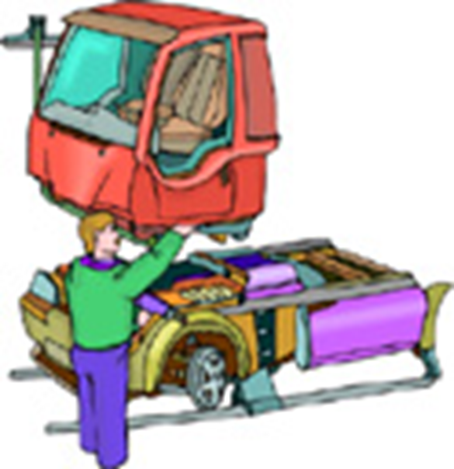
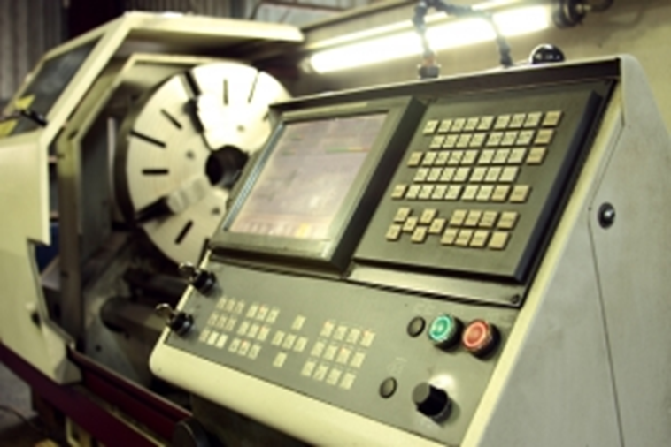
Modern Manufacturing
  Toyota Production System is a manufacturing method that tries to reduce waste of materials, processing time, and workers’ time.
  Computer Numerical Control machines entered the manufacturing plants in 1970, making these machine more productive than manual machines.

Slide 8
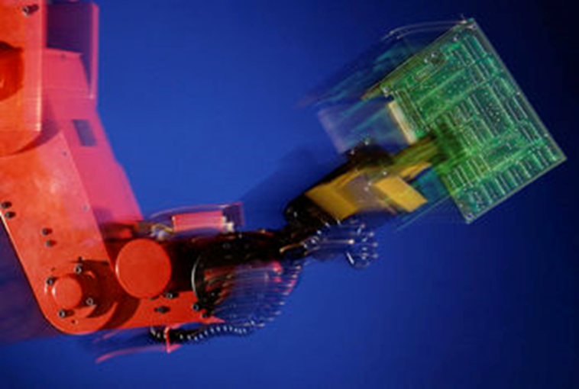
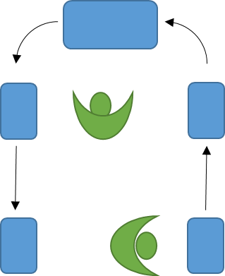
Modern Manufacturing
  Industrial Robots started
  completing dangerous and repetitive tasks on an assembly line at General Motors (1962).
  Work cell is an arrangement of machines that will produce a part within the cell. The machines will be CNC and a person or robot could load materials into the cell and remove finished parts.

Slide 9
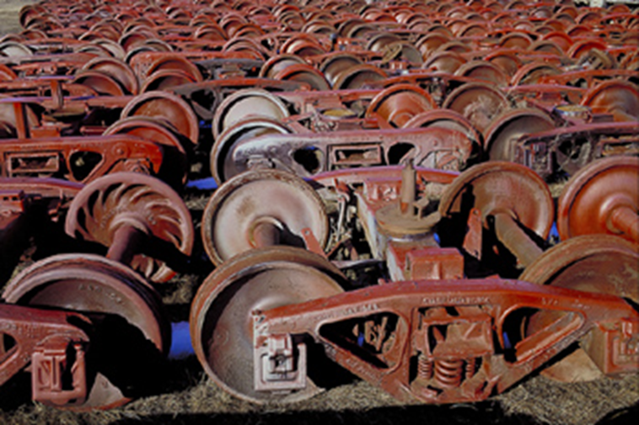
Modern Manufacturing
  Lean Manufacturing is a method of producing products when a customer orders it. This requires predicting customer demand, but saves storage cost of unwanted products.

Slide 10
Careers in Modern Manufacturing
  Computer Aided Designer
  CNC operator
  Manufacturing Technologist
  Logistician
  Supply Manager
  Expeditor
  Quality Control Manager
  Robotics Technician
  Cost Estimator
  Industrial Safety and Health Engineer
  Tool and Die Maker
  Machinist
  Industrial Production Manager
  Industrial Engineer

Slide 11
Resources
  http://www.assemblymag.com/articles/85640-timeline-50-years-of-economic-change-and-manufacturing-progress
  http://www.lean.org/WhatsLean/timeline.cfm

