Slide 1
The Making of Laws
  Principles of Law, Public Safety, Corrections & Security

Slide 3
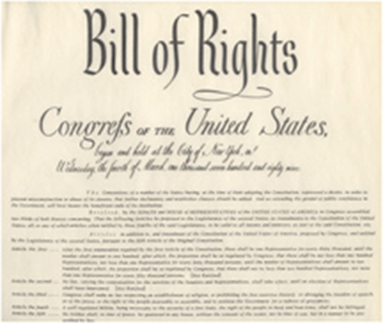
Sources of Laws
  Federal
  U.S. Constitution
  U.S. Criminal Codes
  Judicial decisions interpreting codes
  Executive orders

Slide 4

Sources of Laws
  State
  State constitution
  State criminal codes
  Common law
  Local
  City and county charters
  Municipal and county ordinances or violations
  Common law
  Judicial decisions interpreting the codes or laws

Slide 5
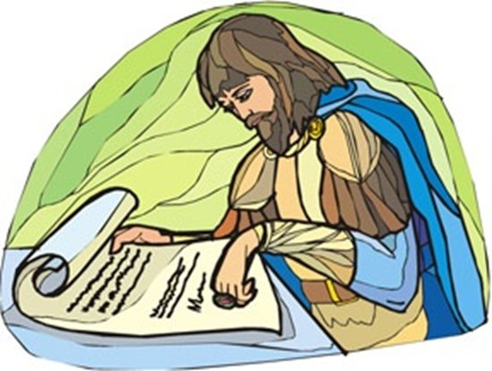
Historical Origins
  Code of Hammurabi
  Magna Carta
  English common law
  English Bill of Rights

Slide 6
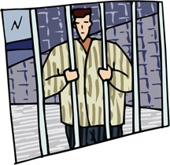

Classifications of Crimes
  Class C Misdemeanor
    Fine up to $500 (ticket)
    Cannot be arrested
    Speeding or Open Container
  Class B Misdemeanor
    Up to 180 days in jail
    $2,000 fine
  Class A Misdemeanor
    Up to 2 years in jail
    $4,000 fine

Slide 7
Classifications of Crimes
  State Jail Felony (SJF):
    180 days to 2 years
    $10,000 fine
  3rd Degree:
    2-10 years
    $10,000 fine
  2nd Degree:
    2-20 years
    $10,000 fine
  1st Degree:
    5-99 years
    $10,000 fine
  Capital:
    Death
    Life without Parole

Slide 8


Amendments
  First Amendment
  Religion
  Speech
  Press
  Peaceful assembly
  Petition for redress of grievances
  Second Amendment
  Right to bear arms

Slide 9
Second Amendment
Places Weapons Prohibited Penal Code 46.03, F3
  A person intentionally, knowing, or recklessly possesses, or carries a weapon onto the physical premises of:
    School grounds, events, or transportation
    A polling place during voting
    Government courts or offices
    A racetrack
    An airport
    1,000 ft from executions
    Third degree felony

Slide 10
Second Amendment
Unlawfully Carrying a Weapon Penal Code 46.02, class A
  A person intentionally, knowingly, or recklessly carries, on or about his person, a handgun (without license)
  Felony if the person carries a gun on premises licensed or issued a permit by the state for the sale or service of alcoholic beverages

Slide 11
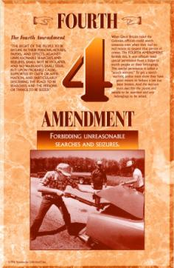
Amendments
  Fourth Amendment
  “The right of the people to be secure in their persons, houses, papers, and effects, against unreasonable searches and seizures, shall not be violated, and no Warrants shall issue, but upon probable cause, supported by Oath or affirmation, and particularly describing the place to be searched, and the persons or things to be seized.”

Slide 12

Fourth Amendment
  Arrest, Search, and Seizure
  CCP 15.22
    A person is arrested when he has been actually placed under restraint or taken into custody by an officer or person executing a warrant of arrest, or by a person who has the authority to arrest

Slide 13
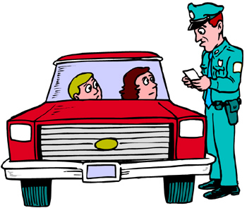
Fourth Amendment
  Elements of Arrest
  Intent
  Authority
  Custody (seizure or detention)
  Understanding of the subject

Slide 14
Fourth Amendment
Absolute Certainty
Beyond a Reasonable Doubt
  Levels of Proof
Criminal Jury Verdict
Non-Suggestiveness of Identification
Clear and Convincing
Civil Trial Decision
Preponderance
Take Case to a Jury
Prima Facie
Arrest, Search, Indictment, Information
Probable Cause
Stop, Frisk, Question
Reasonable Suspicion
Mere Hunch
No Basis for Knowledge

Slide 15
Fourth Amendment
  Guidelines of Arrest
  An arrest may be made anytime of the day or night (CCP 15.23).
  When making an arrest, all reasonable means are permitted to affect it. No greater force, however, shall be resorted to than is necessary to secure the arrest and detention of the suspect (CCP 15.24)

Slide 16
Fourth Amendment
  Temporary Detention
  Reasonable suspicion
  Activity occurring/just occurred
  Person connected to activity
  Limited time
  Florida v. Royer
    Investigative detention
    No longer than necessary
    Scope of detention matches justification
Stops
  Justified if:
    Not fitting time or place
    Fits description of a wanted person
    Emotional, frightened, or intoxicated
    Running/furtive movements
    Loitering, hanging out, or on “look out”
    Crime scene area

Slide 17
Fourth Amendment
  Elements of Arrest
  Intent
  Authority
  Custody (seizure or detention)
  Understanding of the subject

Slide 18
Fourth Amendment
  Elements of Arrest
  Intent
  Authority
  Custody (seizure or detention)
  Understanding of the subject

Slide 19
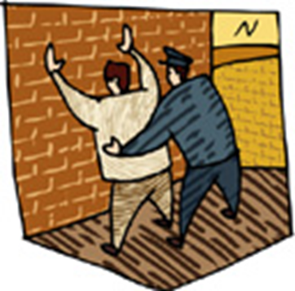
Fourth Amendment
  “Terry Frisk”
  Terry v. Ohio
    Unusual Conduct
    May be armed and dangerous
    Protection of self and others
    Suspicion of crime and weapon to be used
    Careful pat of outer clothing
    Alone and no backup
    Emotions or behavior of suspects

Slide 20
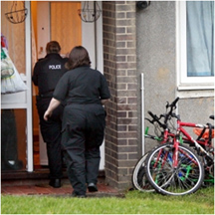
Fourth Amendment
  Search Defined
  Prying into hidden places to look for material which is concealed; it is not a search to observe that which is open to view.

Slide 21
Fourth Amendment
  Search Warrant
  Definition – CCP 18.01
  Neutral and detached magistrate
  Probable cause or staleness
  Sworn affidavit
  Must include:
    The specific offense committed
    The specific property to be seized
    The property is at place to be searched
  Search Beyond a Warrant
  Protective sweep
  Prevent the destruction of evidence
  Discover more, or possible, evidence in plain view elsewhere on the property
  Hunt for evidence or contraband that, as a result of the initial search, is believed to exist in another location on the property

Slide 22
Fourth Amendment
  Exceptions to Search Warrant
  Vehicles
  Open fields
  Anything with consent
  Abandoned property
  Inventory
  Plain view
  Searches Allowed at School
  Backpack searches
  Locker searches
  Vehicles searches
  Strip searches
  The use of metal detectors
  The use of drug dogs
  Consent to search

Slide 23

Fourth Amendment
  Search Incident to Lawful Arrest
  The arrest must be lawful
  Search the area within immediate control
  Contemporaneous with arrest
  Do not destroy evidence

Slide 24
Fourth Amendment
  Plain-View Doctrine
  Coolidge v. New Hampshire
  The initial intrusion must be lawful or in proper position to view the property.
  The discovery must be inadvertent.
  It must be immediately apparent that items are evidence of a crime, contraband, or subject to seizure

Slide 25
Fourth Amendment
  Exclusionary Rule
  CCP 38.23
  No evidence shall be admitted into a criminal trial that was obtained in violation of constitutional rights
  Mapp v. Ohio
    Illegally seized evidence could be excluded from both state and federal cases

Slide 26
Amendment
  Fifth Amendment
  Grand jury
  Double jeopardy
  Self-incrimination
  Due process
  Just compensation for government takings

Slide 27
Amendment
  Double Jeopardy
  Exceptions to Double Jeopardy
    Convicted and asks for a new trial
    Convicted and the case is overturned
    The case results in a hung jury
    Can be tried at both the state and federal levels for the same crime

Slide 28
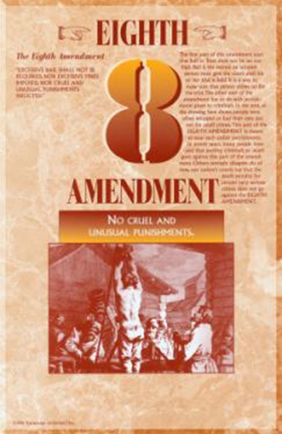
Amendment
  Eighth Amendment
  No excessive bail
  No excessive fines
  No cruel and unusual punishment

Slide 29
Elements of a Crime Definitions
  Actus Reus
    The actions of the person committing the crime as defined by law
  Mens Rea
    The state of mind and intent of the person committing the actus reus

Slide 30
Actus Reus
  Physical or verbal acts that are voluntary
  Can be failure to act or lack of action
  Possession of an illegal or prohibited item
    Constructive possession – does not have physical or actual possession of an illegal item but exercised care, custody, or control over the contraband, knowing it was illegal
    Knowing possession – a person has actual possession and knows that the item is illegal
    Mere possession – a person has actual possession of an illegal item, but does not know it is illegal

Slide 31
Mens Rea
  The state of mind and intent of a person committing the act of a crime
    General intent – the logical outcomes associated with a criminal act
    Transferred intent – a person injures another but did not intend to harm the party
    Constructive intent – the actor did not intend to harm anyone but should have known that his or her behavior created a high risk of injury
  Strict liability

Slide 32
Inchoate Offenses
  Solicitation
    The incomplete crime of urging, requesting, or commanding another person to commit a crime
  Conspiracy
    A criminal act requiring no action other than communication
  Attempt
    A criminal act amounting to more than mere preparation

Slide 33
Classification of Crimes
  Crimes against
    The state
    Persons
    Habitations
    Property
    Public order
    Public morals

Slide 34

Crimes Against Persons
  Murder
  Rape
  Sexual assault
  Kidnapping
  Robbery
  Assault

Slide 35

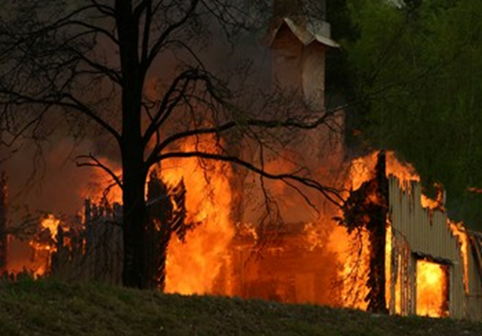
Crimes Against Habitations
  Arson
  Burglary
  Criminal trespass

Slide 36
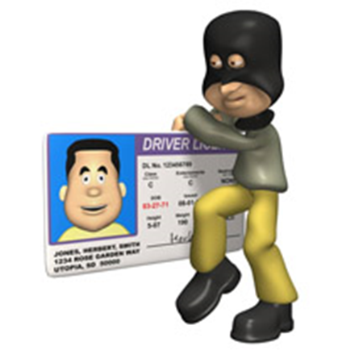
Crimes Against Property
  Theft
  Forgery
  Fraud
  Criminal mischief
  Reckless damage
  Graffiti
  Unauthorized use of a motor vehicle

Slide 37
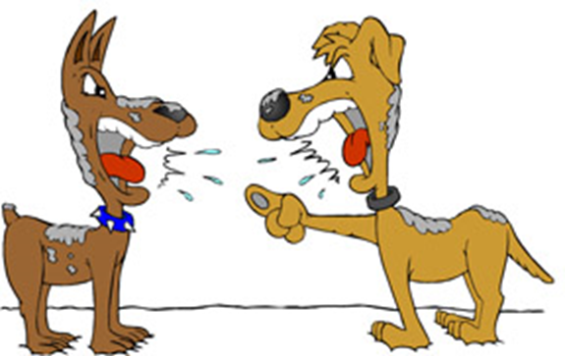
Crimes Against Public Order
  Public intoxication
  Disorderly conduct
  Riot
  Harassment or stalking
  Cruelty to animals
  Dog fighting

Slide 38

Crimes Against Public Morals
  Prostitution
  Possession of child pornography
  Gambling
  Driving while intoxicated
  Engaging in organized crime

Slide 39

Problems with Enforcement
  Rules of evidence
  The Exclusionary rule
  Fruit of the Poisonous Tree Doctrine

Slide 40
Procedures for Enacting Law
  The idea is formatted in the written form of a Bill.
  The bill is sent to a congressional committee.
  The bill goes to House for a vote; if it does not pass, it dies.
  If the bill passes the House vote, it proceeds to Senate.
  The Senate passes the Bill.
  The bill is sent to the President for a signature.
  If the President fails to sign, the Bill goes back to a committee.
  If the President signs the bill, it becomes law.

Slide 41
Resources
  Texas Penal Code http://www.statutes.legis.state.tx.us/
  Bill of Rights http://www.archives.gov/exhibits/charters/charters.html

