Slide 1
Tiny Houses:
Living Large in a Small Space Project

Slide 3
Tiny Houses: Living Large in a Small Space Project
You should now be more familiar with what tiny houses are, their functions, and why they are becoming more popular in construction and design.
With this knowledge you will design your own tiny house.
While designing your tiny house, please keep in mind what was discussed in the multimedia presentation.

Slide 4
Components of the Project
You will be graded on six components for your tiny house design.
The components are:
Design plan for your tiny house
Floor plan
Budget with construction and décor materials for your tiny house, including eco-friendly items
Interior décor design board of your tiny house
Marketing promotion to sell your tiny house
Plan and implement a 3D model of your tiny house
You will use the provided planning sheets to help you in the planning process of each component

Slide 5
Criteria of Components
Tiny House Plans
Floor Plan
Materials Budget (Construction and Décor)
Interior Décor Sample Board
Interior Décor Design Board
Marketing Promotion
Three-Dimensional Model

Slide 6
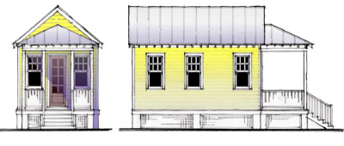
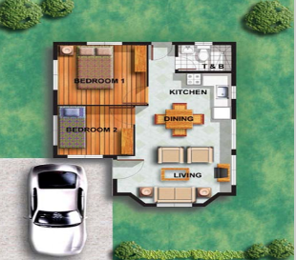
Tiny House Plan
Use the tiny house plan worksheet to help you plan your house.
You will include:
Size of the house
Sketch of how the house will look
Material list
This plan will guide you into the other components of the project

Slide 7
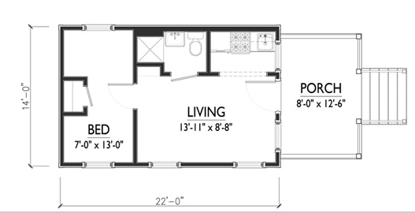
Floor Plan
You will use graph paper and an architect’s scale to create a scale drawing of your tiny house
Include the following:
Measurements
Window and door placement
Storage
Total square footage
Room dimensions
Correct labeling
Must include a living area, bedroom, kitchen, bathroom, and storage

Slide 8
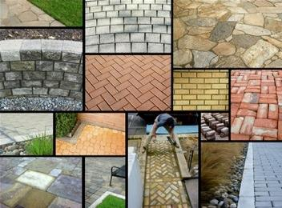
Materials Budget (Construction and Décor)
Use the budget planning worksheet to determine the price of your tiny house
The detailed budget plan of construction and décor will include:
Construction supplies
Tools and equipment
Furniture
Appliances
Backgrounds
Accessories
Lighting

Slide 9
Interior Décor Sample Board
You will use the planning worksheet to plan your board. This will help you when you are researching and finding pictures and samples.
Using a poster board, you will display samples of the décor for the inside of your tiny house.
You will need to keep the principles and elements of design in mind when designing the interior of your tiny house.

Slide 10
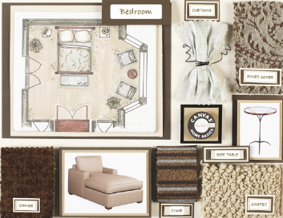
Interior Décor Sample Board
You will need to include the following on your board:
Color Scheme
Furniture
Wall Coverings
Floor Coverings
Window Coverings
Accessories
Lighting

Slide 11
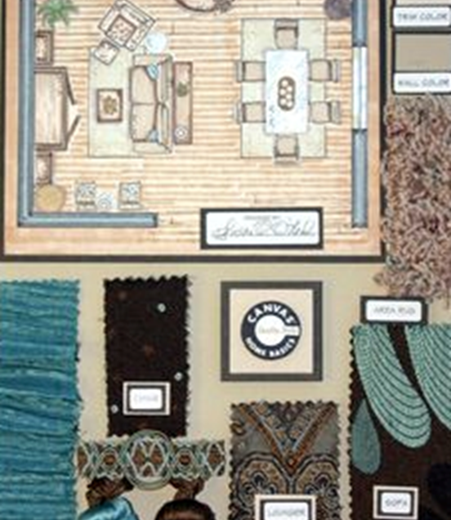
Interior Décor Design Board (Continued)
Include design samples such as wallpaper, paint, fabrics, and other materials to create a pleasing visual on your design board.
Pictures of furniture, accessories, and lighting should also be included. You may find pictures in design magazines or on the Internet.
Floor Plan
Your design board needs to be neat, organized, and pleasing to the eye.

Slide 12
Marketing Promotion
Now that your house is planned, you will need to come up with a marketing campaign to sell your house to the public.
You will need to create a sales promotion to get the attention of individuals who are seeking to purchase a tiny house.
You will use the planning sheet provided to help you plan your advertisement.

Slide 13
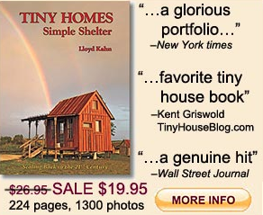
Marketing Promotion
Create an advertisement using the media to promote your tiny house. This can be a newspaper/magazine advertisement, billboard, television commercial, direct mail ad, or website.
The advertisement needs to contain:
Unique name for your house
Floor plan
Sketch of outside of house
Slogan
Use of color
Price

Slide 14
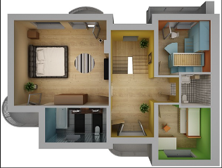
Three-Dimensional Model
You will create a 3D miniature model of the outside as well as the inside décor of your tiny house using your sketches and floor plan as a guideline.
You will use the planning sheet to create a written plan of how you will create your model, which will include:
Size of the model
What materials will you use to build the model
Sketch of model - inside and outside
Be sure your structure is neat and attractive

