Slide 1
Treatment Modalities

Slide 3
Diagnosis
The First Step in Treatment

Slide 4
DSM-IV
Identification & classification of mental illness according to the Diagnostic Statistical Manual of Mental Disorders

Slide 5
DSM-IV
DSM-IV: Provides Five Axes of Classification For Mental Disorders
  Axis I – Clinical Syndromes
  Axis II – Personality Disorders & Mental Retardation
  Axis III – General Medical Conditions
  Axis IV – Psychosocial & Environmental Problems
  Axis V – Global Assessment of Functioning

Slide 6
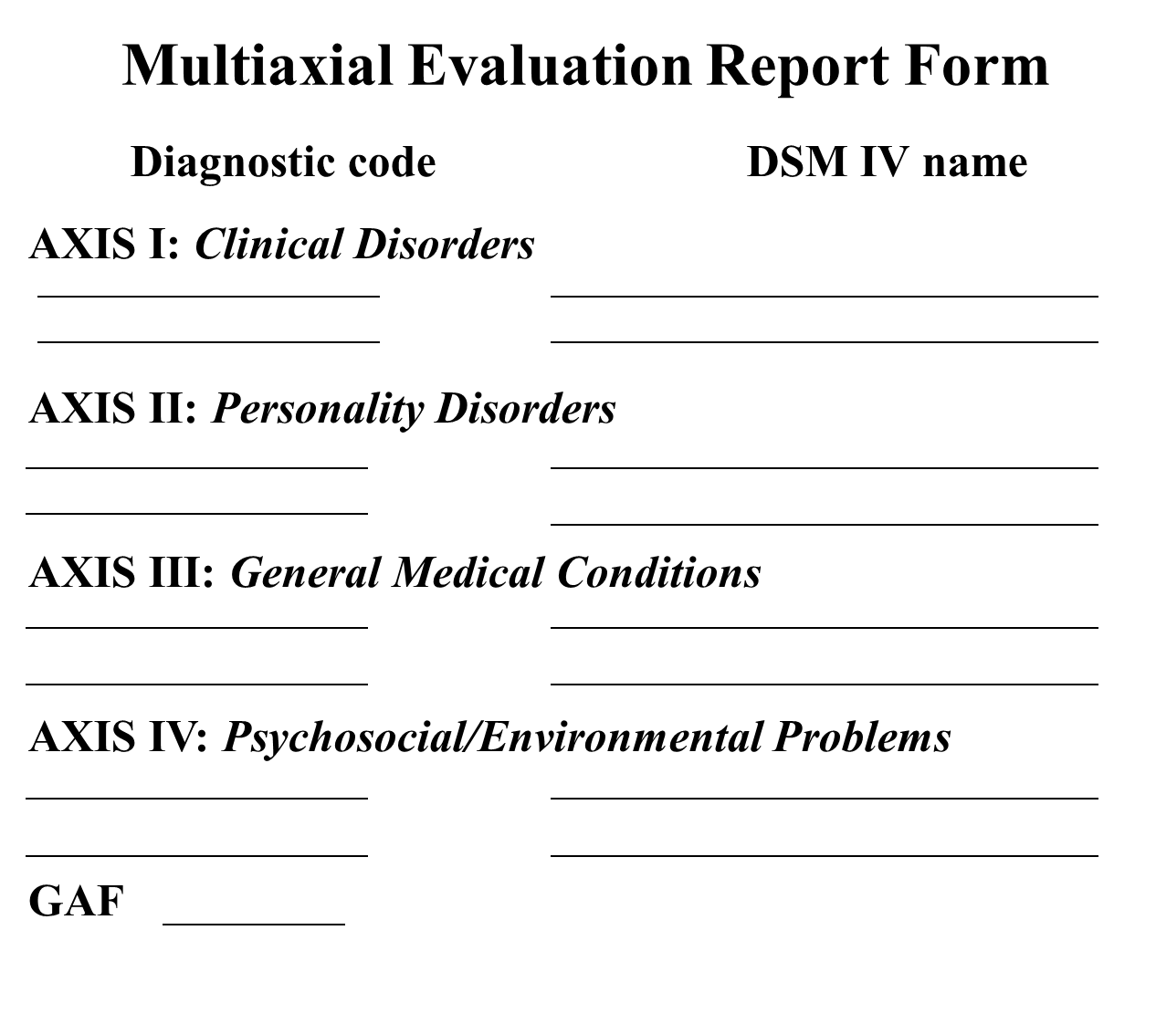
Multiaxial Evaluation Report Form
Notes:
-An example of the classification form used when identifying and classifying patient’s mental health problem.

Slide 7
Modes of Treatment

Slide 8
Psychotropic Medications

Slide 9
Antidepressants
  Used to treat major depressive illnesses
  Takes 3 to 4 weeks to take full effect
  Side effects: dry mouth, drowsiness, weight gain
  Non addictive
  Common antidepressants:
    -Elavil, Prozac, Zoloft

Slide 10
Mood-Stabilizing Drugs
  Alter function of neurotransmitters
  Takes about 4 weeks to a few months for full effect
  Side effects: nausea, diarrhea, tremors
  Lithium – the most common drug
    Used to treat mania and recurrent bipolar illness
    Very toxic (blood levels taken frequently)
    Toxic levels of lithium: difficulty walking, impaired consciousness, coma, seizures

Slide 11
Antianxiety Drugs
  Lessens level of anxiety
  Similar to CNS depressants
  Side effects: sedation, decreased memory, hypotension, nausea, vertigo, drowsiness, slurred speech, paradoxical agitation, dependence
  Common drugs: Xanax, Librium, Valium, Serax, BuSpar

Slide 12
Electro-shock Therapy (EST)
  Reserved for specific types of mental disorders that cannot be treated with medicine
  Most effective in treating moderate to severe depression

Slide 13
Administration of EST
  Patient placed on stretcher & given general anesthetic
  Also given muscle relaxant to counteract grand mal muscular contractions
  given high concentration of oxygen
  Electric current passes between two electrodes placed on patient’s head
  Patient experiences confusion within 5 to 15 minutes following treatment—leaves within few hours

Slide 14
Psychotherapy
  Procedure where person talks about problems with therapist
  Most effective with patients who have mild forms of mental illness

Slide 15
Psychoanalysis
  Psychoanalysis was developed by Freud
  Technique emphasizes analyzing unconscious mind & early childhood experiences
  Use of “free-association” in which patient verbalizes whatever comes to mind
Notes:
-Similar to psychotherapy, but used with patients who have more severe forms of mental illness.
-Sometimes referred to as “talk therapy”.

Slide 16
Psychoanalysis
  Goal is to bring repressed conflicts into conscious mind where they can be dealt with rationally
  Major obstacle: length of time necessary (may take years to complete)
Notes:
-Similar to psychotherapy, but used with patients who have more severe forms of mental illness.
-Sometimes referred to as “talk therapy”.

Slide 17
Group Therapy
  Involves patients meeting together to discuss topics that are relevant to recovery
  Promotes problem identification, “verbal purging”, & patient bonding
  Discussions usually facilitated by: psychiatrist, psychologist, social worker, substance abuse counselor, psychiatric nurse, chaplain

Slide 18
Behavior Modification
  One of the most effective ways to control behavior
  Focuses on behavior of person rather than underlying causes like that of psychoanalytic treatment
  Goal or target behavior is established for patient & a reward is given when goal is met

Slide 19
Methods of Behavior Modification
  Positive reinforcement – “reward” that causes behavior to be repeated
  Negative reinforcement – rewarding stoppage of an undesirable behavior
  Punishment – aversive response that stops unwanted behavior
  Extinction – ignoring behavior so that it eventually will die out
Notes:
Examples:
-positive reinforcement: child is given a gold star for good grades
-negative reinforcement: sassy child is complimented when he acts polite
-punishment: spanking for inappropriate behavior
-extinction: child who “acts out” in attention-seeking fashion is ignored; behavior eventually stops

Slide 20
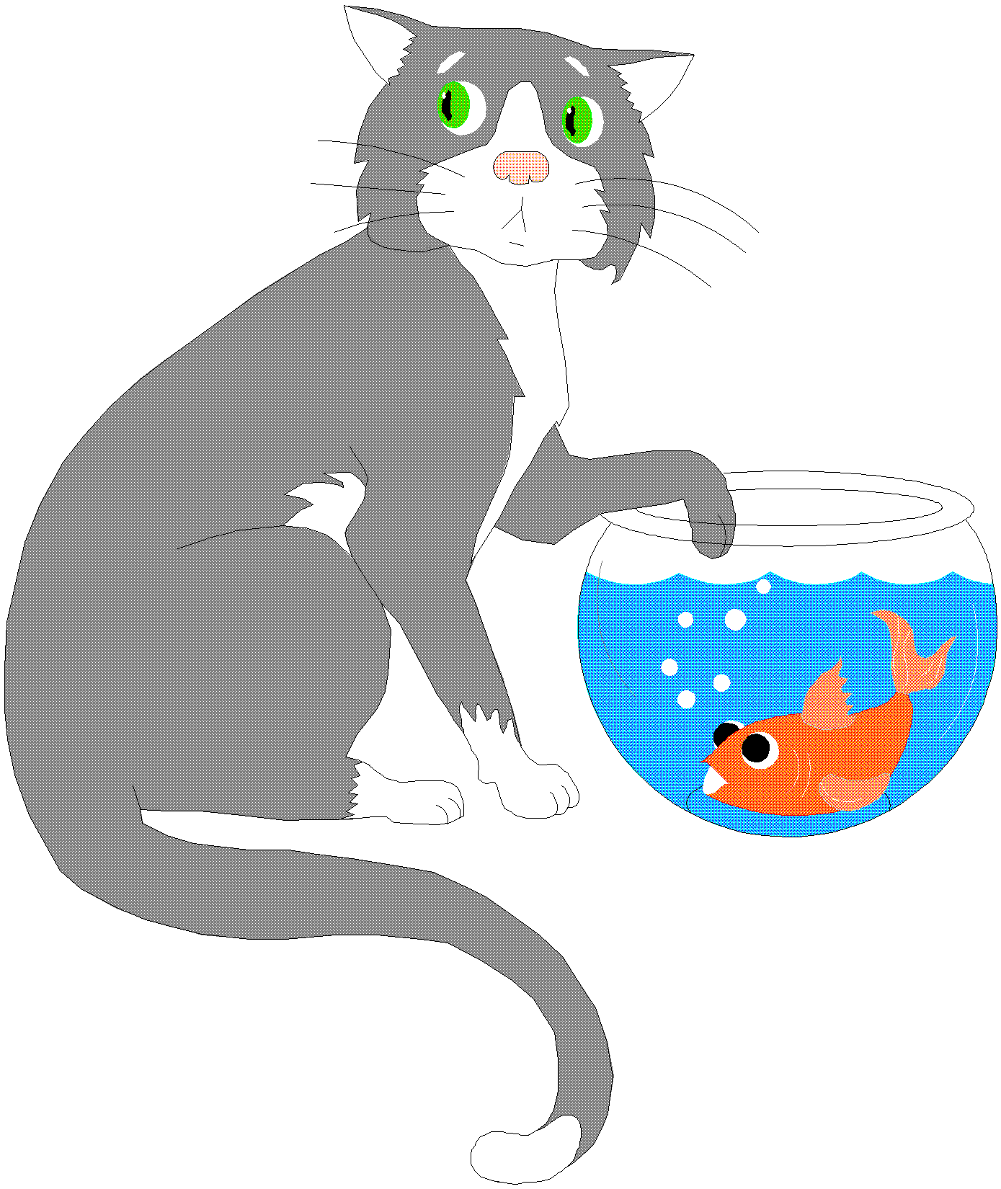
Crisis Intervention
  Intervention of chronic maladaptive behavior before full-blown crisis occurs

Slide 21
Developmental Crises
  When normal progression of development provides issues that are not resolved
  Individual is not able to progress to next stage of development
Notes:
Oftentimes, instead of progressing, individual will fixate at stage of development or use inappropriate coping skills (drinking, drugs, anger, etc.)

Slide 22
Situational Crises
Life changing event that can trigger a crises : (death of family member or friend, divorce, major illness, marriage, birth of child, loss of job, retirement, etc.)

Slide 23

Therapeutic Milieu
Individual’s environment within hospital or mental facility is designed to be socially therapeutic
Notes:
Milieu – French word meaning a trusted environment

Slide 24
Therapeutic Milieu
  Patients encouraged to set up, enforce, & follow their own rules within hospital environment
  This type of environment acts to help patients assume responsibility, function comfortable & with self-confidence
  Therapeutic environment also reinforces responsible, productive behavior
  Social interchange of environment helps pull individuals back into reality

