Slide 1
TRIAL:
BURDEN OF PROOF
AND EVIDENCE
  Court Systems and Practices

Slide 3
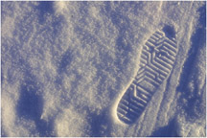

Burden of Proof
  Necessity to prove the facts that are in dispute during a trial
  Two Aspects:
    Determine which party must prove the allegations made
    Determine how much proof is needed

Slide 4
Burden of Proof
Civil Cases:
  Complainant (Plaintiff) has the burden of proof
  Must prove to the judge or jury by a preponderance of the evidence
  Preponderance of the evidence means
  The plaintiff’s evidence is slightly more convincing than the defendant’s evidence
  More likely than not
0% 50%| | 100%

Slide 5
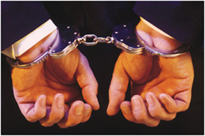
Burden of Proof
Criminal Cases:
  The complainant (prosecutor) has the burden of proof
  Must prove to the judge or jury beyond a reasonable doubt
  Beyond a reasonable doubt means
  The prosecutor must convince the judge or jury that the defendant committed the crime
  95%+ sure of the defendant’s guilt
0% 50%| | 100%
Preponderance Beyond Reasonable Doubt

Slide 6

Burden of Proof
Criminal Cases:
  The defendant has the burden of proof when claiming criminal defense
    Insanity
    Self-Defense
    Duress
    Entrapment
    Necessity
    Accident

Slide 7
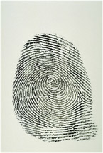
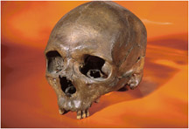
Evidence
Circumstantial Evidence:
  The most common form of evidence
  Indirect evidence
  The jury and judge must draw conclusions based on inferences
Direct Evidence:
  Directly proves a fact!

Slide 8

Evidence
Types of Evidence:
  Real
  Demonstrative
  Documentary
  Testimony

Slide 9
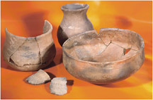

Evidence
  Evidence must be relevant to the case at hand.
  Evidence must fall within the Rules of Evidence:
    Assists in ascertaining the truth
    Encourages fairness
    Avoids judicial delay
  Can include
    Stipulations
    Judicial Notice

Slide 10


Evidence Coming Into Trial
  Suppressed Evidence:
    Evidence kept out of trial due to a legality
      Ex: evidence obtained through an illegal search and seizure
  Offered into evidence:
    Evidence presented by a party in a court case
    To be admitted, it must fall under the proper rule of evidence

Slide 11
Evidence Coming Into Trial
  Admitted into evidence:
    “Comes in”
    Made a part of the case record
    Can be considered by the judge or jury in rendering a decision
    If challenged by an opposing party, it could be “kept out”
      Challenged through objections, such as
        Relevance
        Hearsay
        Lack of personal knowledge
        No proper predicate

Slide 12
Resources
  0131189794, Criminal Courts: Structure, Process, & Issues (2nd Edition), Dean John Champion, Richard D. Hartley, & Gary A. Rabe, Prentice Hall, 2007
  0495599336 Criminal Procedure: Law and Practice (8th Edition), Rolando V. del Carmen, Wadsworth Publishing, 2009

