Slide 1
Types and Sources of Laws
  Court Systems and Practices

Slide 3
Types of Laws
  Criminal Law
  Civil Law
  Administrative Law

Slide 4
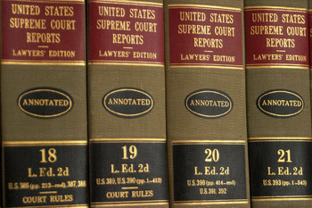
Sources of the Law
  Constitutions
  Statutes
  Case Laws
  Administrative Regulations

Slide 5
Statutory Law
  U. S. Constitution: Supreme law of the land
  Texas Constitution: Cannot conflict with the federal constitution
The fundamental rules that determine how those who govern are selected, the procedures by which they operate, and the limits of their powers

Slide 6
Statutory Law
  Enacted by Federal or State Legislatures
  Found in Codes (Ex: Penal Code)
  Examples: murder, rape, robbery, and terrorism.

Slide 7
Judicial Law/Case Law
  Precedent or stare decisis (“let the decision stand”)
  Court’s Interpretation of Statutory Law
  Appellate Court Decisions
  Can include rulings on
    Procedural matters
    Evidentiary hearings

Slide 8
Substantive Law vs. Procedural Law
  Substantive Law: Law that deals with the content or substance of the law: for example, the legal grounds for divorce
    Substantive law creates legal obligations; essentially it creates law
  Procedural Law: Law that outlines the legal procedures of process to be followed in starting, conducting, and finishing a lawsuit
    Procedural law establishes the methods of enforcing those legal obligations

Slide 9
Due Process`
  Due process is mentioned twice in the Constitution.
    Fifth Amendment: “No person shall…be deprived of life, liberty or property without due process of law.”
    Fourteenth Amendment: “No state shall deprive any person of life, liberty or property without due process of law”

Slide 10

Criminal Law
  Criminal courts exist to enforce the substantive criminal law
    Two basic types of crimes
      Felonies
      Misdemeanors

Slide 11
Presumption of Innocence
  The “state” (prosecution) has the “burden” of proving a defendant guilty of alleged crimes
  Defendants are not required to prove themselves innocent
  Guilt must be “beyond a reasonable doubt”
  Civil cases have a “preponderance of the evidence” requirement

Slide 12

Bill of Rights
  Bill of Rights: the first ten amendments to the U.S. Constitution
  Key amendments linked to criminal law:
    4th: search and seizure
    5th: right to remain silent
    6th: right to attorney and jury
    8th: prohibition against cruel and unusual punishment

Slide 13
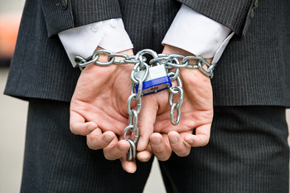
Elements of a Crime
  Corpus delicti: the body or substance of a crime, composed of two elements: the act and the criminal agency producing it
  Actus reus: the guilty act
  Mens rea: guilty state of mind

Slide 14
Civil Law
  Tort: a private or civil wrong, in which the defendant’s actions cause injury to the plaintiff or to property
  Contract: a legally enforceable agreement between two or more parties
  Property: the legal right to use or dispose of particular things or subjects
  Inheritance: property received from a dead person, either by effect of intestacy or a will

Slide 15
Civil Law
  Domestic Relations: relating to the home, the law of divorce, custody, support, and adoption
  Remedy: vindication of claim of right
  Judgment: the official ruling of a court

Slide 16
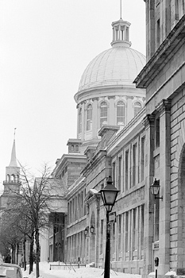
Civil Suits (Lawsuits)
  Plaintiff: the person or party who initiates a lawsuit
  Defendant: the person or party against whom a lawsuit or prosecution is brought
  Damages
    Monetary
    Compensatory
    Punitive
    Specific Performance

Slide 17
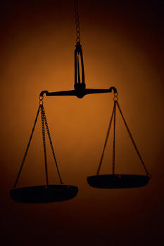
Civil Remedies
  Declaratory Judgment
    Judicial determination of legal rights, e.g., prisoners rights, etc.
  Injunction
    Court Order requiring action or restraint from action
  Types of Injunctions Include
    Preliminary/Temporary
    Permanent
  Sanctions include fines or jail

Slide 18

Civil Remedies to Fight Crime
  Civil suits against offenders
    Drug dealers
    Drunk drivers
  Rape and sexual assault cases
  Vindication
  Asset seizure forfeitures
  Sanctions against gang activity
  Community policing efforts: abatement

Slide 19
Civil Liability Against Criminal Justice Officials
  Prison inmates suing prison administration or guards
  Americans with Disabilities Act
  Use of force cases
  Employment-related law suits

Slide 20
Administrative Law
  Federal Agencies
    Any Federal Agency that has rules and regulations that can be contested
    Ex: Social Security Administration
    Federal Administrative Law judges conduct hearings in contested cases
  State Agencies
    Any State Agency that has rules and regulations that can be contested
    Ex: Texas Alcoholic Beverage Commission
    State Administrative Law judges conduct contested cases

Slide 21
Administrative Law
  Local Entities
    Any local agency or entity that has rules and regulations that can be contested
    Ex: County property taxes
    The entity determines the overseeing of the contested issue

Slide 22
Resources
  0131189794, Criminal Courts: Structure, Process, & Issues (2nd Edition), Dean John Champion, Richard D. Hartley, & Gary A. Rabe
  0495599336, Criminal Procedure (8th Edition), Rolando V. Del Carmen
  9780205478934, Criminal Justice (2nd Edition), James Fagin
  Texas Penal Code http://www.statutes.legis.state.tx.us/

