Slide 1
Types of Warehousing
Principles of Transportation, Distribution & Logistics
TEKS (c) 12 G

Slide 3
Definition of a Warehouse
Warehouses are points in the supply chain where product pauses and is touched.
Consumes both space and time (person-hours).

Slide 4
Why Have a Warehouse?
To better match supply with customer demand
-Toys R Us
-Source product from China
To consolidate product, reduce shipping cost
-Home Depot
-Product differentiation
-New York pricing and labeling
m = vendor
n = store

Slide 5
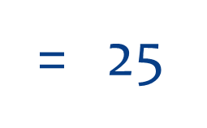
M x N Shipments

Slide 6
M + N Shipments
= 10

Slide 7
Types of Warehouses
Retail Distribution Center (DC)
Service Parts DC
Catalog fulfillment or E-commerce DC
3PL Warehouse
Perishables Warehouse

Slide 8
Types of Warehouses Assignment
You and your partner will develop a mini-presentation over one of the 5 types of warehouses.
What is the purpose of the warehouse?
Who are the customers?
If I was the manager of ….. Name local companies that might use this type of warehouse and why (educated guess)
Existing warehouses around your City
General Requirements
2-3 minutes in length
Highly visual (with citations)
Sell me on using your type of warehouse
See Rubric for Grading

