Slide 1
Waste and Hazardous Materials

Slide 3
Where does your trash go?
  When you think about all the waste we produce including our trash and hazardous materials, where does it go and how do we manage it all?
  Today we will:
    Identify types of waste and hazardous materials
    Research legislation related to waste and hazardous materials
    Identify entities responsible for waste and hazardous material management
    Describe safe handling, storing, and disposal of waste materials including composting and recycling

Slide 4
Background
  Waste has existed since the beginning of time.
  Before recorded history, this waste decomposed in small quantities according to a natural cycle.
  With the development of cities, industrialization, population booms, and the consumption of large amounts of waste, the issue of how to collect and store it appeared.
  As raw material resources become rare and we tackle climate change, recycling and recovery have emerged.

Slide 5
What is Waste?
  Nearly everything we do results in some type of waste material.
  The Environmental Protection Agency (EPA) classifies waste into two categories:
    Hazardous Waste
    Non Hazardous Waste

Slide 6
Non Hazardous Waste Materials
  The EPA defines solid waste as any garbage or refuse, sludge from a wastewater treatment plant, water supply treatment plant, or air pollution control facility and other discarded material, including solid, liquid, semi-solid, or contained gaseous material resulting from industrial, commercial, mining, and agricultural operations, and from community activities.
    There are two broad categories
      Municipal Solid Waste (MSW)– Household trash
      Industrial Waste—includes construction materials, medical waste, etc.

Slide 7
Hazardous Waste Materials
  Hazardous waste is defined as liquid, solid, contained gas, or sludge wastes that contain properties that are dangerous or potentially harmful to human health or the environment. Learn how to properly manage and dispose of hazardous waste.

Slide 8
Entities Responsible for Waste Management
  The Environmental Protection Agency (EPA) is the entity with the primary responsibility to govern waste management

Slide 9
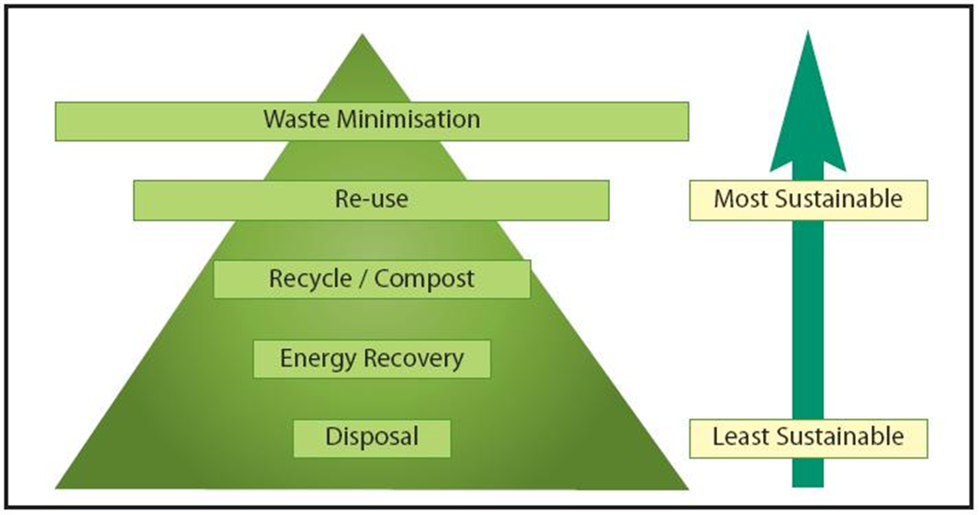
Handling, Storing and Disposal of Waste Safely is Important

Slide 10
Recycling
  Use the EPA Recycling Website to determine how you can recycle the following:
    Electronics
    Compact Fluorescent Lights (CFLs)
    Household Hazardous Waste (batteries, etc.)
    Medical and Pharmaceutical Waste

Slide 11
Composting
  Landfills are brimming, and new sites are not likely to be easily found.
  For this reason there is an interest in conserving existing landfill space and in developing alternative methods of dealing with waste.
  Don’t throw away materials when you can use them to improve your lawn and garden! Start composting instead.
  Learn how to compost by watching this video

Slide 12
Research Waste Legislation
  Use http://www.regulations.gov/#!home to find legislation related to Waste Management
  Is this a big issue? Why or why not?

Slide 13
Activity…
Recycling Program
  Does your school currently have a recycling program for all the materials that may be recycled?
  Plan a recycle program for you school based on the needs you see.
  Consider recycling materials that may be currently in the landfill such as feedbags.

Slide 14
Summary
Evaluation
  Identify types of waste and hazardous materials
  Research legislation related to waste and hazardous materials
  Identify entities responsible for waste and hazardous material management
  Describe safe handling, storing, and disposal of waste materials including composting and recycling

Slide 15
References
  Regulations: http://www.regulations.gov/#!home
  Composting Basics: http://compostguide.com
  EPA Recycling: http://www2.epa.gov/recycle/how-do-i-recycle-common-recyclables and http://www.epa.gov/epawaste/wycd/howdoirecyclemy.htm
  EPA Waste Index: http://www.epa.gov/epawaste/index.htm

Slide 16
College and Career Readiness Standards
  Social Studies I. C. 3
  Social Studies I. E. 1, 4
  Social Studies IV. A. 1, 3

