Slide 1
Welding
Aluminum

Slide 3
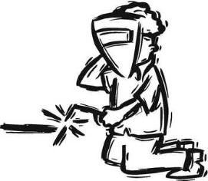
Aluminum
The hardest metal to work with

Slide 4
Today’s Welding Lesson
Procedure:
Setup
Welding Labs
Cleanup & Inspection

Slide 5
Labs
Lab 1 – Flat Weld
Lab 2 – Vertical Weld
Lab 3 – Horizontal Weld
Lab 4 – Lap Weld
Exam Based on Rubric

